Slide 1
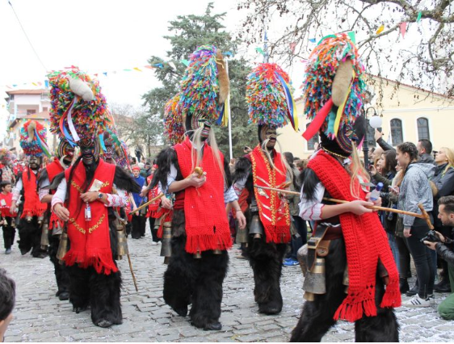
Τhe carnival of Sohos
A look at a very traditional celebration
School year 2023-24
1st Junior High School of Kordelio
A presentation by Maria Paranou

Slide 2
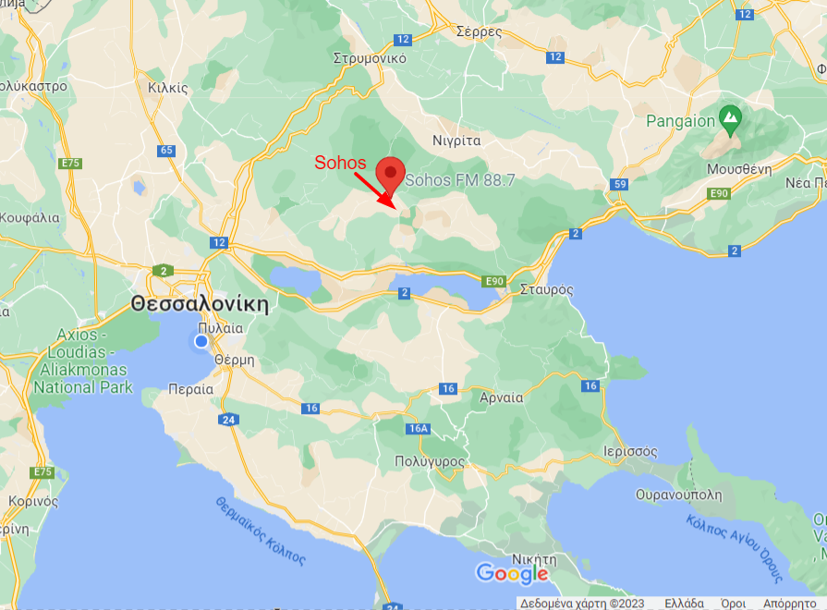
The village of Sohos
50 km from Thessaloniki
altitude of 670 meters
Harsh winters- problems with transportation- quite isolated
Most inhabitants are farmers- quite traditional place

Slide 3
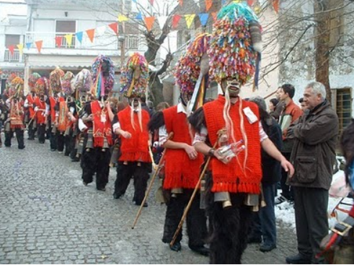
When does it take place?
For how long?
Beginning of carnival in the first week of January- ends just before Lent
Extremely popular among locals- it is the highlight of the winter(usually long, cold and with few distractions)
Everybody dresses up- even babies
Also popular among tourists – parade considered an attraction

Slide 4
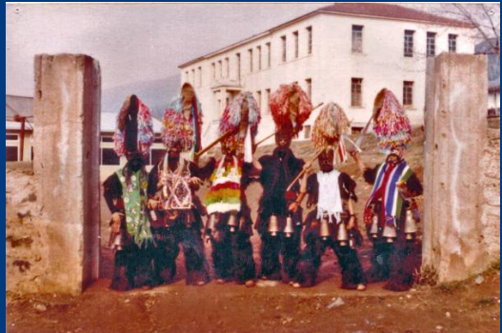
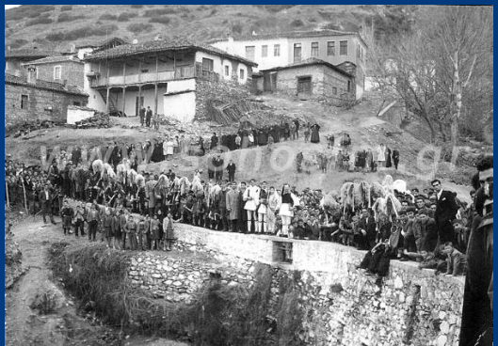
A group of school students dressed up
the carnival in 1956

Slide 5
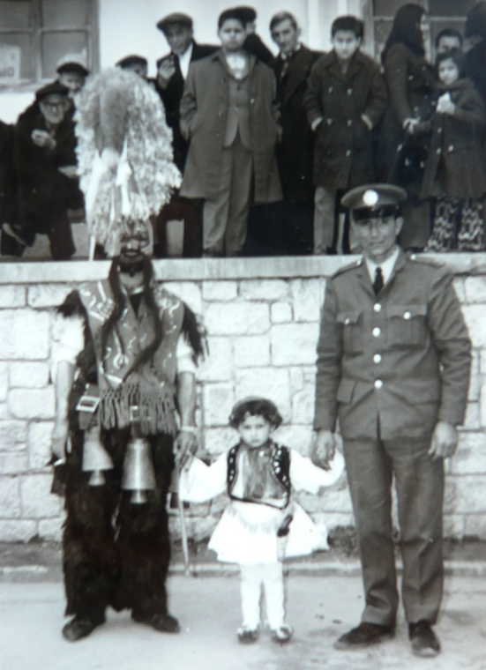
How did it start?
Pagan origins- connected with god Dionysus
Beginning of sping: Celebration of nature and fertility- farmers feel it necessary for a good harvest
Celebrated non-stop since antiquity (even during Nazi occupation)
No changes in the carnival over the years

Slide 6
What do people eat and drink during the carnival of Sohos?
What do they wear?
Food the same as in other parts of Greece
People drink lots of alcohol
Koudounoforoi hold a bottle of tsipouro
A traditional costume with bells hanging from the belt is a must
The stronger the person, the larger the bells

Slide 7
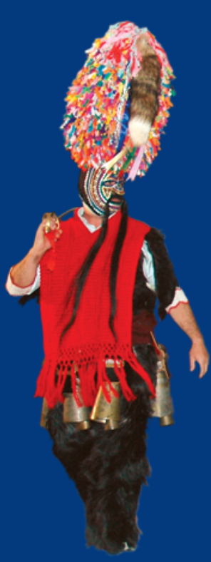
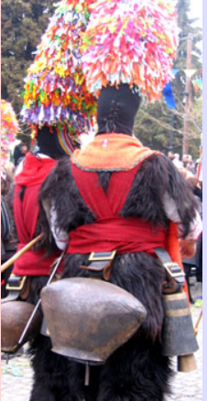
The traditional costume
Face completely covered by a mask
Fox tail serves as a moustache
On top a multicoloured ribbon formation up to 1 meter
Clothes made from animal furs
Five bells in each costume
Bells ring when people move.
Costumes made in the village apart from bells.

Slide 8
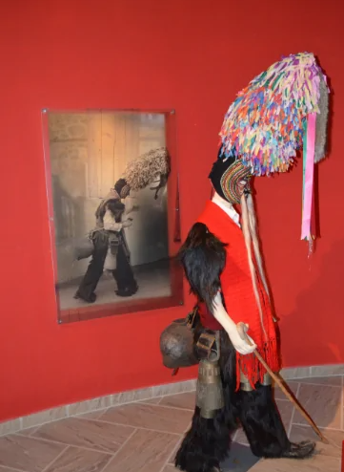
Some interesting facts
In the old days Carnival time ideal for young men to visit their girlfriends’ house
Designs on clothes used by girls to recognize visitors
Bells: the most important part of uniform
Owners of good bells considered privileged
Often given as present from father to son.
Owners of bells with ugly sound often mocked by locals
Locals may travel long distances in search of the perfect bells

Slide 9
What happens during Carnival?
Highlight of Carnival: Last weekend before Lent
People dressed in costumes roam the streets.
Lighting of bonfire in village square in the evening
Parody of a wedding- attraction for tourists
Parade on Clean Monday- Koudounoforoi walk in village center
Many feasts, traditional dances and theatre performances organizeThere are plenty of other events, such as feasts, traditional dances and theatre performances which are organized by the local people.

Slide 10
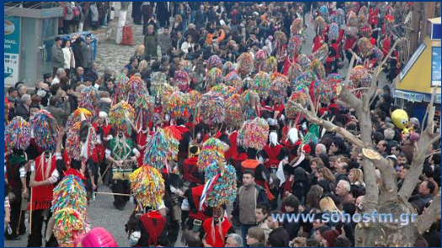
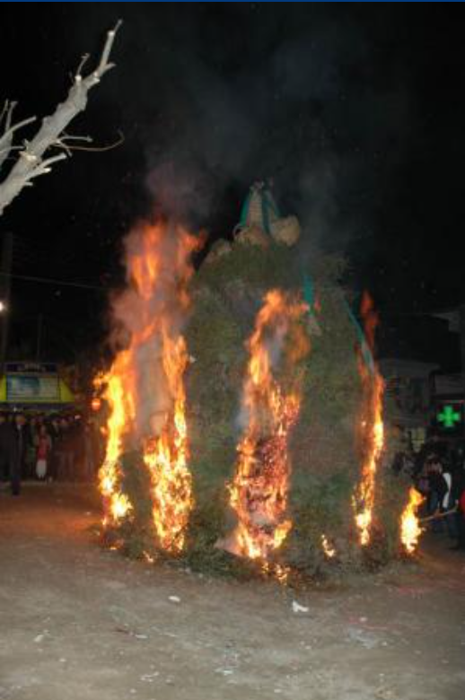
The carnival is a major attraction for the village
A bonfire in the village square

Slide 11
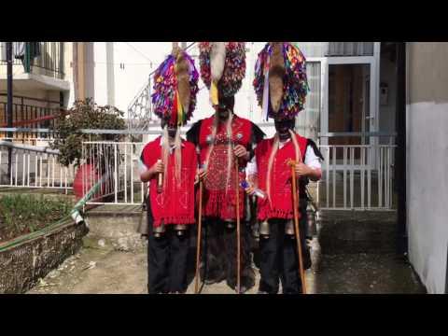
Young and old wearing the costume and dancing in the streets

Slide 12
Bibliography
https://www.greece-is.com/apokries-in-pictures-greeces-most-colorful-carnival-traditions/
http://dim-ag-marin-lerou.dod.sch.gr/selides/el/sohos.htm
https://sohosfm.gr/articles.php?article_id=25
https://ayla.culture.gr/karnavali-soxou/

