Slide 1










CHOCOLATE CHIP COOKIE

Slide 2


INGREDIENTS
250 grs soft butter
250 grs granulated sugar
1 egg yolk
1 vanilla
350grs of sifted all purpose flour
1/2 teaspoon of baking soda
1 packet of chocolate chips or 2
plastic wrap and parchment paper, 2 trays

Slide 3
Execution
Beat the butter with the sugar
Add the egg yolk and the vanilla
Slowly add the flour with the baking soda
Last add the cholotate chips
Cut the dough in 4 parts and roll out every part in a cylinder
Wrap every cylinder in plastic wrap , roll out to even the dough out and fridge for an hour
Cut every cylinder in one inch cookies, shape well and place in a tray with parchment paper on
Do NOT put them one close to the other because the tend to spread and prove in the oven
Preheat the oven in 180o C for about 20 minutes and bake each tray for about 10-12 minutes until the cookies are golden brown.
Do NOT!!!! overbake them.
In the beginning the cookies are soft , but after a while they harden.

Slide 4

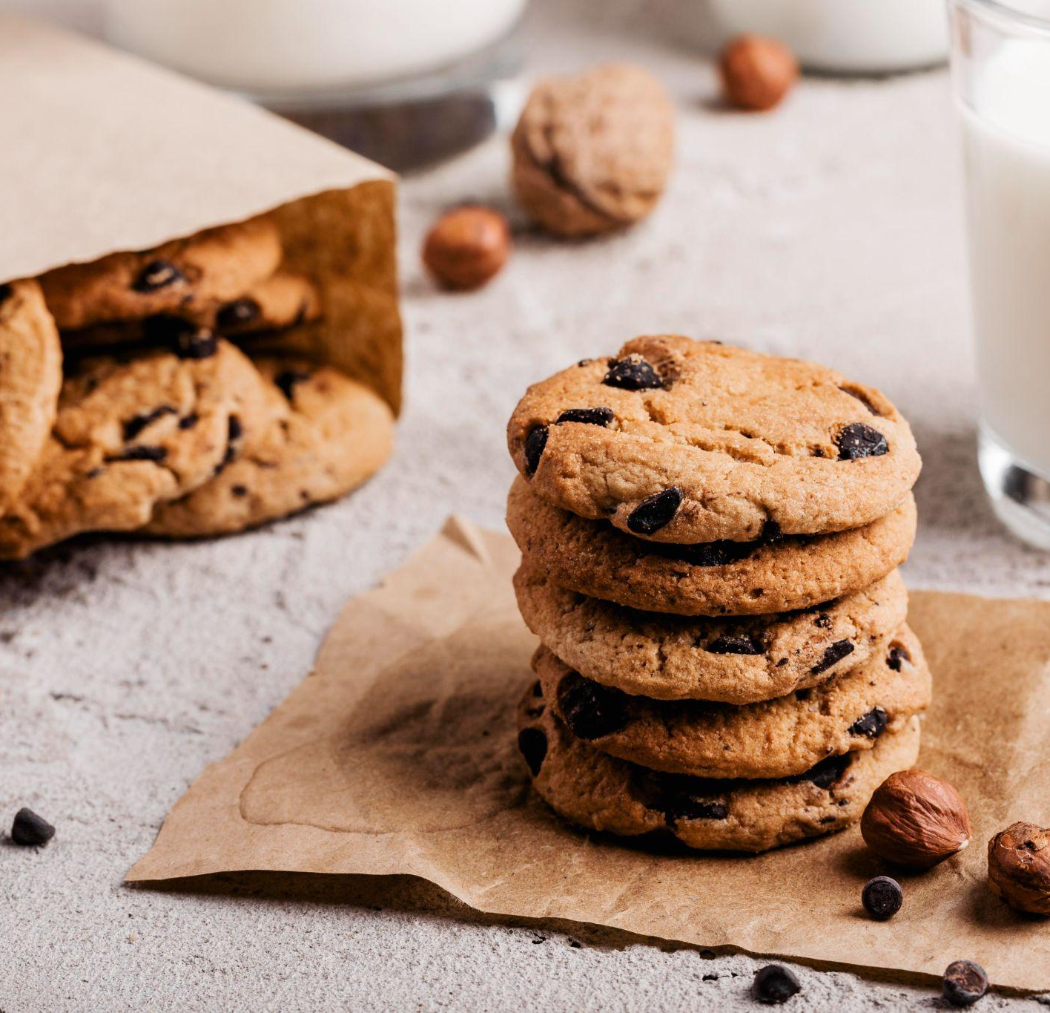

This is what your cookies will look like!!!

Slide 5



Bon Apetite
Please keep this slide for attribution

