Slide 2
Mythical Creatures
In the past, people told stories of fantastic creatures who could do unusual things. These included monsters, animals with magical powers and creatures that are a mixture of human and animal.
Most of these stories started before people wrote things down so they were passed from person to person.
Stories like this are called myths and the creatures from them are sometimes called mythical creatures.
Talk About It…
Can you think of any mythical creatures?

Slide 3
Dragons
Dragons are some of the most famous mythical creatures and they can be found in stories throughout history and across the world. They are usually described as reptile-like creatures, able to fly and breathe fire.

Slide 4
Dragons Around the World
Dragons are an important part of Chinese celebrations, as they are believed to bring good luck. At Chinese New Year, people dress up and perform a dragon dance around the streets.
There is a red dragon on the flag of Wales.
Stories are told of a man called Saint George, who fought a dragon and rescued a princess. Saint George is the patron saint of England. A patron saint is someone who has been chosen to be the protector of a place.

Slide 5
The Loch Ness Monster
The Loch Ness monster is one of the most famous mythical beasts in the world.
Loch Ness is a massive lake in Scotland. ‘Loch’ is the Scottish word for lake.
Loch Ness is so deep you could stand nearly 50 double-decker buses one on top of the other in it!
For over 1000 years, stories have been told about a massive monster who lives in Loch Ness…
Loch Ness

Slide 6
The Loch Ness Monster
The first sighting of the Loch Ness monster, often called ‘Nessie’, was over 1000 years ago.
Saint Columba was a man who travelled around Scotland telling people about Jesus.
One day, Saint Columba needed a boat, which was on the other side of Loch Ness. He asked one of his friends to swim across to get the boat. Halfway through the swim, a huge monster with a long neck appeared from out of the water and started roaring at the swimmer.
Seeing what was happening, the amazed Saint Columba called out to the beast and told it to leave the man alone. At Saint Columba’s command, the monster disappeared.

Slide 7
The Loch Ness Monster
Since then, there have been many people who say they have seen the Loch Ness monster.
There was once a reward of £1m offered to anyone who could catch Nessie but no one has managed it yet.
In recent years, people have taken photos of what they say is Nessie but other people say the photographs are fake.
Special submarines have been sent to find the Loch Ness monster. Once, a huge underwater cave was found. Could this be Nessie’s home?

Slide 8
Mermaids
Mermaids are mythical creatures who have the body of a human and the tail of a fish. Stories of mermaids were told from different groups of people all around the world.
Sailors often believed that mermaids were unlucky and were signs that a voyage was doomed.
A carving of a mermaid, almost 1000 years old, can be seen in Durham Castle.
Mermaids have been in stories and films. Lots of them are based on Hans Christian Andersen’s fairy tale ‘The Little Mermaid’.

Slide 9
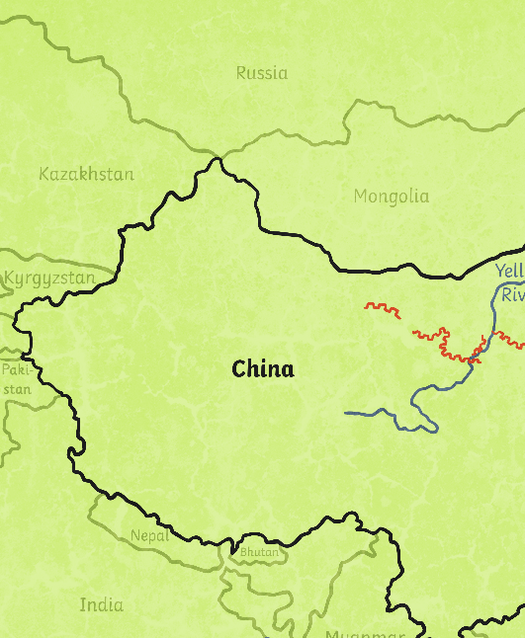
The Abominable Snowman
The Himalayas are a group of mountains that span across lots of countries, including Nepal, China and Bhutan. Mount Everest, the word’s tallest mountain, is in the Himalayas.
For many years, stories have been told about a huge ape-like creature that lives in the Himalayas. Locals call this creature ‘yeti’ or ‘Meh-Teh’. It was said that a long time ago, people in the area worshipped this creature as a god.
As more people began to explore the Himalayas, stories were told of a huge creature leaving massive footprints in the snow.
Himalayas

Slide 10
The Abominable Snowman
In 1921, a man named Charles Howard-Bury led an expedition to Mount Everest. On the trip, they saw huge footprints in the snow. The local guides said they belonged to the ‘wild man of the snows’.
The mysterious creature was given the name ‘Abominable Snowman’ by a journalist, who interviewed people who had been up Mount Everest.'
There have been photographs taken of the creature but they are unclear. Scientists and explorers have studied footprints and the photos but it is still unknown what the Abominable Snowman really is.

Slide 11
Griffin
Thousands of years ago, many different groups of people told stories of a creature known as a griffin.
A griffin was said to have the body, tail and back legs of a lion and the head, wings and front claws of an eagle.
Because the lion was considered the king of the beasts and the eagle the king of birds, a griffin was an important creature.
In ancient times, it was believed that griffins laid special eggs that contained pieces of gold.
Some historians think stories of griffins might have started after people found dinosaur fossils and didn’t know what they were.

Slide 12
Unicorn
A unicorn is a horse-like creature with a horn at the front of its head. Stories of unicorns have been told in many different cultures.
One story that explains why there are no unicorns today comes from the Bible story of Noah’s ark.
Two of every animal were supposed to be carried on the ark but in some versions, the unicorns were too busy playing and didn’t reach it in time.

Slide 13
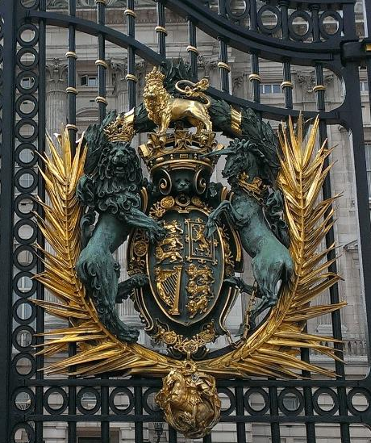
Unicorns
Unicorns have been used as symbols of love, marriage and religion.
A unicorn is one of the creatures on the Queen’s coat of arms, which is one of her special symbols.
It is thought that stories of unicorns might have started after people saw narwhals. Narwhals are whales with a special tusk.
This photo is of the gates of Buckingham Palace. You can see a unicorn on the right.

Slide 14
Phoenix
A phoenix is a mythical bird. Stories of this bird were told in ancient Egypt and ancient Greece.
A phoenix was said to die in a burst of flames before coming back to life again. Because of this, a phoenix became a symbol of overcoming a difficult situation. ‘Rising like phoenix from the flames’ is a saying you might have heard.
The phoenix can be found in many well-known poems and films, including the Harry Potter series.

Slide 15
Think About It
Which is your favourite mythical beast and why?
Do you believe any of these beasts exist? Why or why not?
If you could create your own mythical beast, what would it look like? What would it be able to do?

