Slide 1

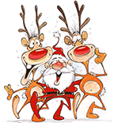
HO-HO-HO
IT'S
CHRISTMAS
TIME

Slide 2
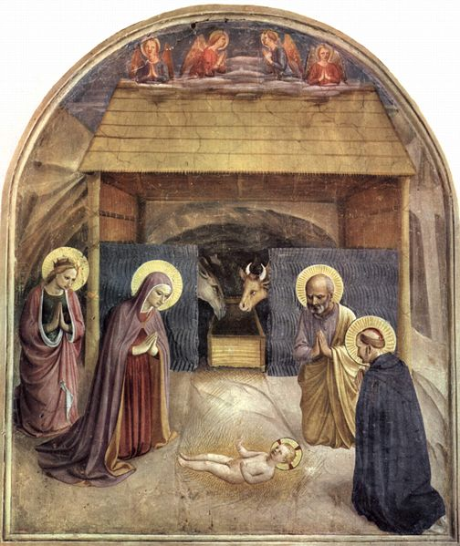
What do we celebrate
at Christmas?
Christmas or Christmas Day is an annual holidaycelebrated on December 25 that commemorates the birth of Jesus of Nazareth.

Slide 3
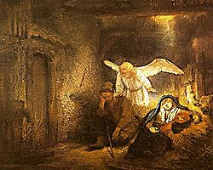
Mary and her husband, Joseph, travel from their home in Nazareth about 150 kilometres south to Bethlehem to register in the census of Quirinius.They find no place for themselves in the inn and they go to a barn. Mary gives birth to Jesus there and she places the newborn in a manger.

Slide 4
Later, wise men, the Magi, bring gifts to Jesus. They are Caspar, Melchior, and Balthasar. On finding him, they give him three symbolic gifts: gold, frankincense and myrrh.

Slide 5
Christmas is fun
because...

Slide 6
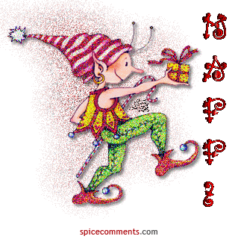

SCHOOLS
ARE
CLOSED

Slide 7
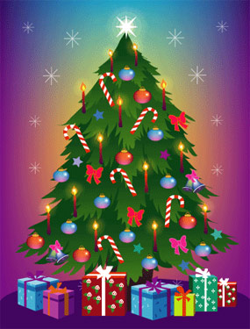
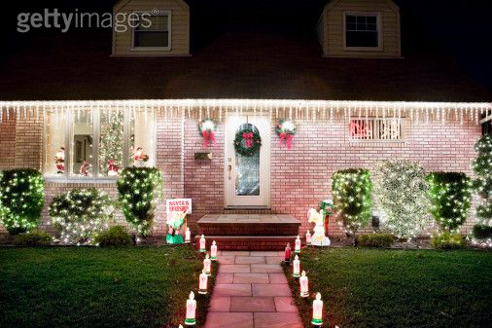
We decorate our
Christmas Tree
and
our houses.

Slide 8
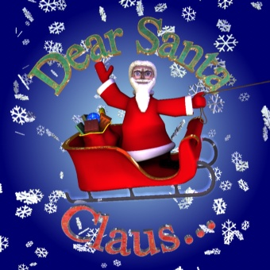
Children write letters to
Santa Claus

Slide 9
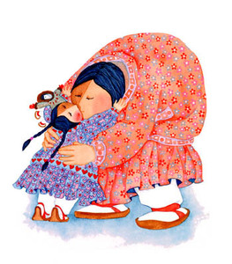
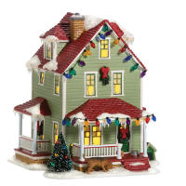
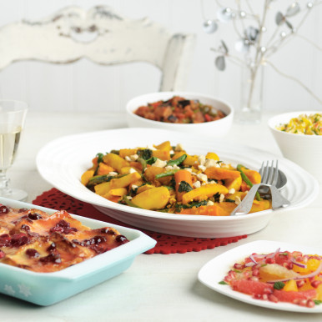
asking him for…
Presents…
Love…
A home…
Food…

Slide 10
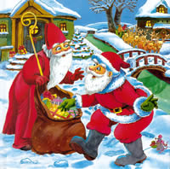
But...
Who was he?
Father Christmas is based on a real person, St. Nicholas, or 'Santa Claus' which comes from the Dutch 'Sinterklaas'. Nicholas is a Christian leader from Myra (in modern-day Turkey) in the 4th century AD. He is very shy, and wants to give money to poor people without them knowing about it.

Slide 11
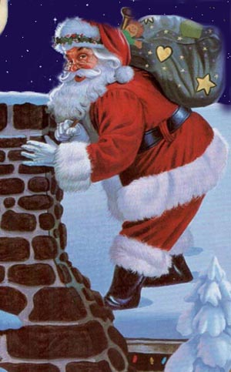
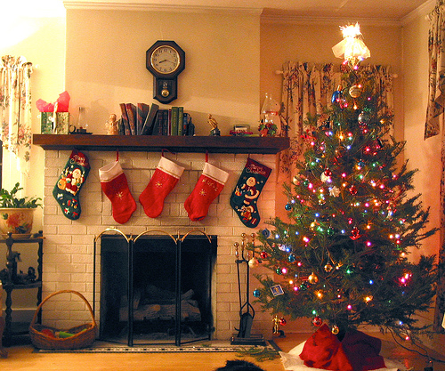
So one day, he climbs the roof of a house and drops a purse of money down the chimney. It lands into a girl’s stocking by the fire!

Slide 12
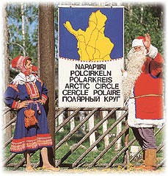
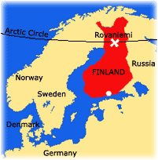
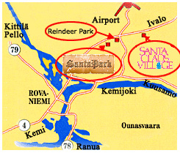
Where does Santa
live?
Santa Claus lives in Lapland, in the north of Finland. You can meet him any day of the year in Rovaniemi, in Santa Claus’ Village on the Arctic Circle.

Slide 13
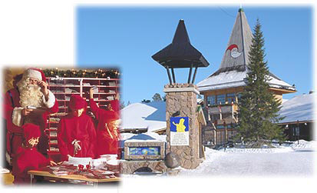
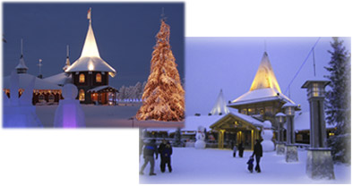
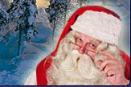
Santa’s secret getaway is in the East of Lapland, on the Korvatunturi Fell, where he was first spotted in the 1920’s. It is situated on the border between Finland and Russia. Mrs. Claus lives there, and so do the elves that prepare the gifts. The Korvatunturi Fell is 483 metres high, and is the shape of an ear.

Slide 14
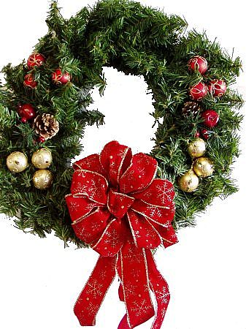
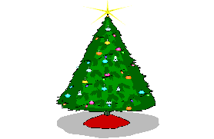
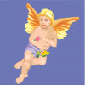

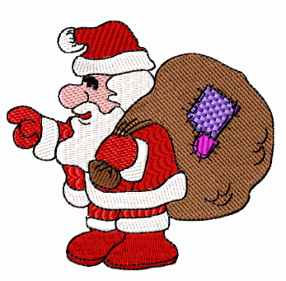

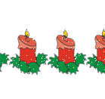
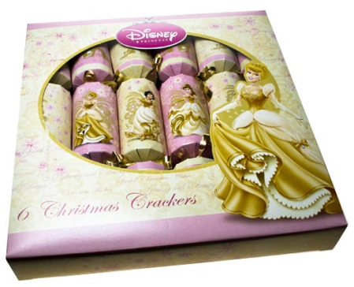
CHRISTMAS DECORATIONS

Slide 15

Why do we use bells?
Ringing of bells at Christmastime is from pagan mid-winter celebrations. When the earth was cold and the sun was dying, evil spirits were thought to be powerful. One of the ways to drive them off was by making a great deal of noise. On Christmas Eve in medieval times, the bells warned the devil of the birth of Jesus. For an hour before midnight, the bells sounded sad. Then, at midnight, they sounded happy to announce the death of evil and the birth of Jesus.

Slide 16

CANDY CANES
A candy maker in Indiana made the candy cane to incorporate symbols of the birth, ministry and death of Jesus.
<>The white is the goodness of Jesus, and the hardness of the candy is the firmness of the promises of God.
<>The shape is the letter J for Jesus, and also represents the staff of the shepherds to help sheep in rough places.
<>The red is for the blood, because Jesus later died for his beliefs and teachings.

Slide 17


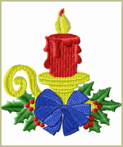
CANDLES
The light from the candle and bonfires imitated the sun, which is scarce in northern areas in winter.
Legend says that lighted candles in windows guide Jesus as he wanders through the streets of the world seeking shelter on Christmas Eve. An old German belief was that Mary, Jesus’ mother, and angels passed over the world on Christmas Eve, and candles showed where they could come in and eat.
The candle at Christmas shows that Jesus was the “light of the world,” and lived a life of love for everyone.

Slide 18


In England, at Christmas dinner, they put Christmas crackers on each plate. In the crackers, there is usually a party hat, a riddle or a toy.
Crackers
with Novelty Gift
Kuckoo Krackers.
Great Fun Crackers containing
a game for everyone to play.

Slide 19
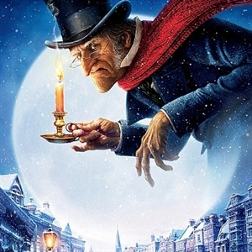
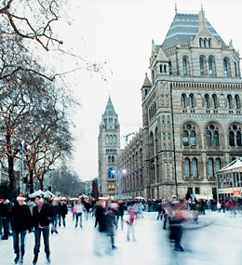
How do children celebrate Christmas in England?

Slide 20

CHRISTMAS EVE
Singing the carols
on the 24th

Slide 21
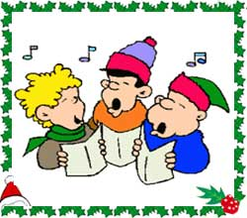
CHRISTMAS CAROLS
History tells us that carols have no connection with Christmas or even with Christianity. The melodies were originally written to accompany an ancient dance form known, as the 'Circle Dance'.

Slide 22
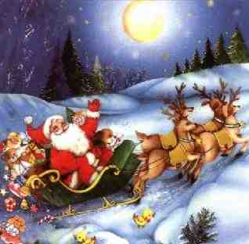
In England, children get their presents on Christmas Eve (December 24th ).

Slide 23
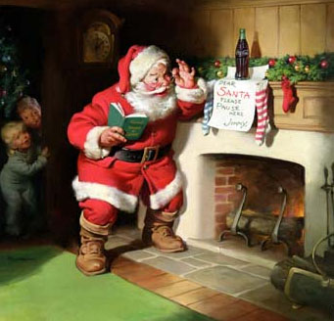
Santa lands on the roofs of the houses and then climbs down the chimney to leave the presents under the Christmas tree.

Slide 24
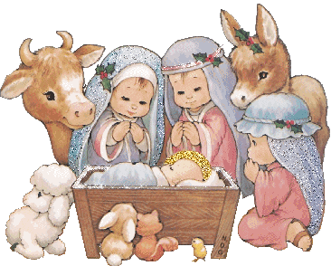

CHRISTMAS DAY

Slide 25
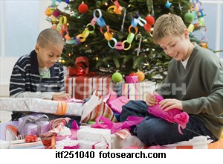
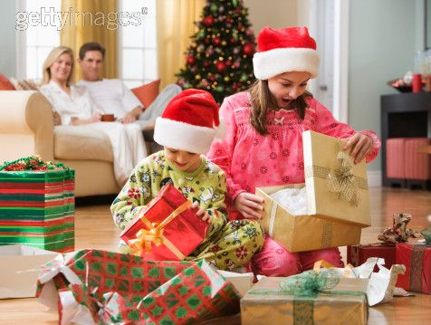
On Christmas Day (25 December), children usually get up very early to unwrap their presents.

Slide 26
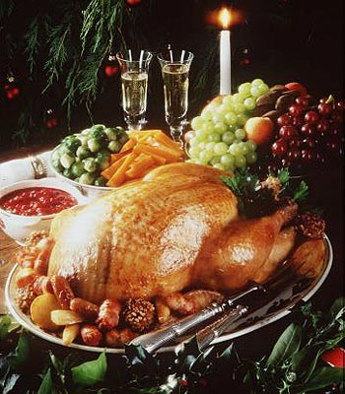
Christmas dinner is served in the early afternoon.
Most people eat turkey and sprouts and a Christmas pudding.

Slide 27
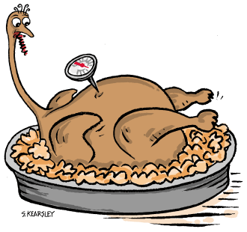
Turkey appears on the menu around 1650 after the European colonisation of North America. Sebastian Cabot introduces it to Europe on his return from the New World. The bird gets its name after merchants from Turkey make it a popular dish.

Slide 28

26th December is called Boxing Day.
In the Middle Ages around 800 years ago churches would open their 'alms boxe' (boxes in which people had put gifts of money) and give the contents to poor people in the neighbourhood on the day after Christmas.

Slide 29
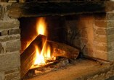

Greek customs
‘Christ’s Wood’
a Christmas custom in Macedonia.
In Northern Greece the landlord goes out in the fields and looks for ‘Christ’s Wood’ on Christmas Eve. It is the best, the strongest and the thickest piece of wood cut off from a pine or olive tree, intending to burn it in the fireplace from Christmas until the Epiphany. The people believe that Christ is getting warm in the cold cave in Bethlehem as the wood is burning in the fireplace.

Slide 30
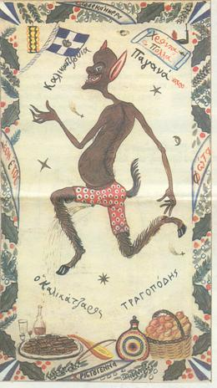
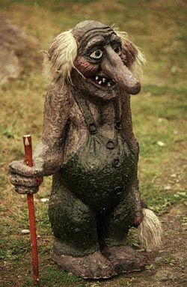
goblins

Slide 31

MANDRAKOULAS
According to the Greek tradition the goblins, or kalli΄kantzari as we call them, are mischievous little creatures; tall, dark and twiggy who claim to be the best dancers in the world and the best singers of all.
They live deep down into the bowels of earth .They try to cut down The Tree of Life. It is the tree Earth is rooted upon but they want to make her sink.
When Christmas is near and although they are close to finally cut it down, they stop. They climb up to the surface of the earth and come into the world of humans. They want to dance, sing and play with people. They get into the houses from the chimneys and they eat home - made sweets. They try to scare the people and their animals with their funny tricks.

Slide 32

