Slide 1
Disclaimer
We hope you find the information on our website and resources useful.
Animations
This resource has been designed with animations to make it as fun and engaging as possible. To view the content in the correct formatting, please view the PowerPoint in ‘slide show mode’. This takes you from desktop to presentation mode. If you view the slides out of ‘slide show mode’, you may find that some of the text and images overlap each other and/or are difficult to read.
To enter slide show mode, go to the slide show menu tab and select either from beginning or from current slide.
You may wish to delete this slide before beginning the presentation.

Slide 2
Disclaimer
We hope you find the information on our website and resources useful.
ESL acronym
This resource has been made for the purpose of teaching English language learners. We know that students can be learning English in many different places, in many different ways and at age, so we try to keep these resources as general as possible.
There are many acronyms associated with English language teaching. These include (but are not limited to) ELT, TEFL, EFL, ELL, EAL and ESOL. While the term ESL may not fully represent the linguistic backgrounds of all students, it is the most widely recognised term for English language teaching globally. Therefore, we use the term ‘ESL’ in the names of our resources to make them easy to find but they are suitable for any student learning to speak English.
You may wish to delete this slide before beginning the presentation.

Slide 3
Riddles
Actions

Slide 4
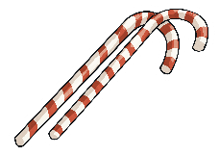
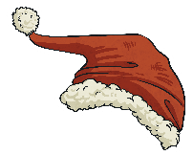
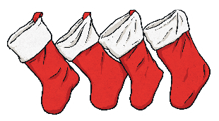
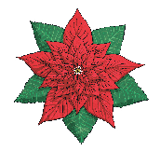
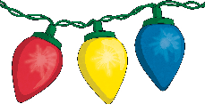
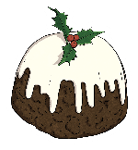


A Riddle Every Day Until Christmas
Snow
1st December
Something made of ice and that falls gently to the ground.
Christmas Eve
3rd December
Skiing
The day before Christmas.
2nd December
ç
A winter sport where people slide down a mountain with two planks on their feet.
Snowman
4th December
A man made of snow that has a carrot for a nose.
Answer
Answer
Answer
Answer
Sleigh
5th December
What does Santa ride in?
Rudolph
7th December
Reindeers
Which reindeer has a red nose?
6th December
Who pulls
Santa’s sleigh?
Elves
8th December
Who helps Santa make presents?
Answer
Answer
Answer
Answer
…White Christmas
11th December
North Pole
I’m dreaming
of a…
9th December
Where does
Santa live?
…the way!
12th December
Turkey
Jingle bells, jingle bells, jingle all…
10th December
Bird that is roasted for Christmas dinner
Answer
Answer
Answer
Answer

Slide 5

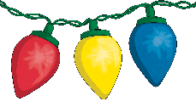
A Riddle Every Day Until Christmas
Snow Angel
13th December
What can you make in the snow by spreading your arms and legs?
Christmas tree
15th December
Mistletoe
Something you decorate with tinsel and lights.
14th December
ç
You must kiss someone if you are standing underneath this plant.
Wreath
16th December
A decoration you hang on your
front door.
Answer
Answer
Answer
Answer
Gingerbread man
17th December
A cookie shaped like a person.
Snowball
19th December
Christmas pudding
A ball made of frozen water that you throw at someone.
18th December
A pudding made of fruits that is sometimes set on fire.
Feliz Navidad
How do you wish someone ‘Merry Christmas’ in Spanish?
20th December
Answer
Answer
Answer
Answer
Candy cane
21st December
A colourful, hare, candy often with red and green stripes.
Cranberry sauce
22nd December
A red sauce eaten with meat, made of berries.
Holly
23rd December
A spiky leaf, with red berries used in Christmas decorations.
Mince pies
24th December
A small, sweet pie filled with dried fruits.
Answer
Answer
Answer
Answer

Slide 6

A funny action for every day until Christmas
Laugh like Father Christmas
Make a snow angel
Stand like a Christmas tree
Gallop like
a reindeer
Throw a snowball
Open a present
1st December
2nd December
3rd December
4th December
5th December
6th December
Climb down a chimney like Father Christmas
Write a Christmas list
Walk like
a turkey
Decorate a Christmas tree
Wrap a present
Eat a
mince pie
7th December
8th December
9th December
10th December
11th December
12th December
Pull a Christmas cracker
Roast a chestnut
Dance like
an elf
Ski down a mountain
Shake a snowglobe
Ring a bell
13th December
14th December
15th December
16th December
17th December
18th December
Sing a Christmas carol
Drink hot chocolate
Walk like a gingerbread man
Glide on ice skates
Wobble
like jelly
Gobble like a turkey
19th December
20th December
21st December
22nd December
23rd December
24th December

