Slide 1
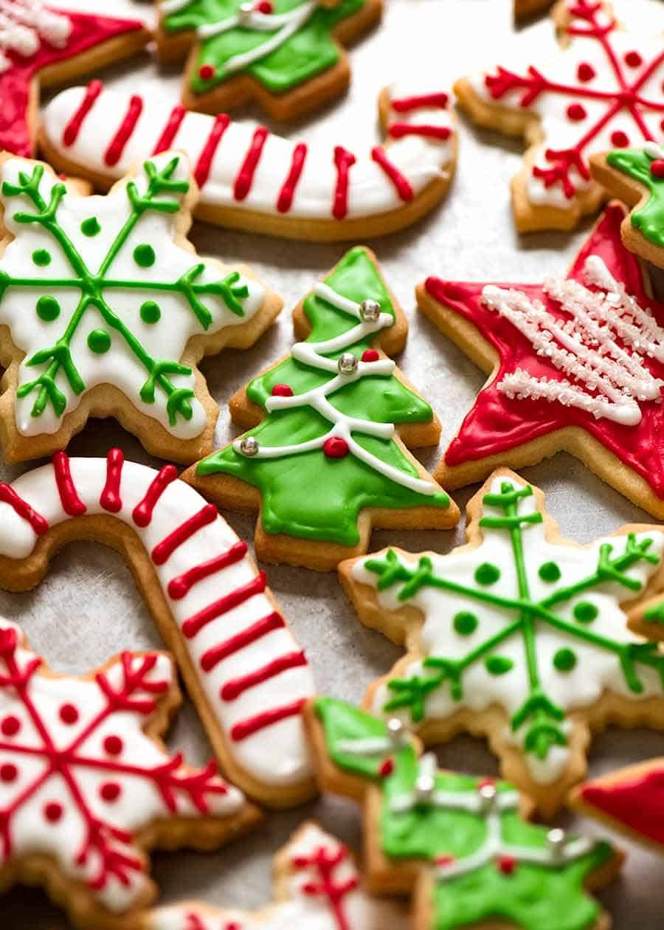
CHRISTMAS COOKIES

Slide 2
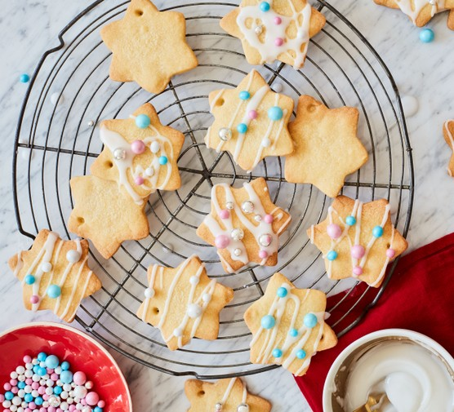
Preparation and cooking time
Prep:10 minutes
Cook:12 minutes
Plus chilling time
Easy
Makes 20 biscuits
CHRISTMAS !!!!!!!!

Slide 3
      INGRIDIENTS
140g icing sugar sieved
1 tsp vanilla extract
1 egg yolk
250g butter cut into small cubes
375g plain flour sieved
DECORATION
To decorate
200g icing sugar sieved
edible food colouring optional
edible gold and silver balls
approx 2m thin ribbon cut into 10cm lengths

Slide 4
Method
step 1
Tip the icing sugar, vanilla extract, egg yolk and butter into a mixing bowl, then stir together with a wooden spoon (or pulse in a food processor until well combined). Add the flour and mix to a firm dough. Shape the dough into two flat discs and wrap them. Chill for 20-30 mins. Heat oven to 190C/fan 170C/gas 5 and line two baking sheets with non-stick baking paper.
step 2
Roll out the dough on a lightly floured surface to about the thickness of two £1 coins. Cut out Christmassy shapes (use a cutter if you like) and place on the baking sheets. Using the tip of a skewer, cut a small hole in the top of each cookie. Bake for 10-12 mins until lightly golden.
step 3
Lift the biscuits onto a wire rack to cool. Meanwhile, mix the icing sugar with a few drops of cold water to make a thick, but still runny icing. Colour with edible food colouring, if you like. Spread it over the cooled biscuits, decorate with edible balls and thread with ribbon when dry.
You can decorate your cookies however you like. You don't need to use any of the materials listed above!!!!!!!!!

Slide 5
NUTRITION PER SERVING
kcal233
fat11g
saturates7g
carbs34g
sugars19g
fibre1g
protein2g
salt0.2glow
Can you resist this temptation?

Slide 6
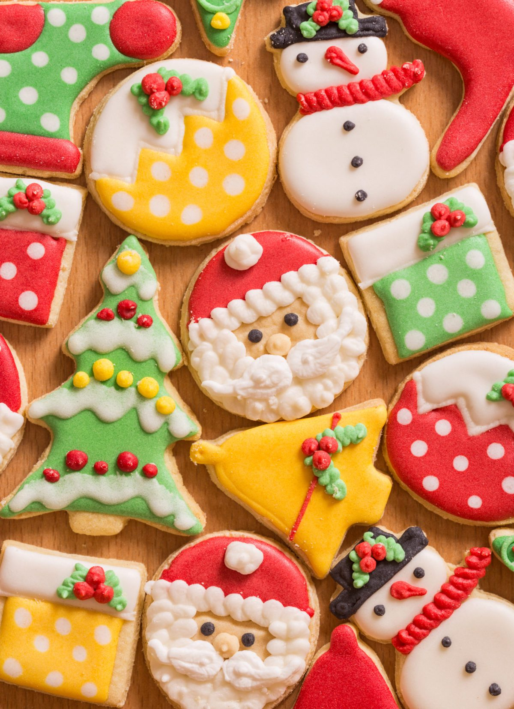
Thank you for watching my presentation!!!!!!!!!!!!!!!!!

Slide 7
Thank you for watching my presentation

