Slide 2
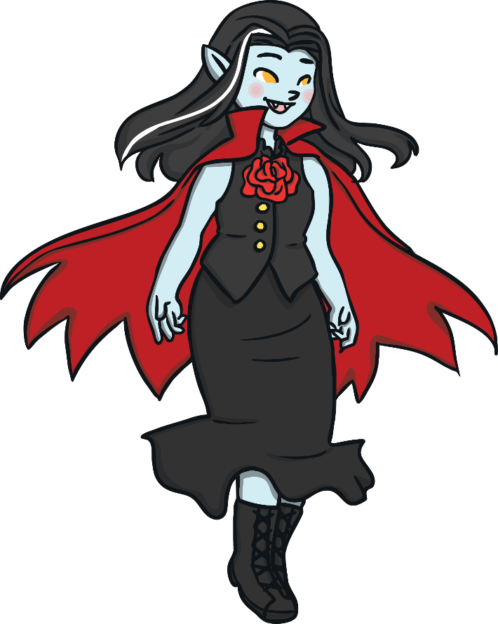
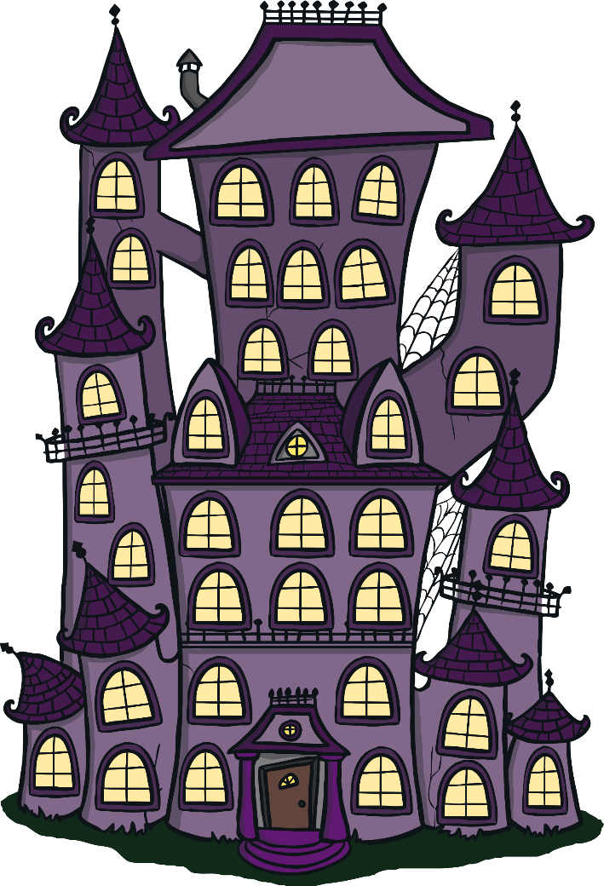
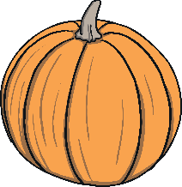
What am I?
Click the pumpkins to reveal the clues, then click the haunted house to reveal the answer.
I am a vampire!
1
I sleep in a coffin
2
I am immortal
3
I drink blood

Slide 3
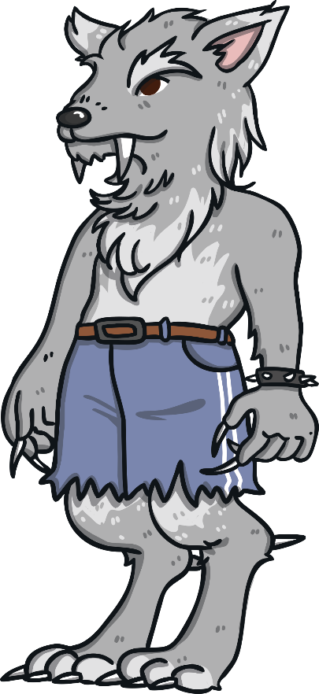
What am I?
Click the pumpkins to reveal the clues, then click the haunted house to reveal the answer.
I am a werewolf!
1
I am a human with a curse
2
I transform when there is a full moon
3
When I transform I become hairy and grow fangs

Slide 4
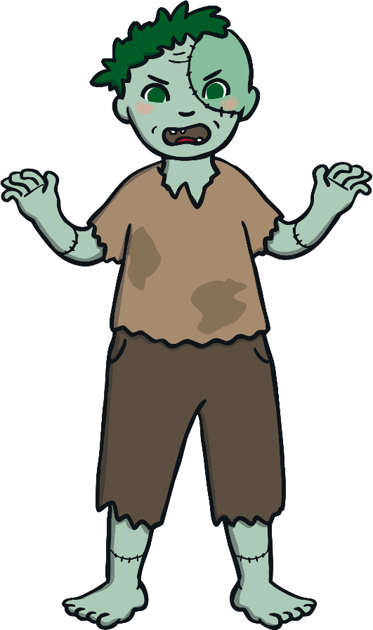
What am I?
Click the pumpkins to reveal the clues, then click the haunted house to reveal the answer.
I am a zombie!
1
I was a human but was bitten
2
I am undead
3
My favourite food is human brains

Slide 5
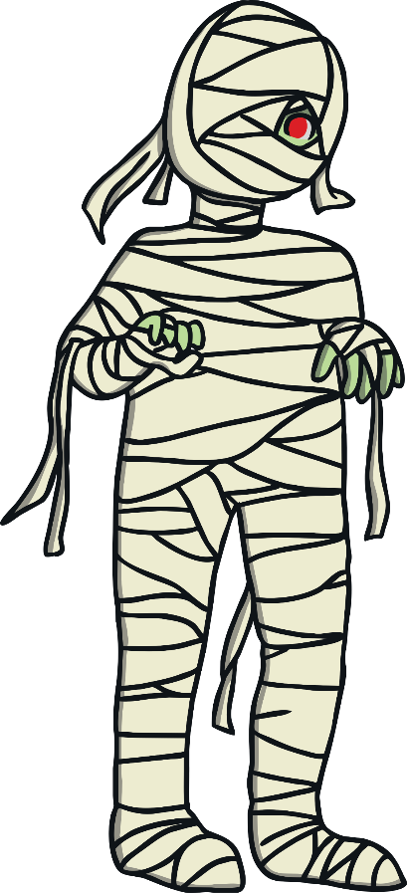
What am I?
Click the pumpkins to reveal the clues, then click the haunted house to reveal the answer.
I am a mummy!
1
I have been in a tomb for many years
2
I am Egyptian
3
I am wrapped in bandages

Slide 6
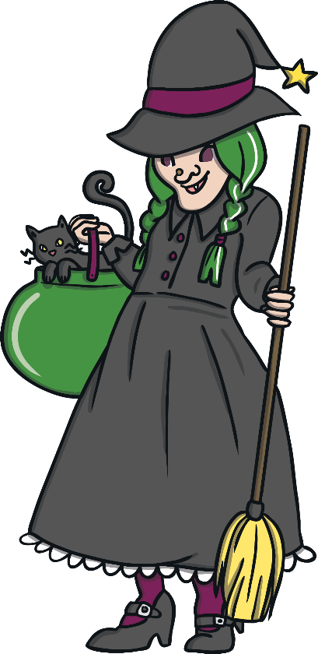
What am I?
Click the pumpkins to reveal the clues, then click the haunted house to reveal the answer.
I am a witch!
1
I cast spell
2
I make potions in my cauldron
3
I ride a broomstick

Slide 7
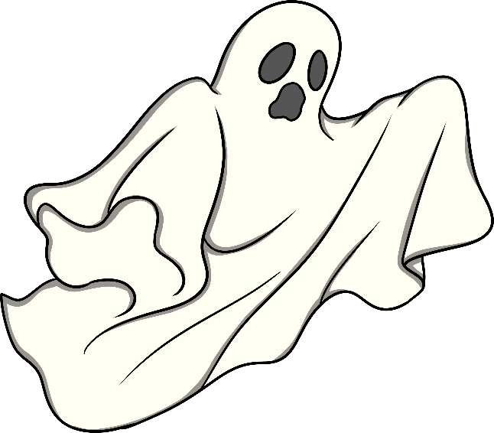
What am I?
Click the pumpkins to reveal the clues, then click the haunted house to reveal the answer.
I am a ghost!
1
I was once a human
2
I can walk through walls
3
I like to haunt people

Slide 8
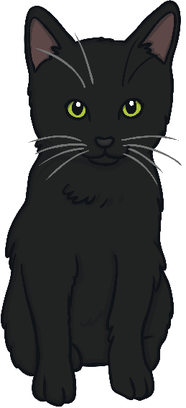
What am I?
Click the pumpkins to reveal the clues, then click the haunted house to reveal the answer.
1
I am a symbol of Halloween
I am a black cat!
2
I am associated with witchcraft
3
I am thought to bring bad luck

