Slide 2

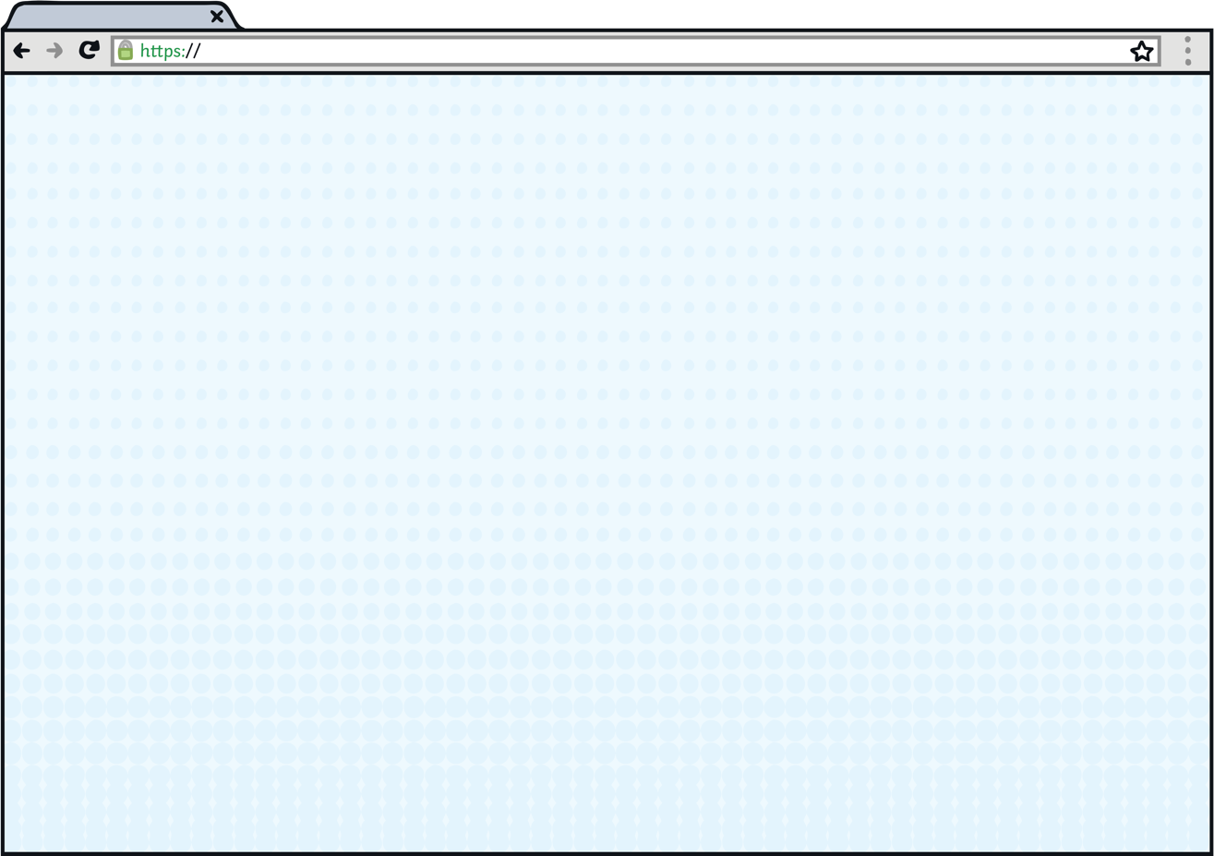

Welcome Page
www.onlinesafety.co.uk
The Internet is amazing when used safely and correctly.
Here are some simple rules that will help you stay safe online.
Press to enter!
Loading….
Be smart and safe by making the right choices.

Slide 3

Welcome Page
www.onlinesafety.co.uk
If you see something online
that upsets you:
STOP - Stop what you are doing. Do not click on the page or reply to any messages.
CLOSE - Close the laptop. Put your phone or tablet down.
TELL - Tell a trusted adult.

Slide 4
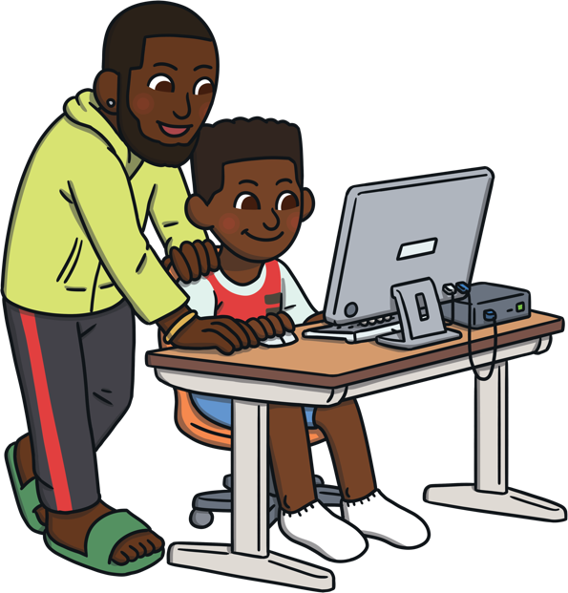
Online Gaming
www.onlinesafety.co.uk/onlinegaming
Online Gaming
Always ask a trusted adult before you play games online.
It is important to be nice to people so that you don't upset them. Remember to treat others how you would like to be treated.
Use a username and avatar instead of your real name and photo when playing games online.
It can be really easy to spend money when playing online games. Always check with a trusted adult before buying anything.

Slide 5

Making Friends
www.onlinesafety.co.uk/makingfriends
Making Friends
Only talk to people you know online. If someone you don’t know sends you a request or message, ask a trusted adult.
Never agree to meet someone in person that you met online. Some people on the Internet might not be who they say they are.

Slide 6
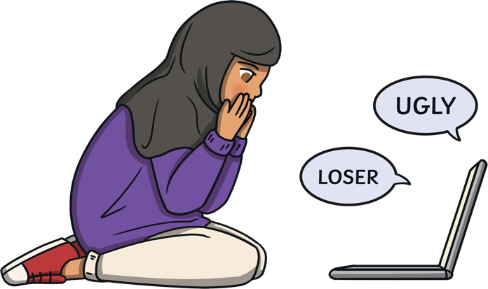
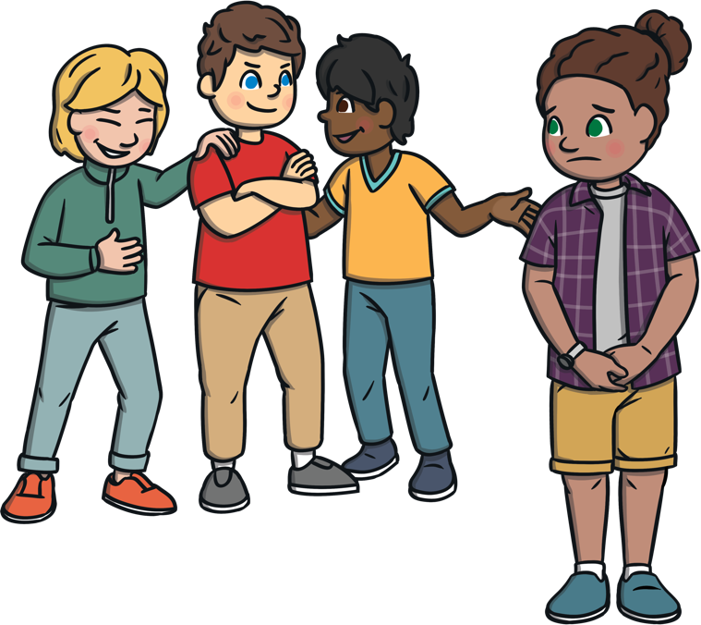
Online Bullying
www.onlinesafety.co.uk/onlinebullying
Online Bullying
Online bullying is when someone is deliberately mean to someone online.
Show any unkind messages, photos or videos to a trusted adult, so they can help you.
It can take place when playing games or talking to people online.
Don’t keep online bullying to yourself! Tell a trusted adult. People want to help you and make it better.
If someone says something that upsets you, tell a trusted adult.

Slide 7
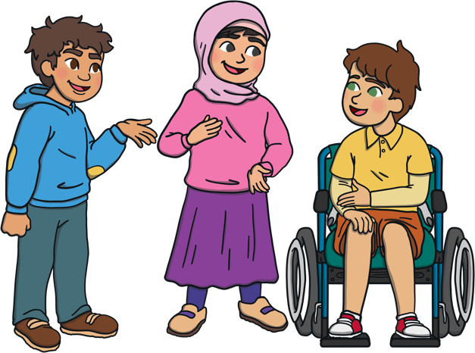
Sharing Information
www.onlinesafety.co.uk/sharinginformation
Sharing Information
Never share any of your personal information online, such as your name, address or school.
Instead of using a photograph, use an avatar to represent your face.
Before you share a photograph or video of you or your friends online, check with a trusted adult.
If you get sent a photograph or video that upsets you, tell a trusted adult.

Slide 8

Sharing Information
www.onlinesafety.co.uk/sharinginformation
Everytime you visit a website, download an app or play a game online, a tiny bit of information about you is saved. This makes up your digital footprint.
Think before you share or write anything online. What you do online can be seen by others and cannot be removed.

Slide 9

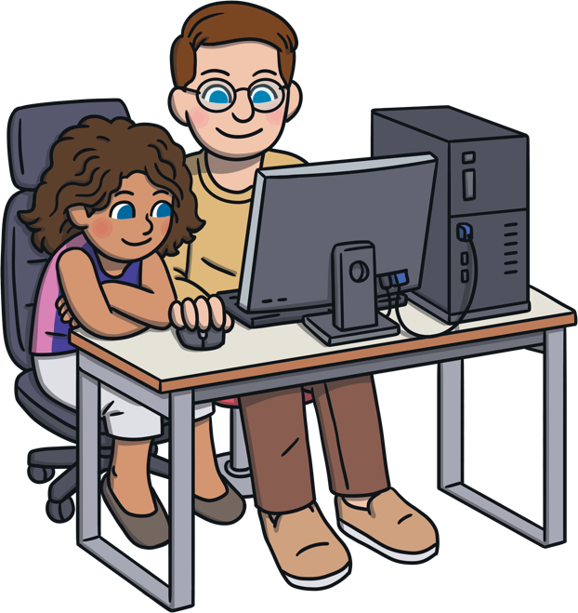

Fake News
www.onlinesafety.co.uk/fakenews
Fake News
Not everything you see or read online is true.
If you’re unsure whether something is true, check with a trusted adult or another website.

Slide 10






Age-Appropriate Content
www.onlinesafety.co.uk/age-appropriatecontent
Age-Appropriate Content
Use child-friendly search engines, such as Kiddle, Swiggle or KidRex.
Make sure you only play games that are age appropriate.
If you see something online that upsets you, make sure you tell a trusted adult.

Slide 11

Online Safety
www.onlinesafety.co.uk
STOP CLOSE TELL
STOP - Stop what you are doing. Do not click on the page or reply to any messages.
CLOSE - Close the laptop. Put your phone or tablet down.
TELL - Tell a trusted adult.

