Slide 1

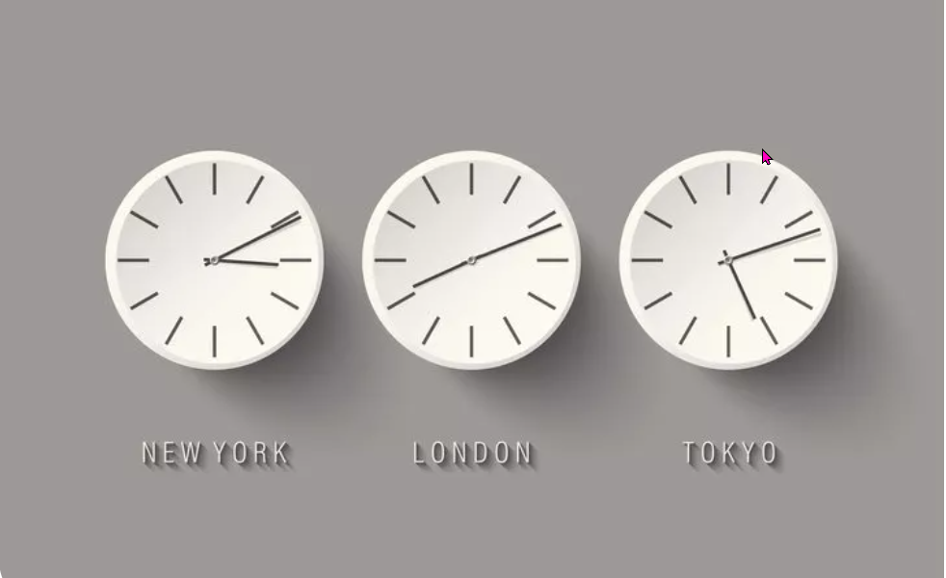
Time
https://www.teachingenglish.org.uk/

Slide 2
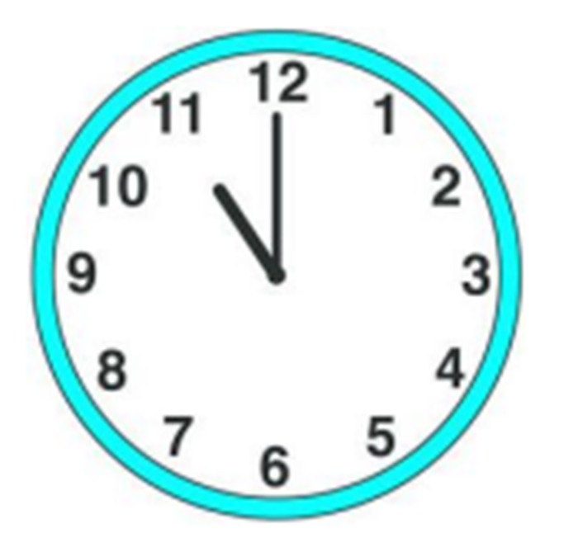
What’s the time?
https://www.teachingenglish.org.uk/

Slide 3




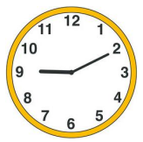
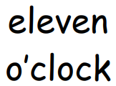
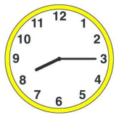

Time
1. | A
2. | B
3. | C
4. | D
https://www.teachingenglish.org.uk/

Slide 4
One moment in time
1.In London it’s 5 o’ clock in the afternoon.
2. In Brazil it’s ____ in the afternoon.
3. In Mexico it’s _____ in the morning.
4. In the US it’s _____ in the morning.
5. In Qatar it’s _____ in the evening.
https://www.teachingenglish.org.uk/

Slide 5
One moment in time - Answers
1.In London it’s 5 o’ clock in the afternoon.
2. In Brazil it’s 2 o’ clock in the afternoon.
3. In Mexico it’s 11 o’ clock in the morning.
4. In the US it’s 8 o’ clock in the morning.
5. In France it’s 6 o’ clock in the evening.
6. In Qatar it’s 8 o’clock in the evening.
https://www.teachingenglish.org.uk/

