Slide 2
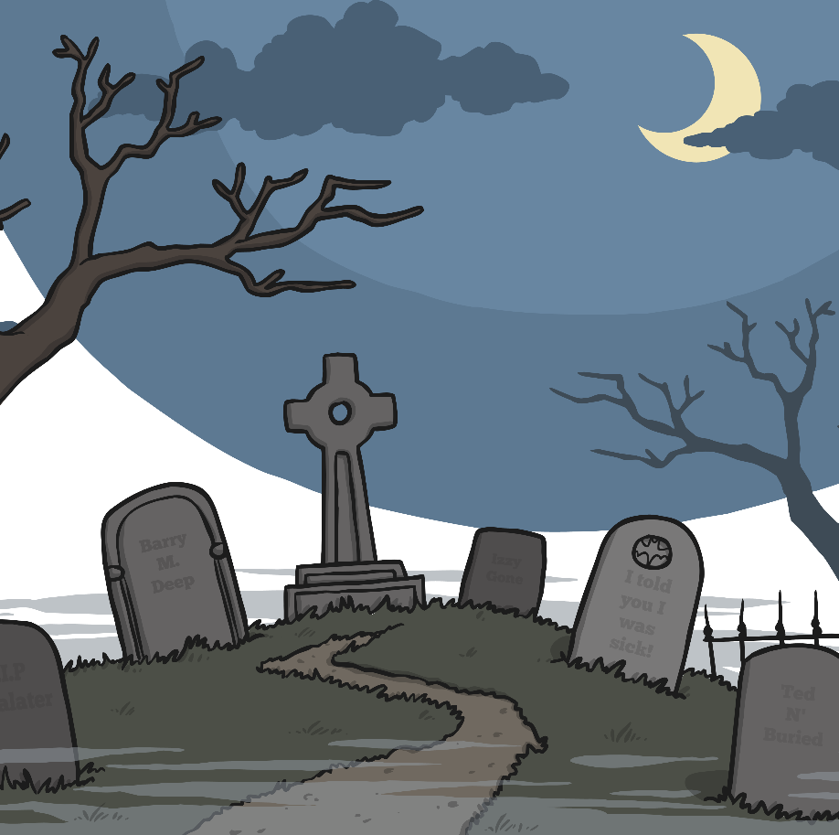

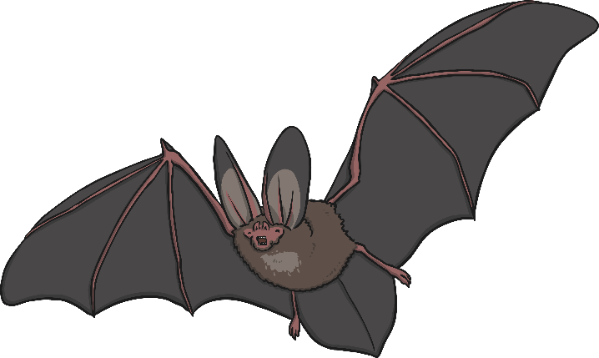

Question 1
Halloween is in which month?
a) September
b) October
c) November

Slide 3
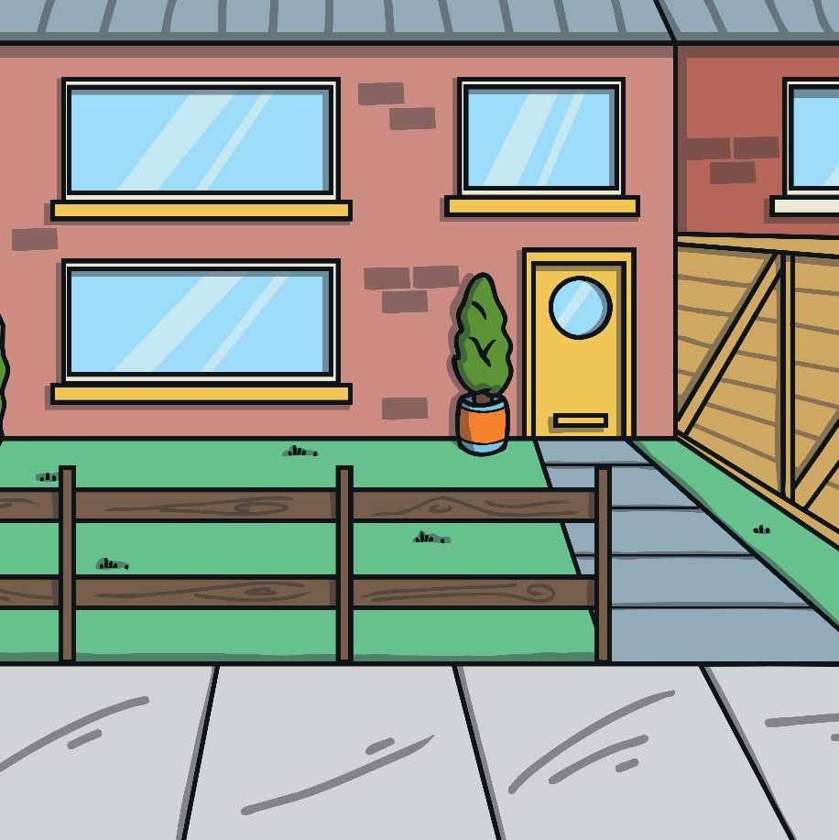
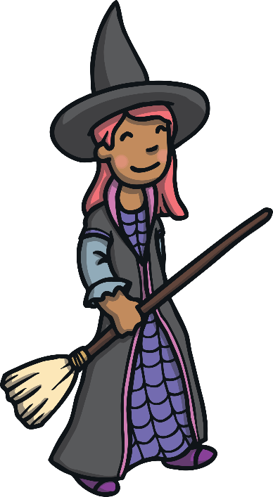
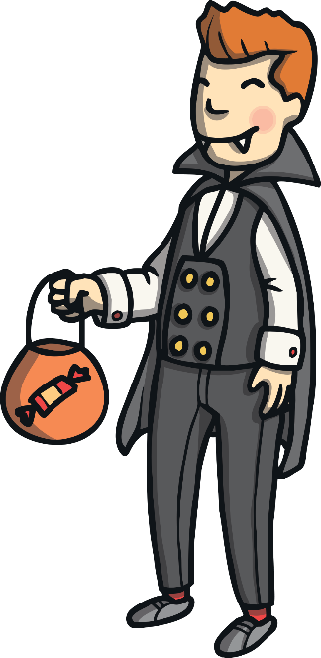
Question 2
What do some children do on Halloween?
a) wash cars
b) dress up and dance
c) dress up and go trick-or-treating

Slide 4
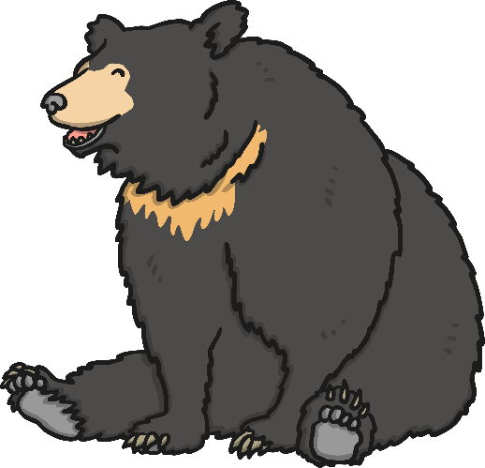
Question 3
Which of these is not a typical Halloween character?
a) a witch
b) a ghost
c) a bear

Slide 5

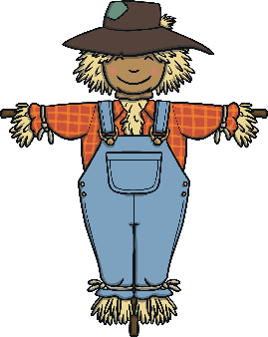
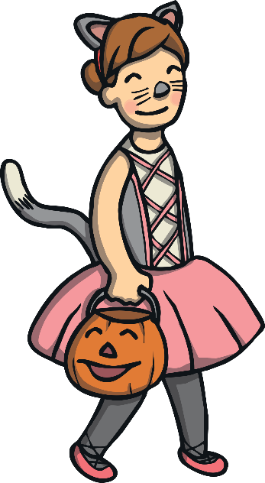
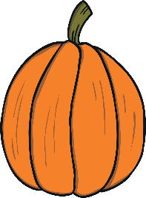

Question 4
Which fruit is often carved in to a scary face?
a) a melon
b) a pumpkin
c) an orange

Slide 6

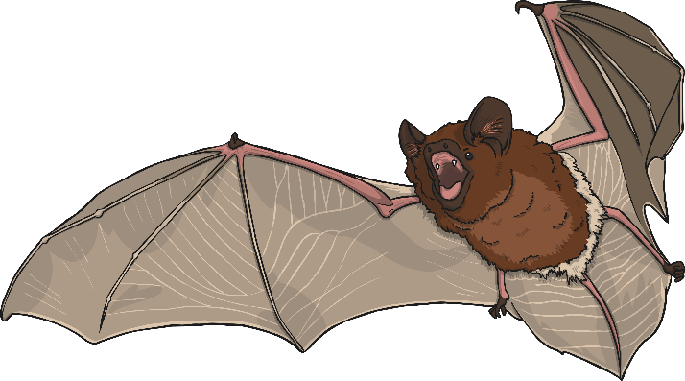
Question 5
Which Halloween animal flies around at night?
a) a bat
b) a bird
c) A dragon

Slide 7
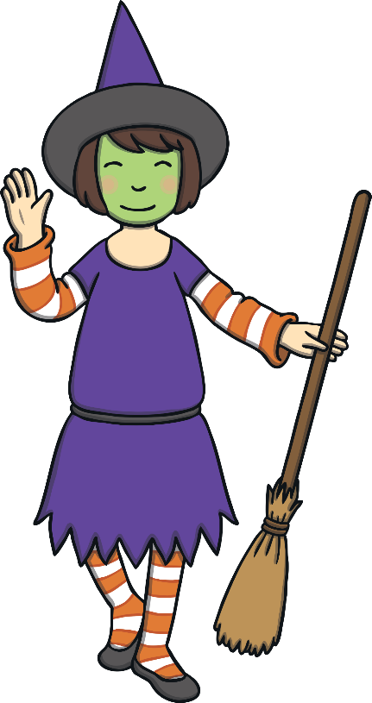
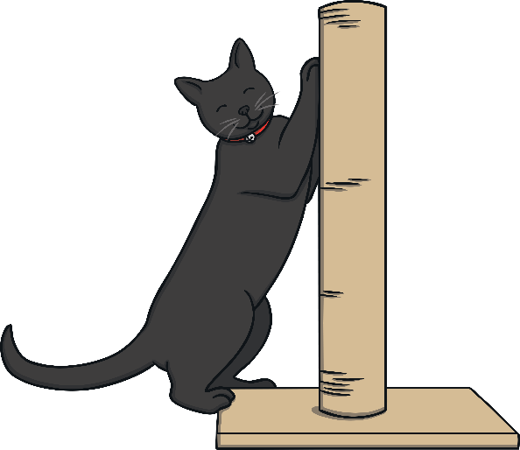
Question 6
What colour is a witch’s cat?
a) grey
b) black
c) white

Slide 8
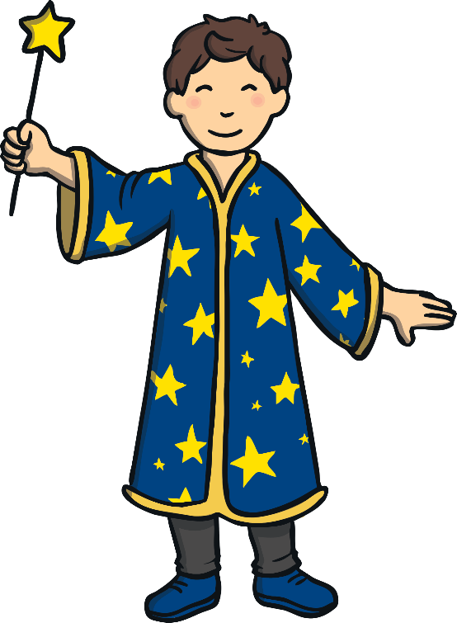
Question 7
How many letters are there in the word Halloween?
a) 8
b) 10
c) 9

Slide 9
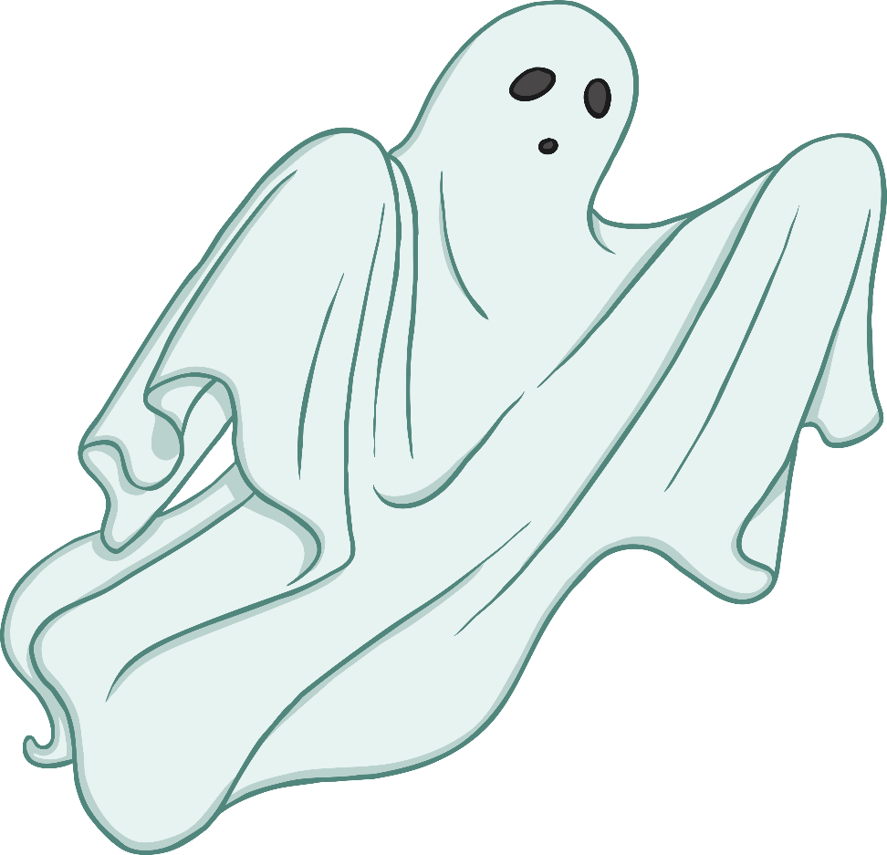
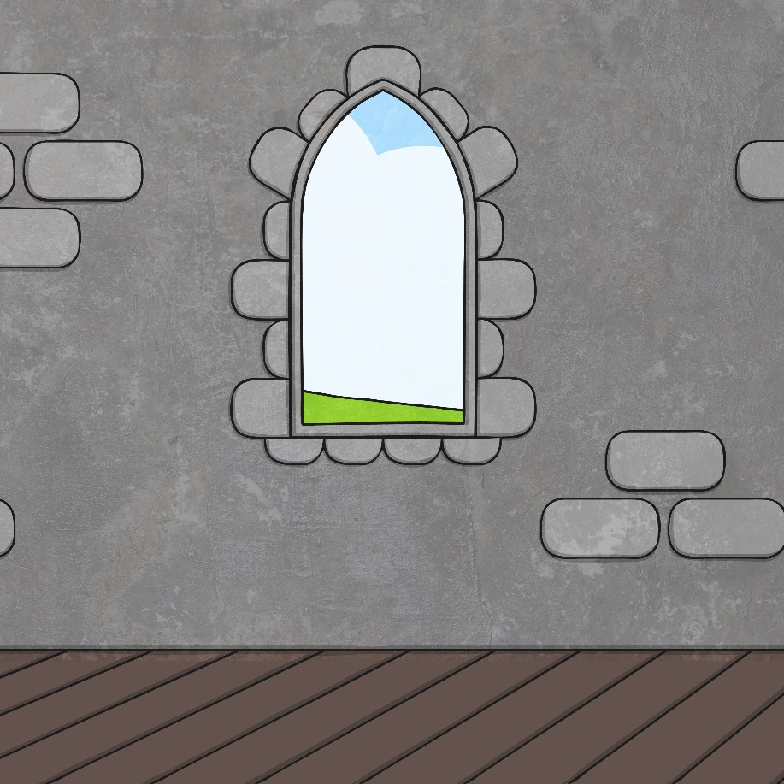
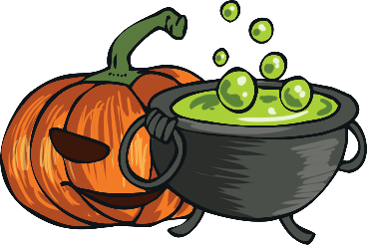
Question 8
What might float around a haunted house?
a) a bird
b) a cloud
c) a ghost

Slide 10
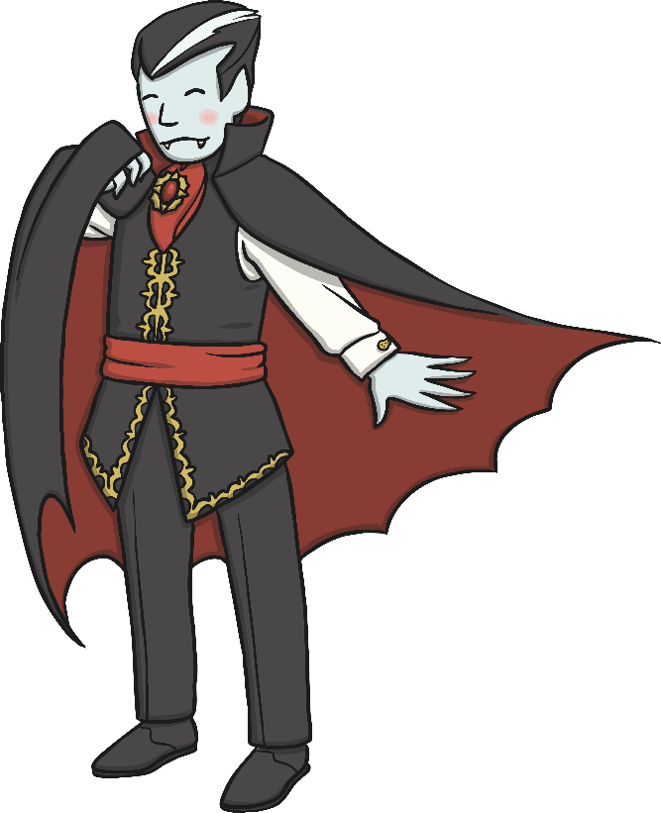
Question 9
What does a vampire have?
a) fangs and a cape
b) fangs and a coat
c) fangs and a vest

Slide 11
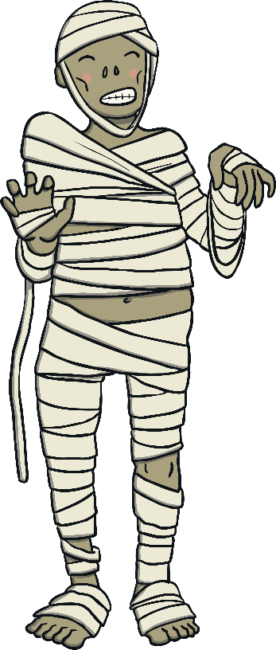
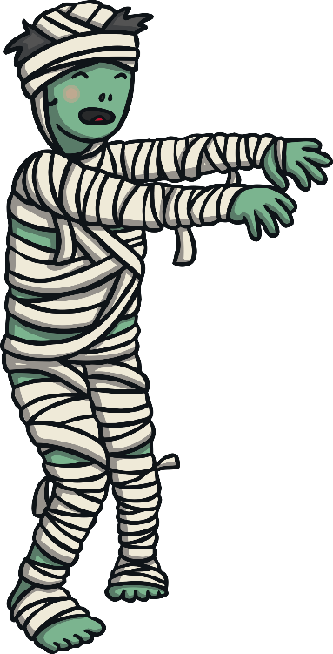
Question 10
What is this?
a) a vampire
b) a skeleton
c) a mummy

