Slide 1
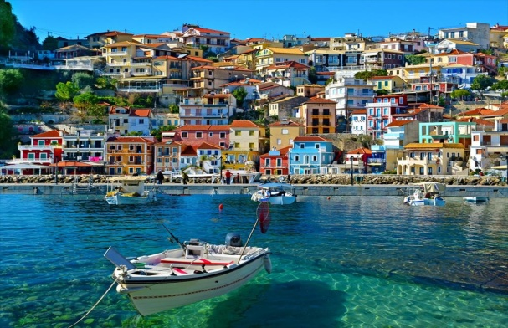
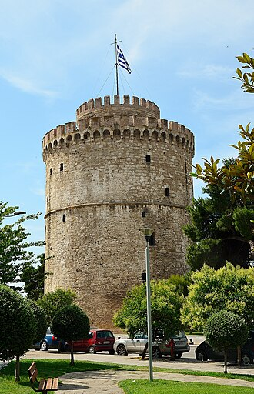
Hi Evanthia
Greece is beautiful and a lot of people speak greek here .It is very good here because we can see a lot of historic places. The food is very tasty and different. Today we are visitng a city, Thessaloniki. Lots of people have dogs or cats here. We are enjoying every moment of our holidays . Hope you like my postcard.
Love,
Artemis.
Thessaloniki
Artemis Papavasiliou
.6720152026 Baka
Thessaloniki Greece

