Slide 1
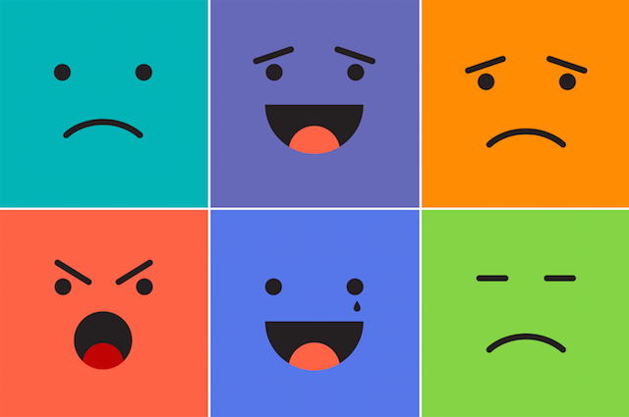
emotions

Slide 2
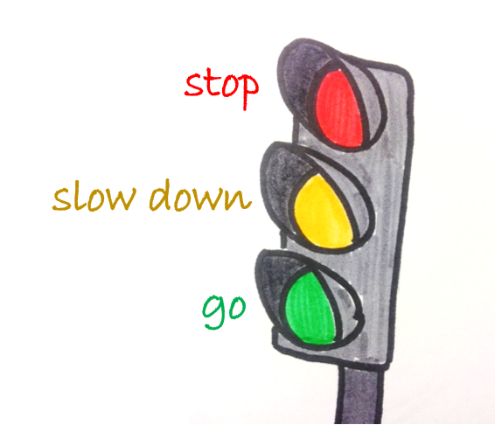
THE ZONES OF REGULATION

Slide 3
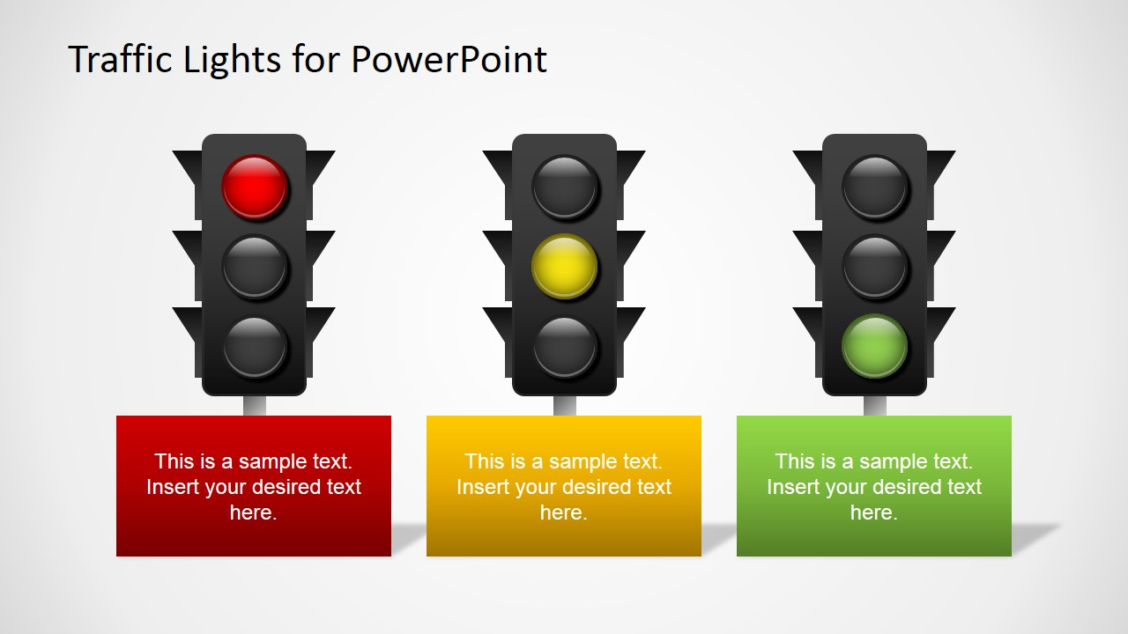



Calm, relaxed
happy
excited

Slide 4
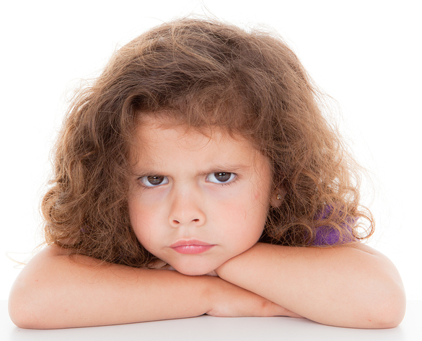
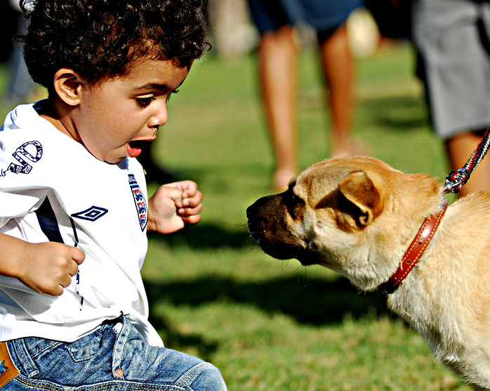
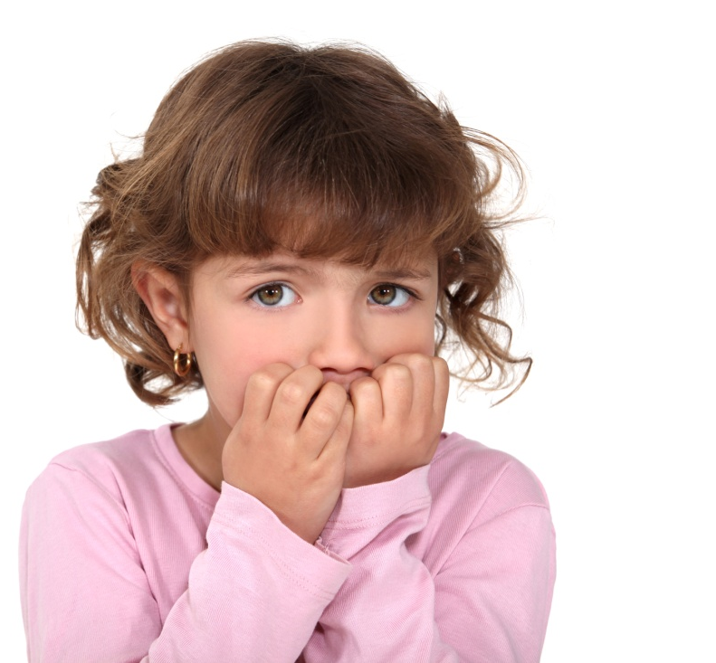
upset
Scared, afraid
Nervous,
anxious

Slide 5
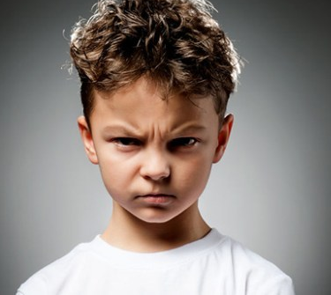
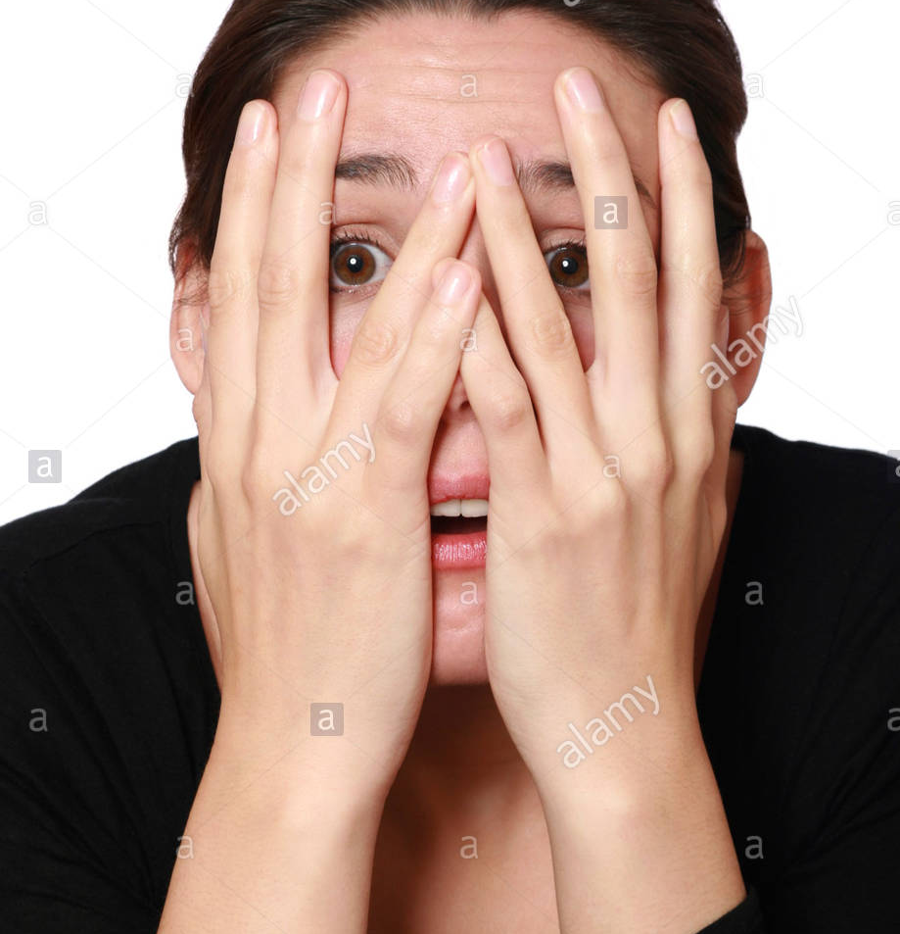
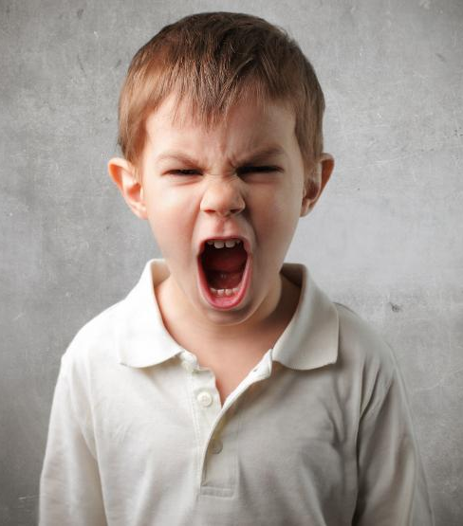
angry
furious
Frightened

Slide 6

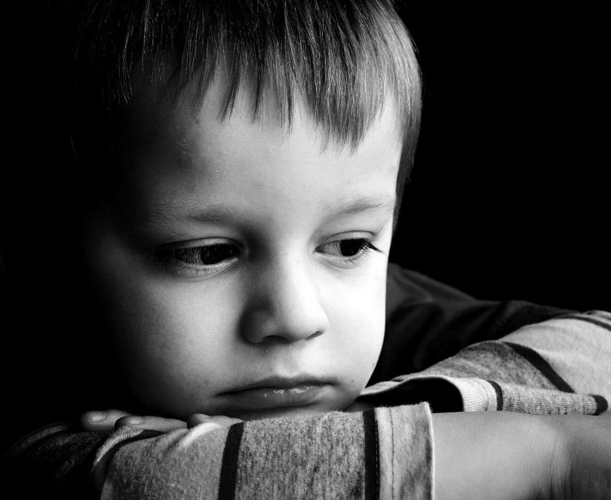
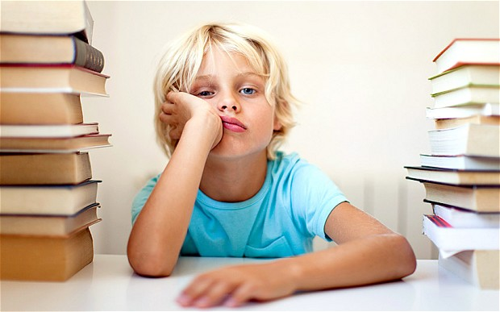
sick
sad
bored

Slide 7
Calm, relaxed
happy
excited

Slide 8
upset
Scared, afraid
Nervous,
anxious

Slide 9
angry
furious
Frightened

Slide 10
sick
sad
bored

Slide 11
Bored
Sad
happy
When you loose a game you feel →
frightened
calm
sick
When you watch a scary movie you feel →
scared
excited
angry
            When you get a present you feel →
excited
upset
bored
            When your life seems the same way every day you feel →

Slide 12
sick
nervous
excited
            When you write a test you feel→
scared
angry
sick
            When you have a fever you feel →
            When you get lost in a strange place you feel→
calm
scared
happy

Slide 13
nervous
sad
excited
            When you get some bad news→
scared
mad
sorry
            When you break a friend's favourite toy →
            When someone takes your book without asking→
calm
angry
excited

Slide 14
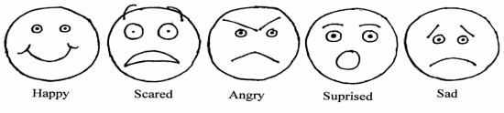
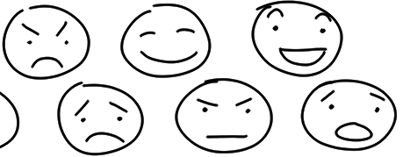

Slide 15


