Slide 1
My dream city !!!
Anastasia Mary Karalis
6th grade
105 Elementary school
Thessaloniki

Slide 2
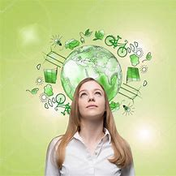
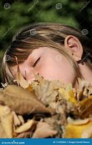
No matter how young or old we are , we never stop dreaming .
Our dreams have to do with imaginary thoughts and fictionary lives in which we would like to participate, because there we feel free and able to face every enemy!
One of my unique dreams is about an environmentally friendly, peaceful, balanced, dream city!!

Slide 3
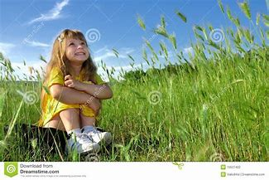
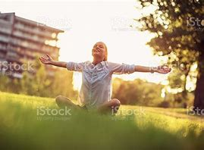
How the city looks like
First and foremost, as an environmentally friendly city one of its basic elements is the creation of many green areas in order to allow people to relax and get rid of stress and forget about their every day problems! For this reason I call my dream city… Tranquility, due to the fact that it is the most peaceful and calm place in the world…

Slide 4


A war free city
In addition, people, meaning families and children, would not have to worry about conflicts between different countries. In this city war would be a state of the past and its devastating consequences would not affect neither people nor the environment!

Slide 5
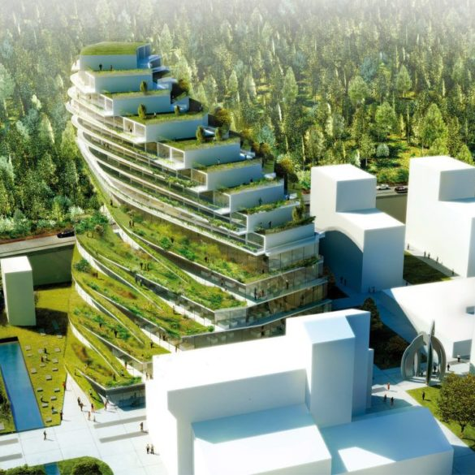
Biodiversity
Moreover in my dream city would exist balance between the buildings and the planted spaces, so that trees, plants and animals could feel safe to grow in an environment free of pollution. This way the biodiversity is increased and protected… Everyone is in charge of planting new trees and cleaning up green spaces..

Slide 6

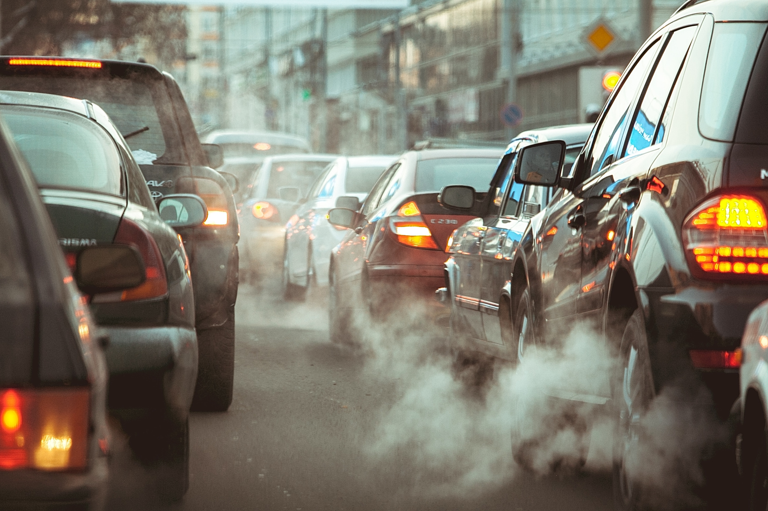
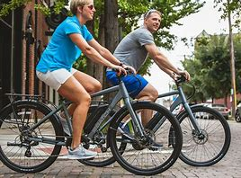
Transportation
In this imaginary place, people prefer using their bicycles for short distances, or even walking!
Furthermore, they use rechargeable electrical cars therefore reducing smog and fumes! Atmospheric pollution is reduced in these ways and the planet Earth can breathe again!

Slide 7


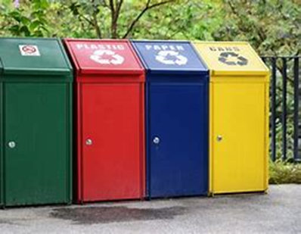
Saving for our children…
In this city people take recycling really seriously and learn from an early age how to do it right, especially it is taught at schools! Every family has special recycling bins and divides rubbish correctly.
The general idea of reusing things is the key to saving energy , therefore caring for our children and our children's children…

Slide 8
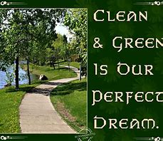
Clean city green city…… my dream city!!!

Slide 9
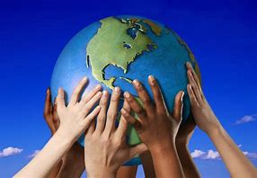
Favorite song based on the topic
Heal the world, Michael Jackson
Think about, ehm, the generations and
Say we wanna make it a better place for our children
And our children's children, so that they
They, they know it's a better world for them
And think if they can make it a better place
There's a place in your heart
And I know that it is love
And this place could be much brighter than tomorrow
And if you really try
You'll find there's no need to cry
In this place you'll feel there's no hurt or sorrow
There are ways to get there
If you care enough for the living
Make a little space
Make a better place
Heal the world

Slide 10
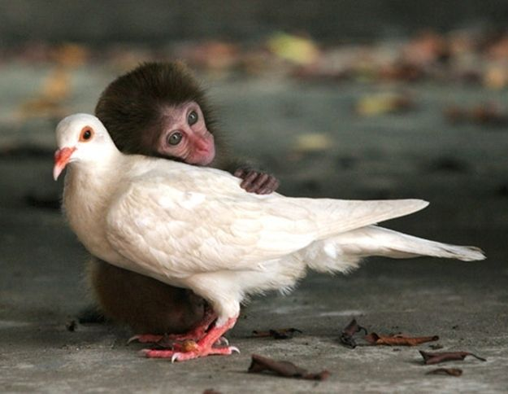
Thank you for your attention!

