Slide 1
Recycling Facts and figures
Did you know that……?

Slide 2
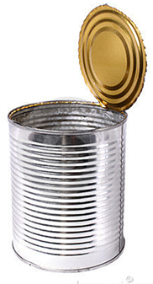
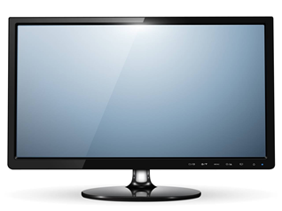
1 recycled
would save enough energy to power a
for
3 hrs ?

Slide 3

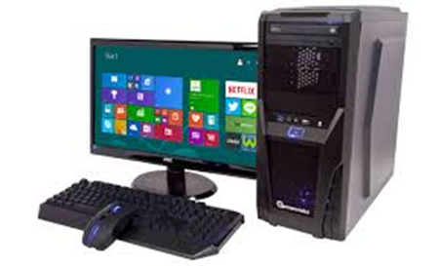
1 recycled
would save enough energy to power a
for…
25’ ?

Slide 4


1 recycled
would save enough energy
to power a 60 watt
for
3 hrs ?

Slide 5
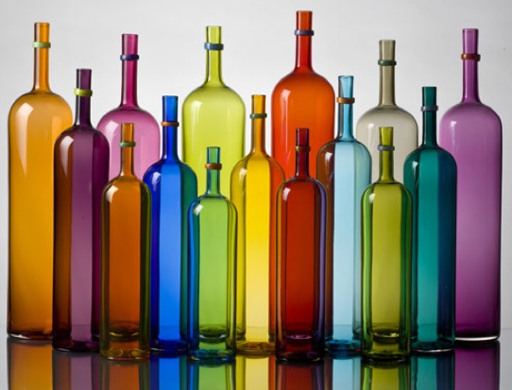
glass is 100% recyclable?
thrown away glass in a dump will never decompose?

Slide 6
70%
How much
less energy is required to recycle paper than produce it using raw materials?
of the rubbish in the dustbins could be recycled?
60%
of the money you pay for a product is for the packaging?
16%

Slide 7
70%
less air pollution recycled paper produces ?
of a vehicle can be recycled?
80%
of the waste in a bin could be composted?
50%

Slide 8
How many
trees we need to make 1 ton of paper?
24
years plastic takes to decompose?
500
tons of water can be contaminated by
1 button battery ?
600

Slide 9
SO
REDUCE
REUSE
RECYCLE

