Slide 1
Environment

Slide 2
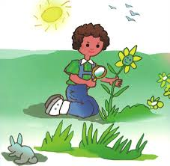
What do we mean by
"Environment"?
Natural environment
all living and
non-living
things

Slide 3
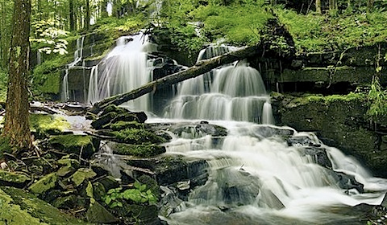
Physical environment
Your physical environment includes both your outdoor and indoor surroundings
Water
Natural
Vegetation

Slide 4
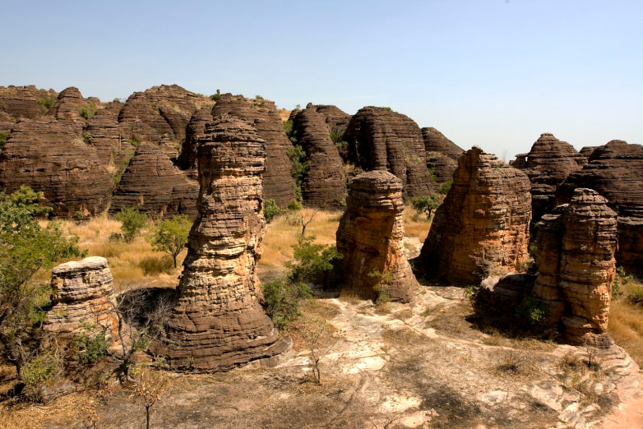
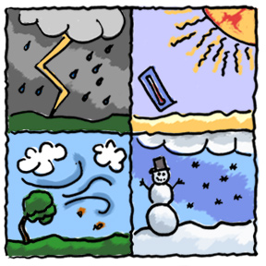
Landform
and rocks
Weather and climate
Examples: rivers, seas , ocean, mountains, rocks, volcanoes, tornadoes

Slide 5
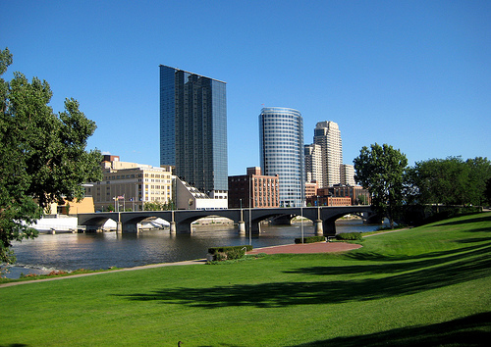
Social / Human environment
our society
&
our culture

Slide 6
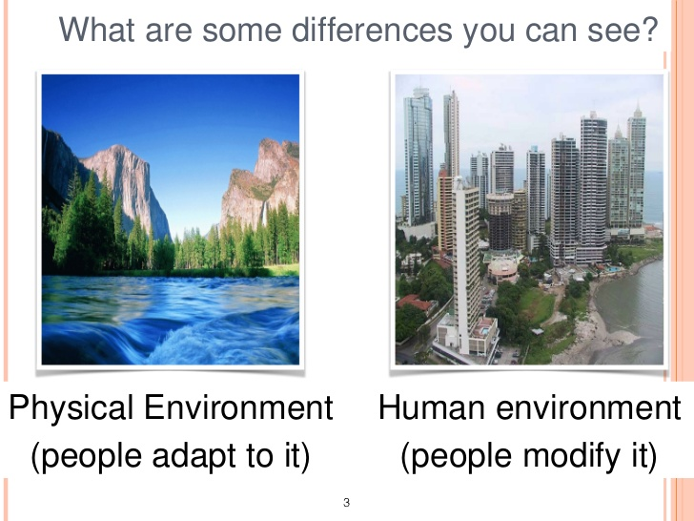

Slide 7
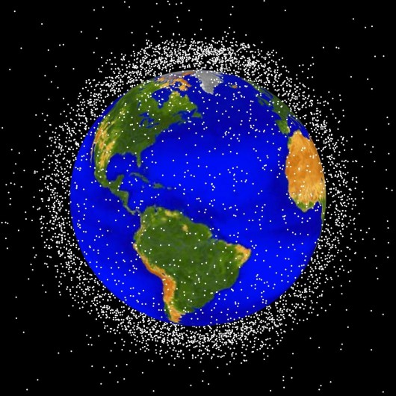
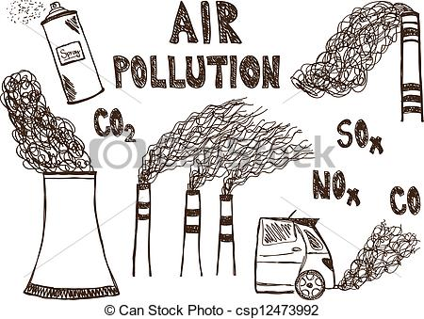
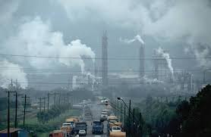
Problems:
*The Earth's atmosphere is a thin layer of gases that surrounds the Earth.
Smog
Fumes
Sprays
Pollution
Air pollution

Slide 8
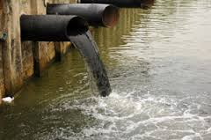
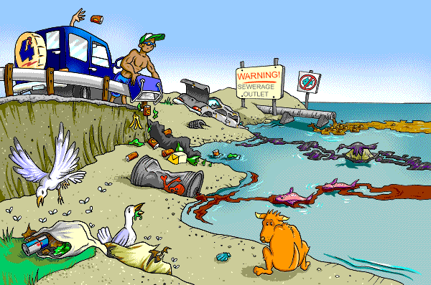
Water pollution
Toxic waste
Garbage
Trash
Rubbish

Slide 9
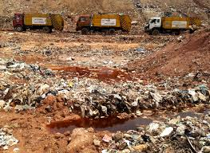
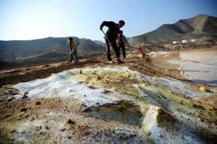
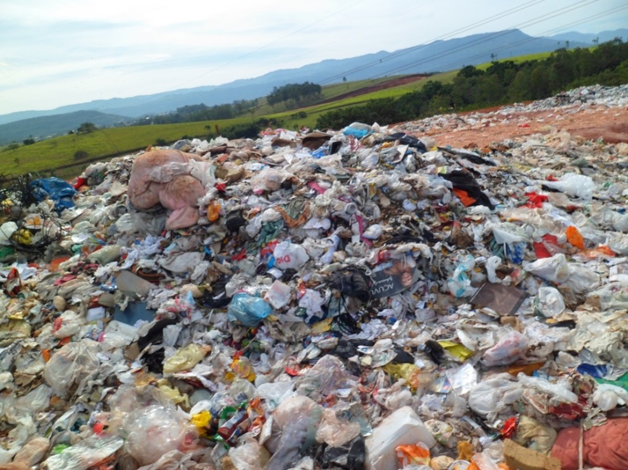
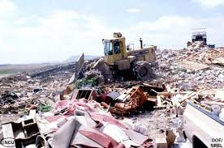
Land pollution

Slide 10
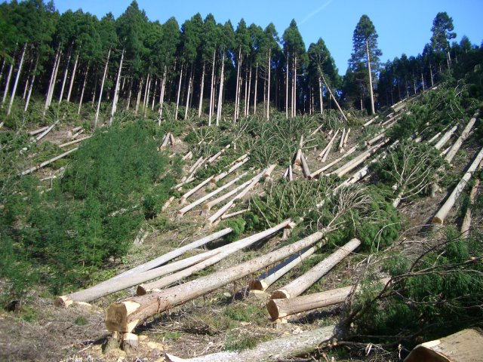
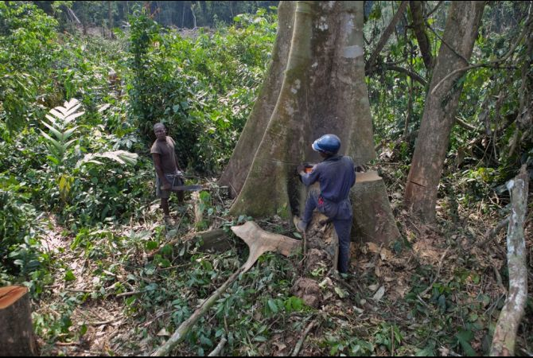
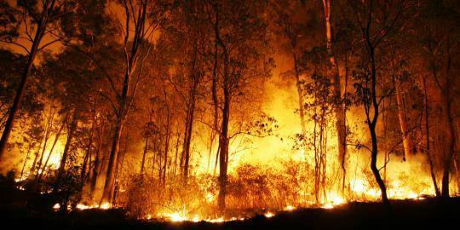
Deforestation
Poor people often chop down/cut down trees for firewood.
Fires

Slide 11
What are the effects of all this destruction of the planet on us and all the other living and non-living things that surround us?

Slide 12

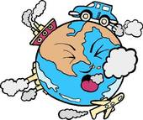
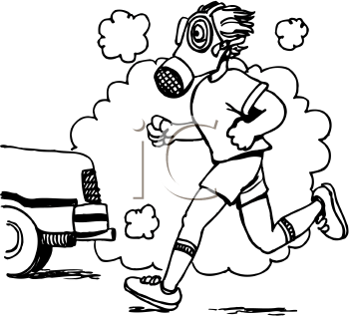
Effects of air pollution
no
clean air
Greenhouse
effect
Global warming

Slide 13
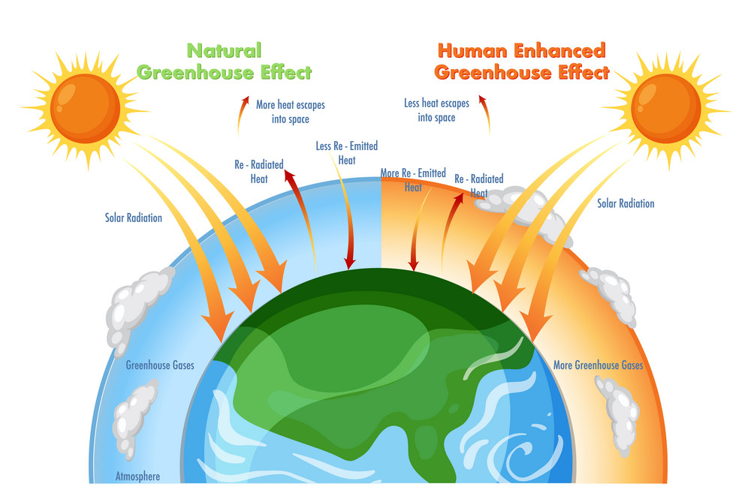

Slide 14

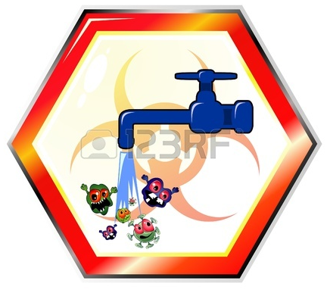

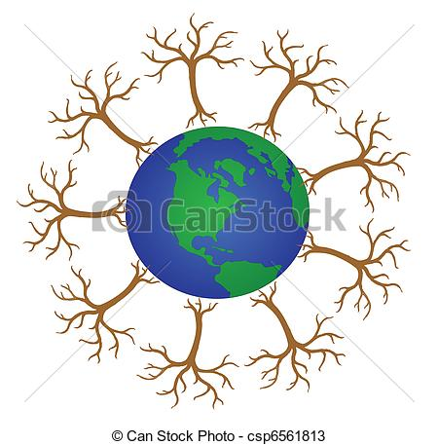
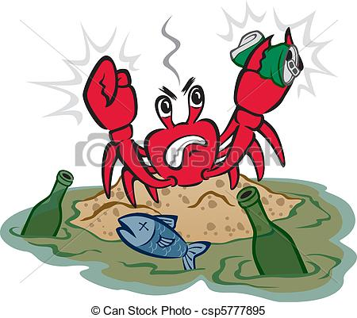
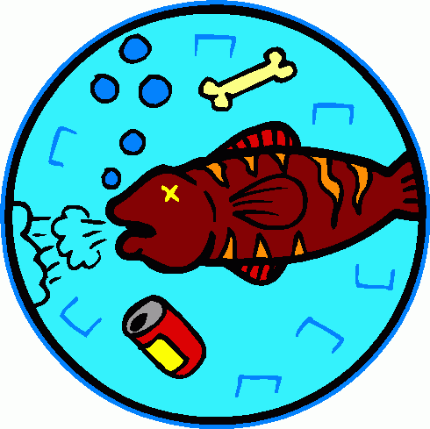
Effects of water pollution
Acid rain

Slide 15
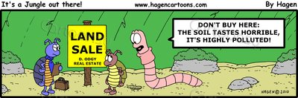
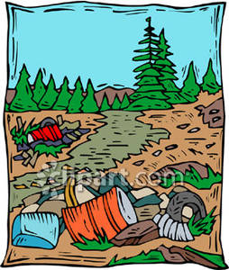
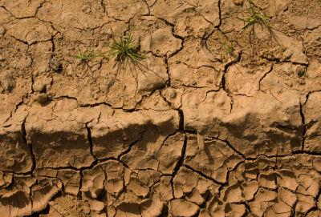
Effects of land pollution
desert land

Slide 16
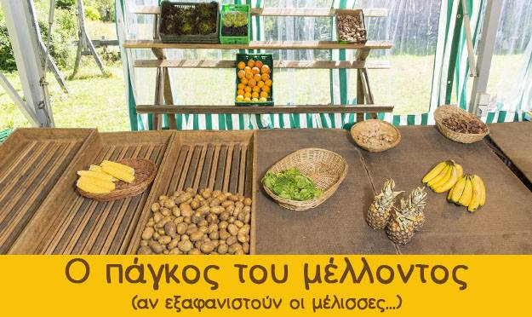
What will happen when bees disappear.

Slide 17
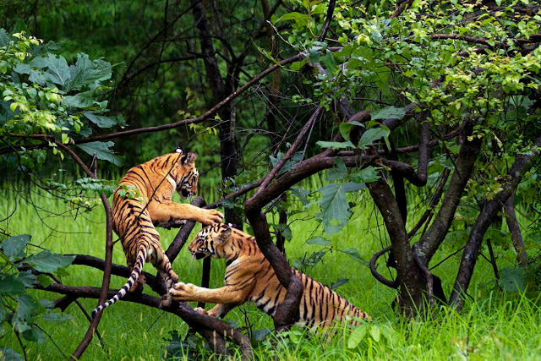
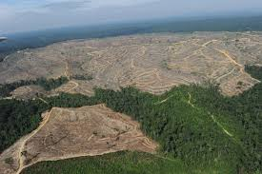
Sumatra
Effects of deforestation
Destruction of natural habitat

Slide 18
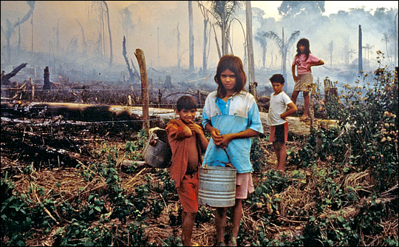
Tropical deforestation

Slide 19
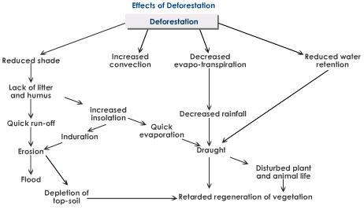

Slide 20
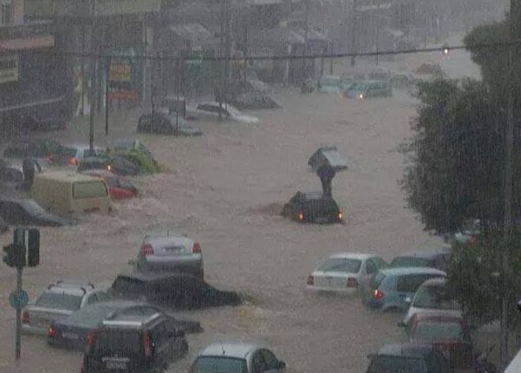
Floods in Athens

Slide 21
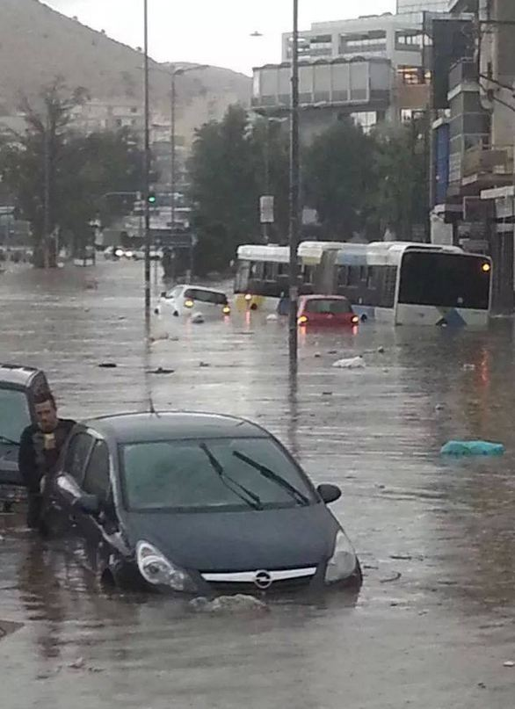
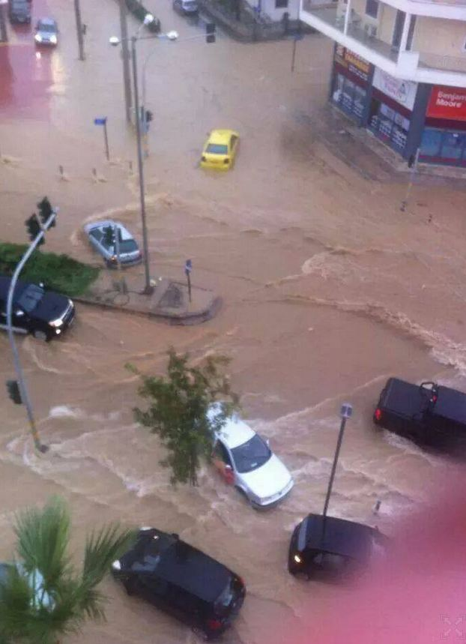

Slide 22
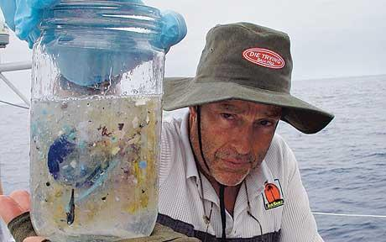
Drowning in plastic

Slide 23
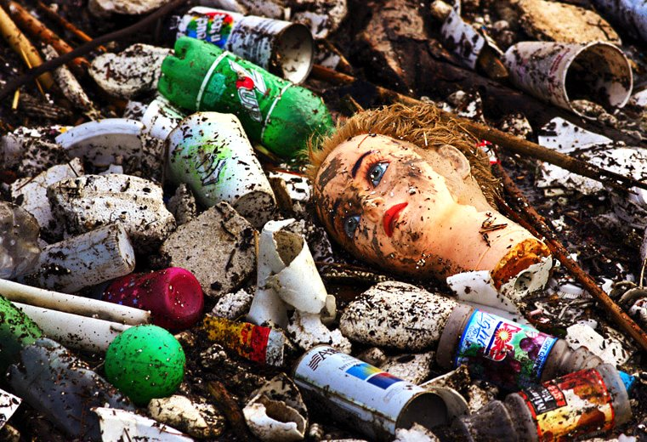
Soup of trash

Slide 24
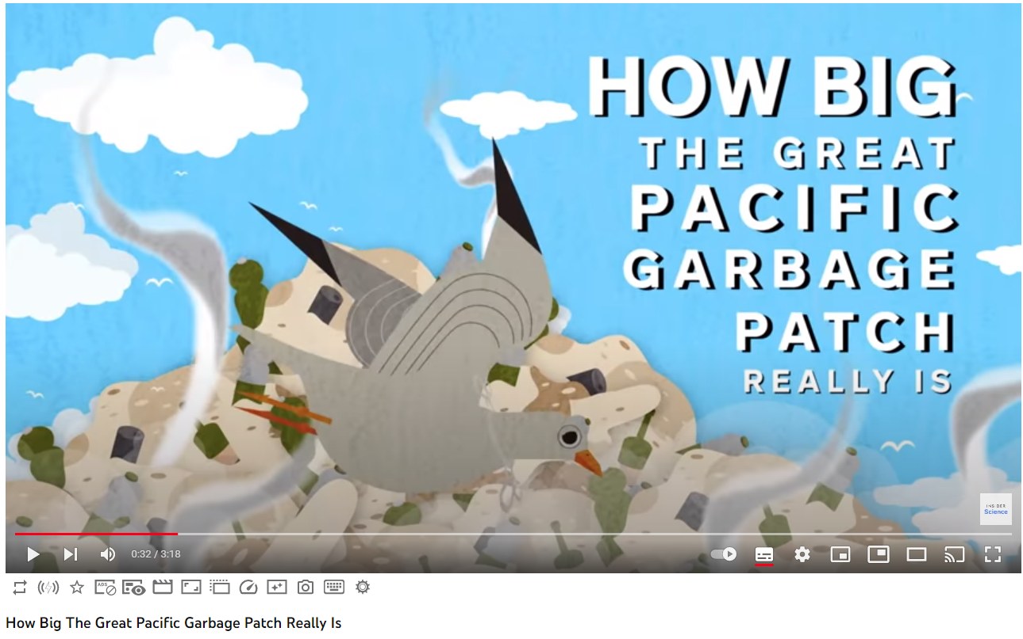
How Big The Great Pacific Garbage Patch Really Is

Slide 25
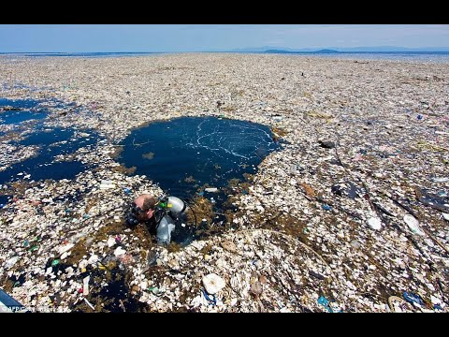
Great pacific garbage patch awareness-video https://www.youtube.com/watch?v=Co43TXJXryI&t=27s

Slide 26
Solutions?

Slide 27
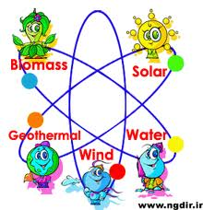
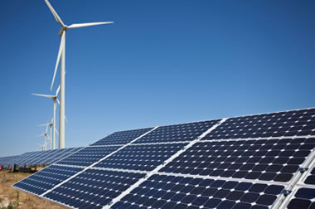
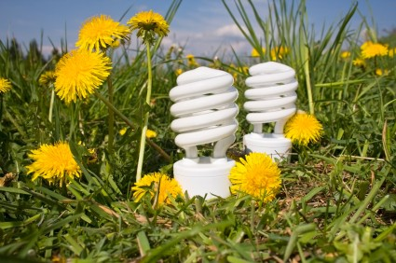
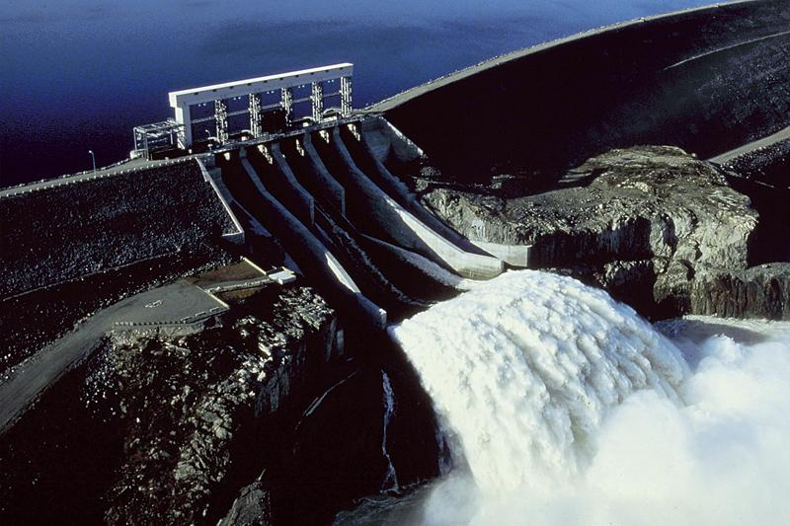
Renewable sources of energy

Slide 28

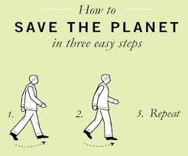
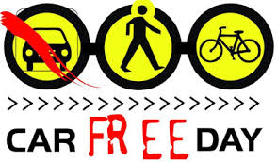

Slide 29
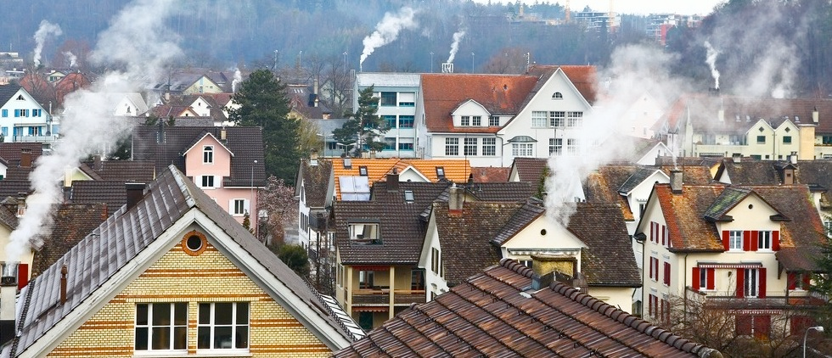
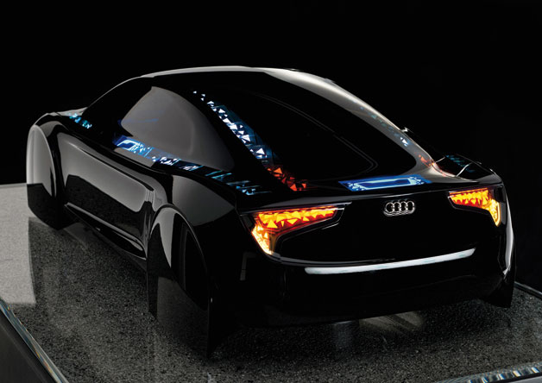
Use filters on chimneys
Buy new tech cars

Slide 30
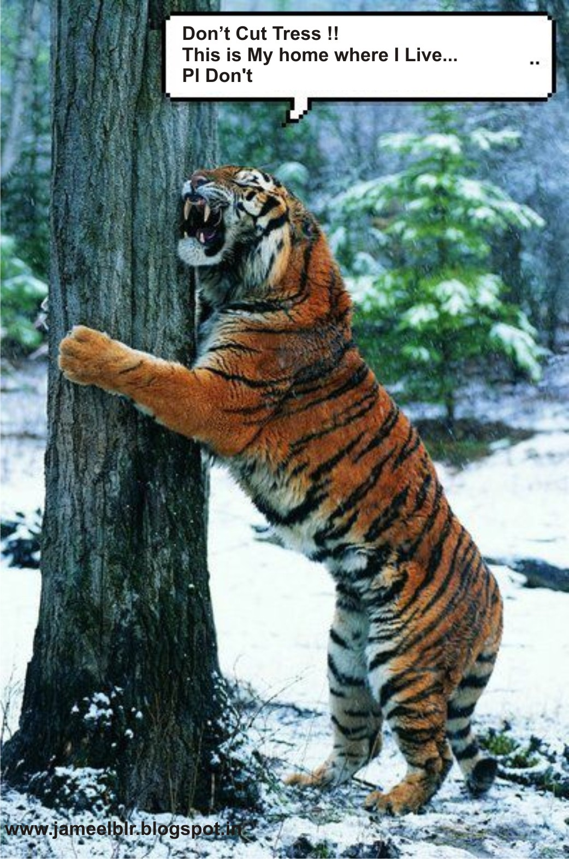
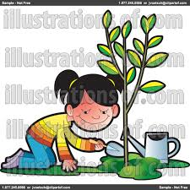

Plant trees

Slide 31


Slide 32


Slide 33




The three 'R's
Recycling bins

Slide 34




Educational videos & songs

Slide 35

Things to be recycled

Slide 36

Things not to be thrown in the recycling bins

Slide 37


Slide 38


Slide 39

song

Slide 40



Slide 41
Thank You
Kingsoft Office
Make Presentation much more fun

