Slide 1



Recycling Facts and figures
Did you know that……?
by
Louvari Maria

Slide 2
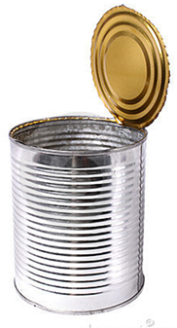

1 recycled
would save enough energy to power a
for
3 hrs ?

Slide 3

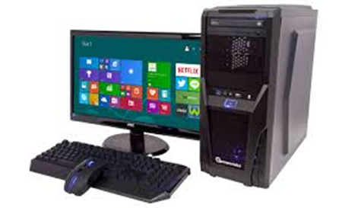
1 recycled
would save enough energy to power a
for…
25’ ?

Slide 4


1 recycled
would save enough energy
to power a 60 watt
for
3 hrs ?

Slide 5
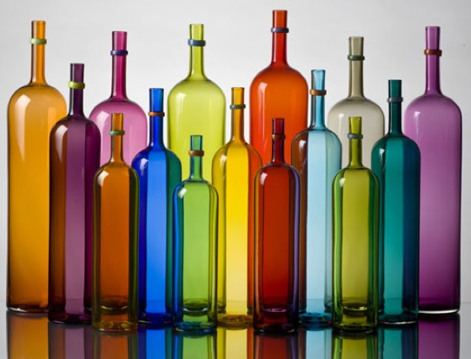
glass is 100% recyclable?
thrown away glass in a dump will never decompose?

Slide 6

70%
Do you know how much
less energy is required to recycle paper than produce it using raw materials?
of the rubbish in the dustbins could be recycled?
60%
of the money you pay for a product is for the packaging?
16%

Slide 7

70%
Do you know how much
less air pollution recycled paper produces ?
of a vehicle can be recycled?
80%
of the waste in a bin could be composted?
50%

Slide 8

Do you Know how many
trees we need to make 1 ton of paper?
24
years plastic takes to decompose?
500
tons of water can be contaminated by
1 button battery ?
600

Slide 9



REDUCE
REUSE
RECYCLE

Slide 10


What do you think you should do from now on?
Song by
Jack Johnson - The 3 R's

