Slide 1
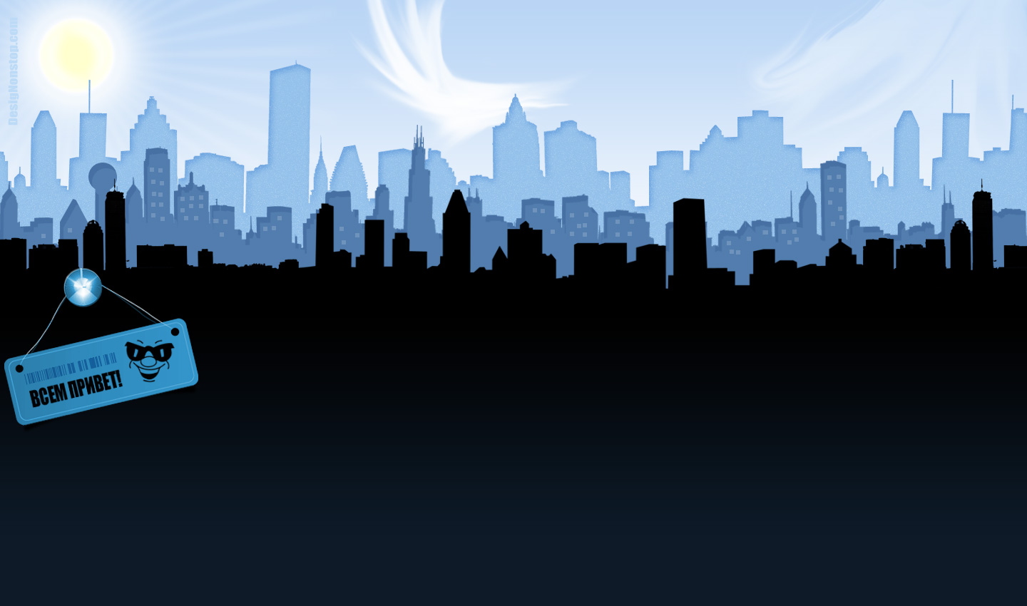

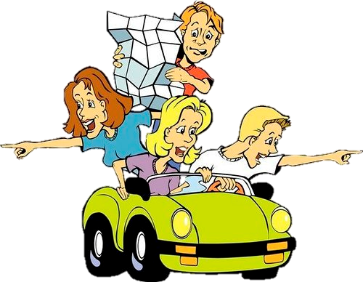
?
BY HERBER

Slide 2

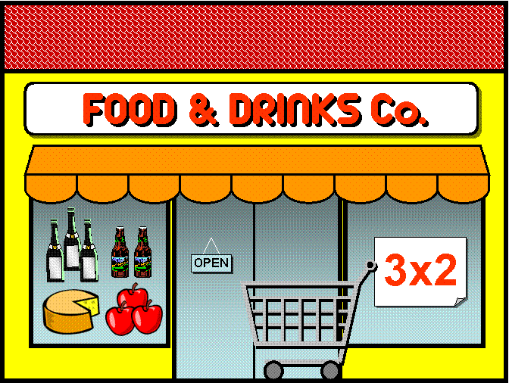
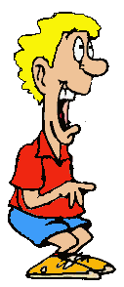
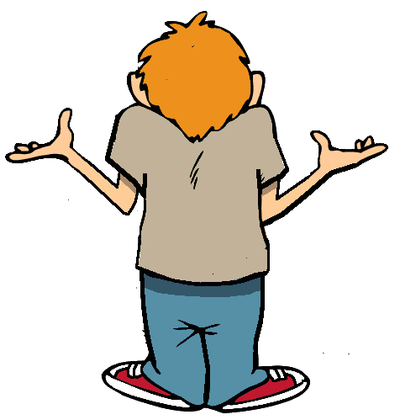
Where’s the supermarket?

Slide 3
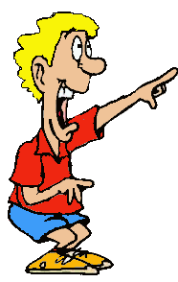

It’s around the corner

Slide 4
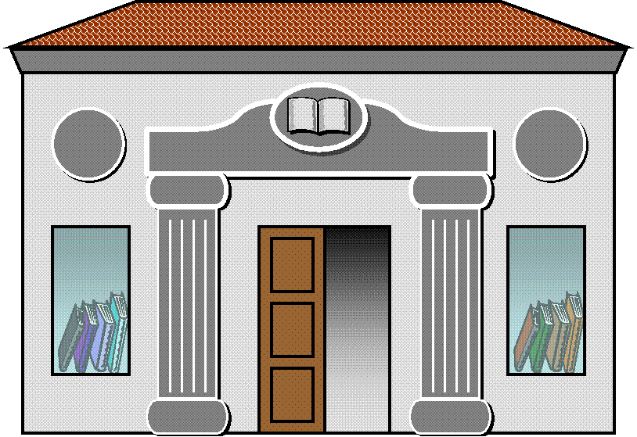

Where’s the library?

Slide 5
It’s across the street

Slide 6
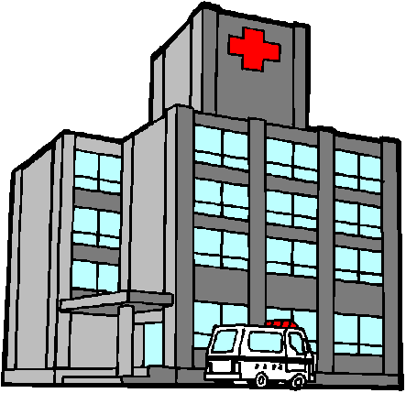

Where’s the hospital

Slide 7
It’s down the street

Slide 8
€
Where’s the bank

Slide 9
€
It’s next to the hospital

Slide 10

Where’s the church

Slide 11
It’s on the left

Slide 12

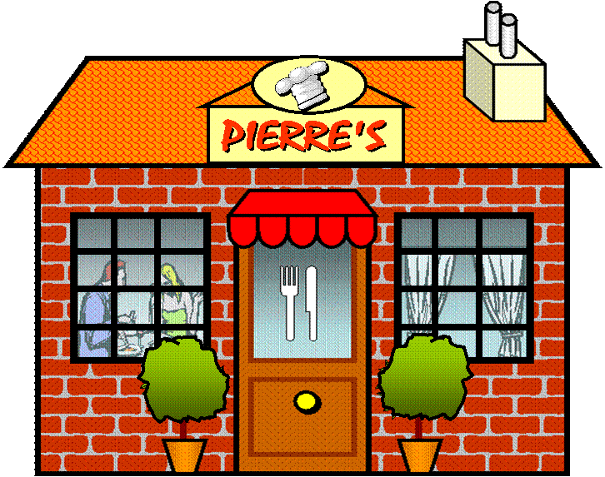
Where’s the restaurant

Slide 13
It’s on the right

Slide 14
How do I get to the museum?

Slide 15

Go straight on

Slide 16
Turn left

Slide 17
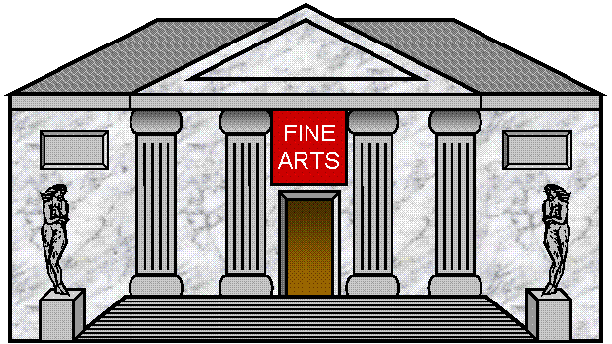
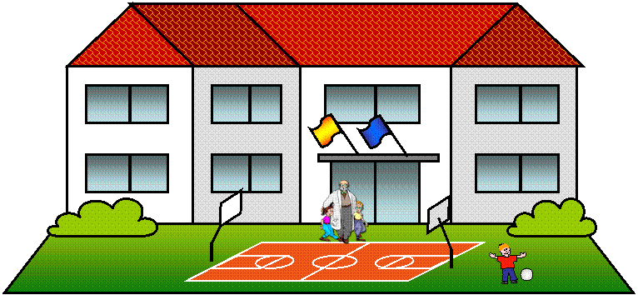
Turn right

Slide 18
It’s across from the school

Slide 19
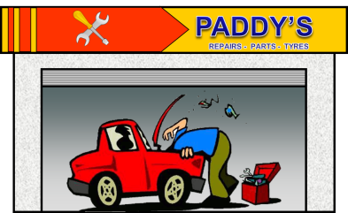
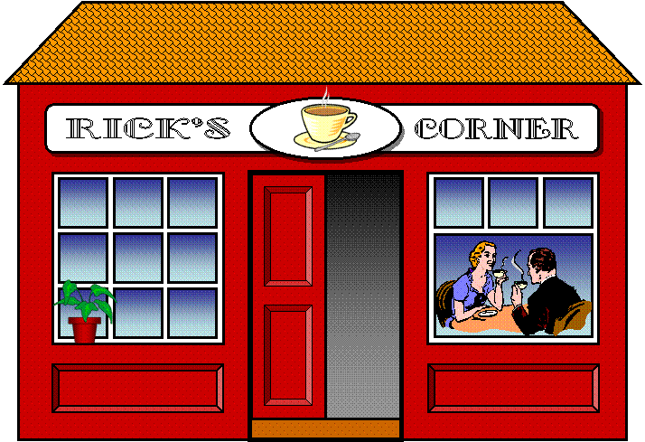
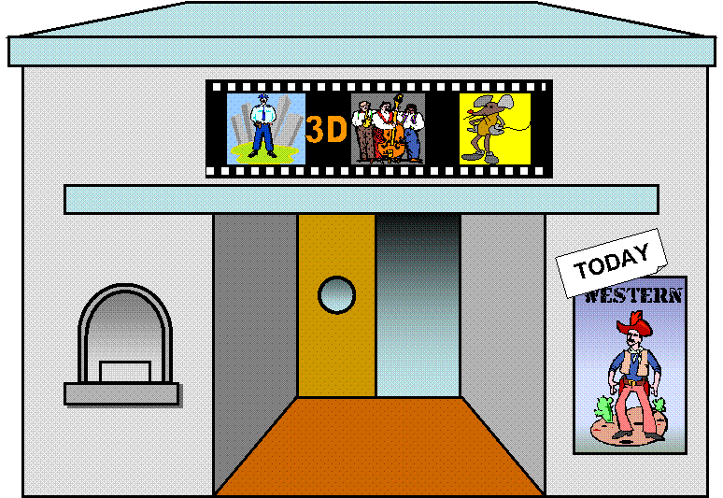
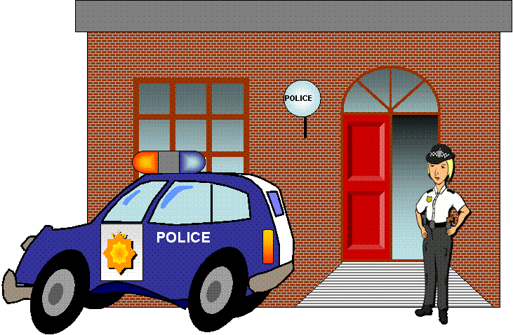
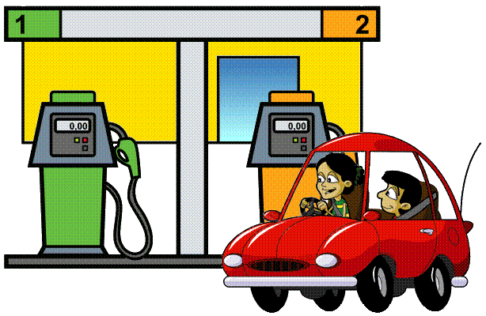
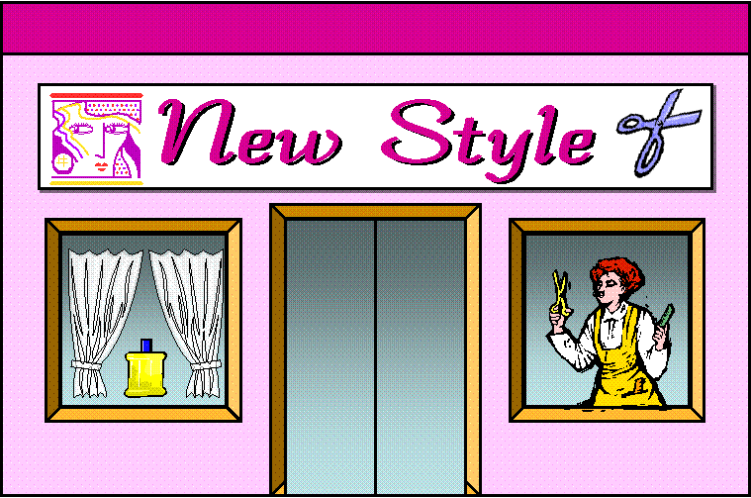
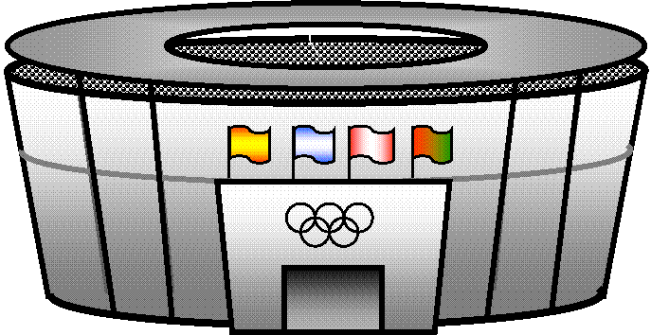
How do I get to the police station?

Slide 20
1. Go two blocks
2. Turn on the right
3. Go one block
4. It’s on the left

Slide 21
How do I get to the hospital?
Park Avenue
Oak Street

Slide 22
1. Go to the corner
2. Turn right
3. Go straight on
4. It’s at the corner of Park Ave. and Oak St.
Park Avenue
Oak Street

Slide 23
How do I get to the stadium?
Park Avenue
Oak Street

Slide 24
1. Go to the corner
2. Turn right
3. Go two blocks
4. It’s on the right opposite the gas station
Park Avenue
Oak Street

Slide 25
How do I get to the garage?
Park Avenue
Oak Street

Slide 26
1. Go two blocks
2. Turn left
4. It’s on the right across from the park
Park Avenue
Oak Street

Slide 27
THANK YOU FOR YOUR HELP!
YOU’RE WELCOME!

