Slide 1
The starry night
By Vincent Van Gogh

Slide 2
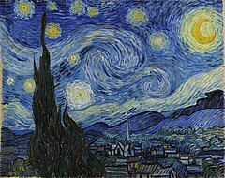

Slide 3
The Starry Night is an oil-on-canvas painting by the Dutch Post Impressionist painter Vincent van Gogh. Painted in June 1889, it depicts the view from the east-facing window of his asylum room at Saint-Rémy-de-Provence, just before sunrise, with the addition of an imaginary village. The Starry Night is one of the most recognizable paintings in Western art.

Slide 4
Van Gogh depicted the view at different times of the day and under various weather conditions, such as the sunrise, moonrise, sunshine-filled days, overcast days, windy days, and one day with rain.

Slide 5
Van Gogh assigned an emotional language to night and nature that took them far from their actual appearances. Dominated by vivid blues and yellows applied with gestural verve and immediacy, The Starry Night also demonstrates how inseparable van Gogh’s vision was from the new procedures of painting he had devised, in which color and paint describe a world outside the artwork even as they telegraph their own status as, merely, color and paint.

Slide 6
