Slide 1
VINCENT VAN GOGH
One of the most popular and emotional artists of all Time
By Maria Paranou
1st Junior High School of Eleftherio-Kordelio, 2026

Slide 2
Reasons for choosing Van Gogh
Hugely popular nowadays
Tragic life story
Died poor- sold only one painting
Deeply emotional paintings (landscapes and portraits)
Unique style

Slide 3
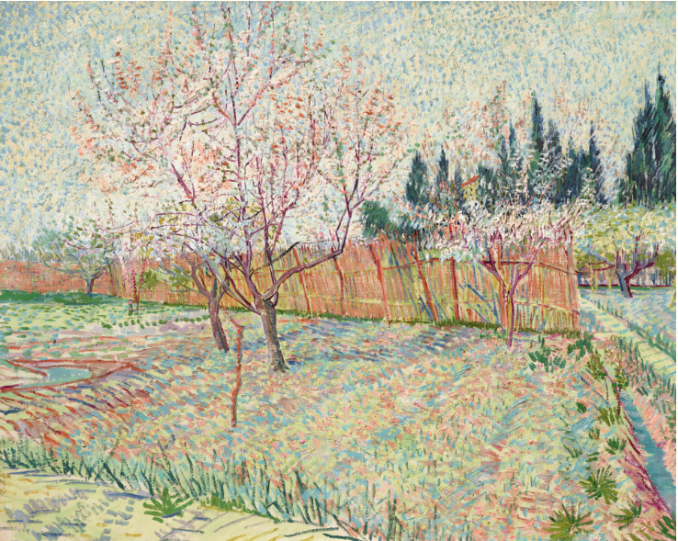
How much do Van Gogh paintings sell for?
Orchard with Cypresses
Sold for $117m, 2022

Slide 4
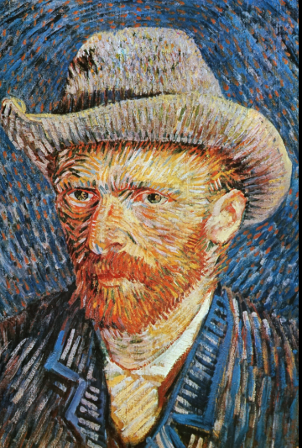
Who was he?
Dutch artist, 1853-1890
Father pastor, 5 brothers+ sisters
Brother Theo supported him
Spent most of his life in France
Sold only one painting
Suffered from depression
Spent a year in asylum
Committed suicide at 37

Slide 5
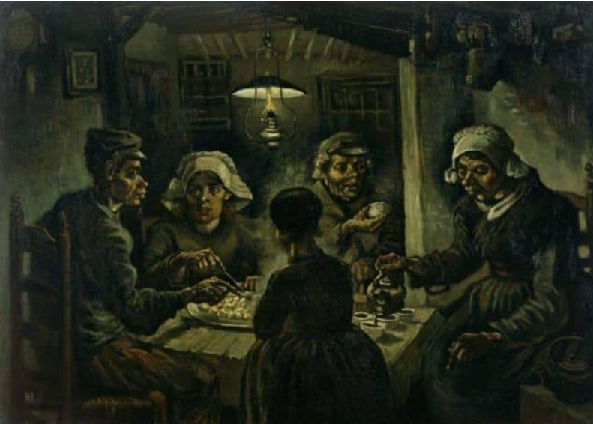
The potato eaters, 1885
An early work
Shows poor family of farmers
Realistic painting
Dark colours
Van Gogh was poor and liked poor people

Slide 6
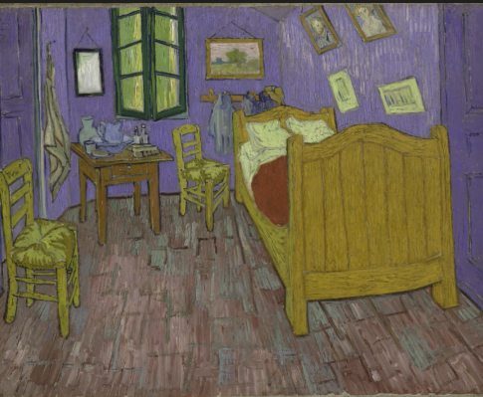
The Bedroom, 1888
Artist’s bedroom in France
Symbolizes rest and peace through bright colours
VS
Others say bright colours show nervous energy and instability

Slide 7
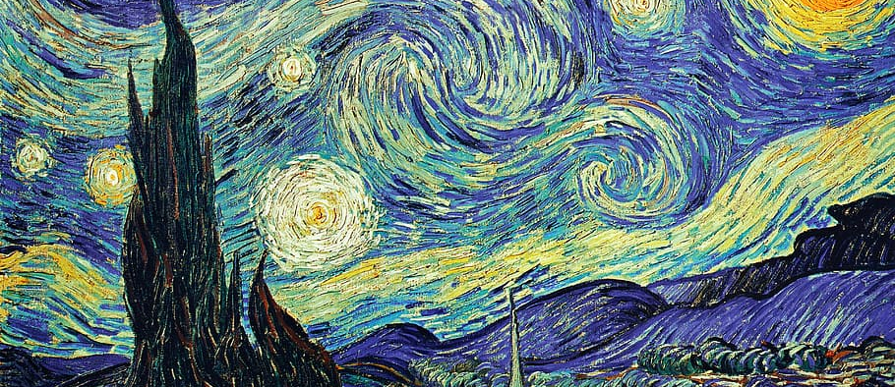
Starry night (1889), one of the most famous works
artist at an asylum
depicts hope

Slide 8
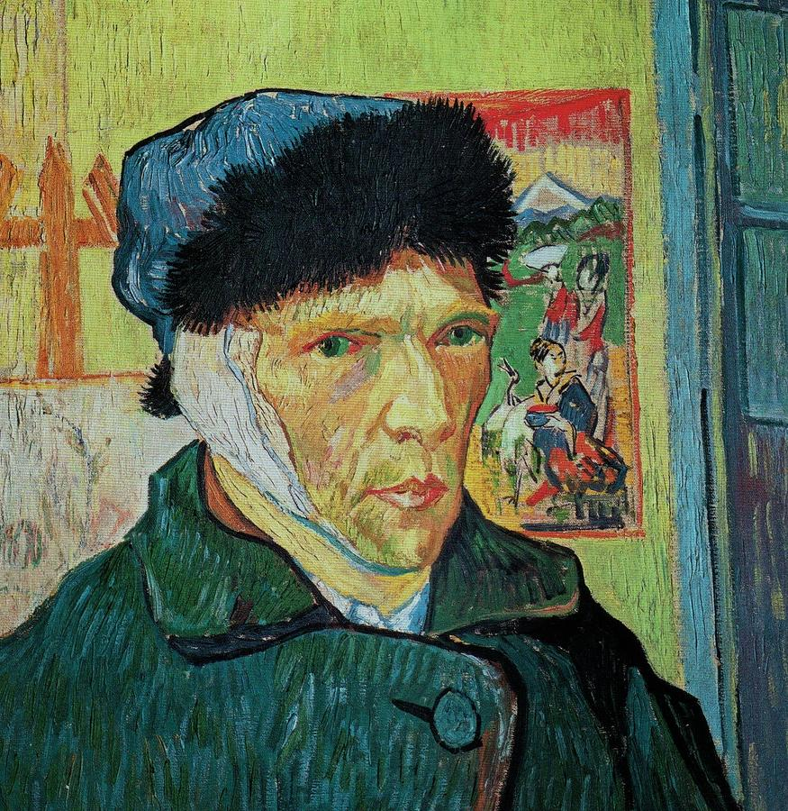
Self portrait with a bandaged ear,1889
Van Gogh cut his own ear during a fight
Proof of his ill mental health

Slide 9
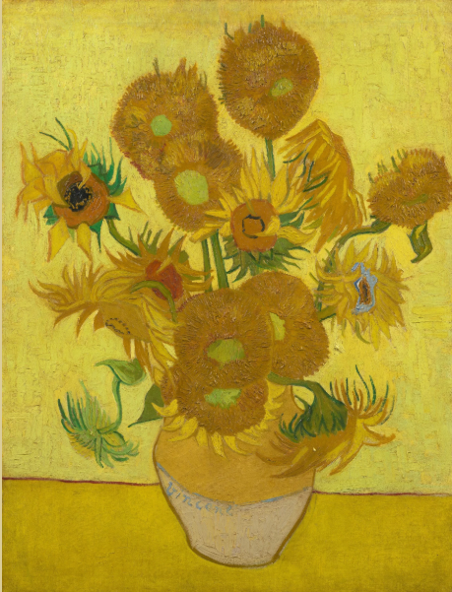
Sunflowers, 1889
Very popular painting
Used only one colour: yellow
Represents gratitude and hope
Typical of his style

Slide 10
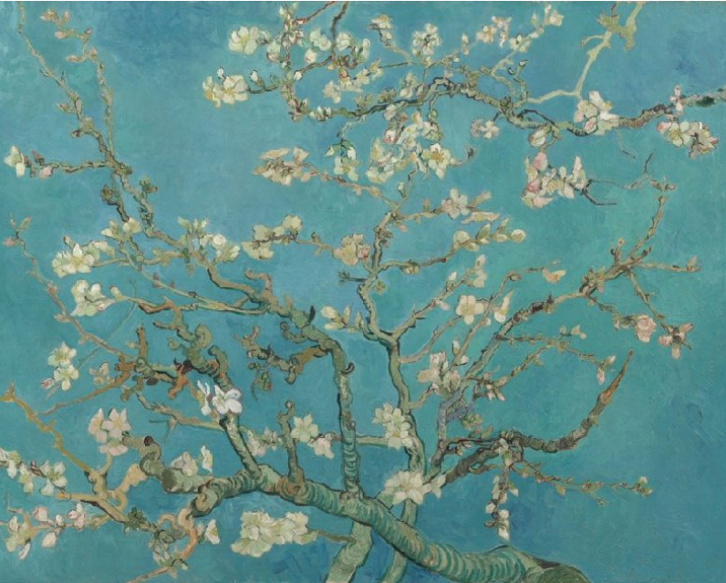
Almond blossom, 1890
Beauty of nature: a popular theme
Gift for baby nephew
Never sold- family possession
Represents new life and arrival of spring
Made after period of mental illness
Japan influences

Slide 11
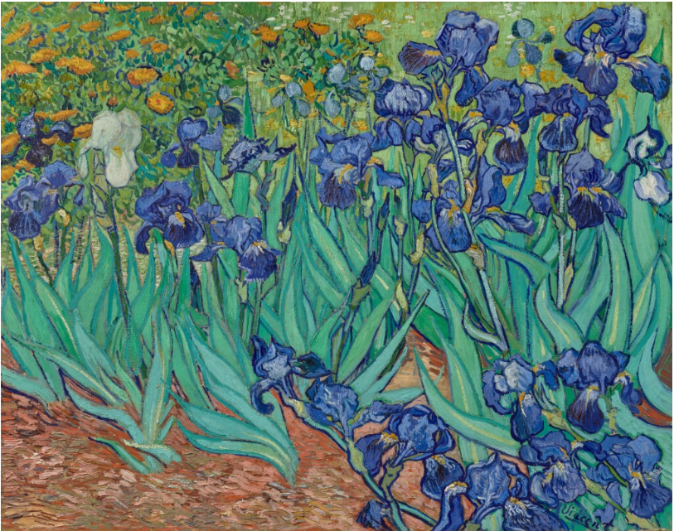
Irises, 1889
Painted at the asylum
Artist struggled with mental illness
A post-impressionist work
Nature: popular theme

Slide 12
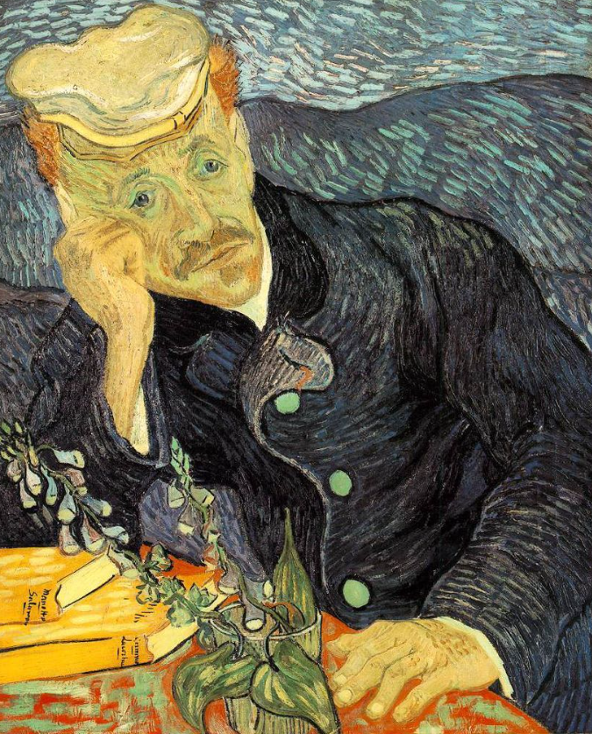
Portrait of Dr Gachet (1890)
Portrait of his doctor
Melancholy expression, doctor looks tired
Painted 6 months before his death
Sold in 1990 for $82.5 million

Slide 13
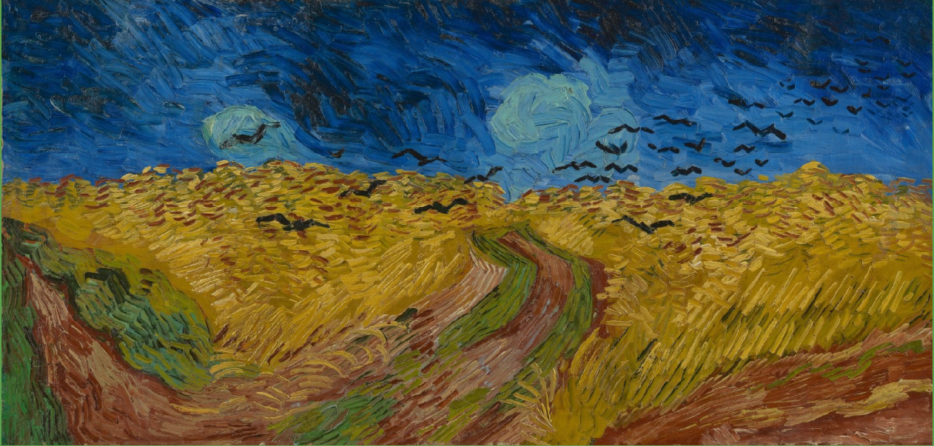
Wheatfield with crows, 1890
Artist’s last work
Expresses sadness, loneliness and approaching death

Slide 14
Where can we see his work?
Van Gogh Museum in Amsterdam
Many other galleries all over the world

Slide 15
