Slide 1
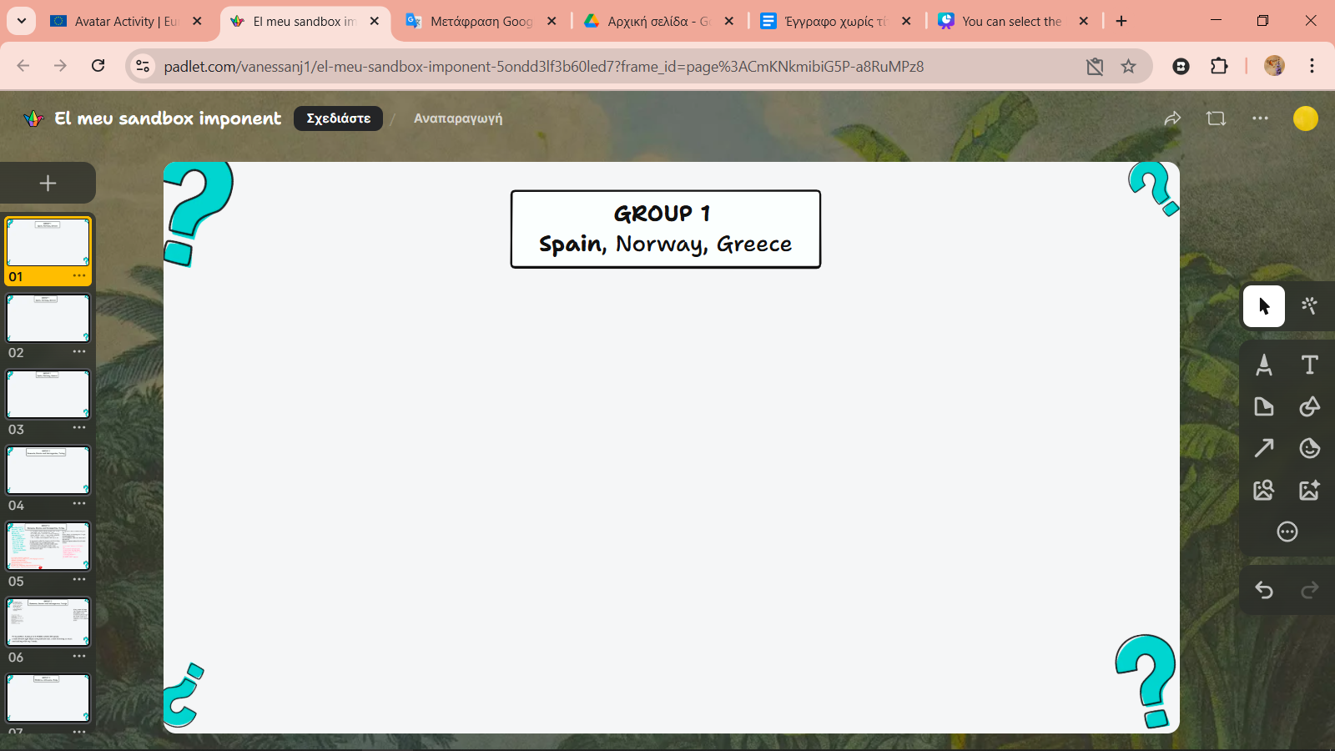
Instructions for
the Collaborative Students Avatar Creation Activity

Slide 2
A separate page has been created for each country. You will search for the group you belong to. Each country stands out from the rest of the same Group, as it is written in bold. For example, here you see the Spain page which belongs to Group 1

Slide 3
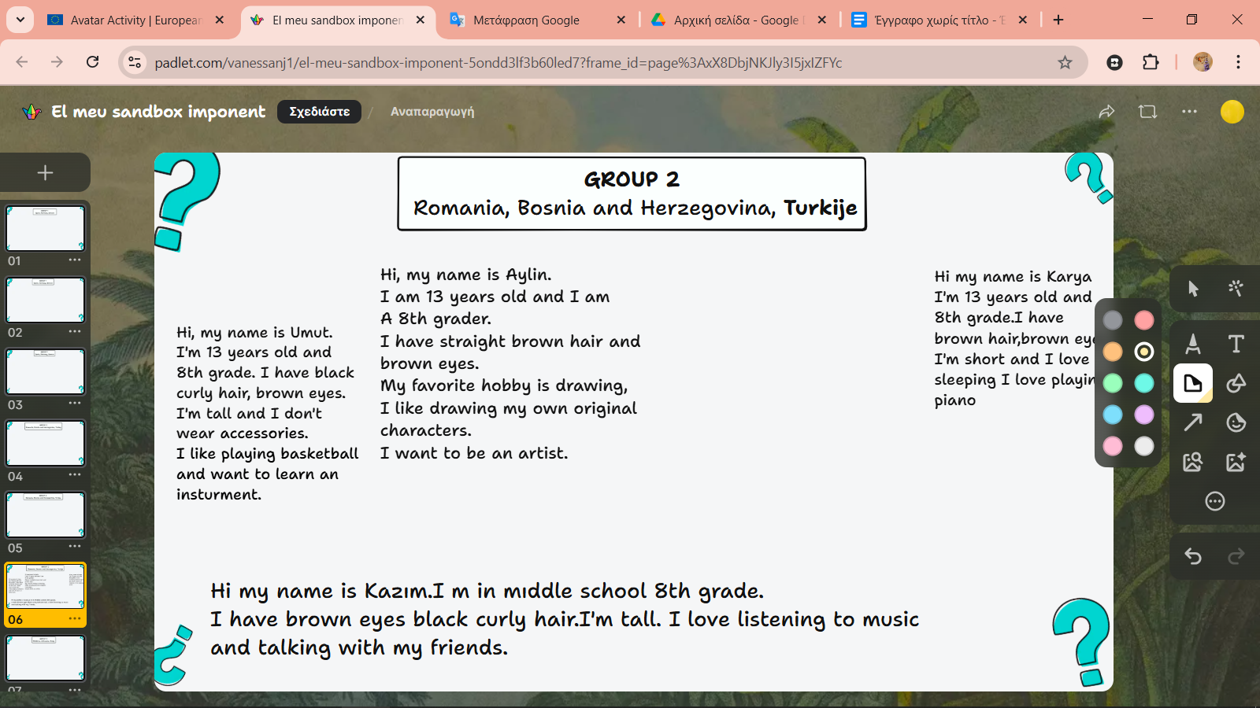

You can select the Notes symbol,
and have students write their description above.

Slide 4
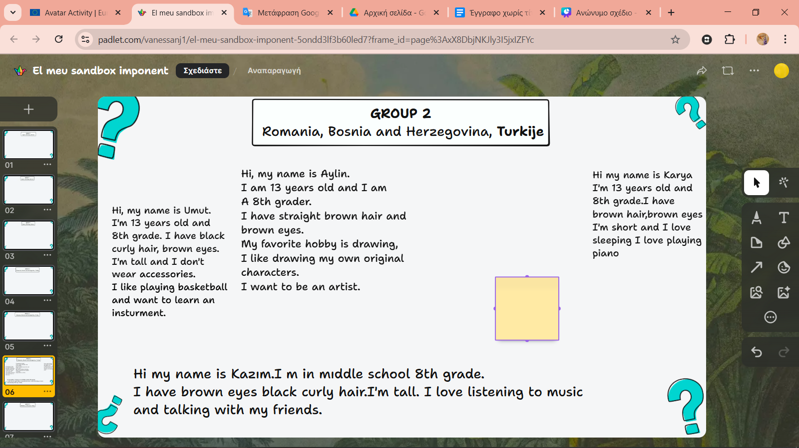

Slide 5
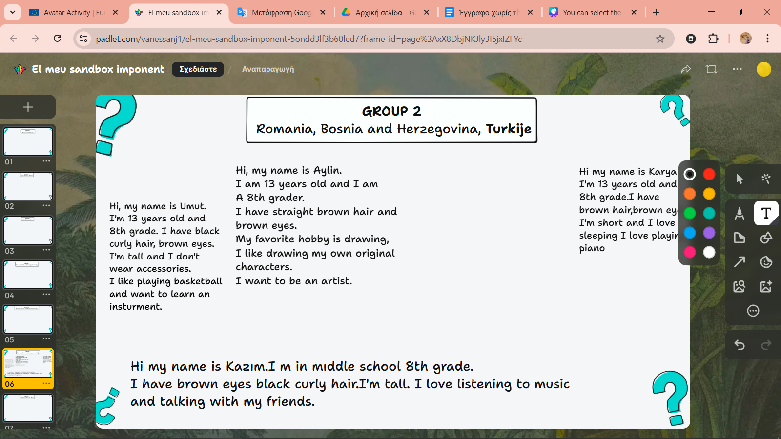
Or you can choose the text symbol and have students write directly where they "click". They can also choose the color of their text.

Slide 6
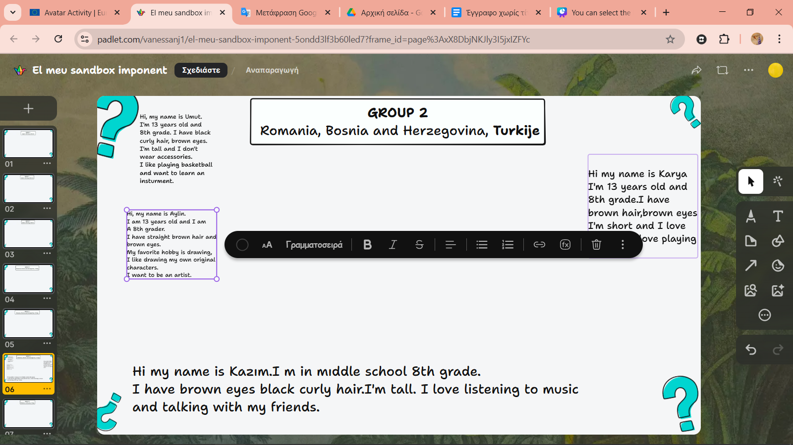
By clicking on the text you can edit it as you wish.
By clicking on the box around the text you can increase or decrease its size.

