Slide 1
My favourite hobby
Hiking

Slide 2
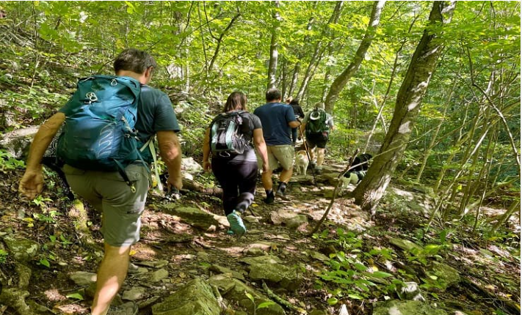
What is hiking?

Slide 3
Hiking vs trekking
People who go hiking go on long walks in nature, often a couple of hours or a up to a day in length. Hiking is a very enjoyable activity but it can also be dangerous for beginners. So, it is preferable to go hiking in groups with an experienced guide as it is very easy to get lost. Personally, I prefer going in groups as there is always the danger of wild animals.
People who go trekking also walk in nature but their journeys are more difficult and usually last longer

Slide 4
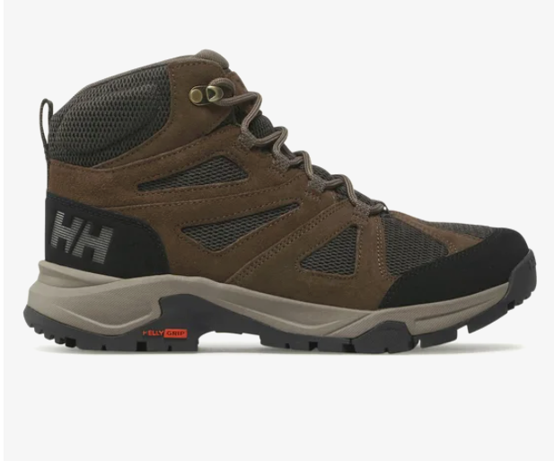
Necessary Equipment
Hiking shoes

Slide 5
Your hiking shoes are the most important piece of equipment. Walking in nature is refreshing but it can also be messy. There is often mud and the ground is rarely even. So it is vital to use a pair of hiking boots which should be preferably waterproof. Hiking boots can be pretty expensive but they are a must.

Slide 6
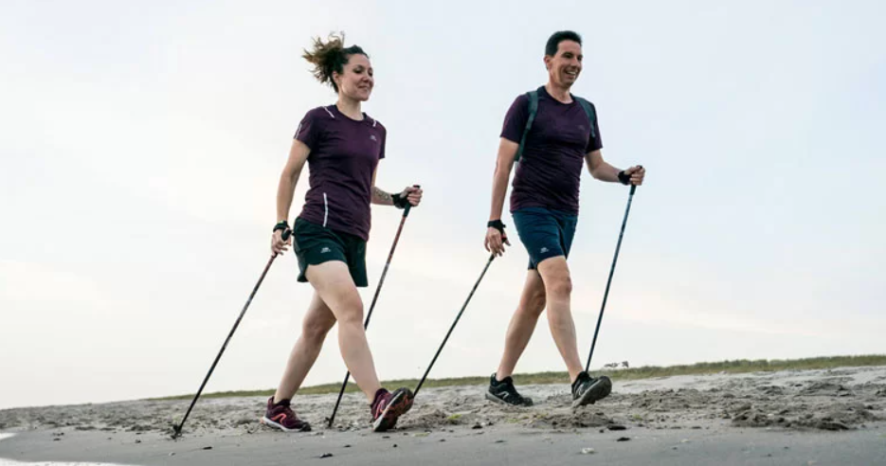
Walking poles

Slide 7
Walking poles can help hikers especially when they walk on uneven ground as they provide support and stability. They can also make a long trail less tiresome for our legs. Some hikers use two walking poles, but I prefer one. Walking poles aren’t particularly expensive.

Slide 8
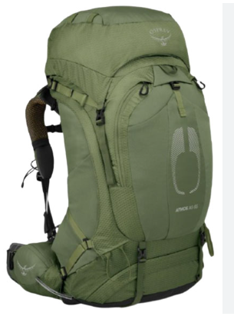
Backpack

Slide 9
Why do you need a backpack?
When someone goes walking in nature for a few hours, a backpack is necessary. Hikers can use them to carry water, snacks and an extra change of clothes. Most people take off their jackets when they start hiking and they put them on when they stop to take a rest, so a backpack is useful. A backpack doesn’t have to be very expensive, but a good backpack can make a hike much more comfortable and enjoyable.

Slide 10
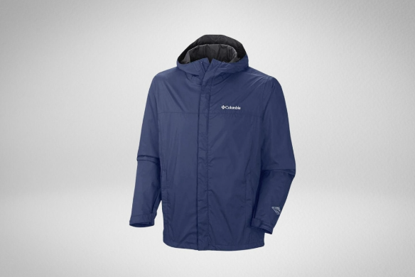
Waterproof jacket

Slide 11
A waterproof jacket is necessary when walking in nature as the weather can be unpredictable. A good waterproof jacket can be quite expensive but there are cheaper options.

Slide 12
Is that all?
No, that is not all. More experienced hikers use thermal clothing in winter and those who are more experienced can also buy a GPS smartwatch. The list is endless.

Slide 13
What are the benefits of hiking?
Like any type of exercise, hiking is good for the body. Hiking has the advantage that it gives us peace of mind, as city life can be stressful. The beauty of nature is the best medicine for a stressed person like me and I always feel satisfied when I finish a hiking trip because they are often challenging.

Slide 14
What are the difficulties of hiking?
Hiking is not a sport for everyone. Apart from the right equipment, it is necesary to be fairly fit.
It is very easy for beginners to get lost and it is best to be part of an organized group.
Hiking equipment is expensive.

Slide 15
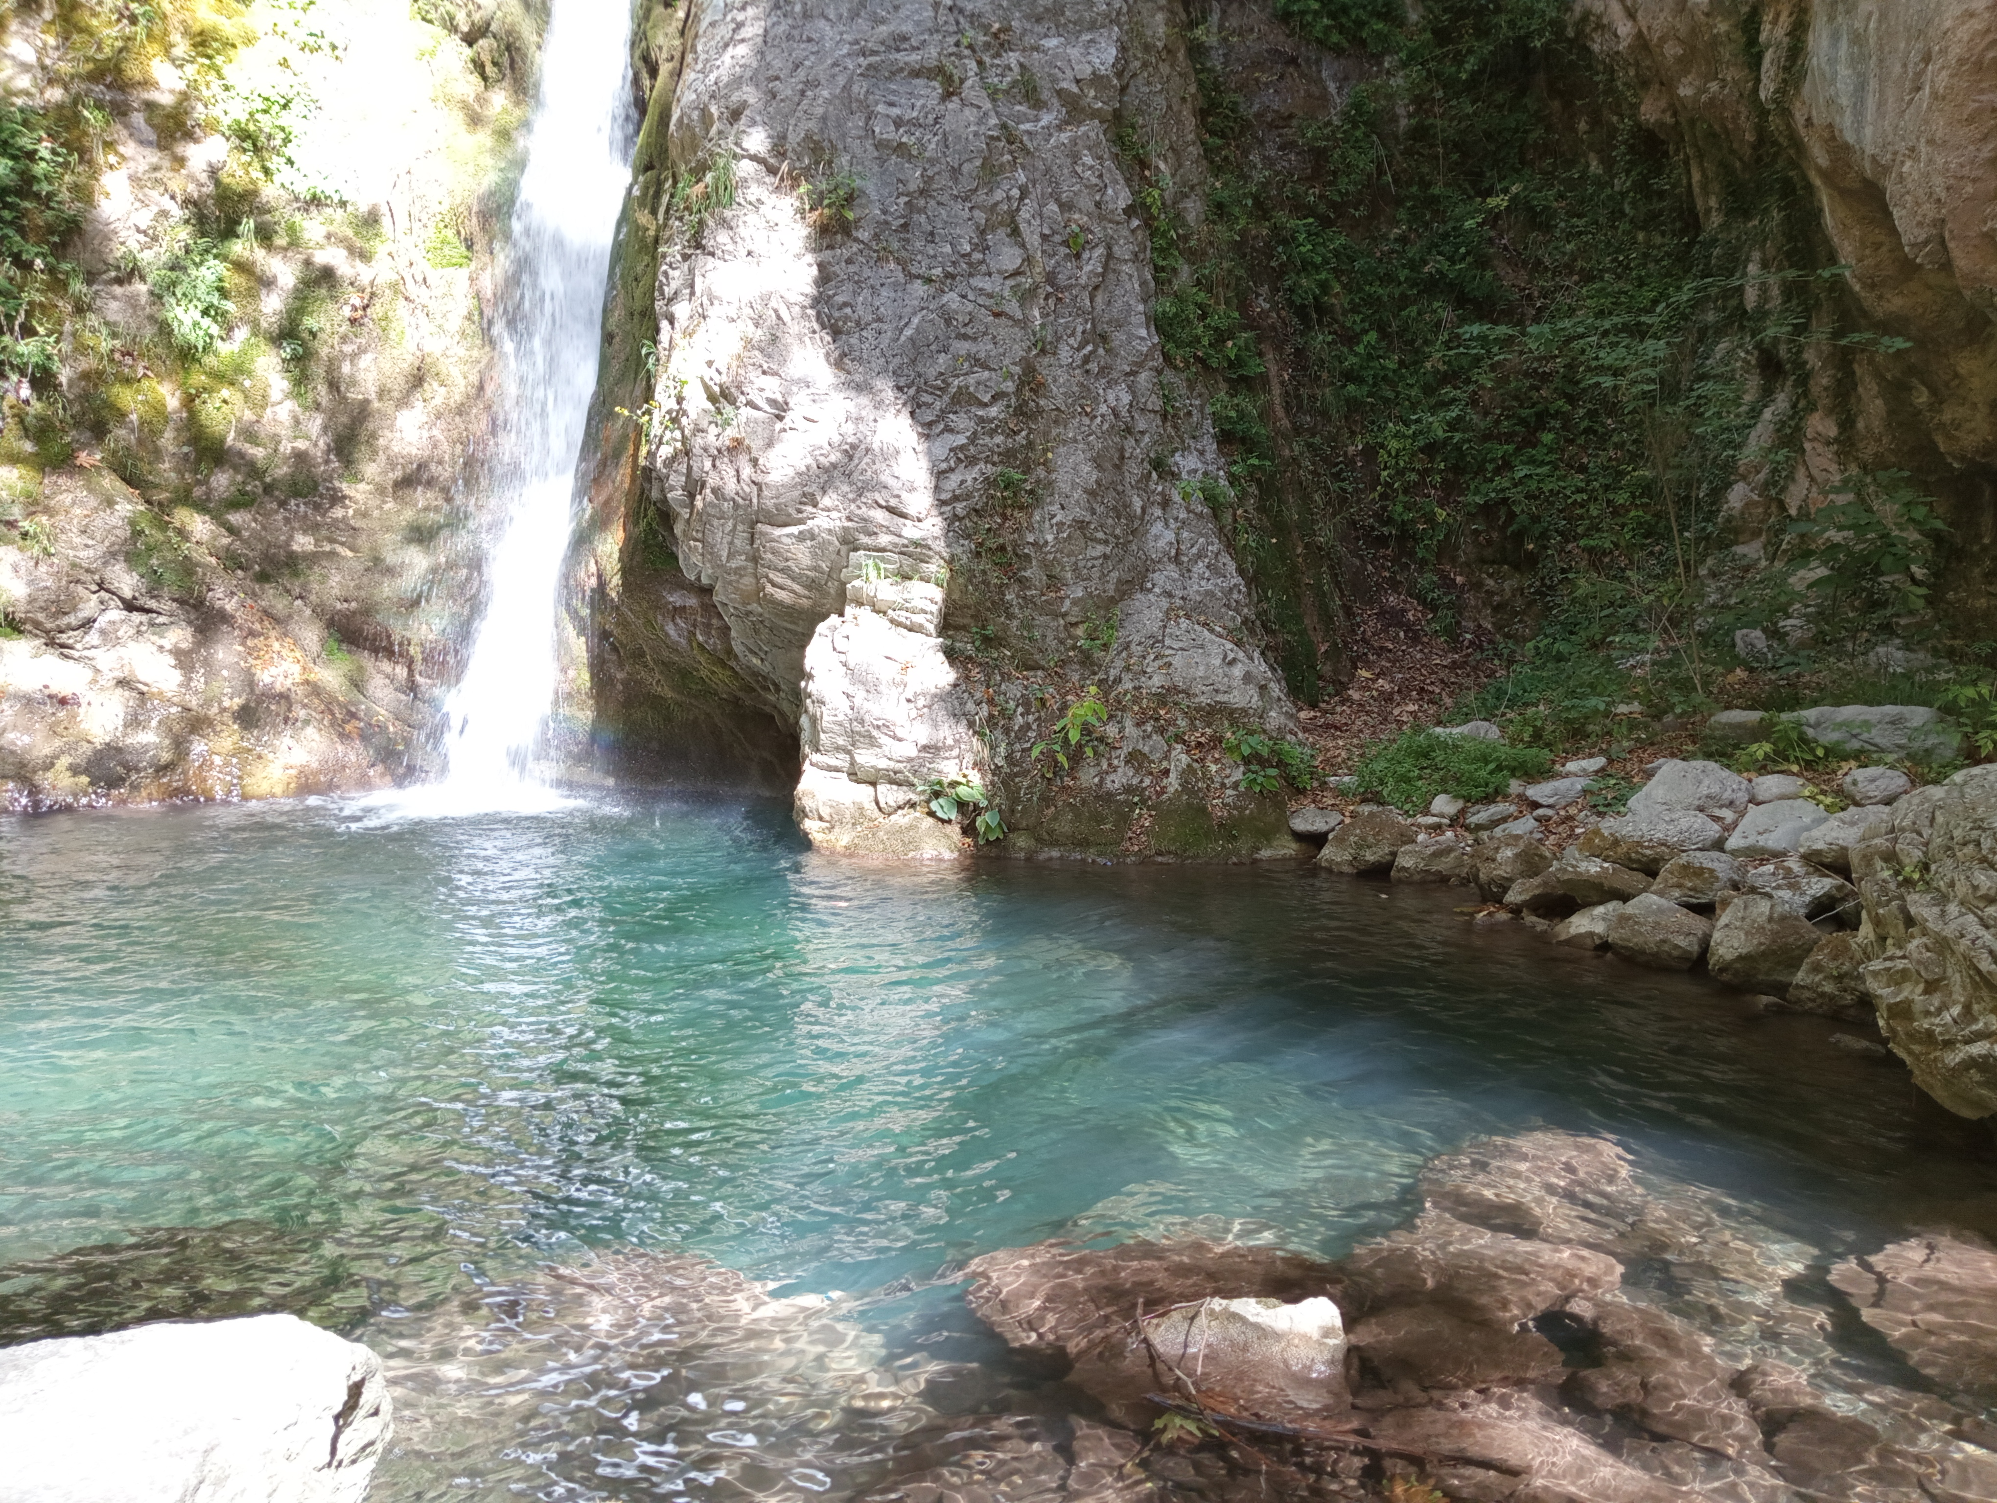
Photos from my hiking trips

Slide 16
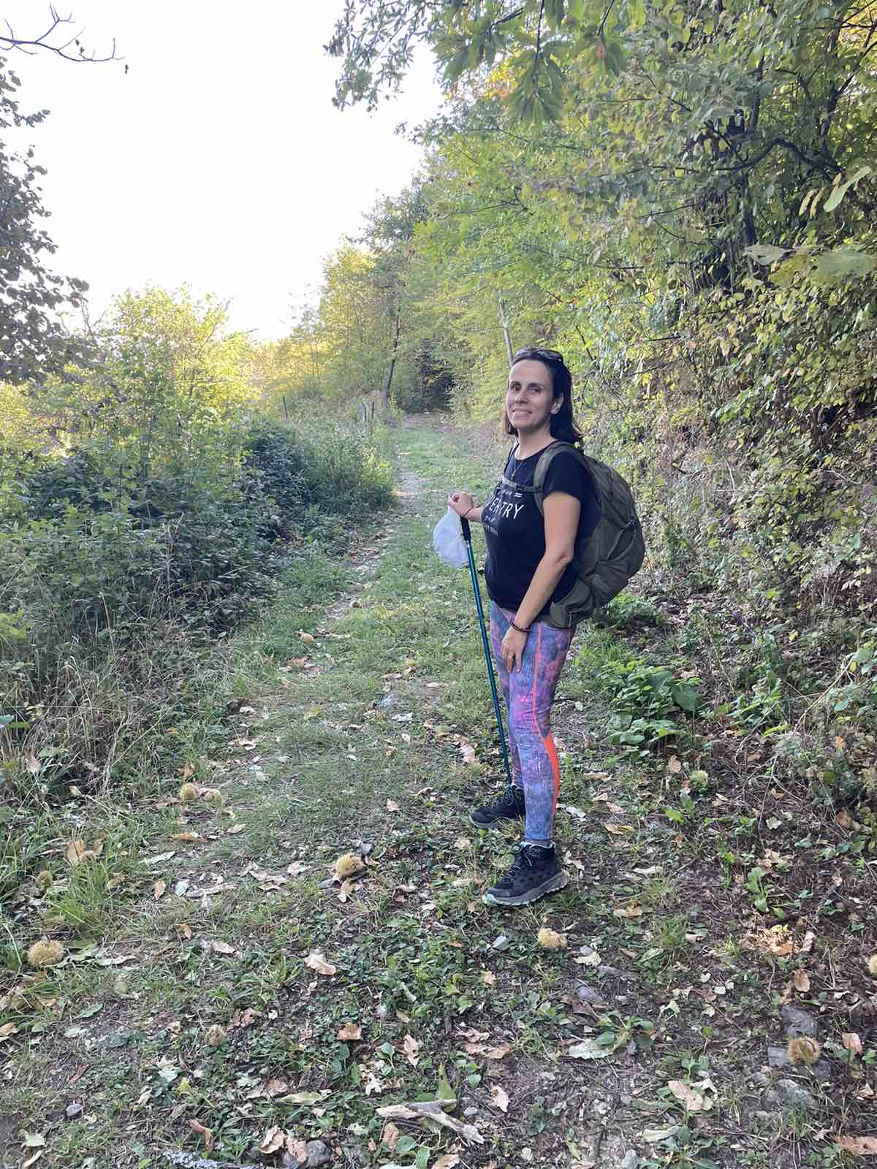
Somewhere near Palaios Panteleimonas

Slide 17
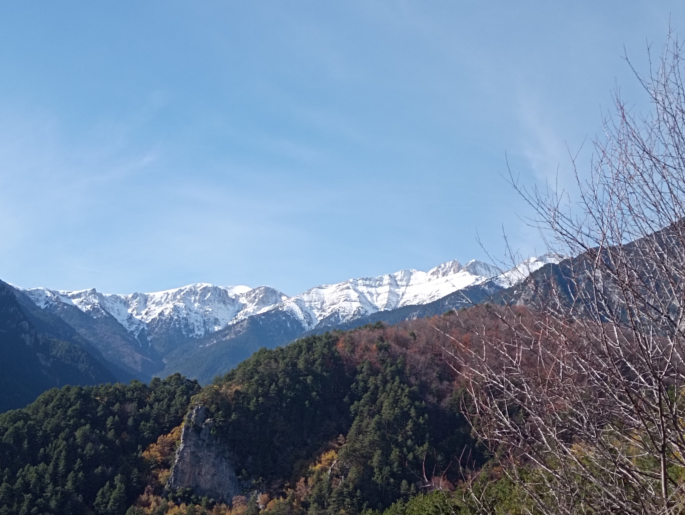
A view from Olympus

Slide 18
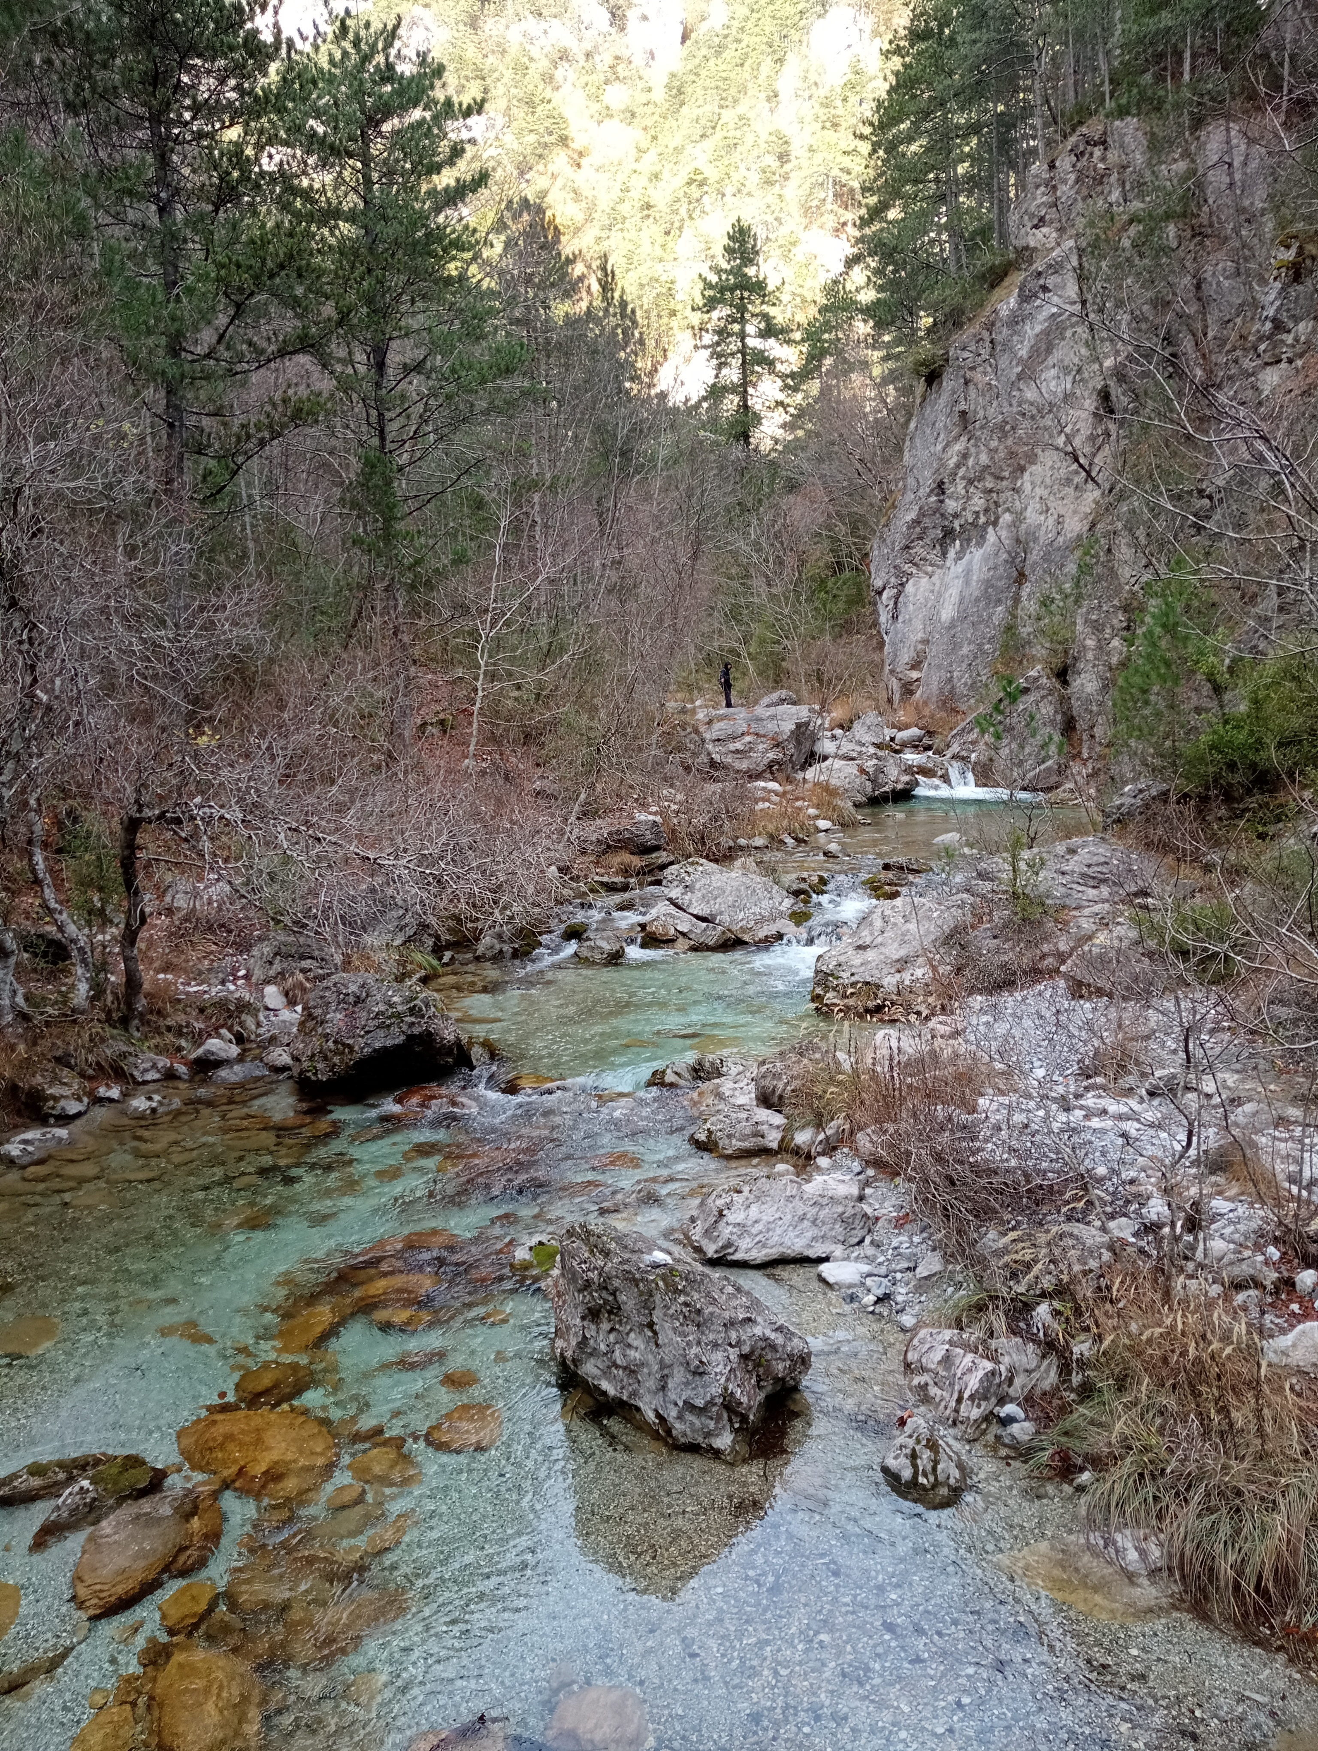
A view of Enipeas river

Slide 19
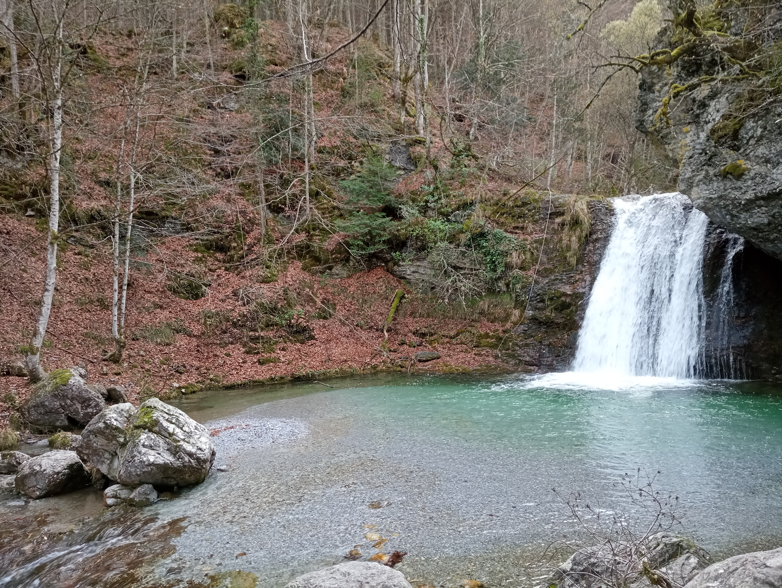
A waterfall in Olympus

