Slide 1

PASSIVE VOICE

Slide 2
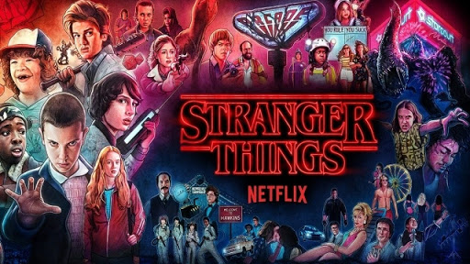
Active Voice
Subject
Verb
Object
Netflix produces Stranger Things.

Slide 3
Passive Voice
Subject
Passive Verb
Agent
Stranger Things is produced by Netflix.

Slide 4
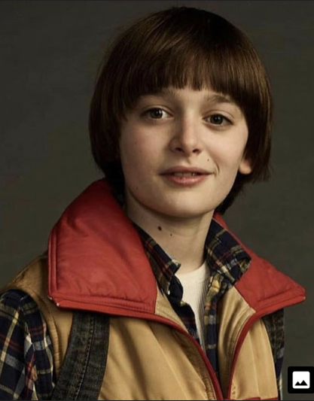
USE OF PASSIVE FORM
We use the passive form of a verb when it is not important who does the action, or when we don't know who does it.
Will Buyers was kidnapped.

Slide 5

If we want to say who does the action, we use 'by‘:
Will
was kidnapped
by a Demogorgon!

Slide 6
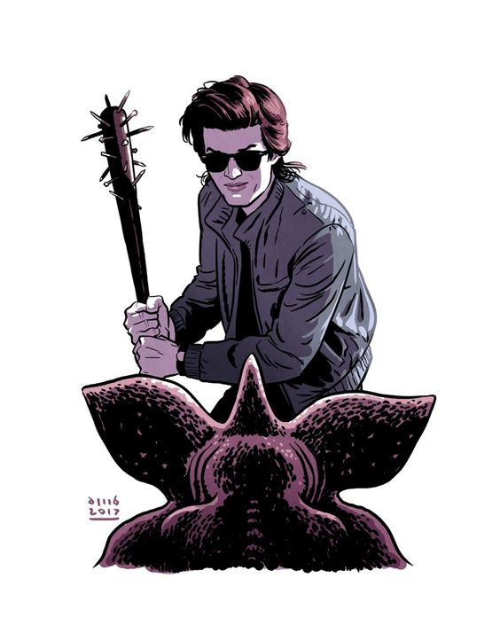
If we want to say the material or the instrument somebody used to do the action, we use ‘with’:
The Demogorgon was hit
by Steve
with a baseball bat.

Slide 7
The passive form of verbs is formed of
BE + the past participle.
THE VERB ‘TO BE’
Present Simple | am/is/are
Present Continuous | am/is/are being
Past Simple | was/were
Past Continuous | was/were being
Future Simple | will be
Future Perfect Simple | will have been
Present Perfect Simple | have/has been
Past Perfect Simple | had been
Am / Is / Are Going to | am / is / are going to be
Present Infinitive | be
Perfect Infinitive | have been
Present Gerund | being

Slide 8
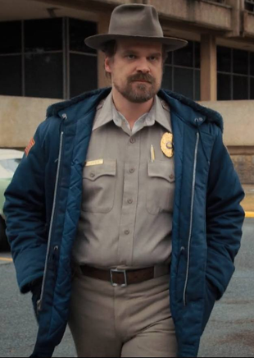
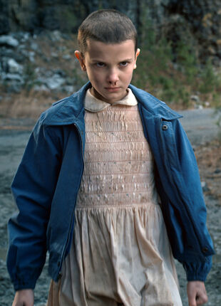
Changing from
Active to Passive
Jim Hopper
adopted
El.
El
was adopted
by Jim Hopper.

Slide 9

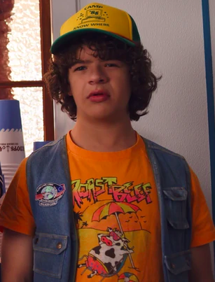
VERBS WITH TWO OBJECTS:
When a verb is followed by two objects, then we have two ways of writing the passive voice.
Dustin gave Dart some chocolate.
1 2
1: Dart was given some chocolate by Dustin.
2: Some chocolate was given to Dart by Dustin.

Slide 10
PERSONAL - IMPERSONAL STRUCTURE
When we have the verbs believe, expect, feel, hope, know, report, say, think etc. there are two ways to write the passive voice:

Slide 11
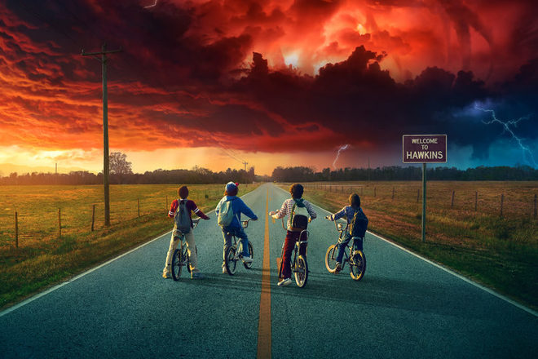
Personal Structure
People believe that strange things happen in Hawkins.
Strange things are believed to happen in Hawkins.

Slide 12
Impersonal Structure
People believe that strange things happen in Hawkins.
It is believed that strange things happen in Hawkins.

Slide 13
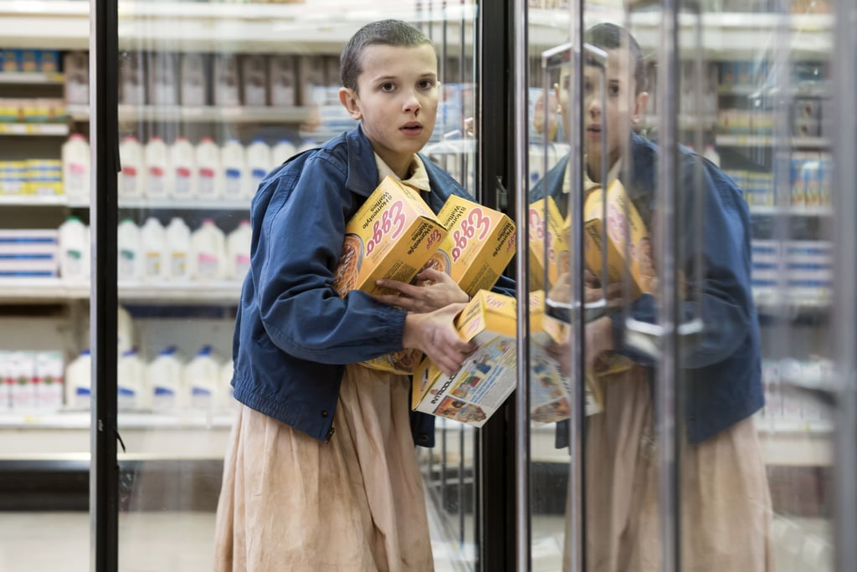
El is taking a lot of Eggo Waffles.
A lot of Eggo Waffles
are being taken by El.

Slide 14
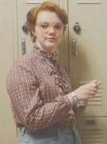
Barbara wears glasses.
Glasses are worn by Barbara.

Slide 15
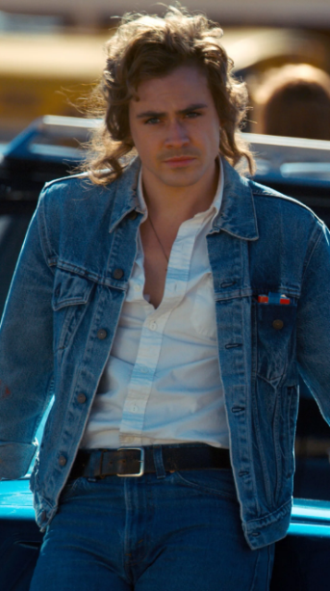
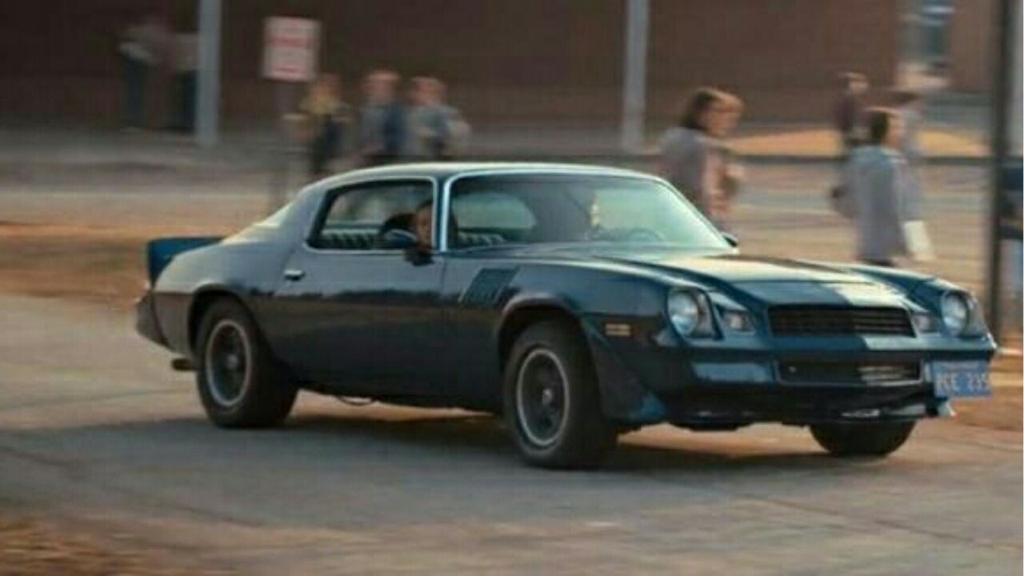
Billy drove a Chevrolet Camaro.
A Chevrolet Camaro was driven by Billy.

Slide 16
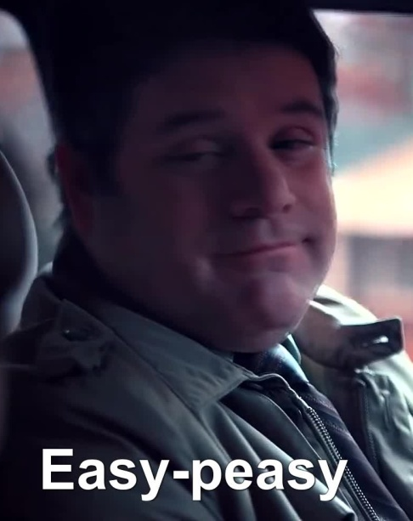
Bob was saying ‘Easy-Peasy’.
‘Easy-Peasy was being said by Bob.

Slide 17
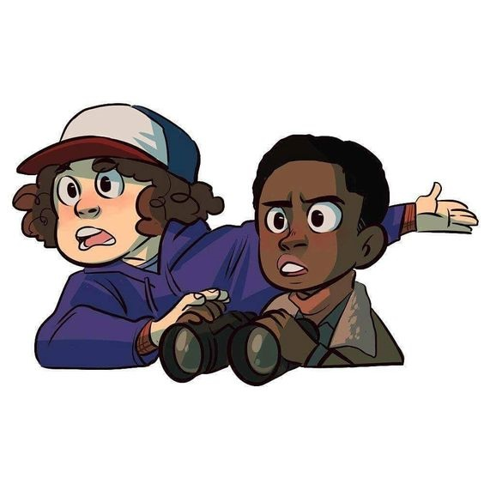

Dustin and Lucas have visited Hawkins Lab.
Hawkins Lab has been visited by Dustin and Lucas.

Slide 18
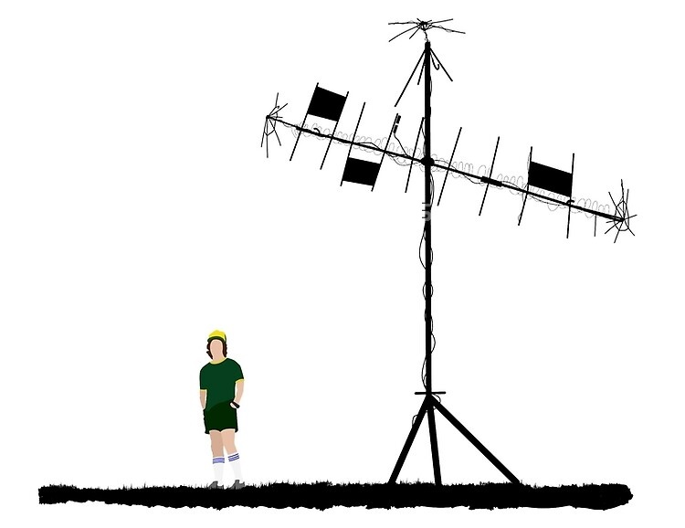
Dustin had created a radio tower.
A radio tower had been created by Dustin.

Slide 19
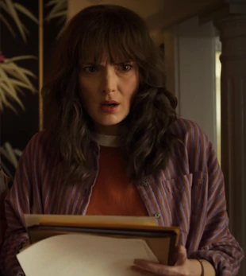
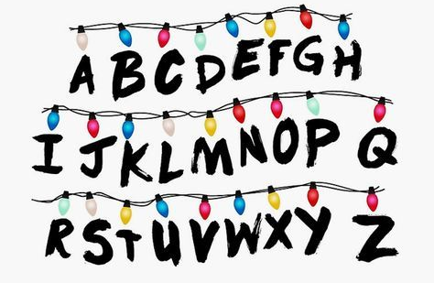
Joyce will find the solution.
The solution will be found by Joyce.

Slide 20
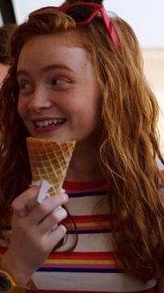
Max is going to eat an ice cream.
An ice cream is going to be eaten by Max.

Slide 21
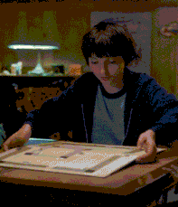
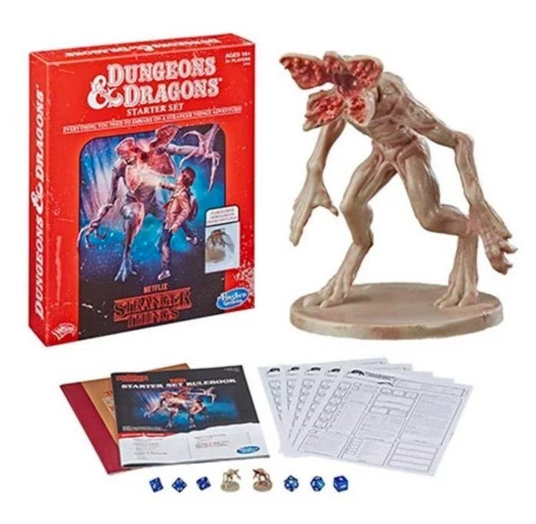
Mike should set up Dungeons and Dragons.
Dungeons and Dragons should be set up by Mike.

Slide 22
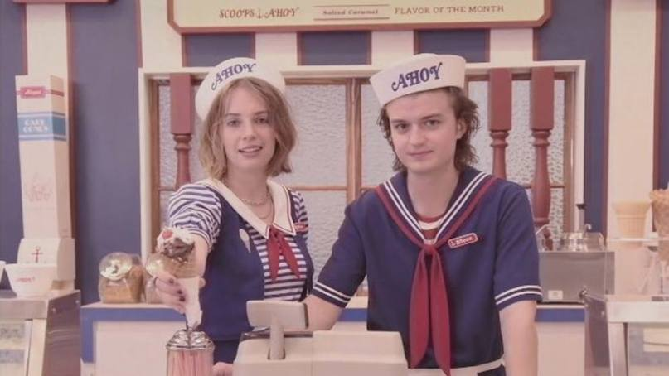
Steve and Robin have to wear sailor costumes.
Sailor costumes have to be worn by Steve and Robin.

Slide 23
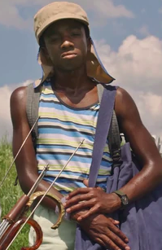
Lucas must have made a plan.
A plan must have been made by Lucas.

Slide 24
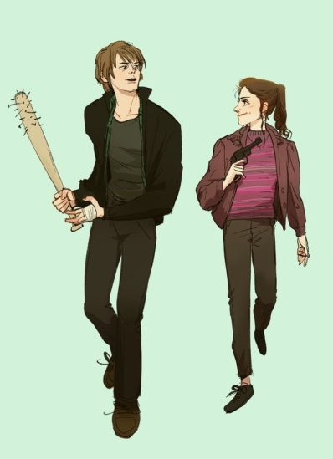
Nancy gave Jonathan a bat.
Jonathan was given a bat by Nancy.
A bat was given to Jonathan by Nancy.

Slide 25
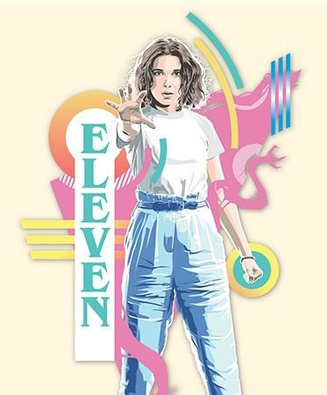
People believe that
Eleven’s power is amazing.
Eleven’s power
is believed
to be amazing.
It is believed that Eleven’s power is amazing.

Slide 26
