Slide 1

conditionals
Conditional “0”
It’s used when the condition is possible in the present.
If + present tense
If I study, I learn.

Slide 2


conditionals
Conditional “1”
It’s used when the condition is possible in the future.
If + future (will)
If you look at the sun,
you will hurt your eyes.

Slide 3
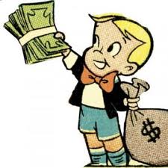
conditionals
Conditional “2”
It’s used when the condition is untrue or impossible.
If + past tense ….would + infinitive
If I were rich,
I would buy a big house.

Slide 4


conditionals
Conditional “3”
It’s used when something was not possible in the past.
If + had + past participle…
Would + have + past participle
If I had studied, I would have
passed the exam.

