Slide 1
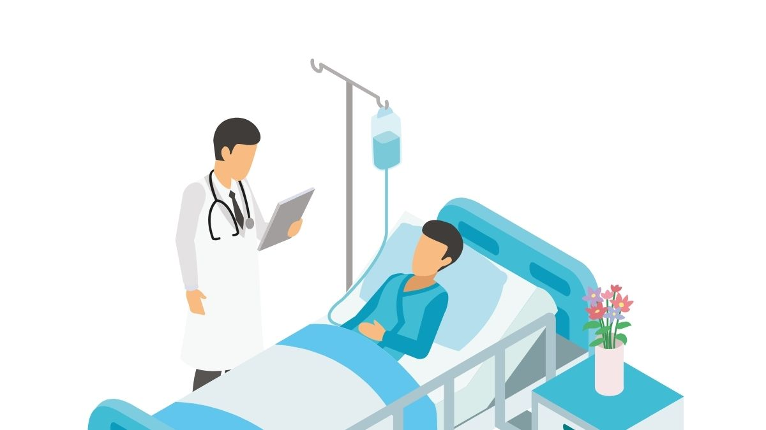


doctor
NEXT
SHOW

Slide 2

chef
NEXT
SHOW

Slide 3
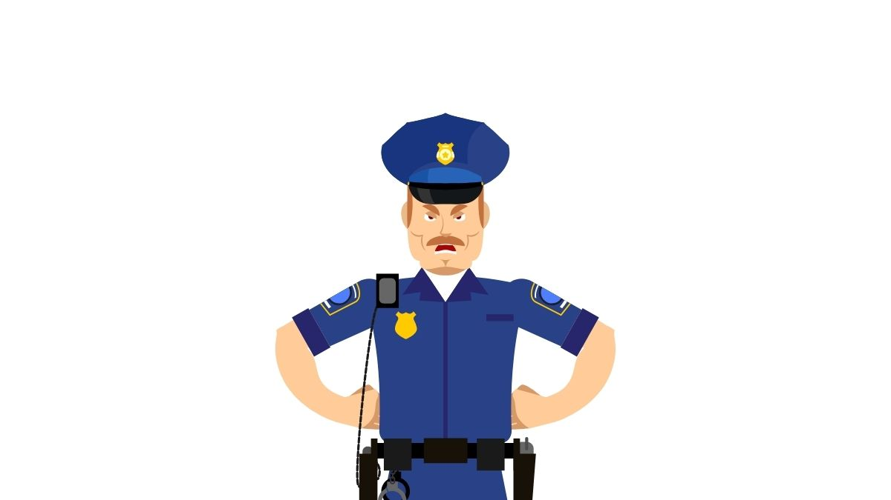
police officer
NEXT
SHOW

Slide 4
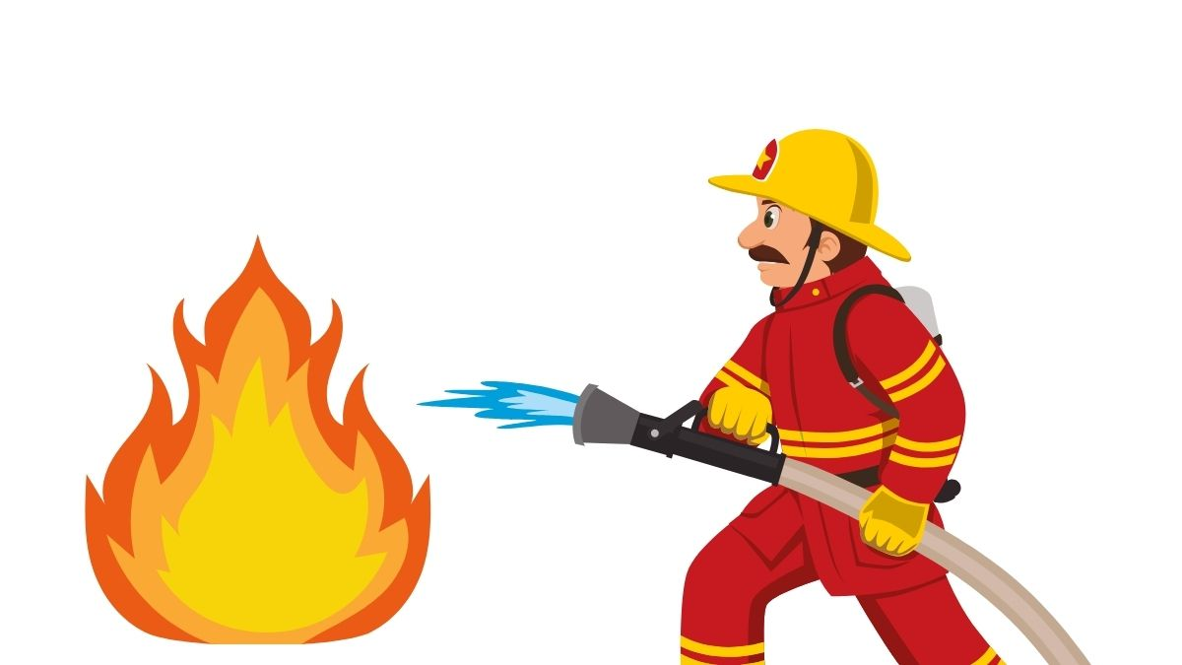
firefighter
NEXT
SHOW

Slide 5
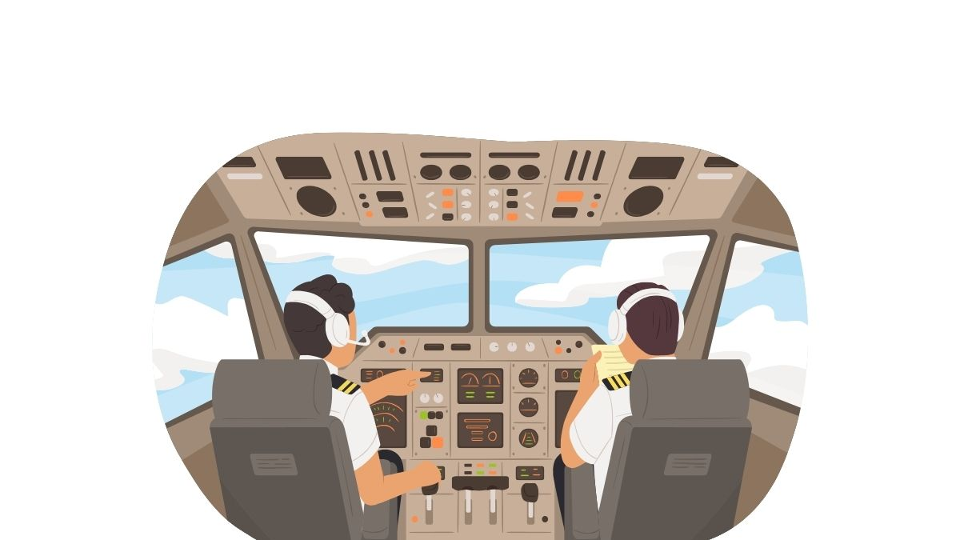
pilot
NEXT
SHOW

Slide 6
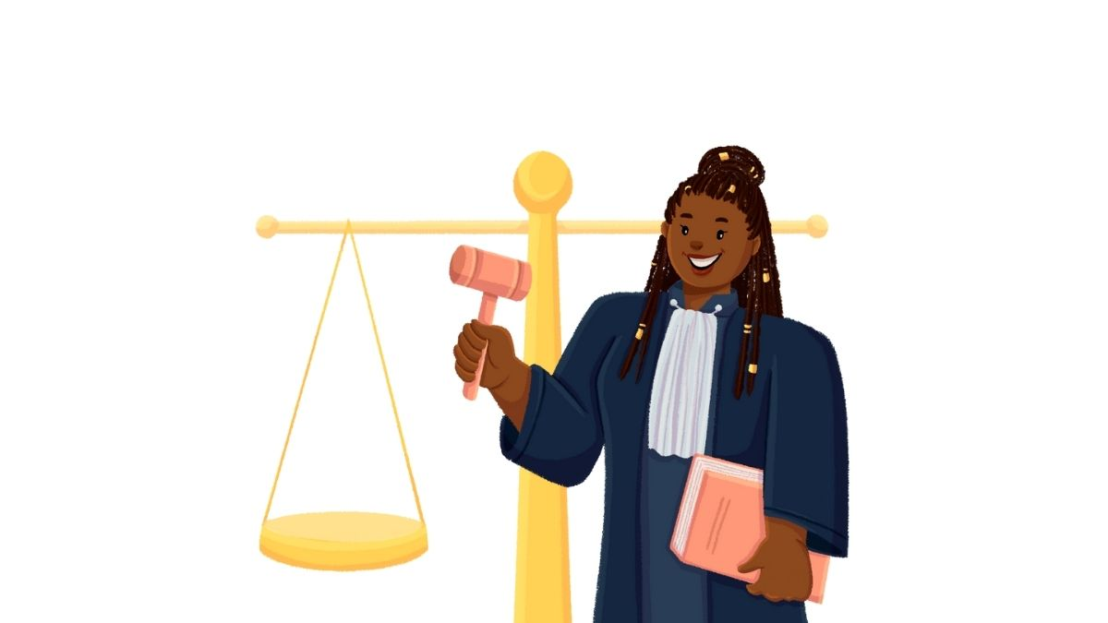
judge
NEXT
SHOW

Slide 7
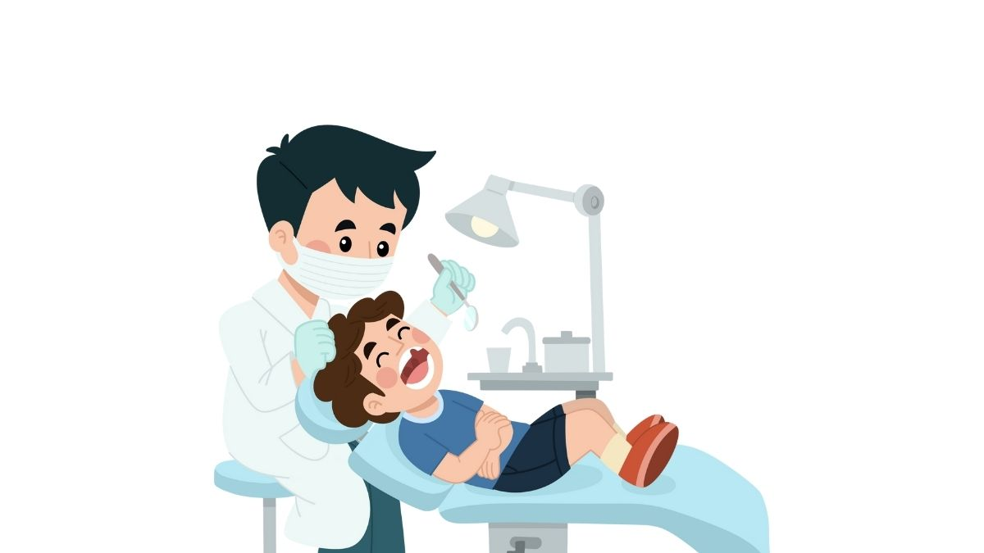
dentist
NEXT
SHOW

Slide 8
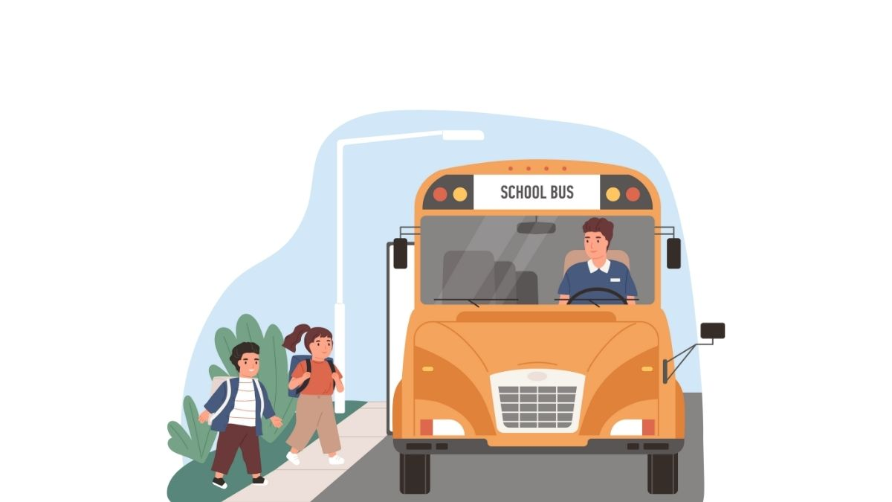
bus driver
NEXT
SHOW

Slide 9

teacher
NEXT
SHOW

Slide 10
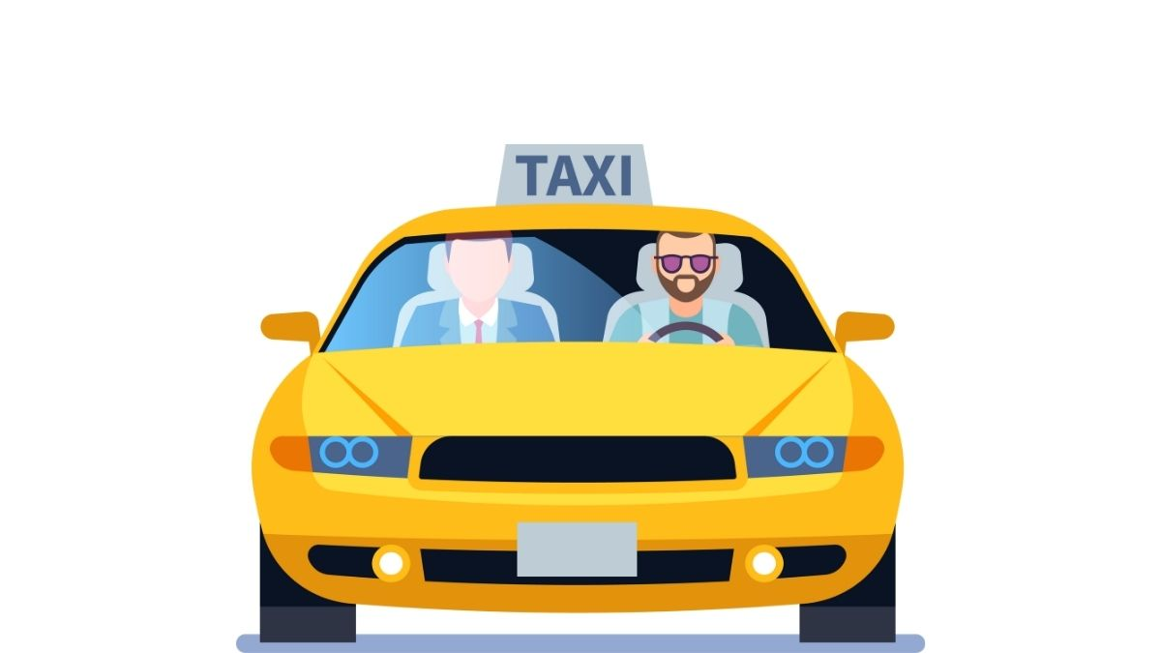
taxi driver
NEXT
SHOW

Slide 11

mechanic
NEXT
SHOW

Slide 12

nurse
NEXT
SHOW

Slide 13
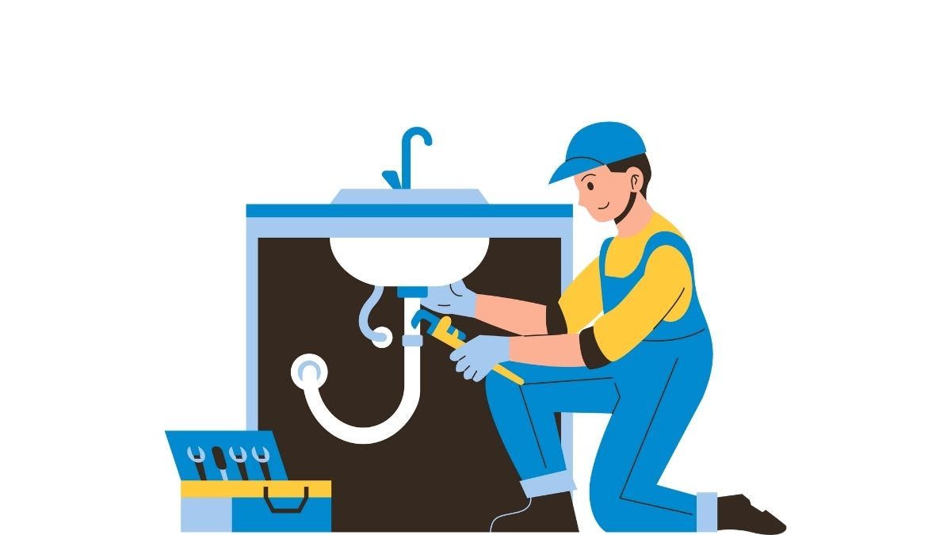
plumber
NEXT
SHOW

Slide 14
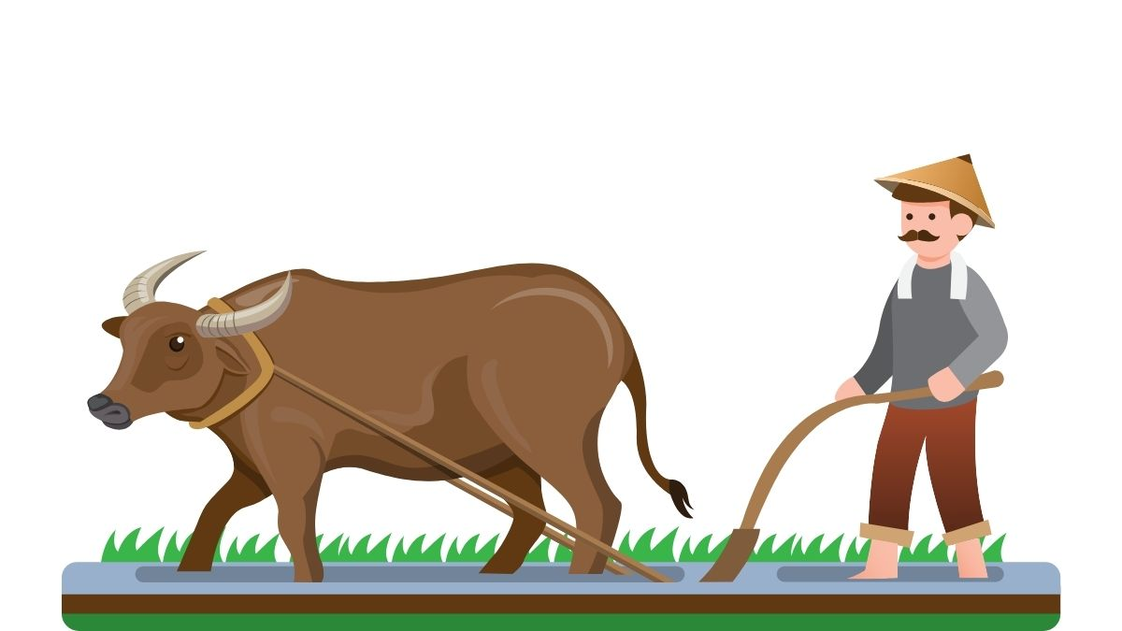
farmer
NEXT
SHOW

Slide 15

engineer
SHOW

