Slide 1

REPORTED SPEECH
4TH SENIOR B

Slide 2
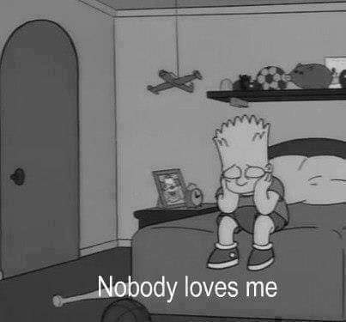
WE USE REPORTED SPEECH TO REPORT WHAT SOMEONE HAS SAID WITHOUT USING THEIR EXACT WORDS.
WHAT DID BART SAY??

Slide 3
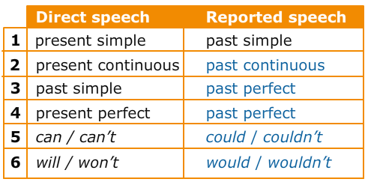
When we change DIRECT SPEECH to REPORTED SPEECH, we usually change the verb form to go ONE TENSE BACK

Slide 4
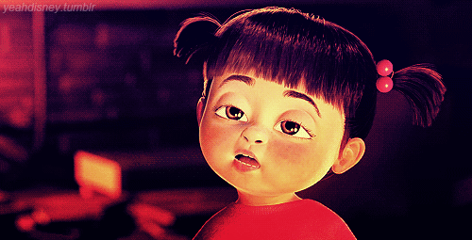
WHAT IS SHE SAYING…????

Slide 5
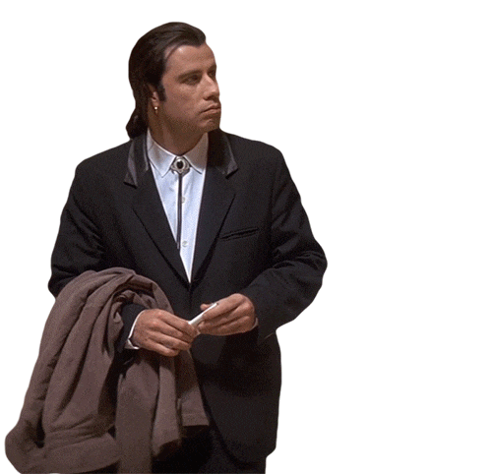
Changing pronouns, personal and possessive.
Pronouns change (or not) depending on the view of the reporter
I | ME | MY
HE/SHE | HIM/HER | HIS/HER
WE | US | OURS
THEY | THEM | THEIR
DIRECT SPEECH: JOHN SAID, “I AM COOKING”
REPORTED SPEECH: JOHN SAID THAT HE WAS COOKING

Slide 6
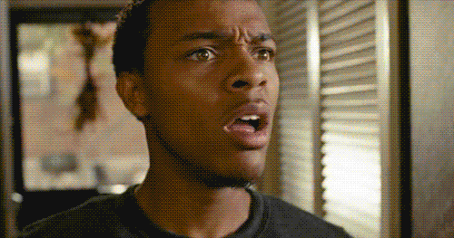

Slide 7
EXAMPLES/EXERCISES:
“I FEEL ILL”
SANDRA SAID
“I’M GOING INTO TOWN”
MARK SAID
“I studied music for five years”
Alex said
(THAT) SHE FELT ILL
(THAT) HE WAS GOING INTO TOWN
(THAT) HE HAD STUDIED MUSIC FOR FIVE YEARS

Slide 8


Slide 9
TIME AND PLACE CHANGES
It is often necessary to make time and place changes in relation to tense changes. TIME EXPRESSIONS:
DIRECT SPEECH | REPORTED SPEECH
NOW | THEN
TODAY | THAT DAY
TONIGHT | THAT NIGHT
YESTERDAY | THE DAY BEFORE
TOMORROW | THE FOLLOWING DAY/THE NEXT DAY
NEXT DAY/WEEK/MONTH/YEAR | THE FOLLOWING DAY/WEEK/MONTH/YEAR

Slide 10
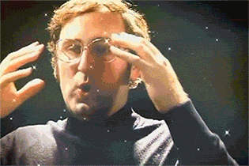

Slide 11
EXAMPLES OF TIME CHANGING:
“I saw Tom yesterday”.
John said
“I’m going to Liza’s party tonight.”
María said
(that) he had seen Tom the day before.
(that) she was going to Liza’s party that night.

Slide 12
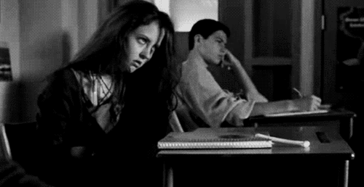
TURN TO PAGE 55 IN YOUR BOOKS….. PLEASE…

Slide 13
SAY & TELL
TELL SOMEBODY (SOMETHING)
She told me her name.
NOT She said me her name.
SAY SOMETHING (TO SOMEBODY)
We said goodbye to our cousins.

Slide 14


