Slide 1
PASSIVE VOICE
Tom eats the cake.
The cake is eaten by Tom.

Slide 2
Tom eats the cake.
Active
S
V
O
The cake is eaten by Tom.
S
Be+V3/ed
by…
Passive
Present simple: am/is/are
Present perfect: have/has been
Past simple: was/were
Past perfect: had been
Future simple: will be
Ect.

Slide 3
Let’s practice!

Slide 4


The car has been fixed by Tom.
Tom
fix

Slide 5


The cake was bought by Sandy 3 days ago.
Sandy
3 days ago
buy

Slide 6

The letters are regularly written by Tom.
Tom
write
regularly

Slide 7

The drawing will be painted by Sandy tomorrow.
tomorrow
Sandy
paint

Slide 8


The homework has been done by the students since Sunday.
Since Sunday
The students
do

Slide 9


The birthday cards are being made by the students at the moment.
The students
At the moment
make

Slide 10

The photos were taken by Tom last week.
Tom
last week
take

Slide 11
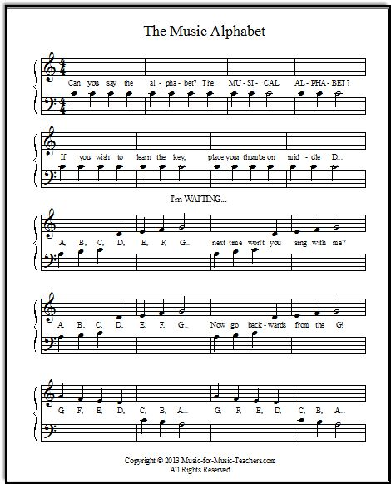
The song is being played by Sandy now.
now
Sandy
play

