Slide 1

Learn Python in three hours
Some material adapted from Upenn cmpe391 slides and other sources

Slide 2
Overview
History
Installing & Running Python
Names & Assignment
Sequences types: Lists, Tuples, and Strings
Mutability

Slide 3
Brief History of Python
Invented in the Netherlands, early 90s by Guido van Rossum
Named after Monty Python
Open sourced from the beginning
Considered a scripting language, but is much more
Scalable, object oriented and functional from the beginning
Used by Google from the beginning
Increasingly popular

Slide 4

Python’s Benevolent Dictator For Life
“Python is an experiment in how much freedom program-mers need. Too much freedom and nobody can read another's code; too little and expressive-ness is endangered.”
- Guido van Rossum

Slide 5
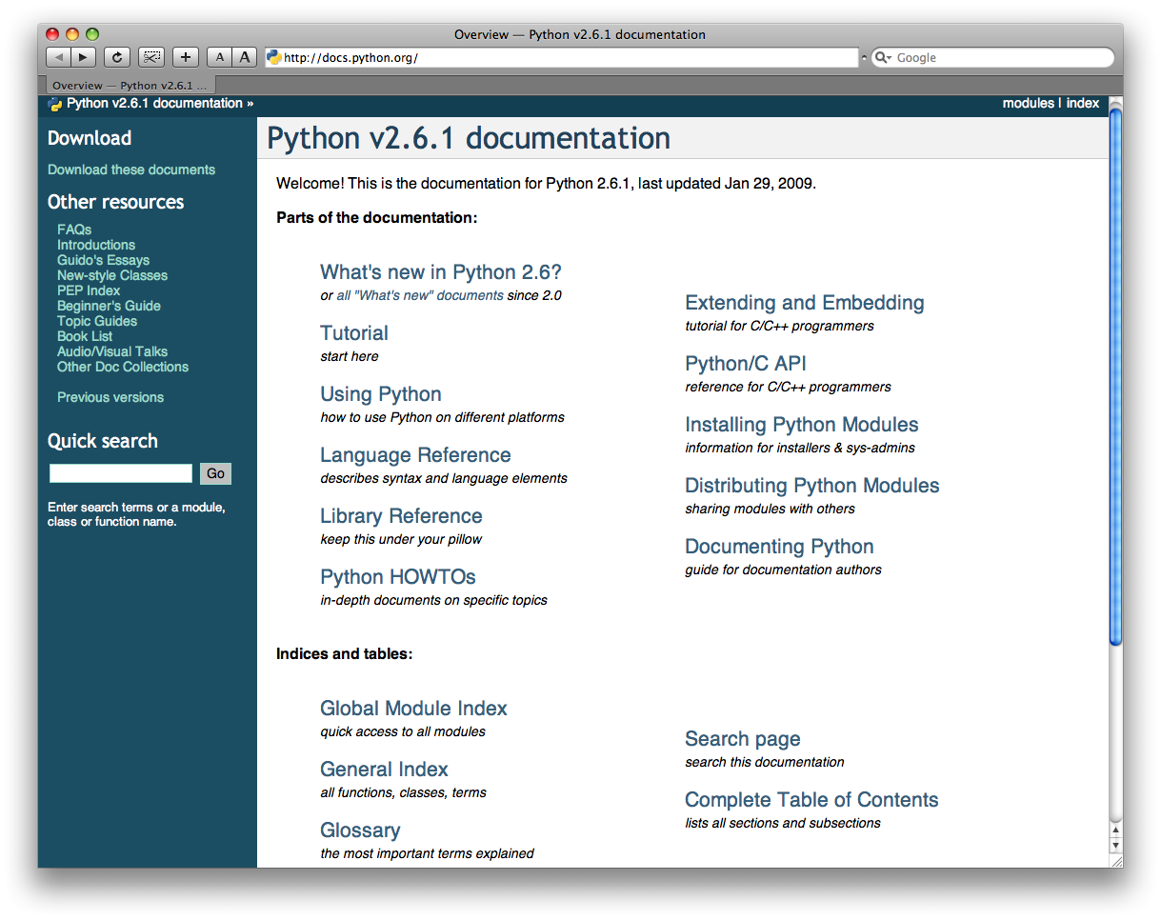
http://docs.python.org/

Slide 6
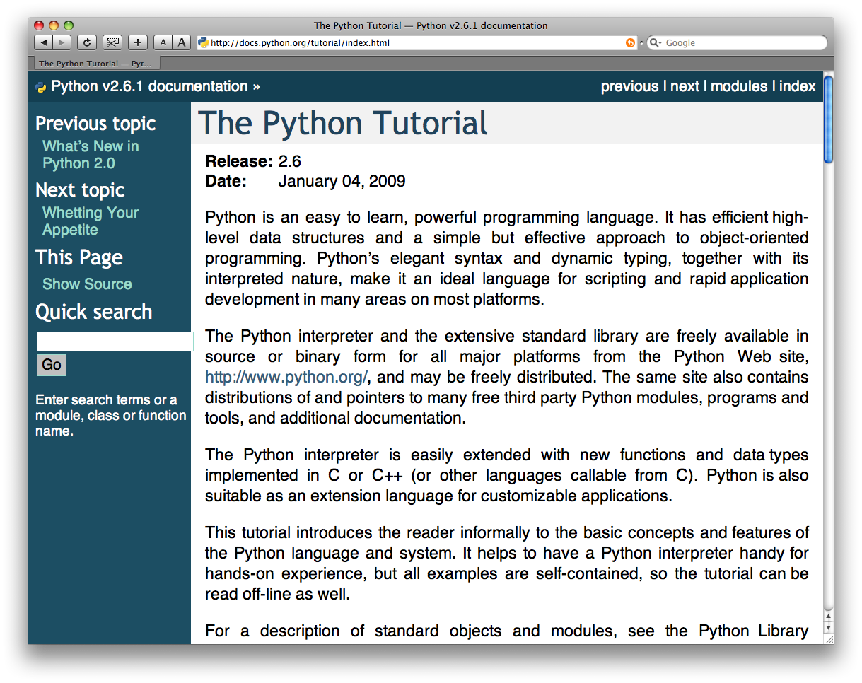
The Python tutorial is good!

Slide 7
Running Python

Slide 8
The Python Interpreter
Typical Python implementations offer
both an interpreter and compiler
Interactive interface to Python with a
read-eval-print loop
    [finin@linux2 ~]$ python
    Python 2.4.3 (#1, Jan 14 2008, 18:32:40)
    [GCC 4.1.2 20070626 (Red Hat 4.1.2-14)] on linux2
    Type "help", "copyright", "credits" or "license" for more information.
    >>> def square(x):
    ... return x * x
    ...
    >>> map(square, [1, 2, 3, 4])
    [1, 4, 9, 16]
    >>>

Slide 9
Installing
Python is pre-installed on most Unix systems, including Linux and MAC OS X
The pre-installed version may not be the most recent one (2.6.2 and 3.1.1 as of Sept 09)
Download from http://python.org/download/
Python comes with a large library of standard modules
There are several options for an IDE
  IDLE – works well with Windows
  Emacs with python-mode or your favorite text editor
  Eclipse with Pydev (http://pydev.sourceforge.net/)

Slide 10
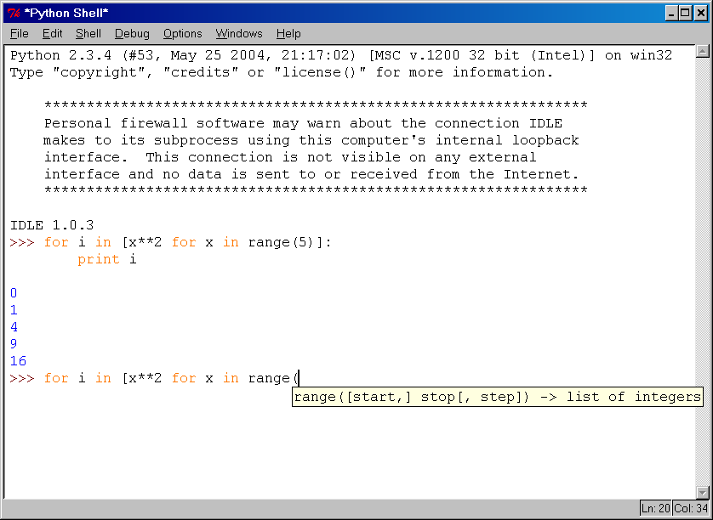
IDLE Development Environment
IDLE is an Integrated DeveLopment Environ-ment for Python, typically used on Windows
Multi-window text editor with syntax highlighting, auto-completion, smart indent and other.
Python shell with syntax highlighting.
Integrated debugger
with stepping, persis-
tent breakpoints,
and call stack visi-
bility

Slide 11
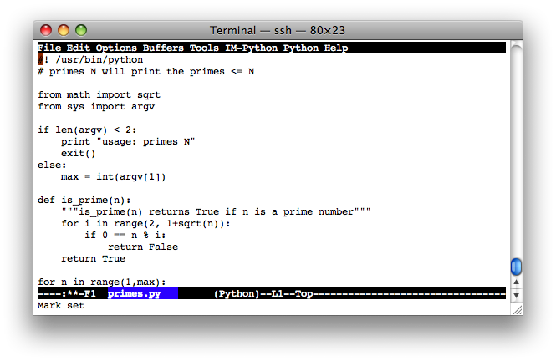
Editing Python in Emacs
Emacs python-mode has good support for editing Python, enabled enabled by default for .py files
Features: completion, symbol help, eldoc, and inferior interpreter shell, etc.

Slide 12
Running Interactively on UNIX
On Unix…
  % python
  >>> 3+3
  6
Python prompts with ‘>>>’.
To exit Python (not Idle):
  In Unix, type CONTROL-D
  In Windows, type CONTROL-Z + <Enter>
  Evaluate exit()

Slide 13
Running Programs on UNIX
Call python program via the python interpreter
  % python fact.py
Make a python file directly executable by
  Adding the appropriate path to your python interpreter as the first line of your file
    #!/usr/bin/python
  Making the file executable
    % chmod a+x fact.py
  Invoking file from Unix command line
    % fact.py

Slide 14
Example ‘script’: fact.py
#! /usr/bin/python
def fact(x):
"""Returns the factorial of its argument, assumed to be a posint"""
if x == 0:
return 1
return x * fact(x - 1)
print
print ’N fact(N)’
print "---------"
for n in range(10):
print n, fact(n)

Slide 15
Python Scripts
When you call a python program from the command line the interpreter evaluates each expression in the file
Familiar mechanisms are used to provide command line arguments and/or redirect input and output
Python also has mechanisms to allow a python program to act both as a script and as a module to be imported and used by another python program

Slide 16
Example of a Script
#! /usr/bin/python
""" reads text from standard input and outputs any email
addresses it finds, one to a line.
"""
import re
from sys import stdin
# a regular expression ~ for a valid email address
pat = re.compile(r'[-\w][-.\w]*@[-\w][-\w.]+[a-zA-Z]{2,4}')
for line in stdin.readlines():
for address in pat.findall(line):
print address

Slide 17
results
python> python email0.py <email.txt
bill@msft.com
gates@microsoft.com
steve@apple.com
bill@msft.com
python>

Slide 18
Getting a unique, sorted list
import re
from sys import stdin
pat = re.compile(r'[-\w][-.\w]*@[-\w][-\w.]+[a-zA-Z]{2,4}’)
# found is an initially empty set (a list w/o duplicates)
found = set( )
for line in stdin.readlines():
for address in pat.findall(line):
found.add(address)
# sorted() takes a sequence, returns a sorted list of its elements
for address in sorted(found):
print address

Slide 19
results
python> python email2.py <email.txt
bill@msft.com
gates@microsoft.com
steve@apple.com
python>

Slide 20
Simple functions: ex.py
"""factorial done recursively and iteratively"""
def fact1(n):
ans = 1
for i in range(2,n):
ans = ans * n
return ans
def fact2(n):
if n < 1:
return 1
else:
return n * fact2(n - 1)

Slide 21
Simple functions: ex.py
671> python
Python 2.5.2 …
>>> import ex
>>> ex.fact1(6)
1296
>>> ex.fact2(200)
78865786736479050355236321393218507…000000L
>>> ex.fact1
<function fact1 at 0x902470>
>>> fact1
Traceback (most recent call last):
File "<stdin>", line 1, in <module>
NameError: name 'fact1' is not defined
>>>

Slide 22
The Basics

Slide 23
A Code Sample (in IDLE)
x = 34 - 23 # A comment.
y = “Hello” # Another one.
z = 3.45
if z == 3.45 or y == “Hello”:
x = x + 1
y = y + “ World” # String concat.
print x
print y

Slide 24
Enough to Understand the Code
Indentation matters to code meaning
  Block structure indicated by indentation
First assignment to a variable creates it
  Variable types don’t need to be declared.
  Python figures out the variable types on its own.
Assignment is = and comparison is ==
For numbers + - * / % are as expected
  Special use of + for string concatenation and % for string formatting (as in C’s printf)
Logical operators are words (and, or, not) not symbols
The basic printing command is print

Slide 25
Basic Datatypes
Integers (default for numbers)
  z = 5 / 2 # Answer 2, integer division
Floats
  x = 3.456
Strings
  Can use “” or ‘’ to specify with “abc” == ‘abc’
  Unmatched can occur within the string: “matt’s”
  Use triple double-quotes for multi-line strings or strings than contain both ‘ and “ inside of them:
  “““a‘b“c”””

Slide 26
Whitespace
Whitespace is meaningful in Python: especially indentation and placement of newlines
Use a newline to end a line of code
    Use \ when must go to next line prematurely
No braces {} to mark blocks of code, use consistent indentation instead
    First line with less indentation is outside of the block
    First line with more indentation starts a nested block
Colons start of a new block in many constructs, e.g. function definitions, then clauses

Slide 27
Comments
Start comments with #, rest of line is ignored
Can include a “documentation string” as the first line of a new function or class you define
Development environments, debugger, and other tools use it: it’s good style to include one
  def fact(n):
  “““fact(n) assumes n is a positive integer and returns facorial of n.”””
  assert(n>0)
  return 1 if n==1 else n*fact(n-1)

Slide 28
Assignment
Binding a variable in Python means setting a name to hold a reference to some object
  Assignment creates references, not copies
Names in Python do not have an intrinsic type, objects have types
  Python determines the type of the reference automatically based on what data is assigned to it
You create a name the first time it appears on the left side of an assignment expression:
x = 3
A reference is deleted via garbage collection after any names bound to it have passed out of scope
Python uses reference semantics (more later)

Slide 29
Naming Rules
Names are case sensitive and cannot start with a number. They can contain letters, numbers, and underscores.
  bob Bob _bob _2_bob_ bob_2 BoB
There are some reserved words:
  and, assert, break, class, continue, def, del, elif, else, except, exec, finally, for, from, global, if, import, in, is, lambda, not, or, pass, print, raise, return, try, while

Slide 30
Naming conventions
The Python community has these recommend-ed naming conventions
joined_lower for functions, methods and, attributes
joined_lower or ALL_CAPS for constants
StudlyCaps for classes
camelCase only to conform to pre-existing conventions
Attributes: interface, _internal, __private

Slide 31
Assignment
You can assign to multiple names at the same time
  >>> x, y = 2, 3
  >>> x
  2
  >>> y
  3
This makes it easy to swap values
  >>> x, y = y, x
Assignments can be chained
  >>> a = b = x = 2

Slide 32
Accessing Non-Existent Name
Accessing a name before it’s been properly created (by placing it on the left side of an assignment), raises an error
>>> y
Traceback (most recent call last):
File "<pyshell#16>", line 1, in -toplevel-
y
NameError: name ‘y' is not defined
>>> y = 3
>>> y
3

Slide 33
Sequence types: Tuples, Lists, and Strings

Slide 34
Sequence Types
Tuple: (‘john’, 32, [CMSC])
  A simple immutable ordered sequence of items
  Items can be of mixed types, including collection types
Strings: “John Smith”
  Immutable
  Conceptually very much like a tuple
List: [1, 2, ‘john’, (‘up’, ‘down’)]
  Mutable ordered sequence of items of mixed types

Slide 35
Similar Syntax
All three sequence types (tuples, strings, and lists) share much of the same syntax and functionality.
Key difference:
  Tuples and strings are immutable
  Lists are mutable
The operations shown in this section can be applied to all sequence types
  most examples will just show the operation performed on one

Slide 36
Sequence Types 1
Define tuples using parentheses and commas
  >>> tu = (23, ‘abc’, 4.56, (2,3), ‘def’)
Define lists are using square brackets and commas
  >>> li = [“abc”, 34, 4.34, 23]
Define strings using quotes (“, ‘, or “““).
  >>> st = “Hello World”
  >>> st = ‘Hello World’
  >>> st = “““This is a multi-line
  string that uses triple quotes.”””

Slide 37
Sequence Types 2
Access individual members of a tuple, list, or string using square bracket “array” notation
Note that all are 0 based…
>>> tu = (23, ‘abc’, 4.56, (2,3), ‘def’)
>>> tu[1] # Second item in the tuple.
‘abc’
>>> li = [“abc”, 34, 4.34, 23]
>>> li[1] # Second item in the list.
34
>>> st = “Hello World”
>>> st[1] # Second character in string.
‘e’

Slide 38
Positive and negative indices
>>> t = (23, ‘abc’, 4.56, (2,3), ‘def’)
Positive index: count from the left, starting with 0
  >>> t[1]
  ‘abc’
Negative index: count from right, starting with –1
  >>> t[-3]
  4.56

Slide 39
Slicing: return copy of a subset
>>> t = (23, ‘abc’, 4.56, (2,3), ‘def’)
Return a copy of the container with a subset of the original members. Start copying at the first index, and stop copying before second.
  >>> t[1:4]
  (‘abc’, 4.56, (2,3))
Negative indices count from end
  >>> t[1:-1]
  (‘abc’, 4.56, (2,3))

Slide 40
Slicing: return copy of a =subset
>>> t = (23, ‘abc’, 4.56, (2,3), ‘def’)
Omit first index to make copy starting from beginning of the container
>>> t[:2]
(23, ‘abc’)
Omit second index to make copy starting at first index and going to end
>>> t[2:]
(4.56, (2,3), ‘def’)

Slide 41
Copying the Whole Sequence
[ : ] makes a copy of an entire sequence
>>> t[:]
(23, ‘abc’, 4.56, (2,3), ‘def’)
Note the difference between these two lines for mutable sequences
>>> l2 = l1 # Both refer to 1 ref,
# changing one affects both
>>> l2 = l1[:] # Independent copies, two refs

Slide 42
The ‘in’ Operator
Boolean test whether a value is inside a container:
    >>> t = [1, 2, 4, 5]
    >>> 3 in t
    False
    >>> 4 in t
    True
    >>> 4 not in t
    False
For strings, tests for substrings
    >>> a = 'abcde'
    >>> 'c' in a
    True
    >>> 'cd' in a
    True
    >>> 'ac' in a
    False
Be careful: the in keyword is also used in the syntax of for loops and list comprehensions

Slide 43
The + Operator
The + operator produces a new tuple, list, or string whose value is the concatenation of its arguments.
>>> (1, 2, 3) + (4, 5, 6)
(1, 2, 3, 4, 5, 6)
>>> [1, 2, 3] + [4, 5, 6]
[1, 2, 3, 4, 5, 6]
>>> “Hello” + “ ” + “World”
‘Hello World’

Slide 44
The * Operator
The * operator produces a new tuple, list, or string that “repeats” the original content.
>>> (1, 2, 3) * 3
(1, 2, 3, 1, 2, 3, 1, 2, 3)
>>> [1, 2, 3] * 3
[1, 2, 3, 1, 2, 3, 1, 2, 3]
>>> “Hello” * 3
‘HelloHelloHello’

Slide 45
Mutability:
Tuples vs. Lists

Slide 46
Lists are mutable
>>> li = [‘abc’, 23, 4.34, 23]
>>> li[1] = 45
>>> li
[‘abc’, 45, 4.34, 23]
We can change lists in place.
Name li still points to the same memory reference when we’re done.

Slide 47
Tuples are immutable
>>> t = (23, ‘abc’, 4.56, (2,3), ‘def’)
>>> t[2] = 3.14
Traceback (most recent call last):
File "<pyshell#75>", line 1, in -toplevel-
tu[2] = 3.14
TypeError: object doesn't support item assignment
You can’t change a tuple.
You can make a fresh tuple and assign its reference to a previously used name.
>>> t = (23, ‘abc’, 3.14, (2,3), ‘def’)
The immutability of tuples means they’re faster than lists.

Slide 48
Operations on Lists Only
>>> li = [1, 11, 3, 4, 5]
>>> li.append(‘a’) # Note the method syntax
>>> li
[1, 11, 3, 4, 5, ‘a’]
>>> li.insert(2, ‘i’)
>>>li
[1, 11, ‘i’, 3, 4, 5, ‘a’]

Slide 49
The extend method vs +
+ creates a fresh list with a new memory ref
extend operates on list li in place.
  >>> li.extend([9, 8, 7])
  >>> li
  [1, 2, ‘i’, 3, 4, 5, ‘a’, 9, 8, 7]
Potentially confusing:
  extend takes a list as an argument.
  append takes a singleton as an argument.
  >>> li.append([10, 11, 12])
  >>> li
  [1, 2, ‘i’, 3, 4, 5, ‘a’, 9, 8, 7, [10, 11, 12]]

Slide 50
Operations on Lists Only
Lists have many methods, including index, count, remove, reverse, sort
>>> li = [‘a’, ‘b’, ‘c’, ‘b’]
>>> li.index(‘b’) # index of 1st occurrence
1
>>> li.count(‘b’) # number of occurrences
2
>>> li.remove(‘b’) # remove 1st occurrence
>>> li
[‘a’, ‘c’, ‘b’]

Slide 51
Operations on Lists Only
>>> li = [5, 2, 6, 8]
>>> li.reverse() # reverse the list *in place*
>>> li
[8, 6, 2, 5]
>>> li.sort() # sort the list *in place*
>>> li
[2, 5, 6, 8]
>>> li.sort(some_function)
# sort in place using user-defined comparison

Slide 52
Tuple details
The comma is the tuple creation operator, not parens
  >>> 1,
  (1,)
Python shows parens for clarity (best practice)
  >>> (1,)
  (1,)
Don't forget the comma!
  >>> (1)
  1
Trailing comma only required for singletons others
Empty tuples have a special syntactic form
  >>> ()
  ()
  >>> tuple()
  ()

Slide 53
Summary: Tuples vs. Lists
Lists slower but more powerful than tuples
  Lists can be modified, and they have lots of handy operations and mehtods
  Tuples are immutable and have fewer features
To convert between tuples and lists use the list() and tuple() functions:
  li = list(tu)
  tu = tuple(li)

