Slide 1

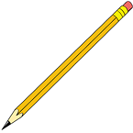
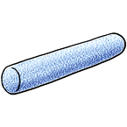
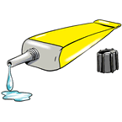
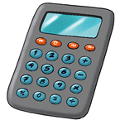
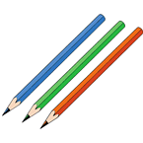
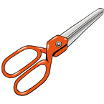
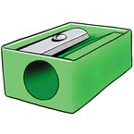
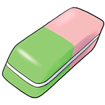

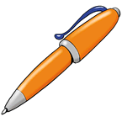
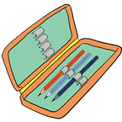
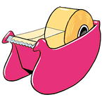
In the classroom
Globe
pencil
Chalk
Glue
calculator
CLICK ON A PICTURE TO READ AND LISTEN
Pencil sharpener
Coloured pencils
scissors
Pen
Notebook
Rubber
Tape
Pencilcase

Slide 2
What is this?
It´s a globe.
Great Job!
It´s a notebook .
Try Again

Slide 3
What is this?
It´s a pencil sharpener.
Great Job!
It´s a notebook .
Try Again

Slide 4
What is this?
It´s a notebook .
Try Again
It´s chalk.
Great Job!

Slide 5
What is this?
It´s a rubber.
Try Again
It´s glue.
Great Job!

Slide 6
What is this?
It´s a pencil.
Great Job!
It´s a pen.
Try Again

Slide 7
What are these?
They are coloured pencils.
Great Job!
They are pens.
Try Again

Slide 8
What is this?
It´s a ruler.
Try Again
It´s a pen.
Great Job!

Slide 9
What is this?
It´s a calculator.
Great Job!
It´s a rubber.
Try Again

Slide 10
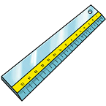
What is this?
It´s a ruler.
Great Job!
It´s a book.
Try Again

Slide 11
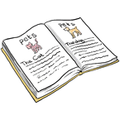
What is this?
It´s a book.
Great Job!
It´s a notebook .
Try Again

Slide 12

Thanks for playing!.

