Slide 1
Present Simple

Slide 2
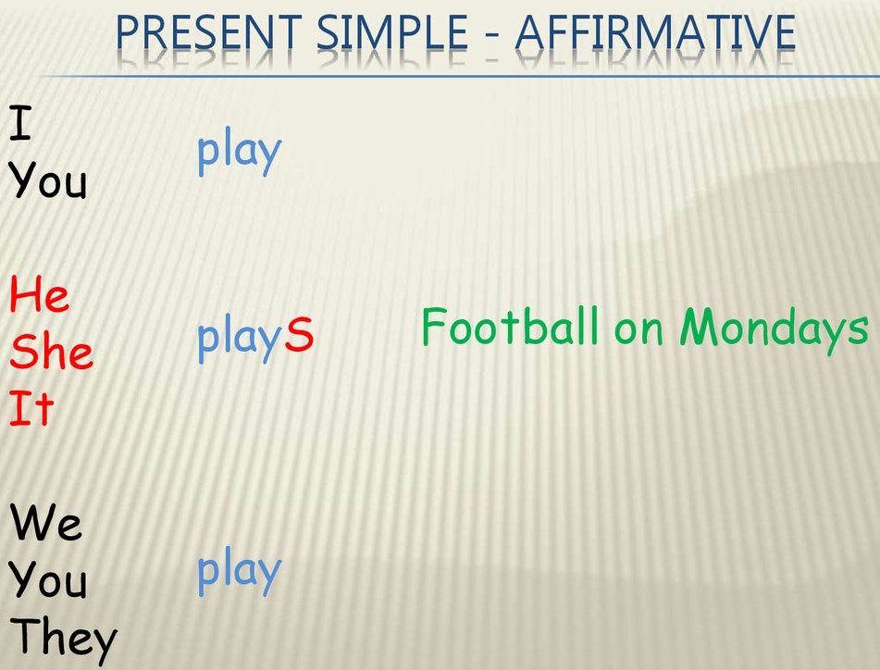

Slide 3
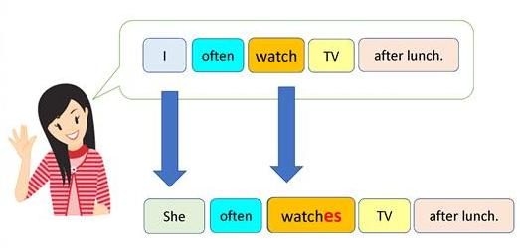

Slide 4
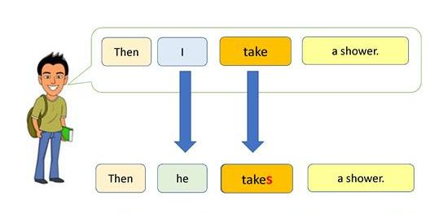

Slide 5
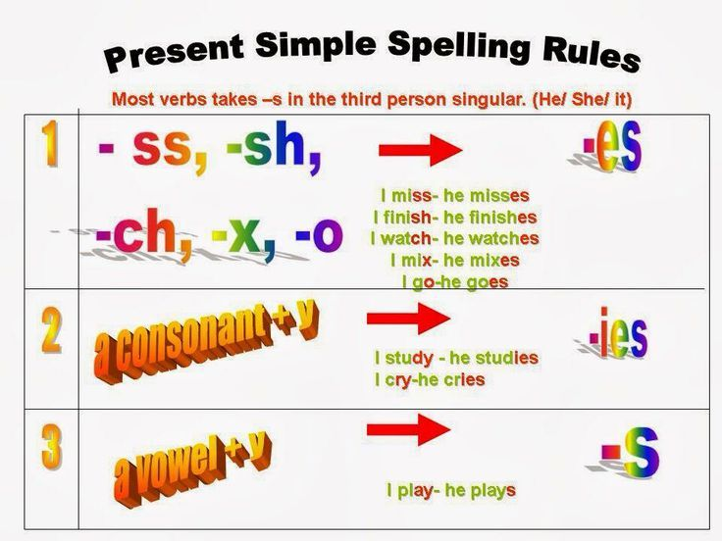

Slide 6
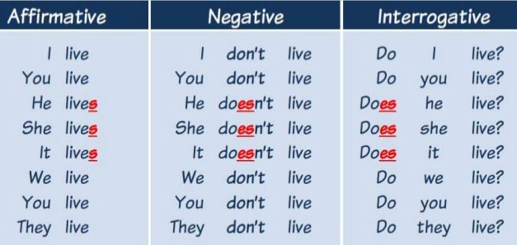

Slide 7
My brother__plays_(play) handball in a club.
What_does__your mother ____do__ (do) ?
Our neighbours _____go_(go) to the cinema very often .
What time _do___you ___go__(go) to bed on week days ?
I never__wash______(wash) my car.

Slide 8
My sister _likes__(like) doing the housework.
Where _does___your mother _buy___ (buy) her bread ?
Why __do___you _want___(want ) to see the headmaster ?
We __learn____(learn ) a second foreign language at school.
__Does__it___often rain__(often/ rain ) in Scotland ?
What ___do_you___do___(do ) on Sundays ?

