Slide 1
Present Perfect

Slide 2
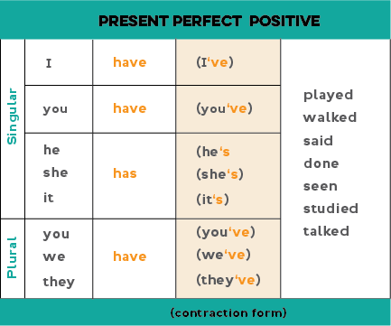

Slide 3
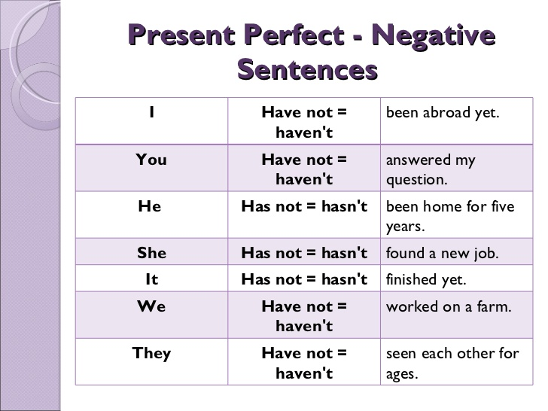

Slide 4
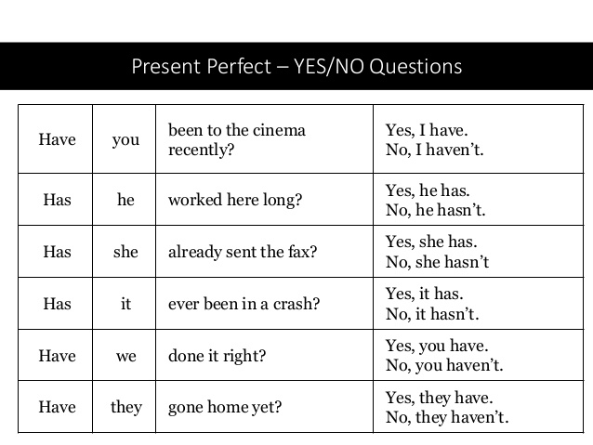

Slide 5
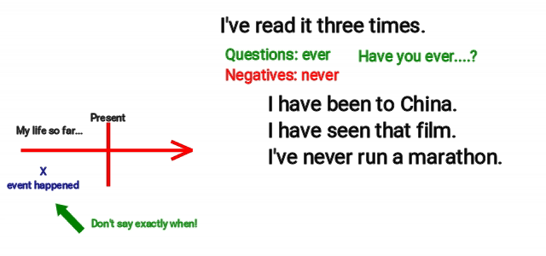
Για κάτι που έγινε στο παρελθόν αλλά δεν ξέρουμε πότε (και δεν μασ ενδιαφέρει)

Slide 6
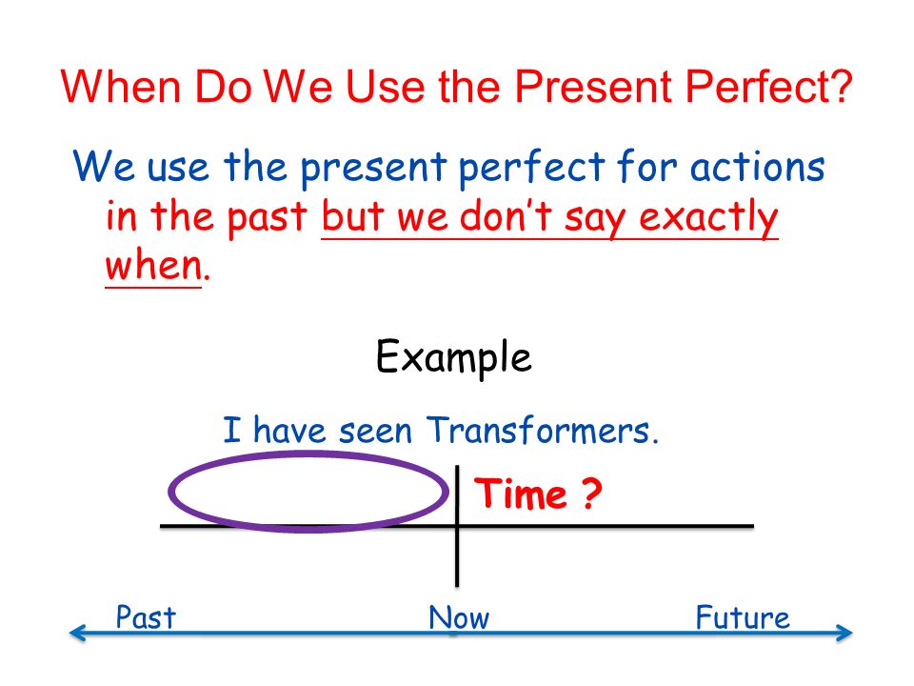

Slide 7

Look!!
Paul has broken his leg
Paul broke his leg last week

Slide 8
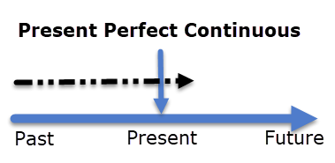
Για μια πράξη που άρχισε στο παρελθόν και συνεχίζεται στο παρόν.
I have known Mary for ten years
We have lived here for a year
Richard has had his computer for six months

Slide 9
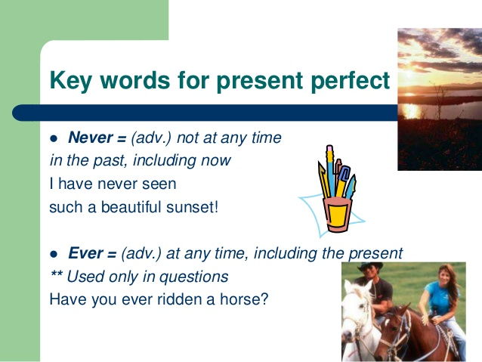

Slide 10
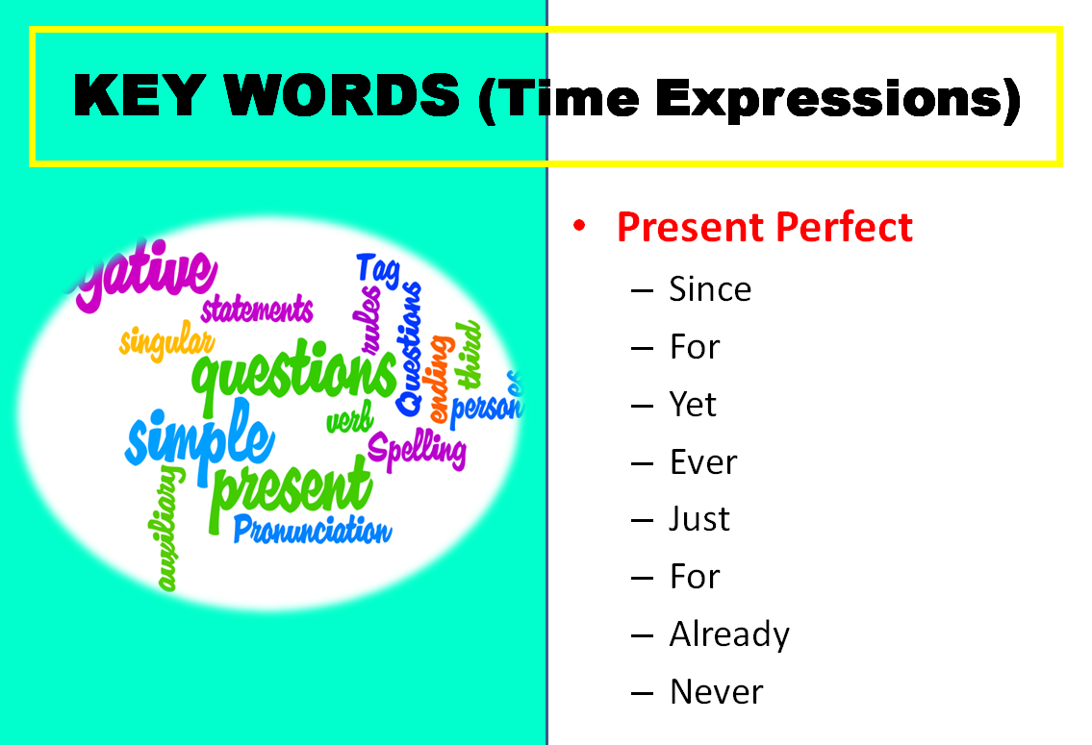

Slide 11
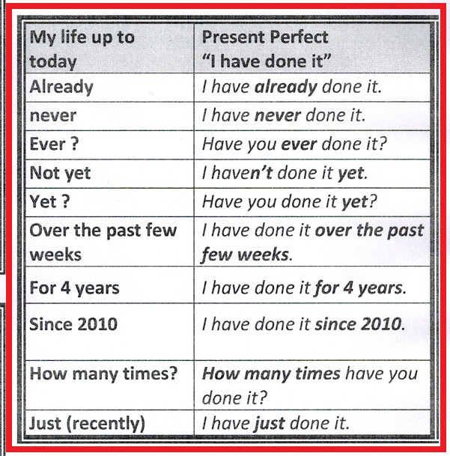

Slide 12
Workbook, 56, exercise 6
a. Can I go to my friend’s party?
b. Will fail your exams or will get low/bad marks
c. I will help you or I will change the tyre
d. You will be/become an astronaut
e. I won’t be late again
f. You should study at the National Drama School

