Slide 1
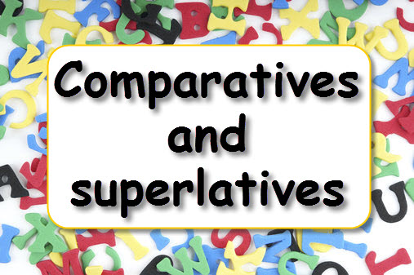

Slide 2
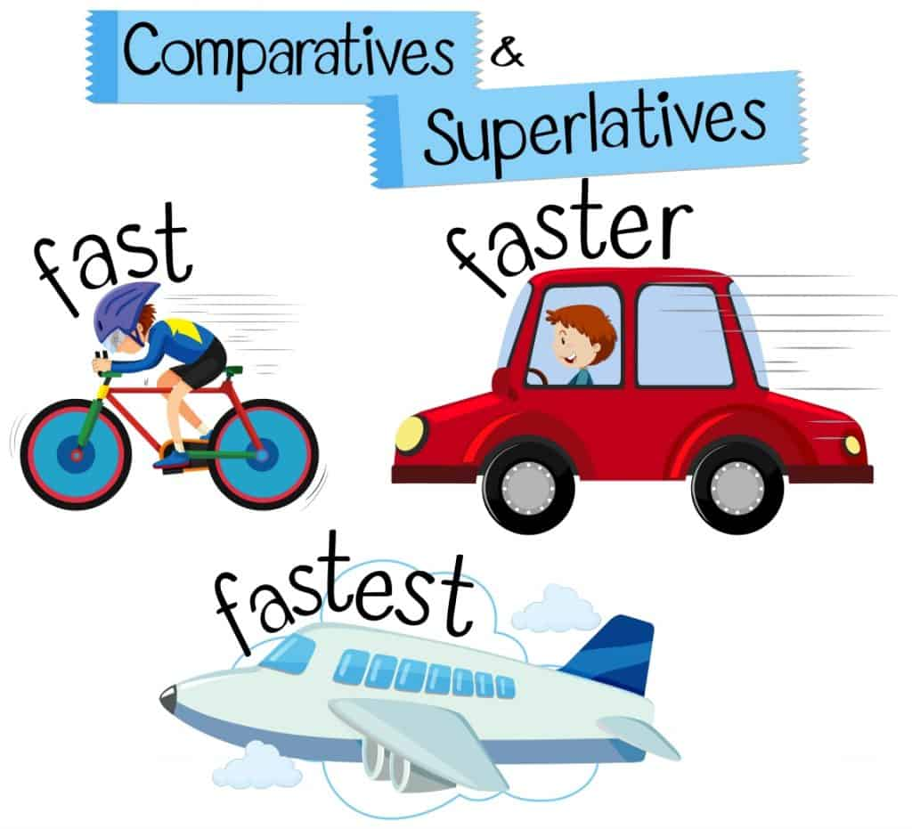

Slide 3
Comparative = συγκριτικός
Peter is taller than John
Mary is younger than Helen

Slide 4
Superlative = υπερθετικός
Peter is the tallest of all
Mary is the youngest in class

Slide 5
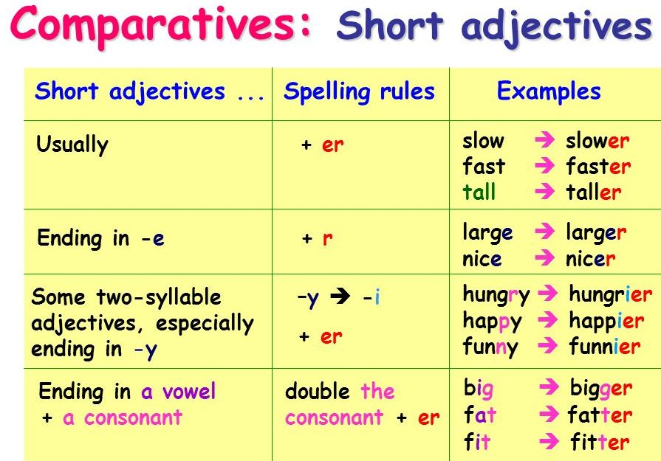
Spelling Rules

Slide 6
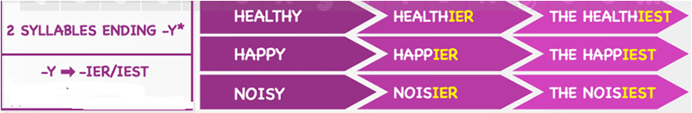
Δισύλλαβα σε -y

Slide 7
Άλλα δισύλλαβα
Clever – cleverer – cleverest
Narrow – narrower – narrowest
Quiet – quieter – quietest

Slide 8
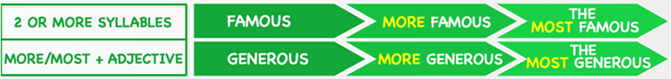
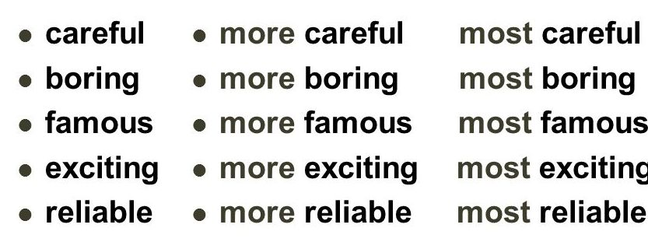
Μερικά δισύλλαβα και πολυσύλλαβα επίθετα

Slide 9
Επίθετα σε - ful → more/ most
Harmful – more harmful – most harmful
Useful – more useful – most useful
Careful – more careful – most careful

Slide 10
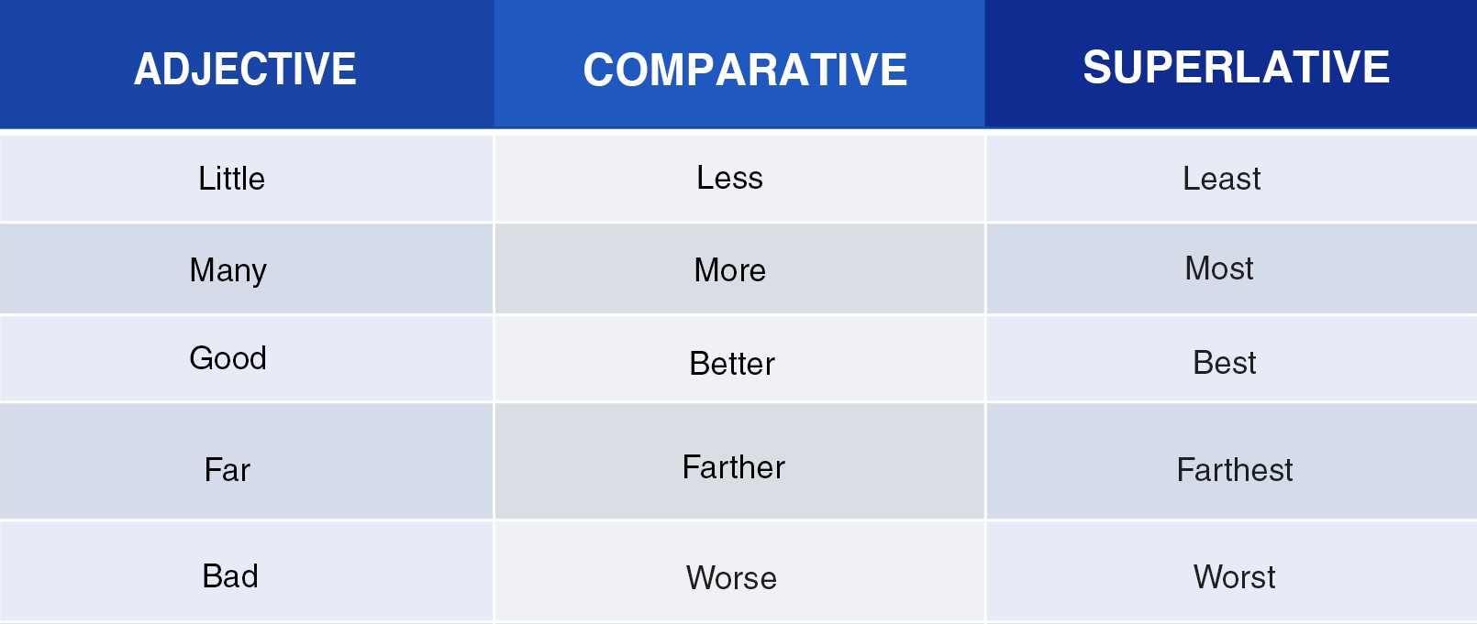
Irregular

Slide 11
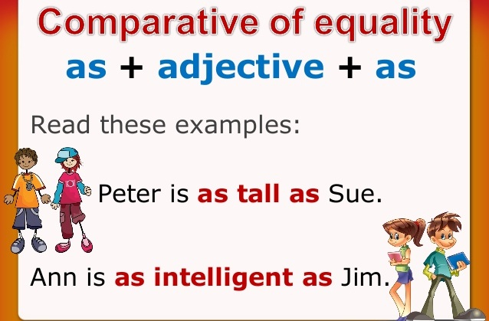

Slide 12
Comparative or superlative?
1. April is __ (warm) than January.
2. August is the __ (hot) month of the year.
3. November is __ (cold) than September.
4. It is the __ (old) tree in this park.
5. My mobile is __ (expensive) than yours.

Slide 13
Comparative or superlative?
6. This text is the __ (easy) text in the book.
7. It is the __ (boring) film this week.
8. Pam’s hair is __ (long) than Kate’s hair.
9. The __ (beautiful) place is Paris.
10. These cakes are the __ (good) in this shop.

Slide 14
Comparative or superlative?
11. Your car is __ (cheap) than mine.
12. Bob is __ (tall) than Nick.
13. Sam is the __ (tall) boy in our class.
14. This building is the ___ (beautiful).

