Slide 1

The sun comes out

Slide 2
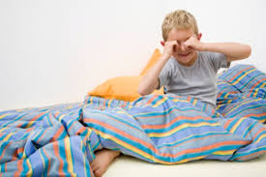
Get up

Slide 3

Get dressed

Slide 4
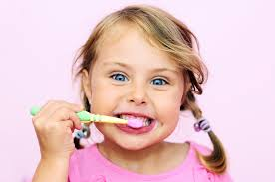
Brush your teeth

Slide 5

Eat breakfast

Slide 6

Go to school

Slide 7
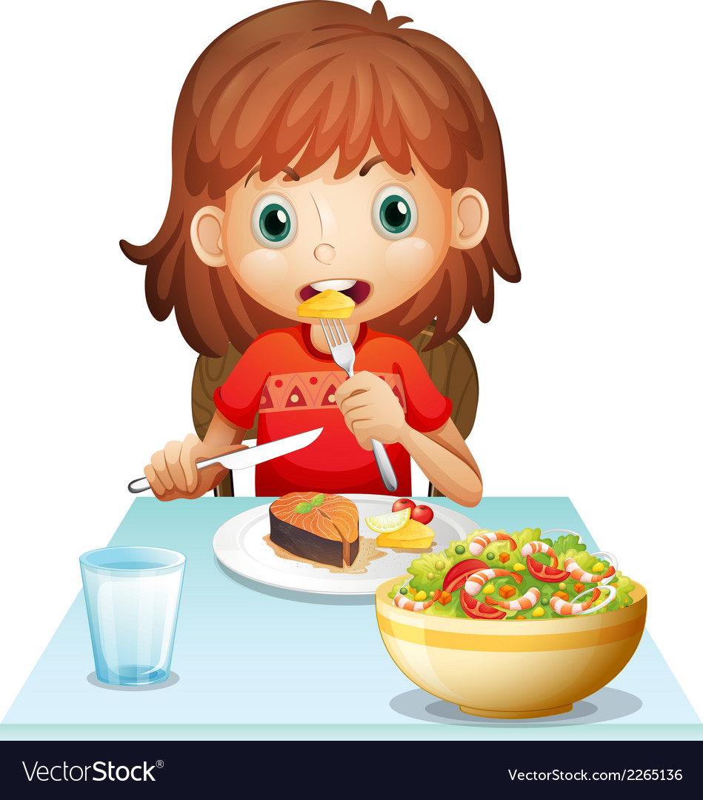
Eat lunch

Slide 8

Play at the park

Slide 9


The sun comes down –out comes the moon

Slide 10
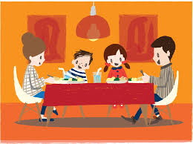
Eat dinner

Slide 11

Have a shower

Slide 12

Read a book

Slide 13
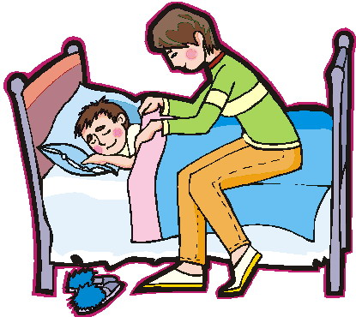
Go to bed

