Slide 1
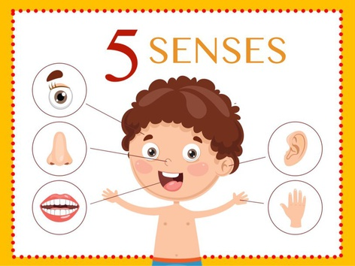
Five senses

Slide 2
