Slide 1
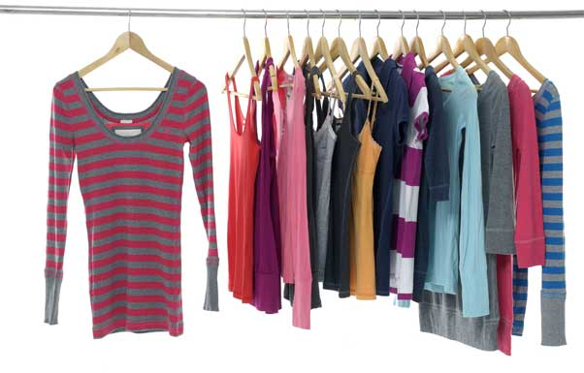
Cothes
What is it made of? (material)

Slide 2
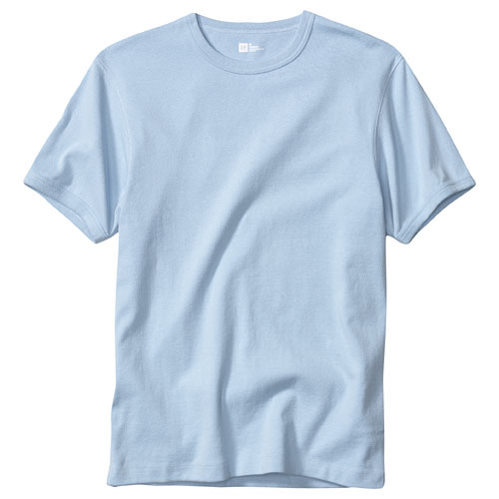
This is a ______.

Slide 3
This is a cotton T-shirt.

Slide 4
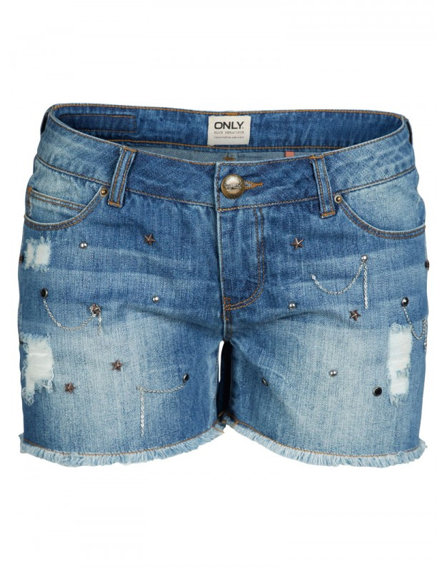
These are some _______

Slide 5
These are some denim shorts.

Slide 6
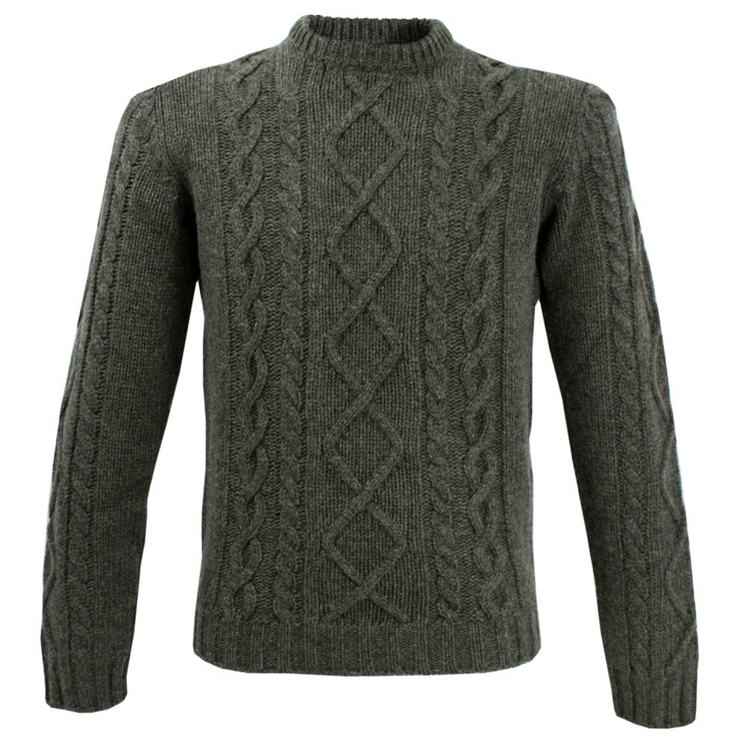
This is a grey _______.

Slide 7
This is a grey woolen jumper.

Slide 8
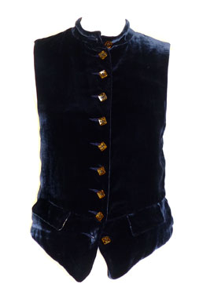
This is a blue ________.

Slide 9
This is a blue velvet waistcoat.

Slide 10
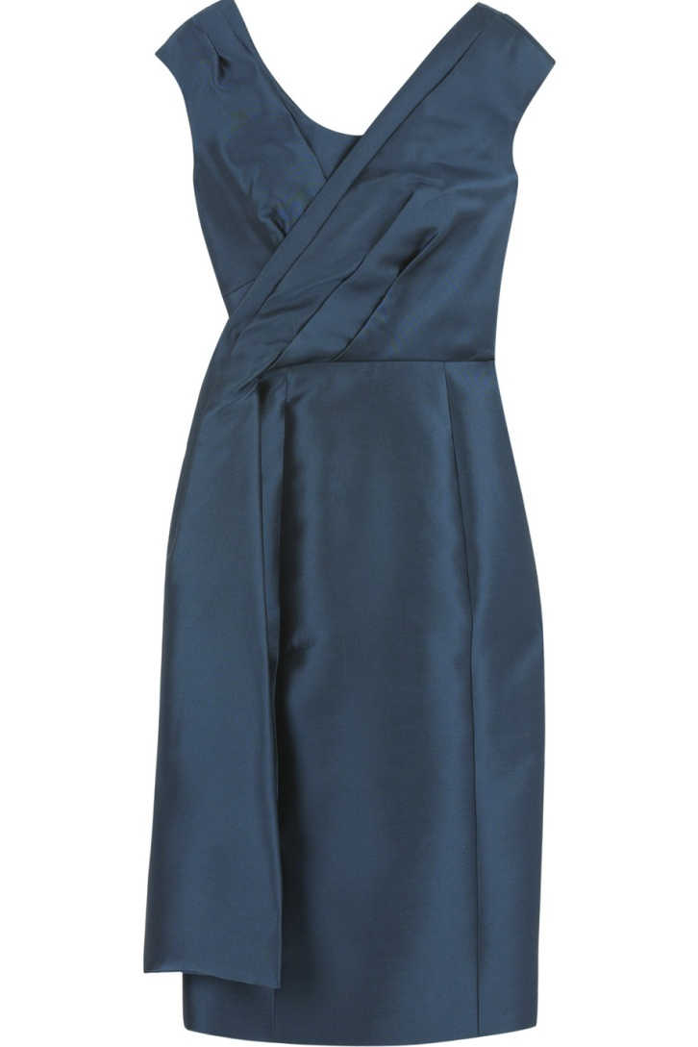
This is a __________

Slide 11
This is a silk dress.

Slide 12
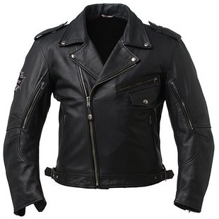
This is a ______.

Slide 13
This a leather jacket.

Slide 14
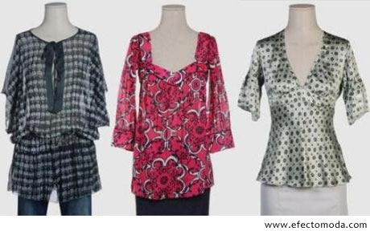
What is the pattern?

Slide 15
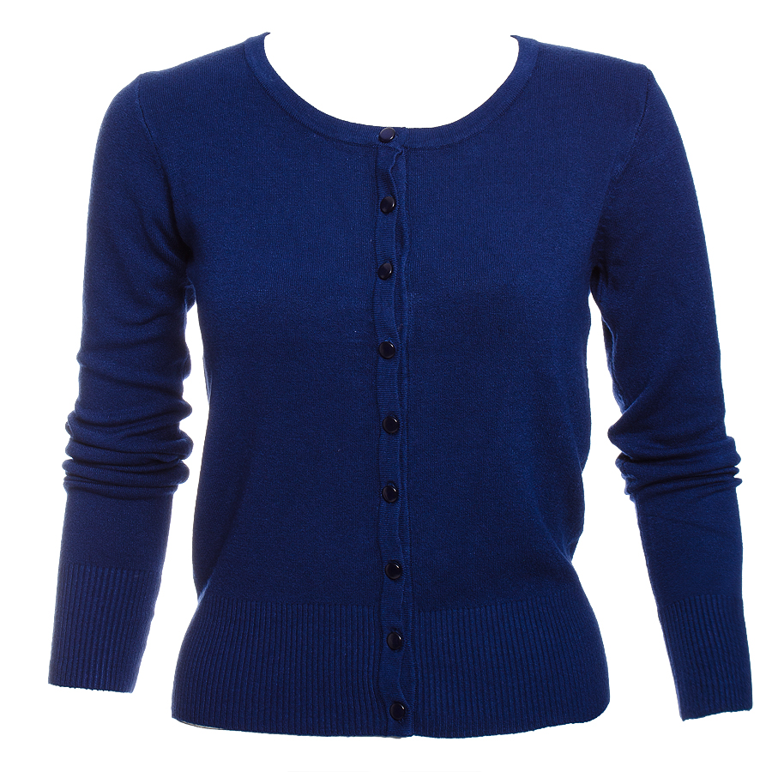
This is a _____ blue ______.

Slide 16
This is a plain blue cardigan.

Slide 17
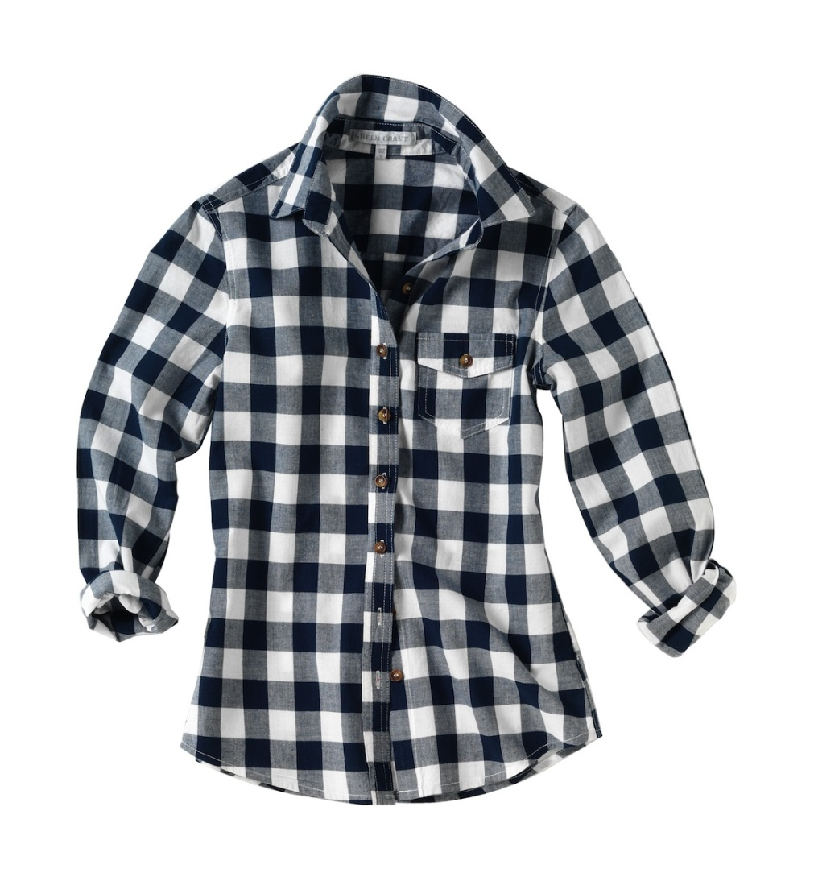
This is a _________

Slide 18
This is a checked shirt

Slide 19
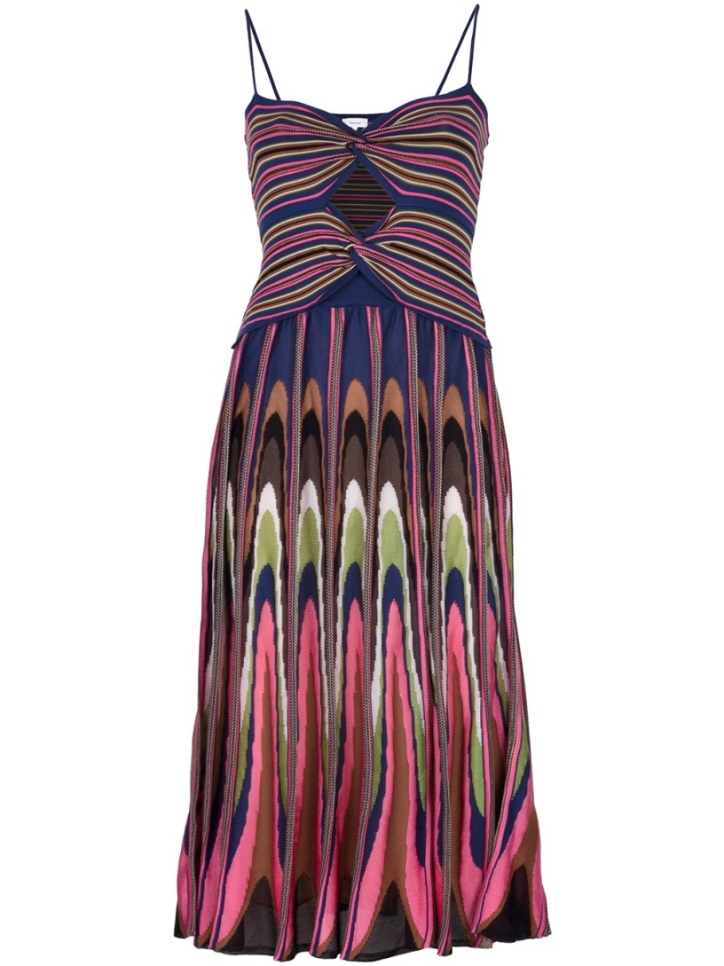
This is a _______ .

Slide 20
This is a patterned dress

Slide 21
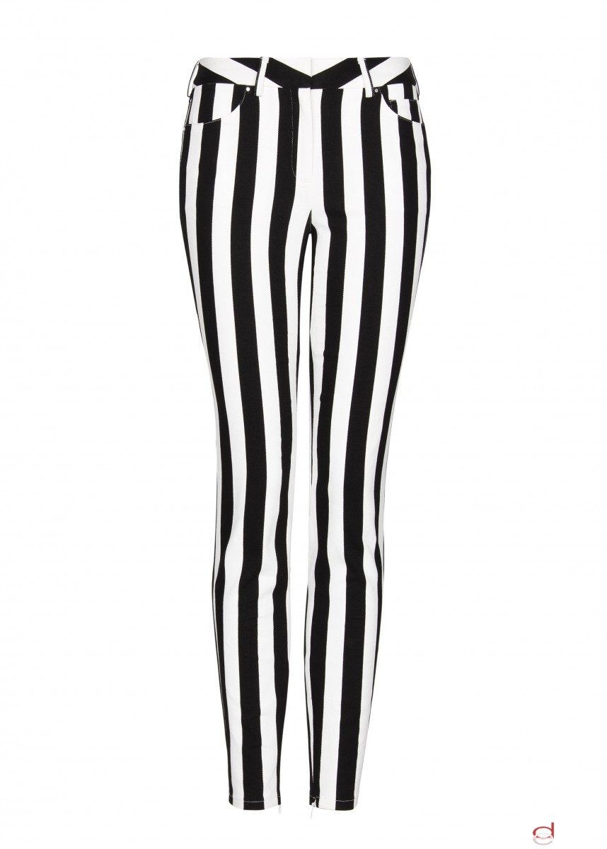
This is a pair of _________

Slide 22
This is a pair of striped trousers.

Slide 23
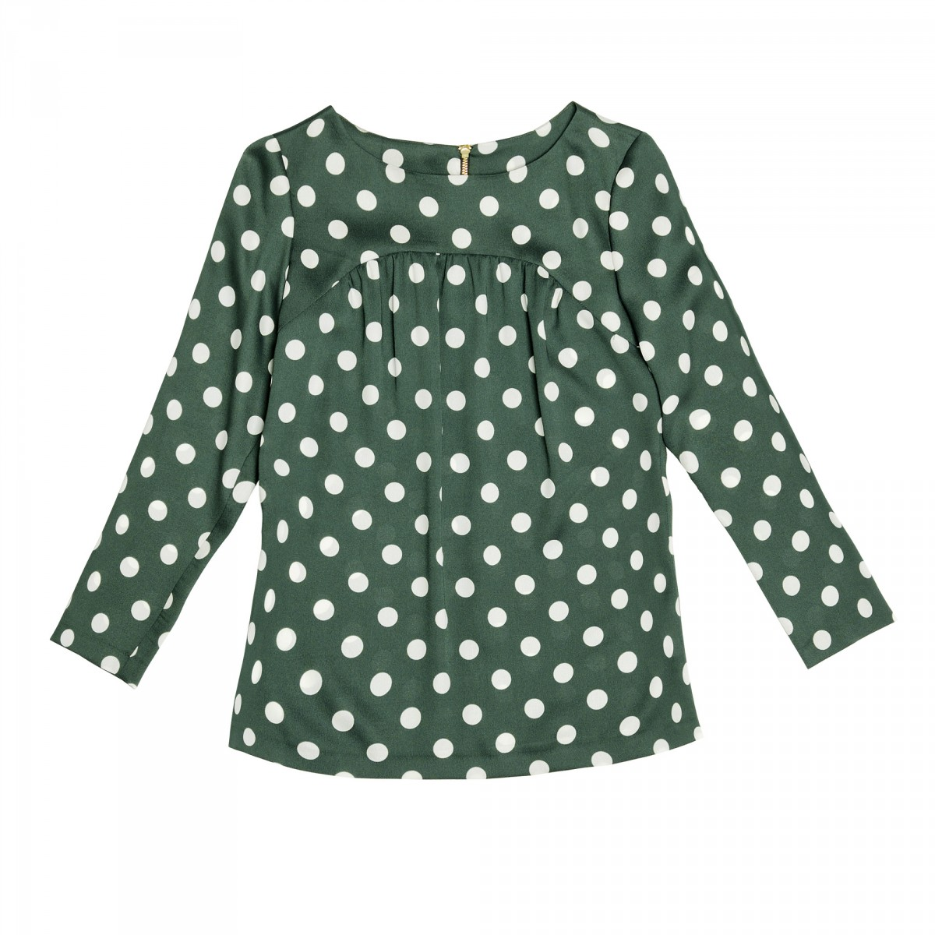
This is a _______ .

Slide 24
This is a polka dotted blouse.

