Slide 1
CLOTHES, PATTERNS, MATERIALS & STYLES VOCABULARY

Slide 2
CLOTHES

Slide 3
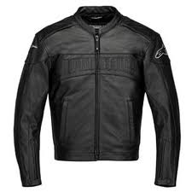
JACKET

Slide 4
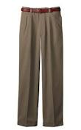
PANTS / TROUSERS

Slide 5
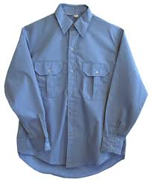
SHIRT

Slide 6
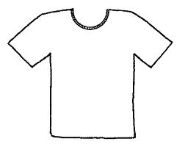
T-SHIRT

Slide 7
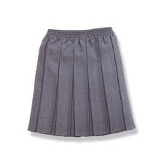
SKIRT

Slide 8
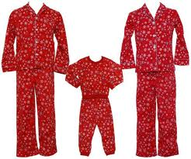
PYJAMAS

Slide 9
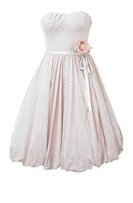
DRESS

Slide 10
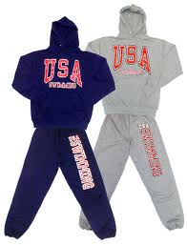
SWEATSHIRTS AND SWEATPANTS

Slide 11
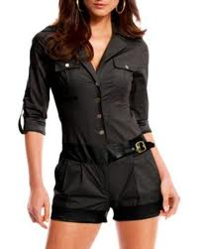
JUMPSUIT

Slide 12
STYLES

Slide 13
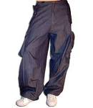
BAGGY PANTS

Slide 14
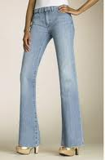
BOOTCUT JEANS

Slide 15
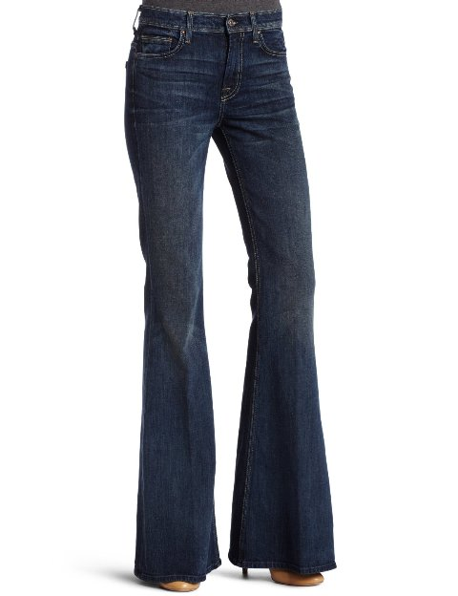
FLARED
PANTS

Slide 16
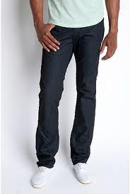
FITTED
PANTS

Slide 17
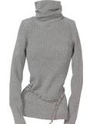
TURTLENECK

Slide 18
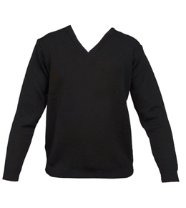
V-NECK

Slide 19
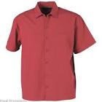
SHORT-SLEEVED

Slide 20
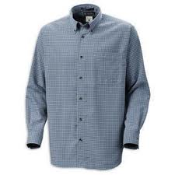
LONG-
SLEEVED

Slide 21
MATERIALS

Slide 22
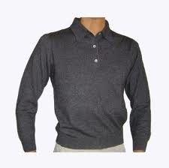
WOOL / CASHMERE

Slide 23
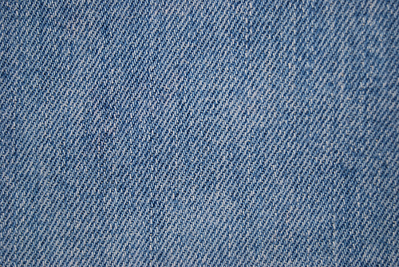
DENIM

Slide 24

SILK / SATIN

Slide 25
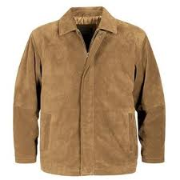
SUEDE

Slide 26
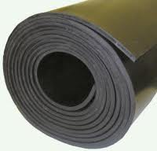
RUBBER

Slide 27
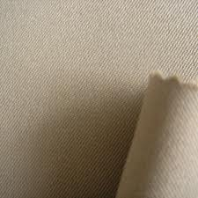
POLYESTER

Slide 28
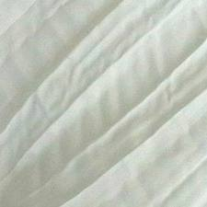
COTTON

Slide 29
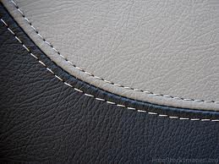
LEATHER

Slide 30
PATTERNS

Slide 31
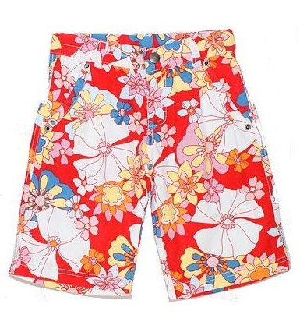
FLORAL PRINT

Slide 32

POLKA-DOTTED

Slide 33
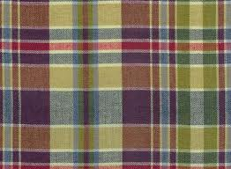
PLAID/CHECKED

Slide 34

STRIPED

Slide 35
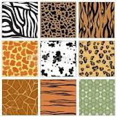
ANIMAL PRINT

