Slide 1

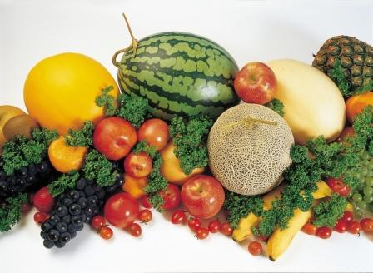
I Like Fruit
Copyright 2010 abcteach.com

Slide 2
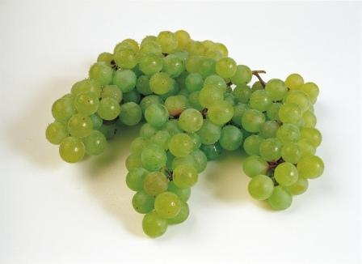
I like grapes.
Copyright 2010 abcteach.com

Slide 3
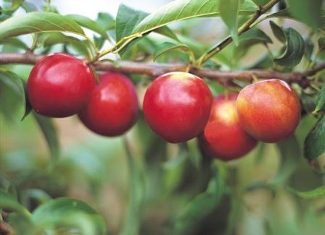
I like apples.
Copyright 2010 abcteach.com

Slide 4
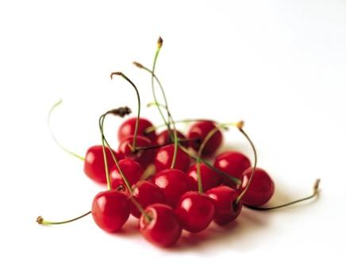
I like cherries.
Copyright 2010 abcteach.com

Slide 5
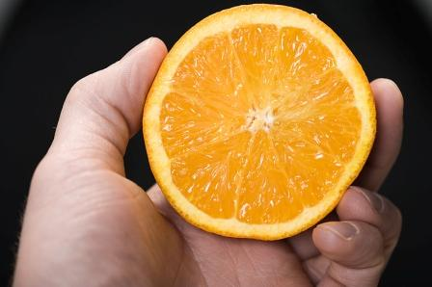
I like oranges.
Copyright 2010 abcteach.com

Slide 6
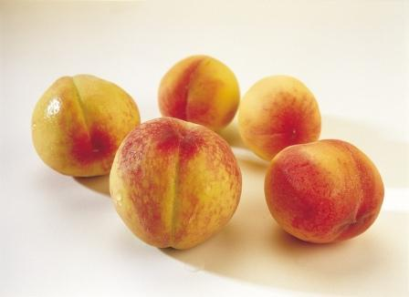
I like peaches.
Copyright 2010 abcteach.com

Slide 7
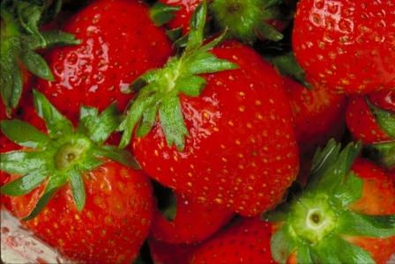
I like strawberries.
Copyright 2010 abcteach.com

Slide 8
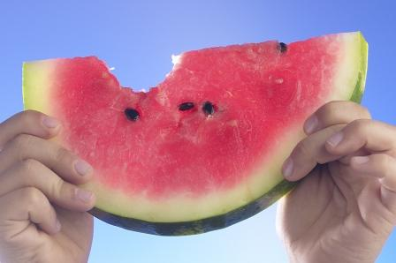
I like watermelon.
Copyright 2010 abcteach.com

Slide 9
I like fruit.
Mmm…
http://members.abcteach.com/content/i/i_like_fruit_color_bw.pdf
http://members.abcteach.com/content/i/i_like_fruit_color.pdf
Copyright 2010 abcteach.com

