Slide 1

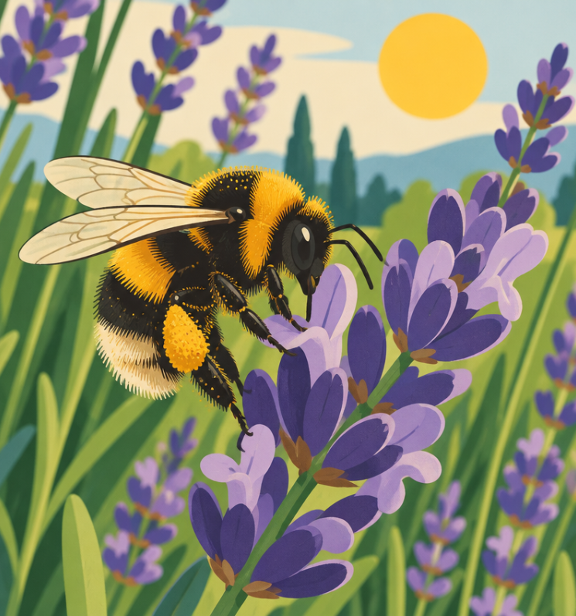
Busy Bees
Nature's tiny helpers

Slide 2
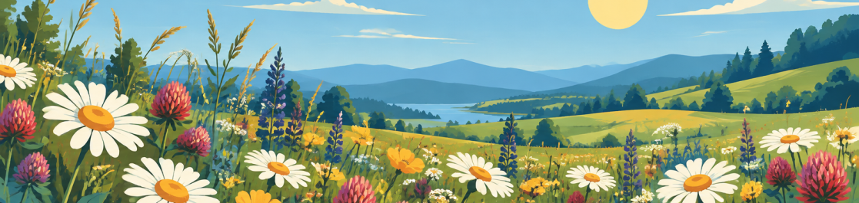
A World Without Buzz?
Imagine a garden with no buzzing insects!
Without bees, many of our favourite sweet fruits and colourful flowers could not grow at all.

Slide 3
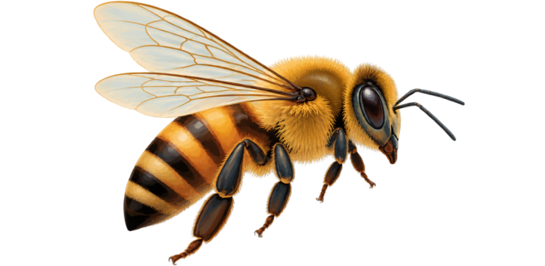

Key Words
Fly - To move smoothly through the air using wings.
Flowers - The colourful parts of plants that make seeds and sweet nectar.

Slide 4
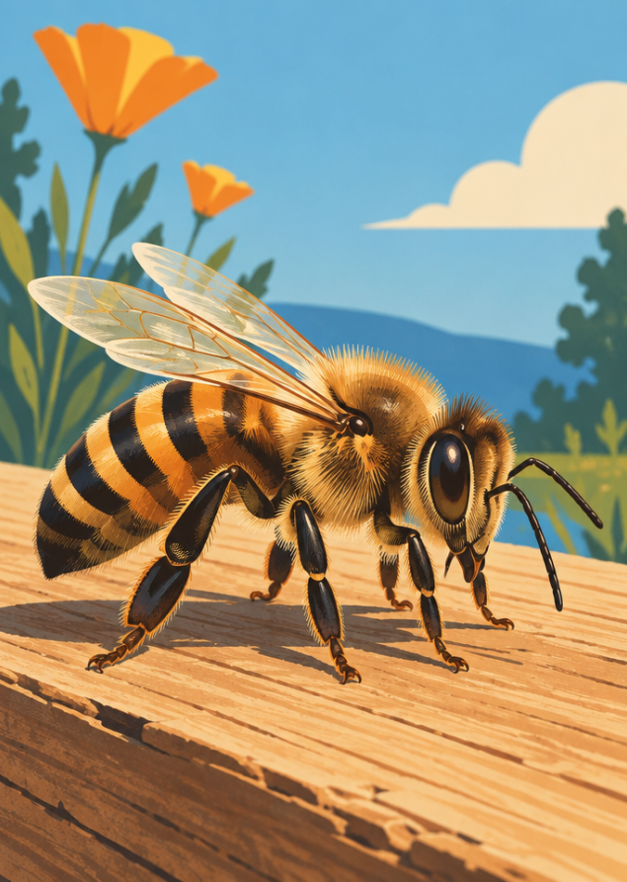
Meet the Honeybee
A bee is a tiny insect with six legs and four wings.
Its body has bright yellow and black stripes.
Tiny hairs cover its body to collect yellow dust called pollen.

Slide 5
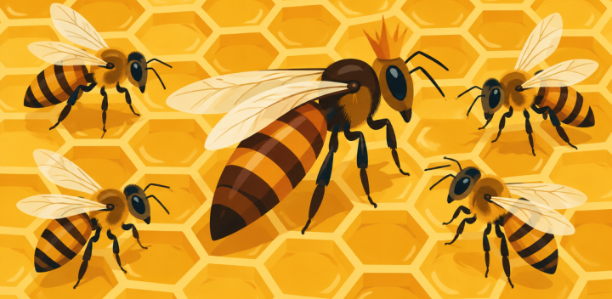
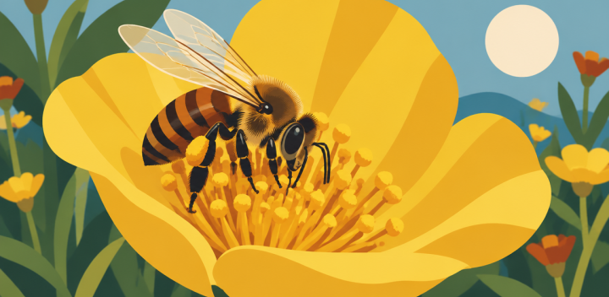
Life in the Hive
The Queen
One special mother bee lays every egg for the entire colony.
The Workers
Female bees fly outside, gather food, and protect their home.

Slide 6
Hive Check
Who lays all the eggs inside the hive?
1.
The Queen bee
2.
The Worker bee
3.
A butterfly
4.
A garden bird

Slide 7
Hive Check
✅
Who lays all the eggs inside the hive?
✓
1.
The Queen bee
2.
The Worker bee
3.
A butterfly
4.
A garden bird

Slide 8
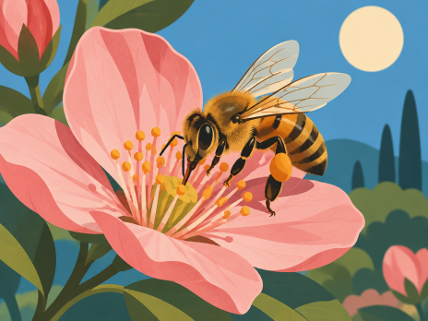
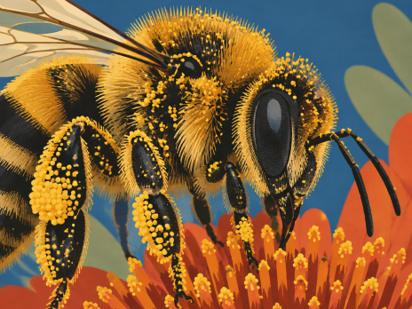
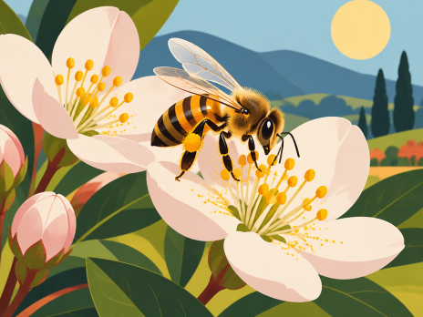
Pollination Steps
1. Drink
A bee visits a bloom to sip sweet nectar.
2. Stick
Sticky yellow pollen dust clings to its hairy coat.
3. Share
The bee flies onwards, helping new seeds grow.

Slide 9
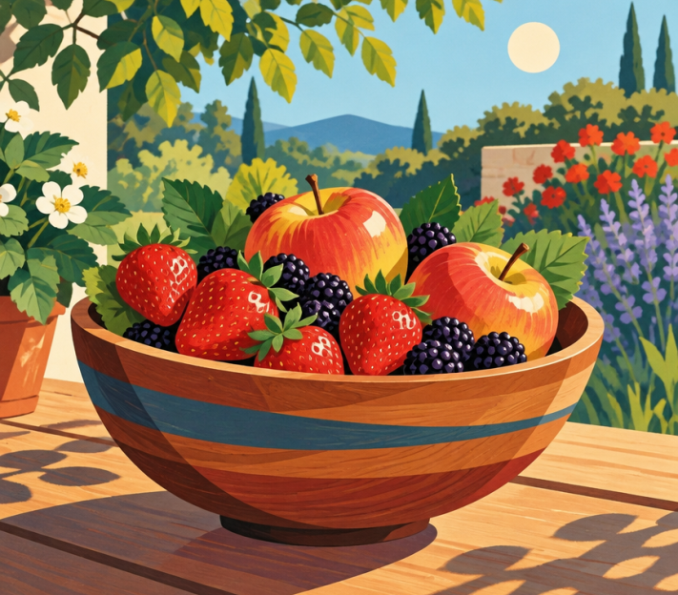
Why Bees Matter
Bees help feed people and animals across our planet!
Apples, strawberries, and carrots need bees to grow.
They keep nature healthy, colourful, and green.
🧠
Remember
Every third mouthful of food relies on pollinators!

Slide 10
Helping Our Bees
1
Plant colourful flowers in garden pots or window boxes.
2
Provide fresh water in a shallow dish with clean pebbles.
3
Be gentle and kind whenever you watch them at work outside.

Slide 11
Bee Hero Review
Bees help our environment grow healthy food and flowers.
👍 TRUE
👎 FALSE
🤔 Be ready to explain your thinking.

Slide 12
Bee Hero Review
✅
Bees help our environment grow healthy food and flowers.
✓
👍 TRUE
👎 FALSE
🔑 Why is that?
They carry pollen between blossoms as they fly

