Slide 1
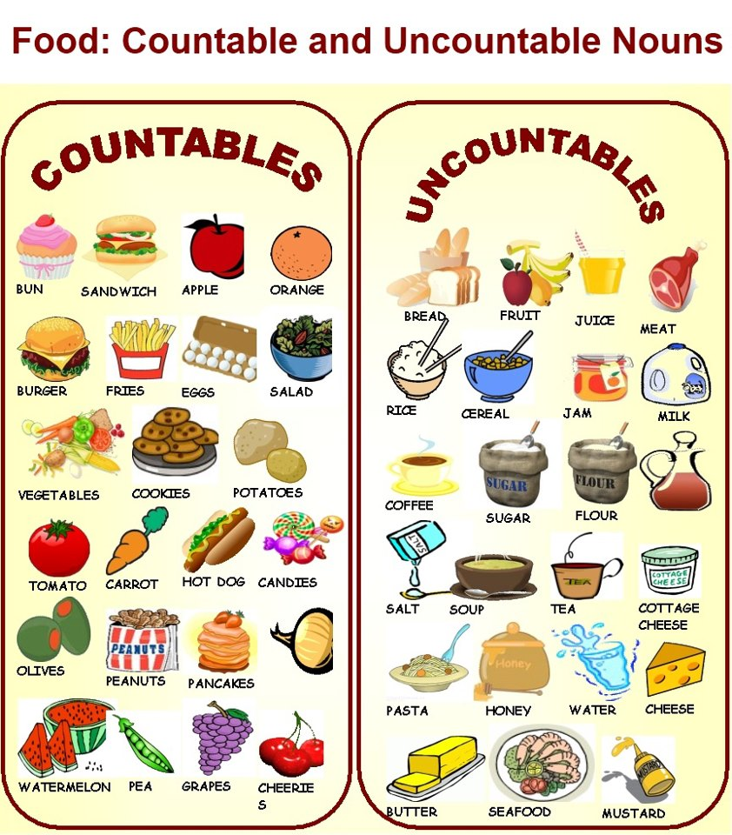


Maria Stalia
Class 6
27th primary school of
Thessaloniki

Slide 2
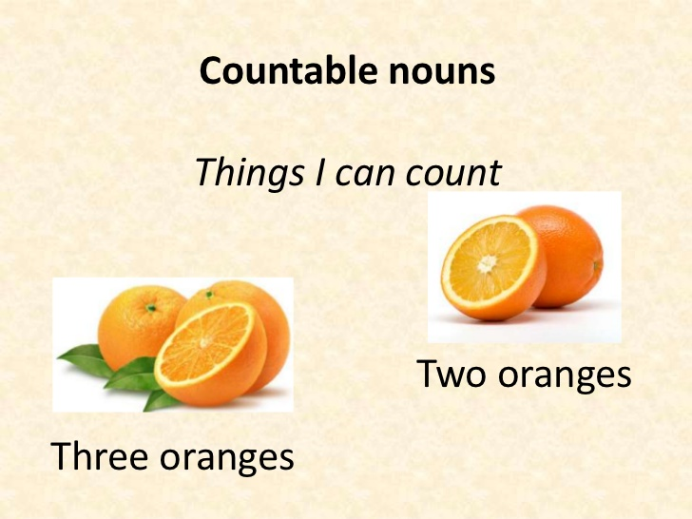
What do we mean by this?
Countable
Countable nouns
are the things that we can count
A book
An apple
1,2,3...books
1,2,3... Bananas
1,2,3... Apples
1,2,3... Houses
1,2,3... dolls

Slide 3
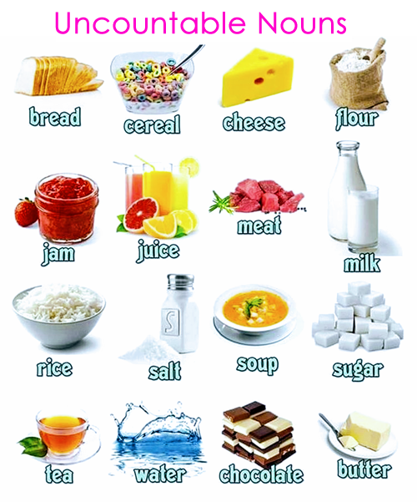

What do we mean by this?
Uncountable nouns
Uncountable
are the things that we can’t count
Liquids (water, wine, beer , coffee , tea etc.)
Chocolate
Sugar
Butter
Toothpaste
Salt, pepper
Cereal
Pasta
Cheese
Meat
Money
Hair

Slide 4
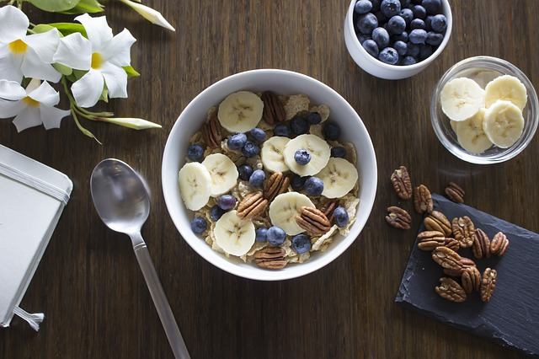
Uncountable nouns
Instead of using a or an, there are some phrases to show the weight, the package, the container, etc.
A glass of
A bottle of
A bowl of
A carton of
A tube of
A box of
A packet of
A kilo of

Slide 5
Countable and uncountable nouns
Some(μερικά)
Any (καθόλου)
We use some in affirmative
We’ve got some books in the bookcase.
We need some sugar for the cake.
Exception: Would you like some tea?
We use a lot of/lots of in affirmative
A lot of/lots of (πολλοί/-ές-ά/πολύ)
Mary has got a lot of/lots of dresses
Mum has got a lot of/lots of bread
We use any in questions
Have you got any apples?
Do you need any flour?
We use any in negative
I haven’tgot any pencils in my bag
She hasn’t got any milk in her glass

Slide 6
Quantifiers
Countable
Uncountable
Many (negative + questions)
Have you got many friends here?
I haven’tgot many oranges in the fridge
How many? (questions)
How many balloons has she got?
A few(=αρκετά) (questions + affirmative)
I’ve got a few muffins. Let’s eat them!
Have you got a few minutes?
Few(=σχεδόν καθόλου) (affirmative)
We’ve got few strawberries. We can’t make a cake.
Much (negative + questions)
Have you got much coffee?
I haven’t got much tea.
How much? (questions)
How much money have you got?
A little (=αρκετό) (questions + affirmative)
Mum has got a little butter. She can make a cake
Can I have a little water, please?
Little(=σχεδόν καθόλου)
I’ve got little sugar. I can’t make a cake.

