Slide 1

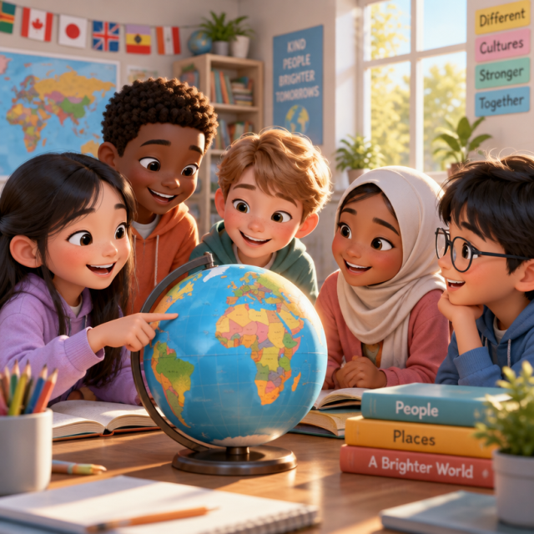
Meeting the Newcomers
Discovering stories and cultures from new friends around the world.

Slide 2

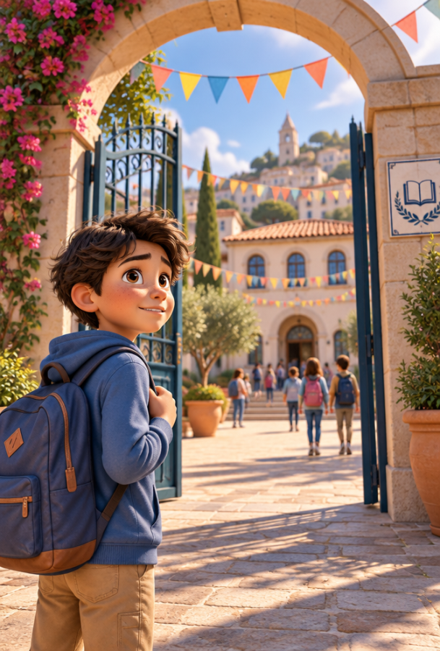
A Brand New Beginning
Imagine arriving at a brand new school where everyone speaks a different language. How would you feel walking through the gates on your very first morning?

Slide 3
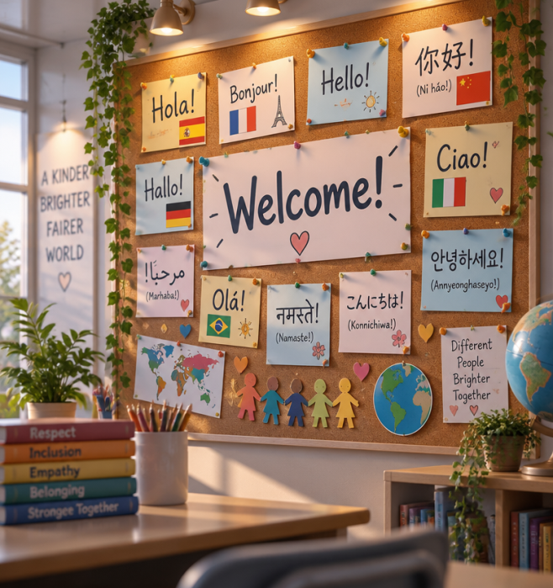
Our Goals Today
In this lesson, you will:
Explore real experiences shared by newly arrived classmates.
Understand geographic and environmental terms that describe their homelands.
Practise empathy and ways to offer a welcoming hand.

Slide 4
Key Vocabulary
Places & People
Newcomer: A person who has recently arrived.
Capital: The central city of government.
Border: The line separating countries.
Homeland: The native country you love.
Land & Challenges
Coast: Land meeting the sea or ocean.
Plain: A broad, flat expanse of land.
Environmental problems: Damage to nature.
Natural disasters: Sudden violent natural events.

Slide 5
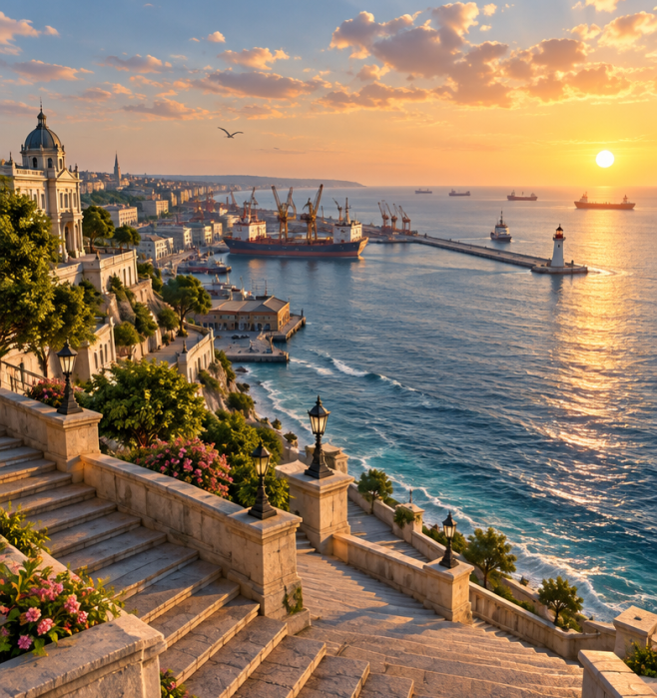
Sasha's Story: Ukraine
Sasha comes from Odessa, a historic port city on the Black Sea coast. Ukraine has wide agricultural plains, high Carpathian peaks, and the long Dnipro River flowing across it.
⚠️
Watch out
The 1986 Chernobyl nuclear disaster created lasting environmental problems, affecting safe drinking water supplies.

Slide 6
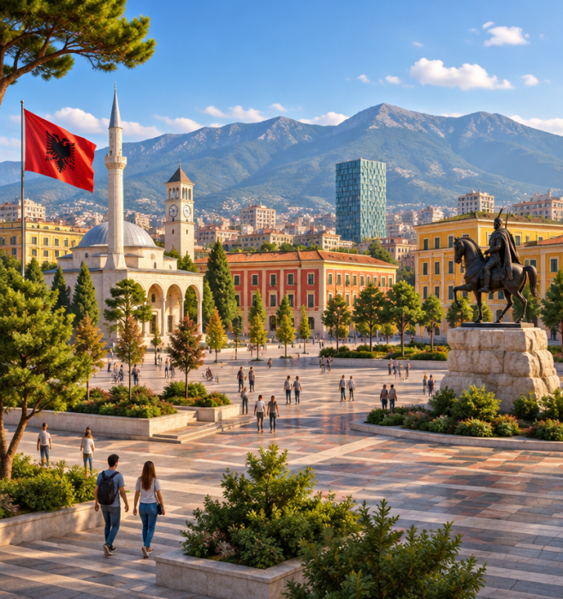
Christina's Story: Albania
Christina comes from Tirana, the lively capital of Albania. Her country shares borders with Greece, Montenegro, and Serbia, facing the Adriatic and Ionian seas with stunning beaches.
🧠
Remember
Albania faces natural disasters like earthquakes along its southern coast. Christina proudly recalls humanitarian Mother Teresa.

Slide 7
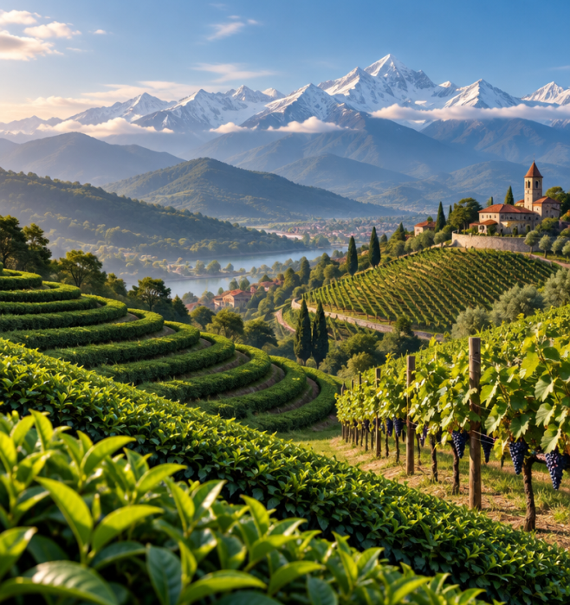
Georgi's Story: Georgia
Georgi's homeland sits between the Black Sea, Turkey, and Russia. Famous in Greek mythology as ancient Colchis, Georgia is celebrated for dramatic mountains and warm sunny weather.
🤯
Fun fact
Along the coastal valleys, farmers harvest lush tea plantations, fragrant citrus groves, and sweet grapes for juice.

Slide 8
Connecting Our Experiences
Shared Challenges
Many families move abroad to find work or build safer lives. Leaving home means missing familiar dishes, family traditions, and close childhood friends.
Building Belonging
Welcoming newcomers starts with simple acts: pronouncing names correctly, asking questions about their traditions, and inviting them to join lunchtime games.

Slide 9

Voices of the Newcomers
Listen to the audio and answer the questions
A Chat by the Lockers
▶ Play audio
1
What does Georgi miss most from his homeland?
2
Where does Georgi's uncle work?
3
What sport does Elena invite Georgi to play after school?
4
How did ancient Greeks refer to the sea near Georgia?

Slide 10
Voices of the Newcomers
✅
Check your answers below
A Chat by the Lockers
▶ Play audio
1
His uncle and the warm citrus groves along the coast.
2
He works in Tbilisi, the capital city of Georgia.
3
Elena invites him to play basketball in the school courtyard.
4
They called it Pontus Euxinos.

Slide 11

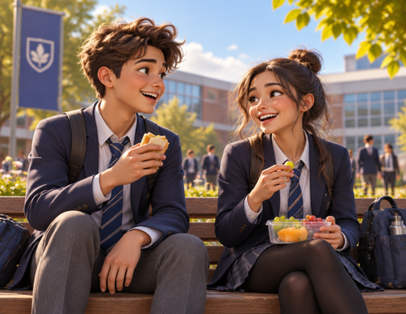
Creating a Welcoming School
Imagine a new pupil joins your class tomorrow from another country. What is one practical thing you and your classmates could do during their first week to help them feel at home?

Slide 12
Creating a Welcoming School
✅
You might have said...
Invite them to lunch or a game. Learn their name and ask about customs.
Offer a tour of the classrooms, library, and canteen.
Be patient and teach each other useful everyday words.

Slide 13
Welcoming New Classmates
A new pupil named Alex has just joined your 6th-grade class from abroad. Which action is the best way to help them feel comfortable during their first week?
1.
Avoid speaking to them until they have learnt enough English to start a conversation with you.
2.
Make sure you pronounce their name correctly and invite them to play basketball with your friends at lunchtime.
3.
Only talk to them when your teacher explicitly asks you to translate a task for them in class.
4.
Test their knowledge by asking them difficult questions about the history of their hometown right away.

Slide 14
Welcoming New Classmates
✅
A new pupil named Alex has just joined your 6th-grade class from abroad. Which action is the best way to help them feel comfortable during their first week?
1.
Avoid speaking to them until they have learnt enough English to start a conversation with you.
✓
2.
Make sure you pronounce their name correctly and invite them to play basketball with your friends at lunchtime.
3.
Only talk to them when your teacher explicitly asks you to translate a task for them in class.
4.
Test their knowledge by asking them difficult questions about the history of their hometown right away.

