Slide 1






Irregular verbs (in groups)

Slide 2



write drive ride wake wear steal get forget win
wrote drove rode woke wore stole got forgot won

Slide 3


begin drink swim sing ring run sit give come
began drank swam sang rang ran sat gave came

Slide 4


spend send build learn burn dream smell lose
spent sent built learnt burnt dreamt smelt lost

Slide 5



read put cut hurt cost hit set let
read put cut hurt cost hit set let

Slide 6



think teach catch bring buy fight
thought taught caught brought bought fought

Slide 7




know grow throw blow fly draw
knew grew threw blew flew drew

Slide 8

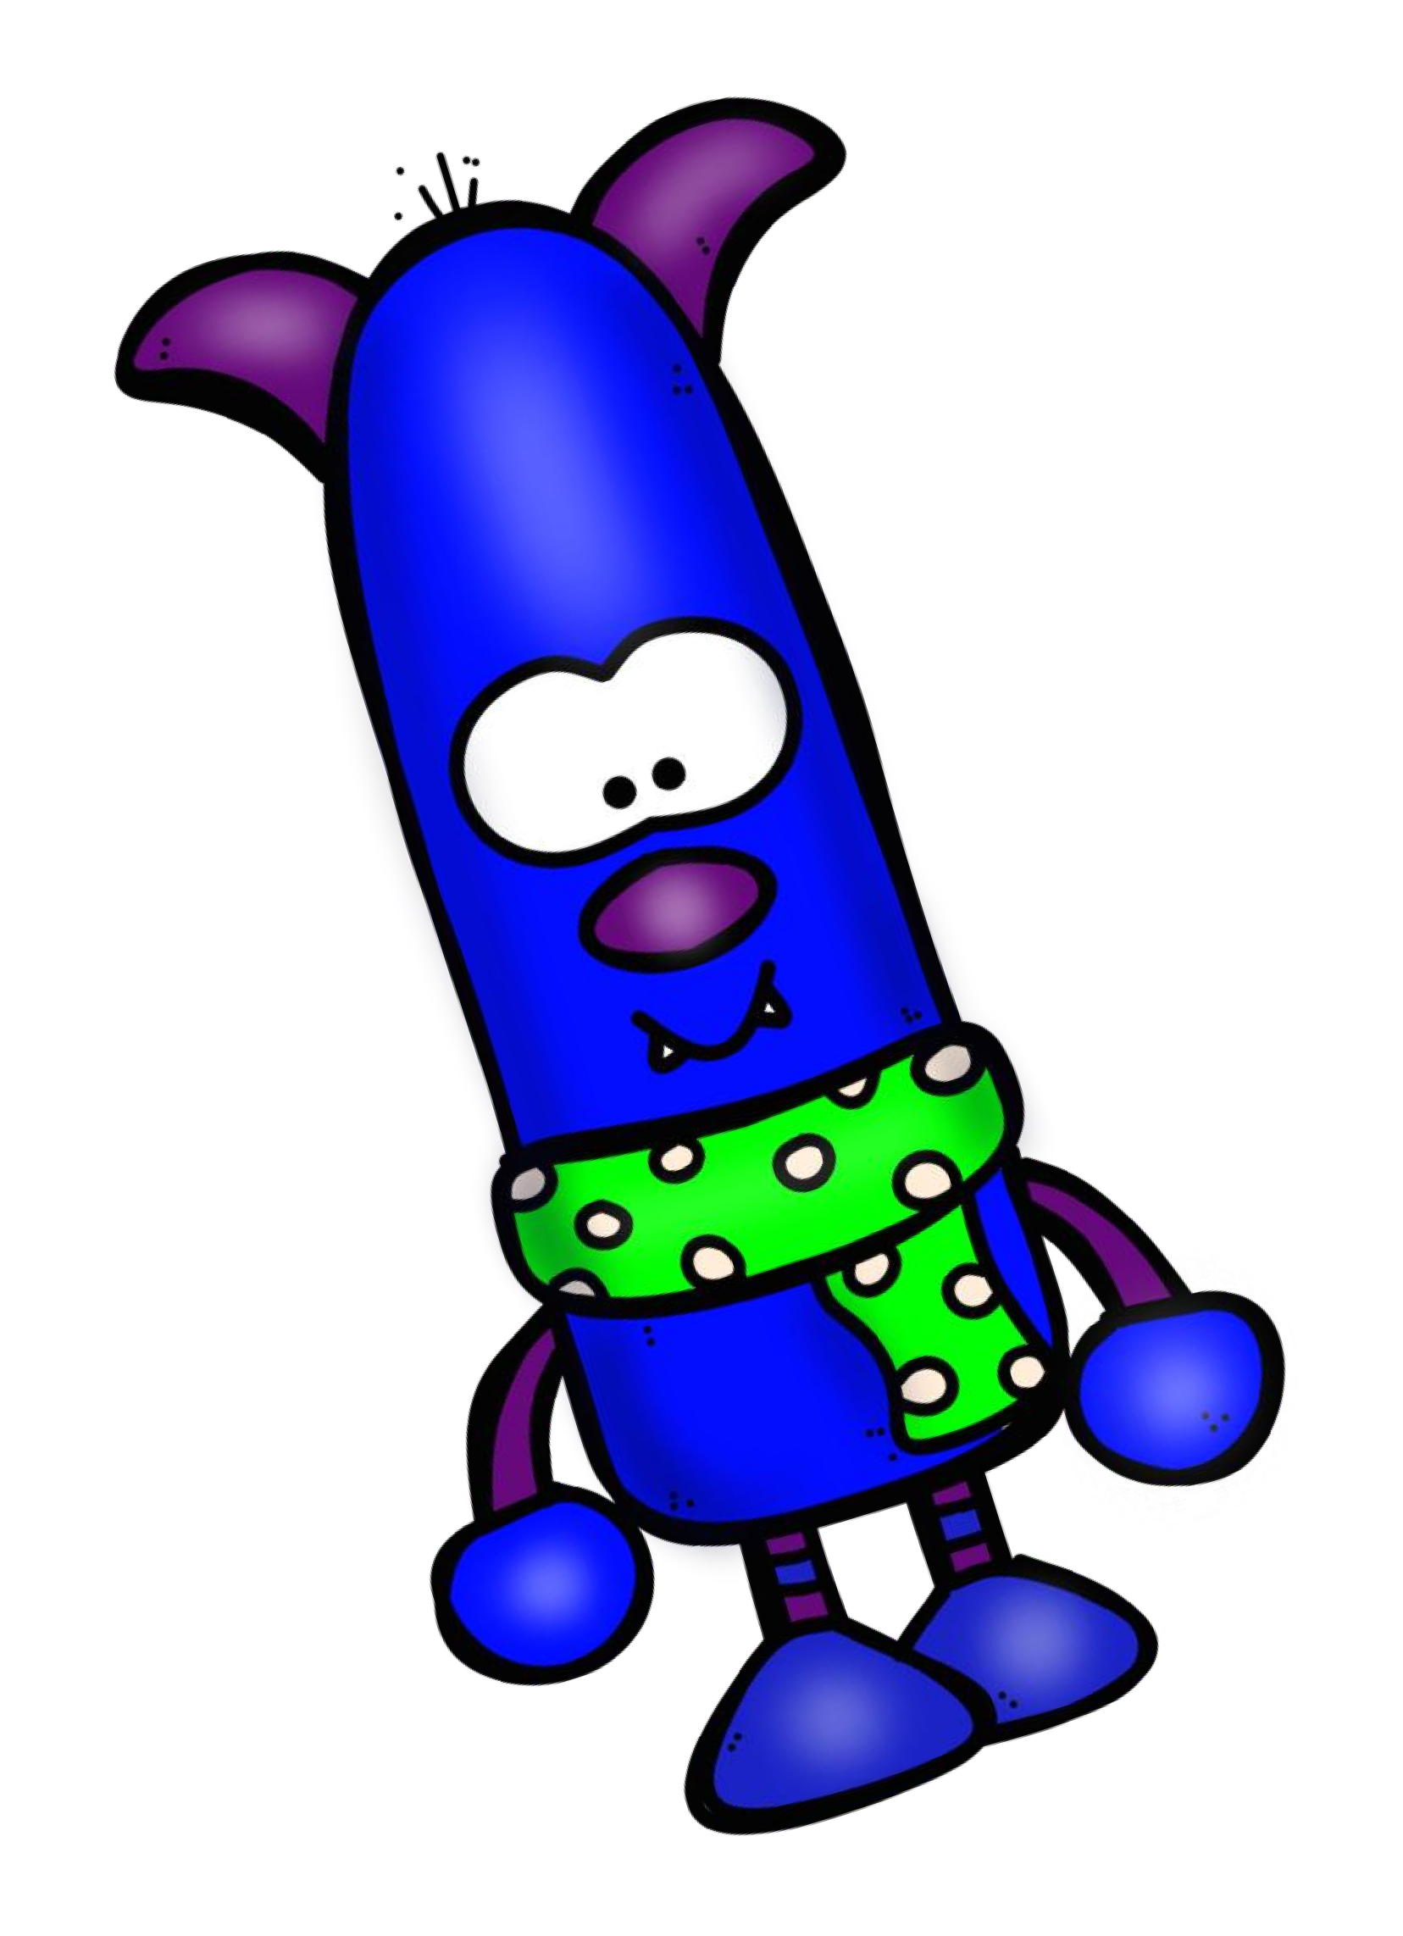
meet feed choose shoot
met fed chose shot

Slide 9


took mistook stood understood
take mistake stand understand

Slide 10


feel keep sleep leave
felt kept slept left

Slide 11


stuck hung dug stung
stick hang dig sting

Slide 12



said paid laid
say pay lay

Slide 13


sell tell
sold told

Slide 14



bite hide
bit hid

Slide 15


fell held
fall hold

Slide 16




be do have go
make eat see hear find light lie
was/were did had
went made ate saw heard found lit
lay

Slide 17


Thank you for downloading this
product!
Copyright © VouLa Papadimitriou 2020
Credits for cLipart, border, frames & backgrounds:

