Slide 1

How to write a Biography
English 6th Grade

Slide 2
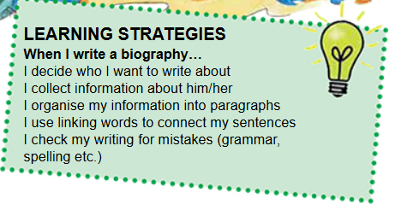
English 6th Grade, Pupil’s Book, Unit 4, Lesson 2, 3. Practice

Slide 3
The Parts of a Biography
Introduction
Name, Surname, Date and place of birth/death, profession
Early Years
Family, education
Career
Work, honors and awards
Personal Life
Extra information about their personal life
Impact
Why is this person important?

Slide 4
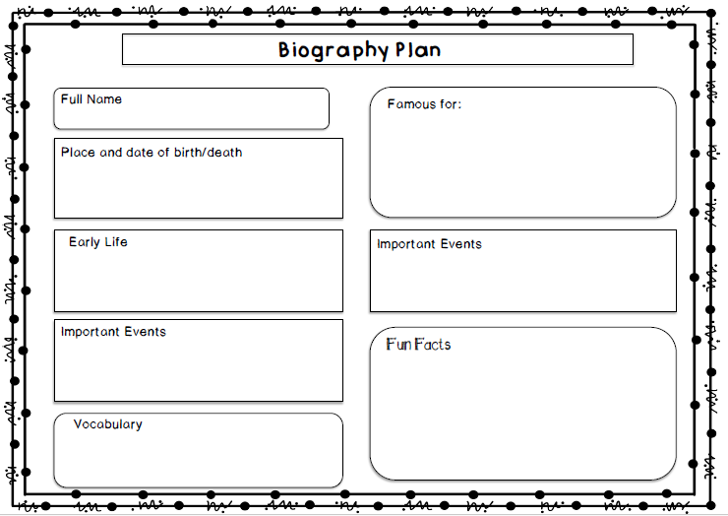
https://drive.google.com/file/d/1lgwEX04nqe9kZxbkp95h6Q-IR1XVM6qw/view

Slide 5
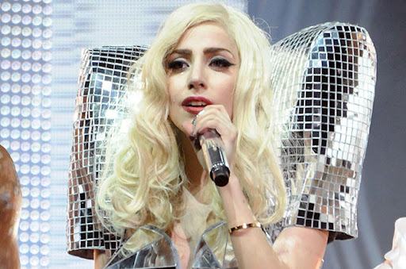
Time for a project!
https://view.genially.com/6073fbbfaa41800d2f2a51e9/horizontal-infographic-review-biographies-6th-grade

Slide 6
Thank you ☺

