Slide 3
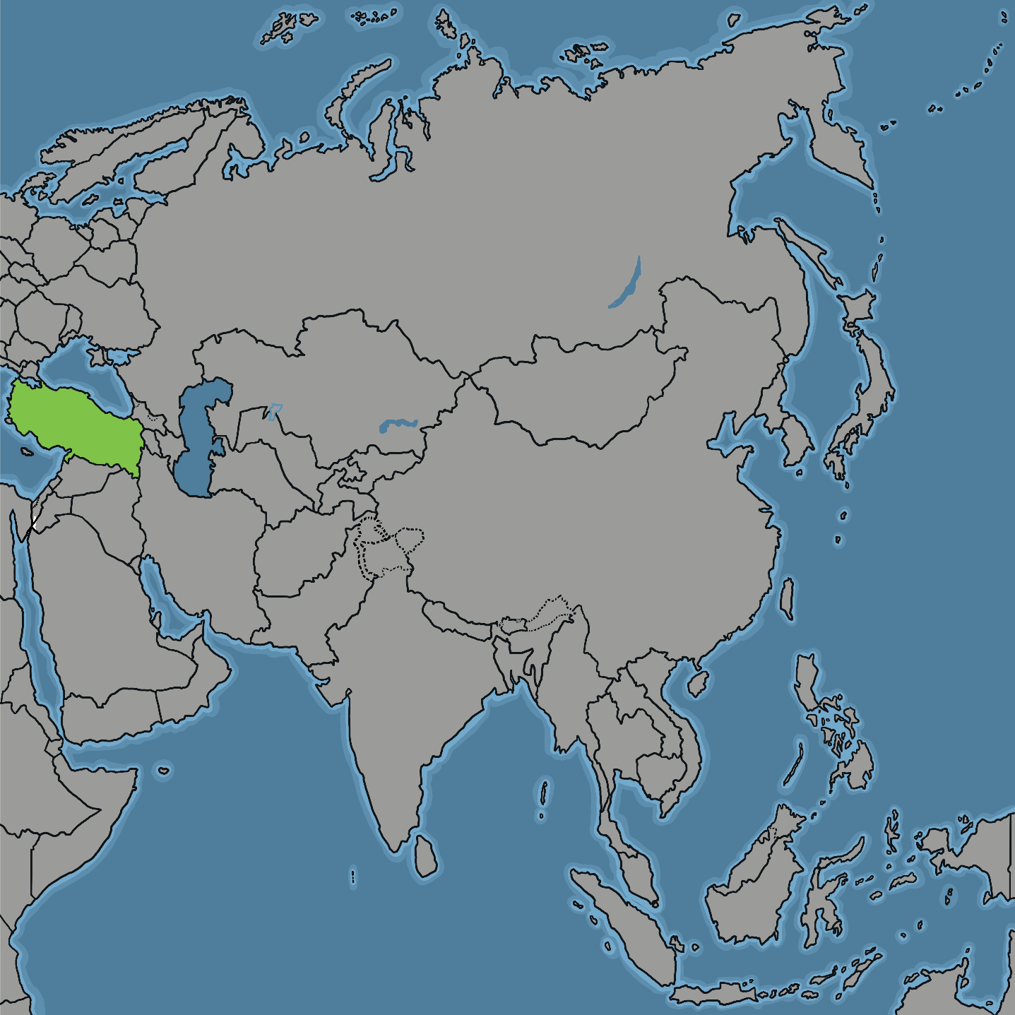
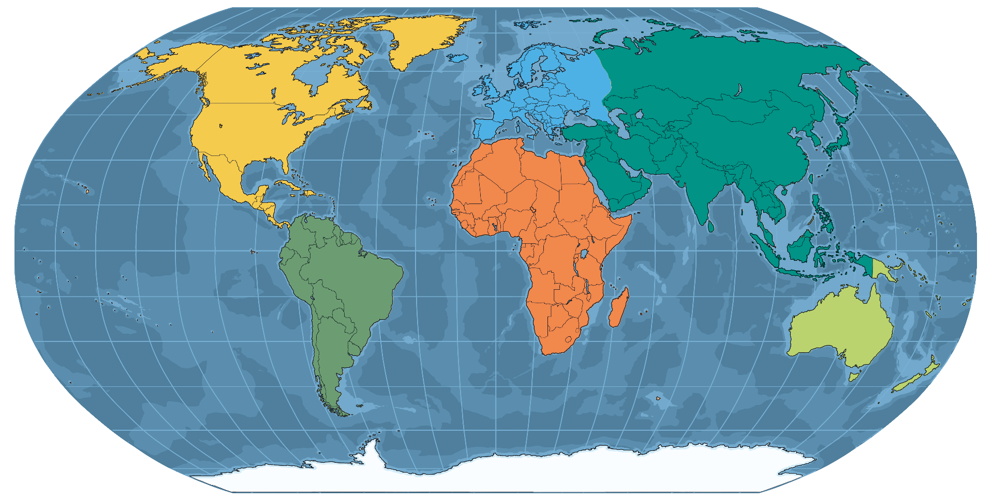
Where is Türkiye?
Türkiye is in two continents. Most of Türkiye is in Asia. It is also in Europe.

Slide 4
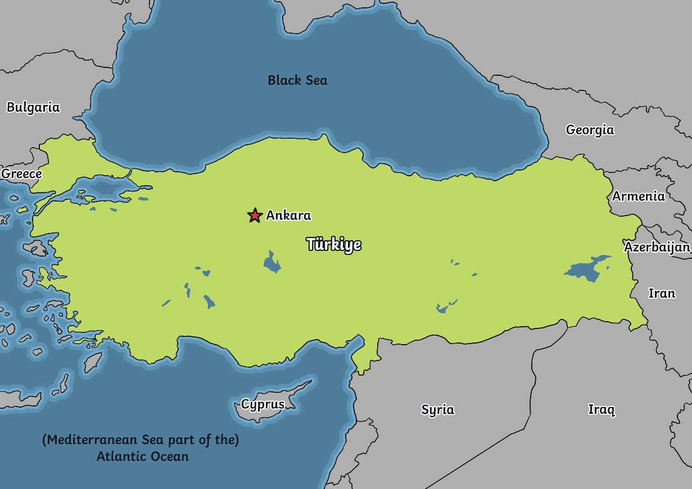
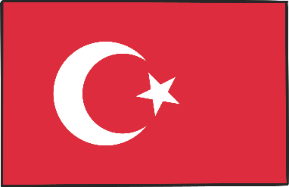
Where is Türkiye?
  Quick Facts
Capital City: Ankara
Population: 85 million (2023)
Currency: Turkish lira
Official Language: Turkish
Flag

Slide 5
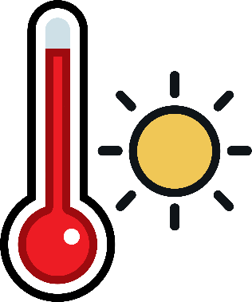
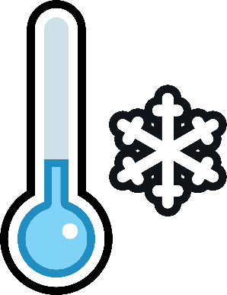

What is Türkiye’s climate like?
Summers in Türkiye are hot and dry.
Winters in Türikye are mild and wet.
The hottest months are July and August.
The average temperature is around 12°C (82.4°F).

Slide 6
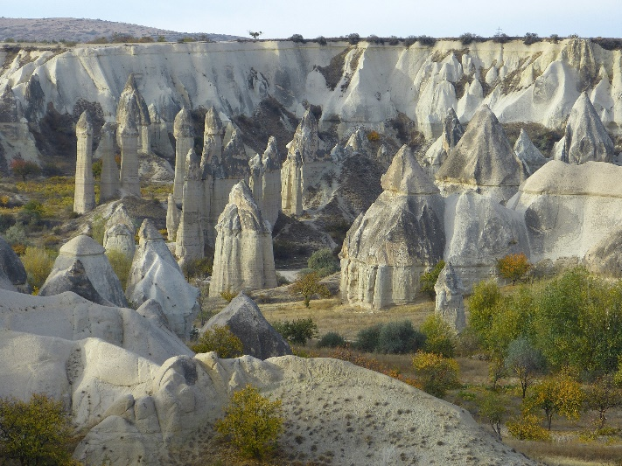
What landmarks can be seen?
A famous landmark is called the Fairy Chimneys.
The rocks were formed after a volcanic eruption.
Houses and churches have been carved out of the rock.

Slide 7
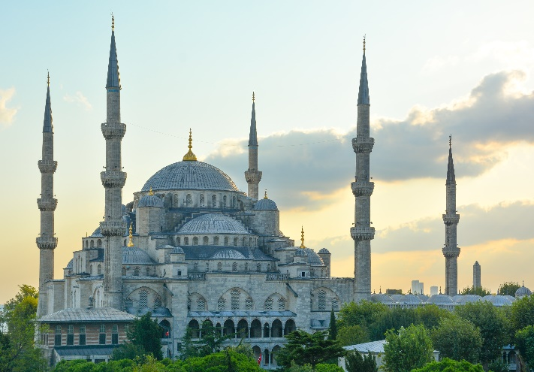
What landmarks can be seen?
The Blue Mosque is one of the most famous mosques in Türkiye.
Many people visit this mosque every year.
It has over 200 stained glass windows.

Slide 8
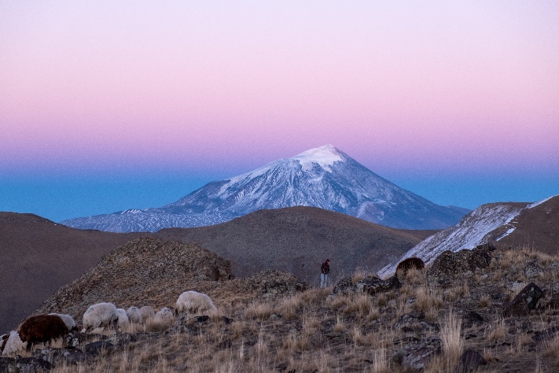
What is Türkiye’s landscape like?
There are lots of mountains in Türkiye.
Mount Ararat is the highest mountain peak.
It is 51737 metres (16,854 feet) tall.

Slide 9
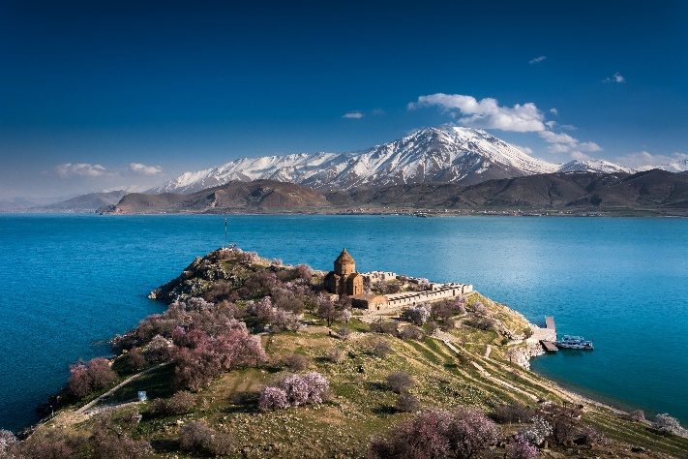
What is Türkiye’s landscape like?
Lake Van is the largest lake in Türkiye.
It is over 74 miles wide (119km) at its widest point.
The longest river that flows through Türkiye is the Euphrates.
It also flows through Syria and Iraq.

Slide 10
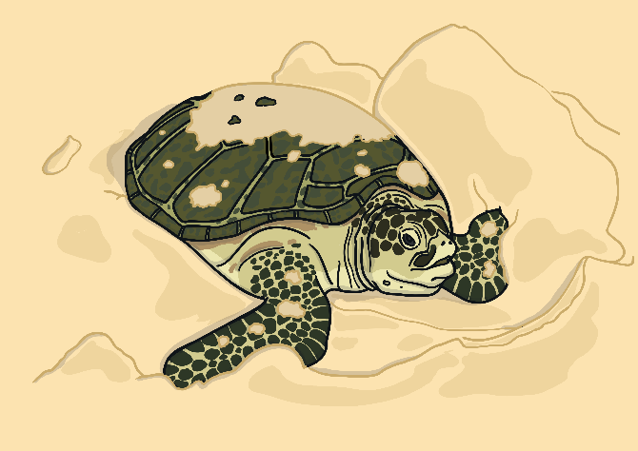
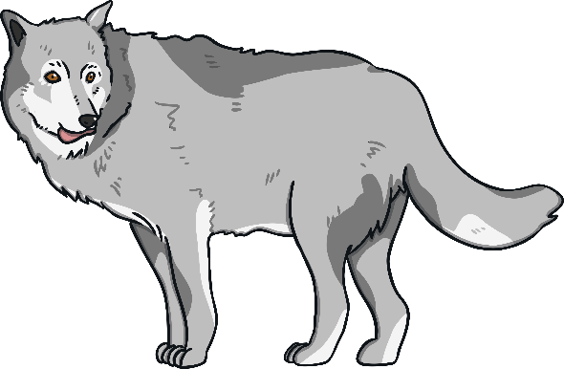
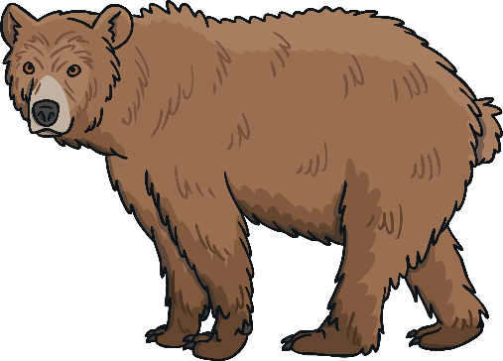

What wildlife live in Türkiye?
Sea turtles live in the seas surrounding Türkiye. They lay their eggs on the beaches.
Grey wolves live in the mountains and forests.
Brown bears live in the forests.
Other animals live in Türkiye such as lynx, mountain goats and wildcats.

Slide 11
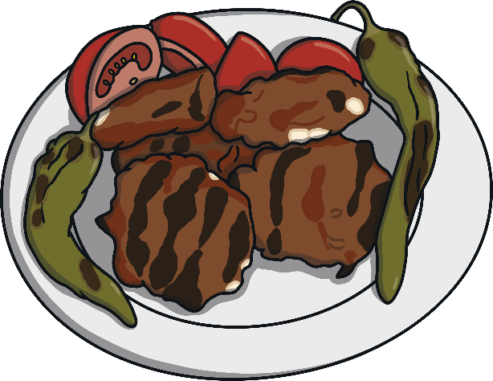
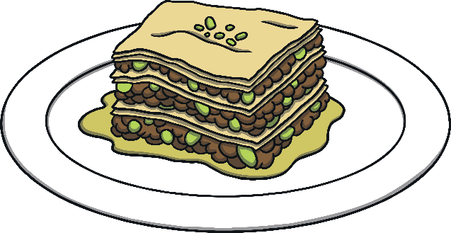
What food do people eat in Türkiye?
Türkiye is well-known for its flavourful food.
Köfte are meatballs made from lamb or beef and spices.
Baklava is a sweet dish. It is made from pastry with nuts and syrup.
Meze is a selection of dishes. They can include meat, fish or vegetables. Friends and family share the food.

Slide 12
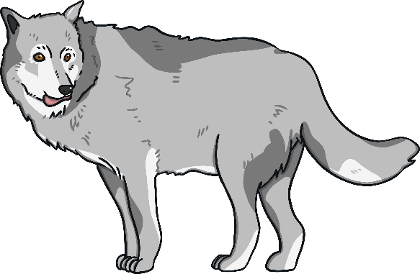
What are the national symbols of Türkiye?
The national flower of Türkiye is the tulip.
The national bird of Türkiye is the redwing.
The grey wolf is the national animal.
Türkiye celebrates its national day on 29th October.

Slide 13
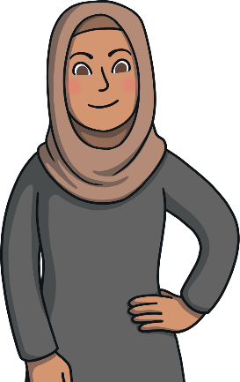
What religion do the people of Türkiye follow?
The majority of people that live there are Muslim. They follow the religion of Islam.

Slide 14
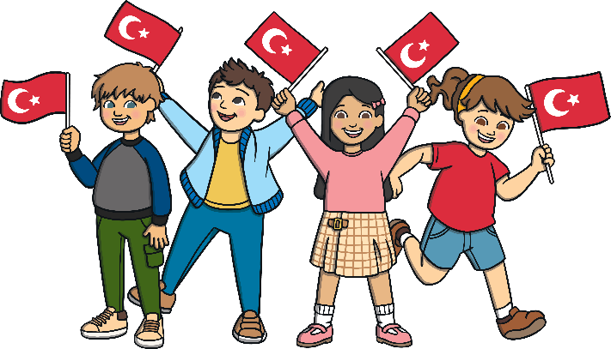
?
Interesting Facts
The largest city in Türkiye is Istanbul.
Turkiye is home to the world's second oldest underground railway.
Türkiye is a popular country that people visit for their holidays.
Hazelnuts grow in Türkiye.
Turkiye is actually part of two continents, Asia and Europe.

Slide 15
?
Quick Quiz
1. What is the capital of Türkiye?
Ankara
2. Which continent is Türkiye in?
Asia and Europe
3. Name two colours on the Turkish flag.
Red and white
4. What is the national animal of Türkiye?
Grey wolf
5. What is the official language of Türkiye?
Turkish

