Slide 1
Merry Christmas

Slide 2
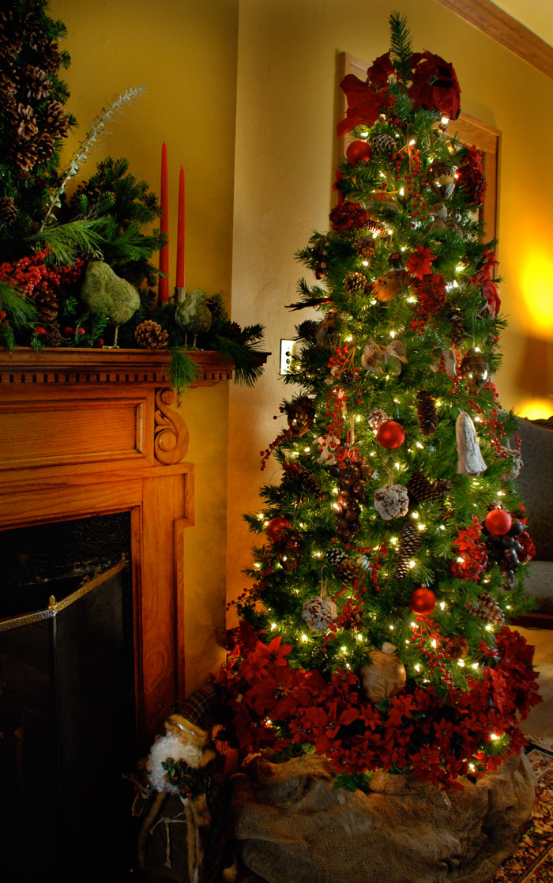
Christmas tree

Slide 3
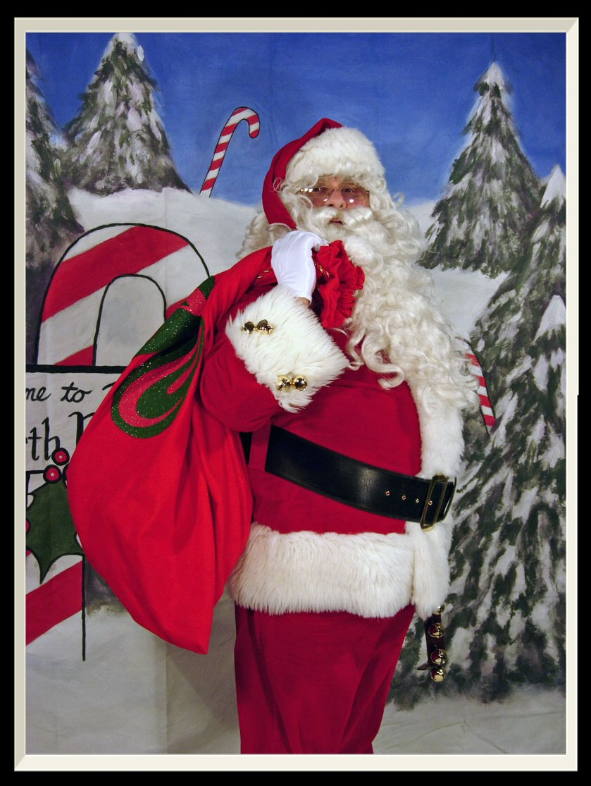
Santa klaoys

Slide 4
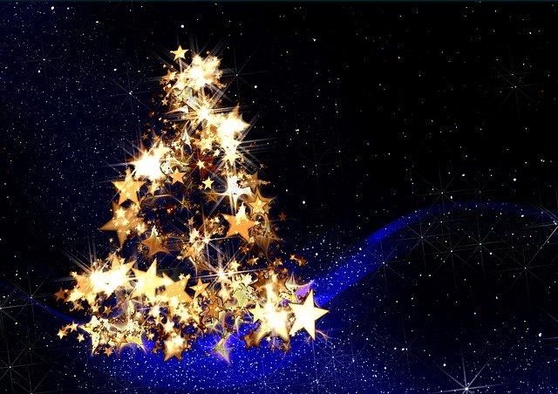
stars

