Slide 1

School Subjects
Agapi Dendaki

Slide 2

Language

Slide 3
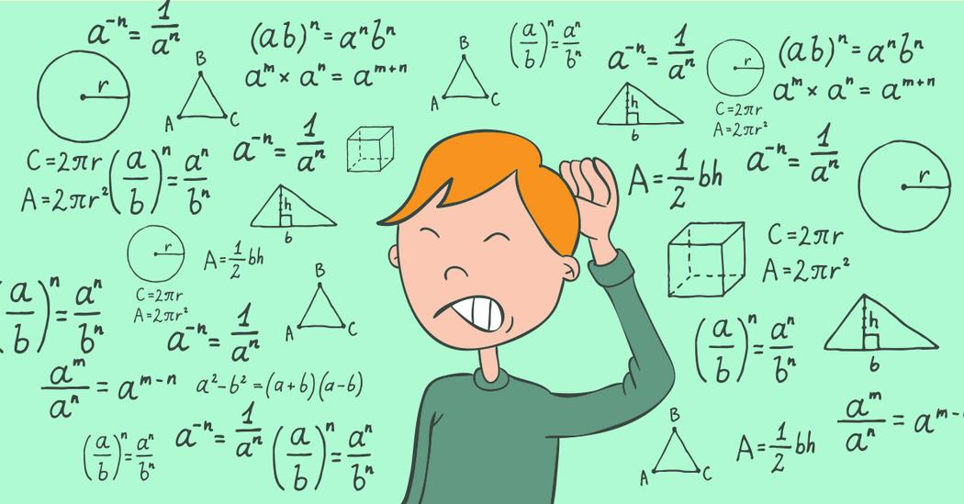
Maths

Slide 4

English/French

Slide 5

Geography

Slide 6
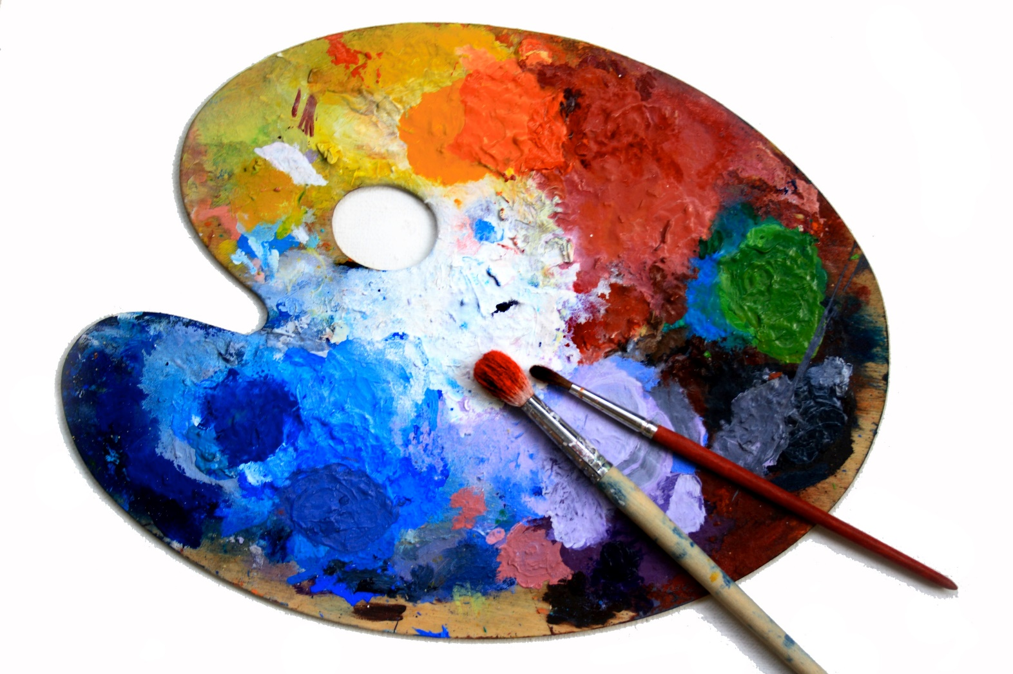
Art

Slide 7

Drama

Slide 8

Music

Slide 9

Information Technology

Slide 10

Environmental Studies

Slide 11

Religious Studies

Slide 12

Physical Education

Slide 13

Social and Political Studies

Slide 14

Physics/Science

Slide 15
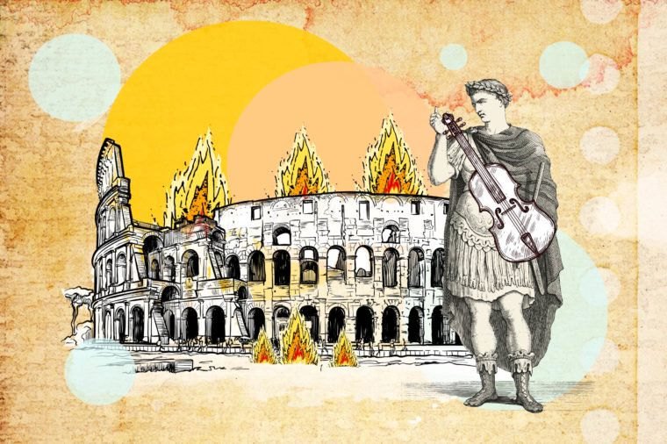
History

Slide 16
School subjects
Information Technology
Environmental Studies
Religious Studies
Physical Education
Social and Political Studies
Physics/Science
History
Language
Maths
English/French
Geography
Art
Drama
Music

Slide 17
Environmental Studies
1. Earthquakes are often followed by tsunamis.

Slide 18
2. The majority of the Greek people are Christians.
Religious Studies

Slide 19
3. How much is 3 times 12?
Maths

Slide 20
4. Now put on a very angry expression on your face.
Drama

Slide 21
5. Pin the icon of Movie Maker on your desktop.
Information Technology

Slide 22
6. Turn to your partner and talk about your daily routine. (Do not use Greek.)
English/French

Slide 23

7. If you mix red and blue, what colour do you get?
Art

Slide 24
8. The French Revolution started in 1789.
History

Slide 25
9. The subject must agree with the verb in a sentence.
Language

Slide 26
10. Isaac Newton discovered the law of gravity.
Physics/Science

Slide 27
11. Greece borders Albania.
Geography

Slide 28
12. Use the diaphragm to breathe and open your mouth widely to sing.
Music

Slide 29
13. Run around the playground to warm up. Three laps are enough. .
Physical Education

Slide 30
14. Democracy is a regime where people go to elections and decide who will represent them.
Social and Political Studies

