Slide 1




Mindfulness for students
1^{ο} Πειραματικό Δημοτικό Σχολείο Θεσσαλονίκης
2025-2026
Στ1

Slide 2

Why?
Increased focus, attention, self-control, classroom participation, compassion.
Improved academic performance, ability to resolve conflict, overall well-being.
Decreased levels of stress, depression, anxiety, disruptive behavior.

Slide 3
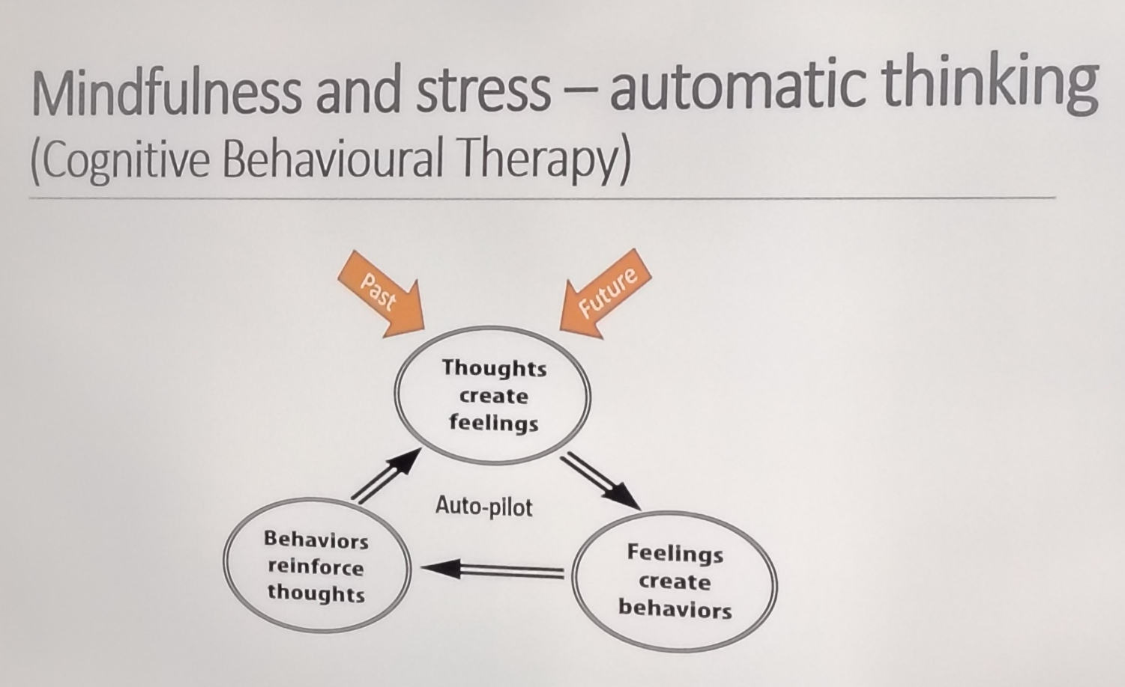

Slide 4
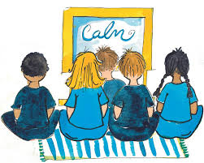
Mindfulness for Kids - Video
Be the pond
Kids Zen Den

Slide 5
Mindfulness for Kids - Music
Bliss
What a wonderful world

Slide 6
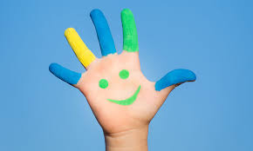
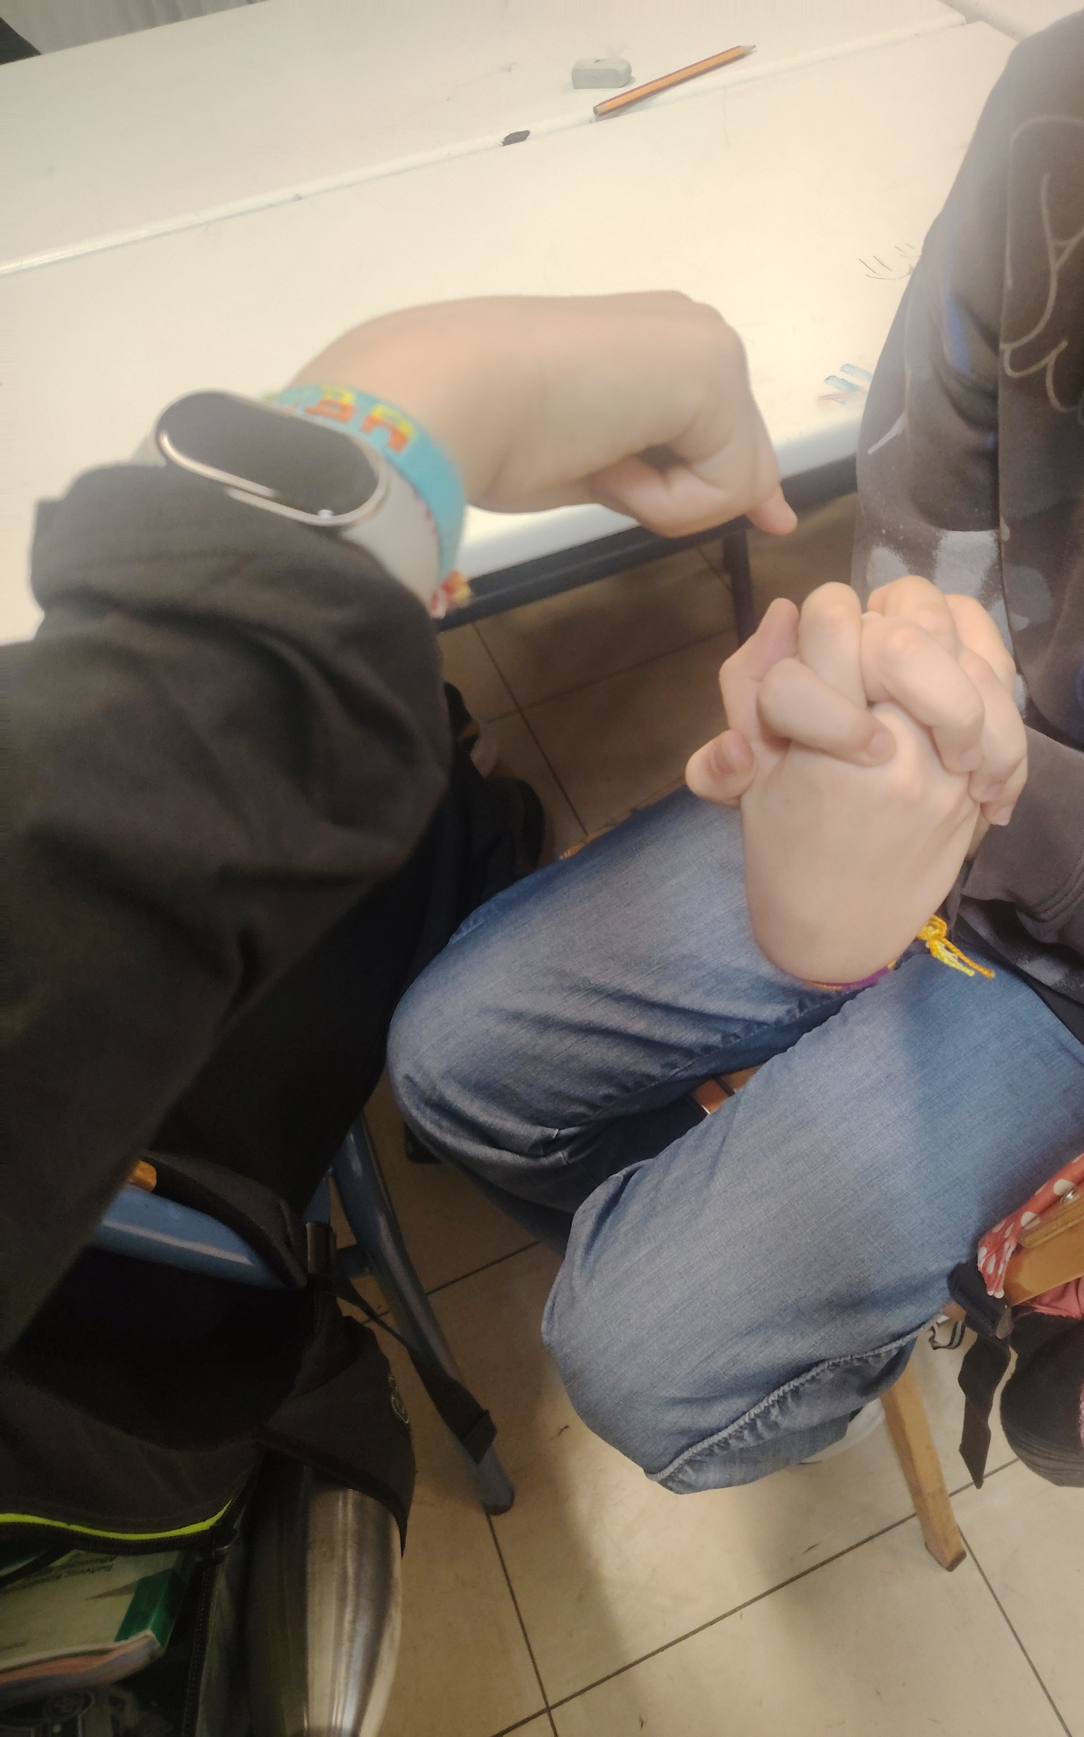
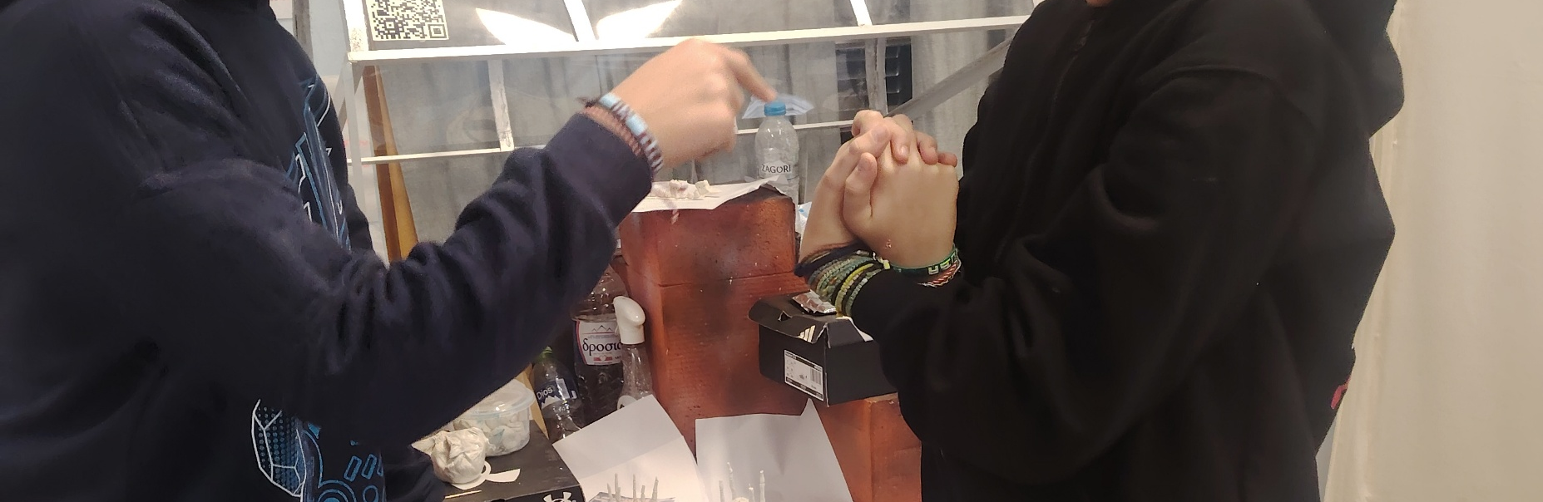
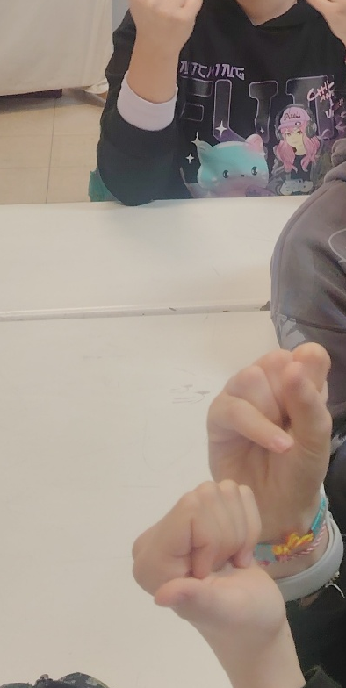
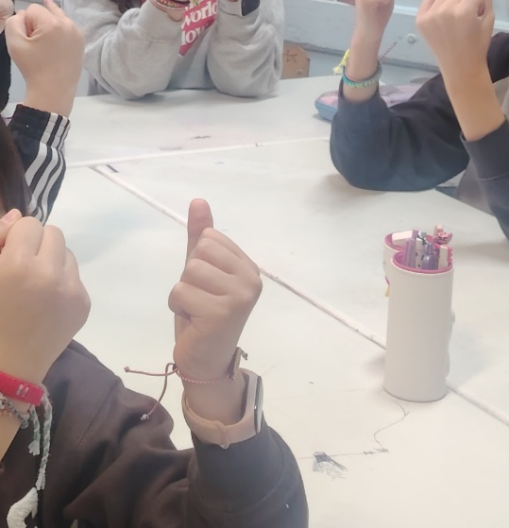
Mindfulness in our classroom

Slide 7
How?

Slide 8
How?

Slide 9
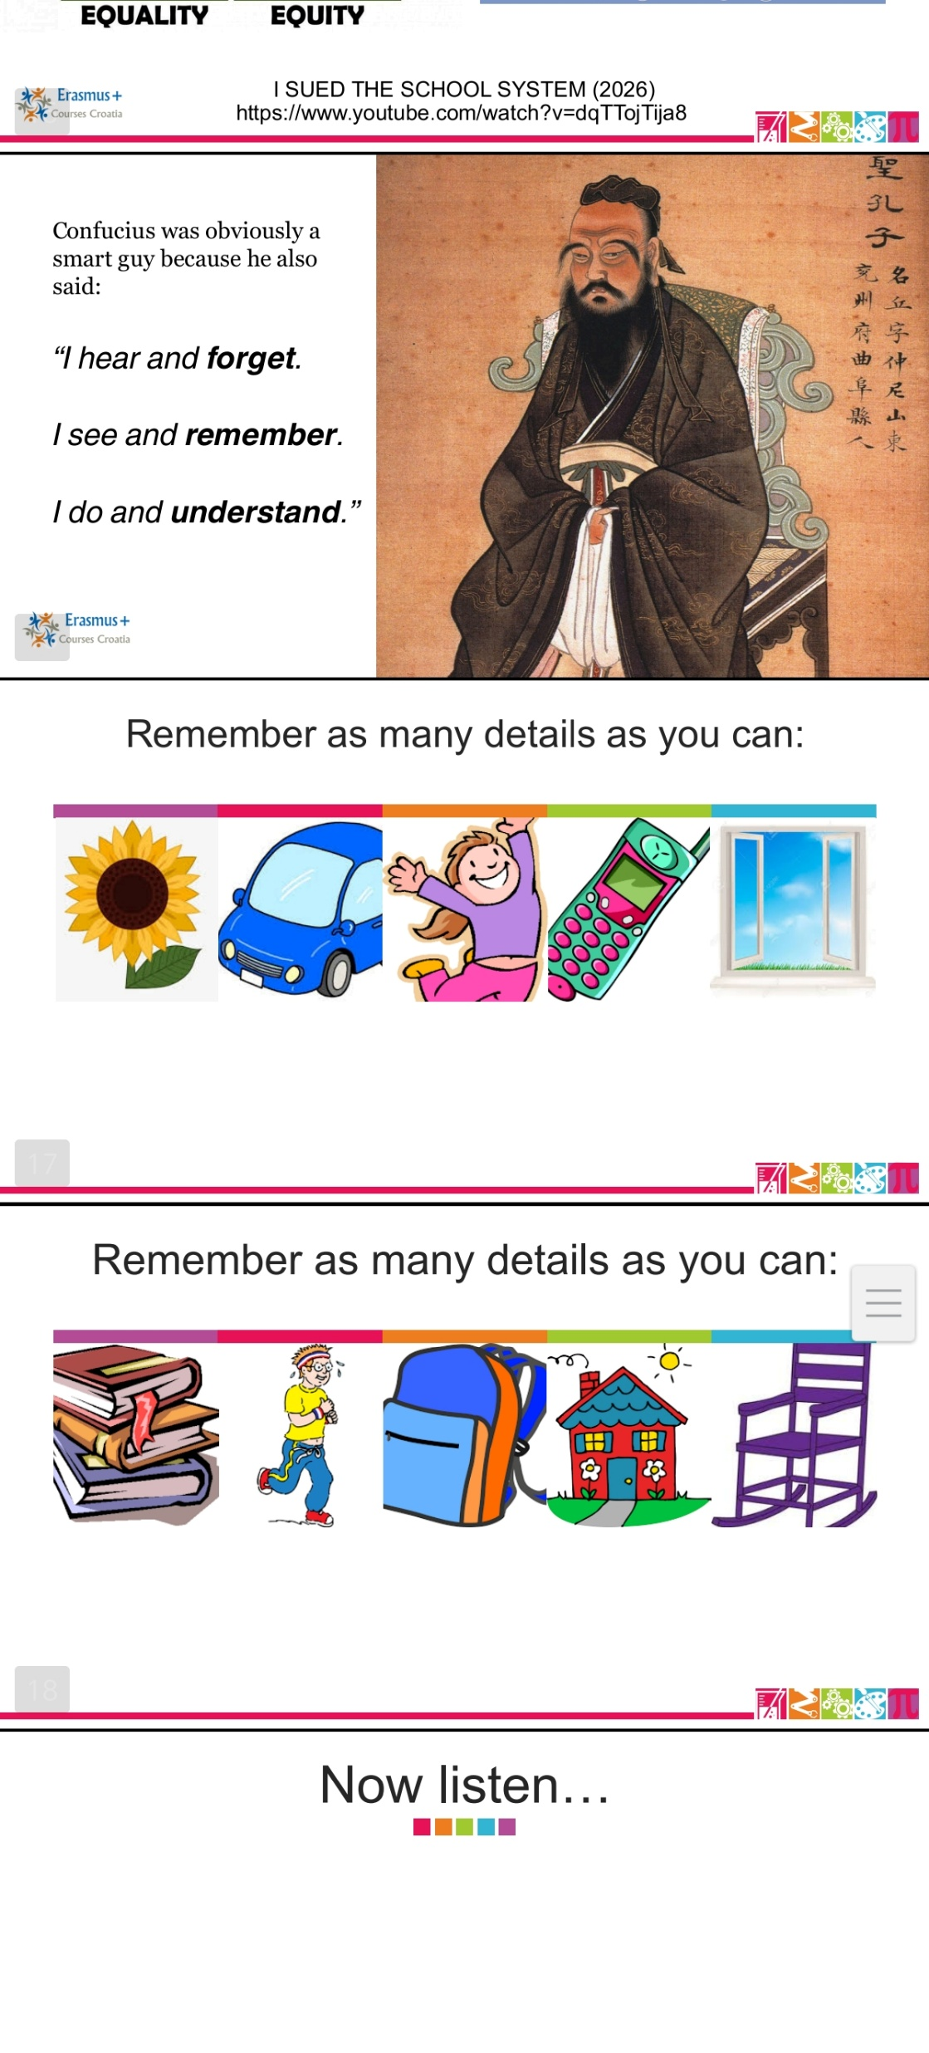
Exercise 1 (a)

Slide 10
Exercise 1 (b)

Slide 11
Exercise 1 (c)

Slide 12
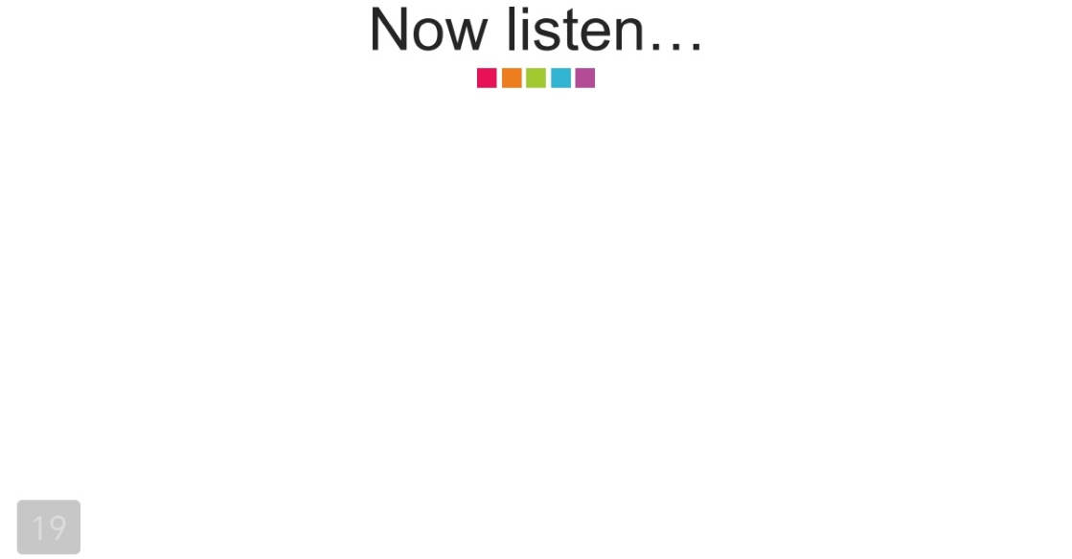
Exercise 1 (d)

Slide 13
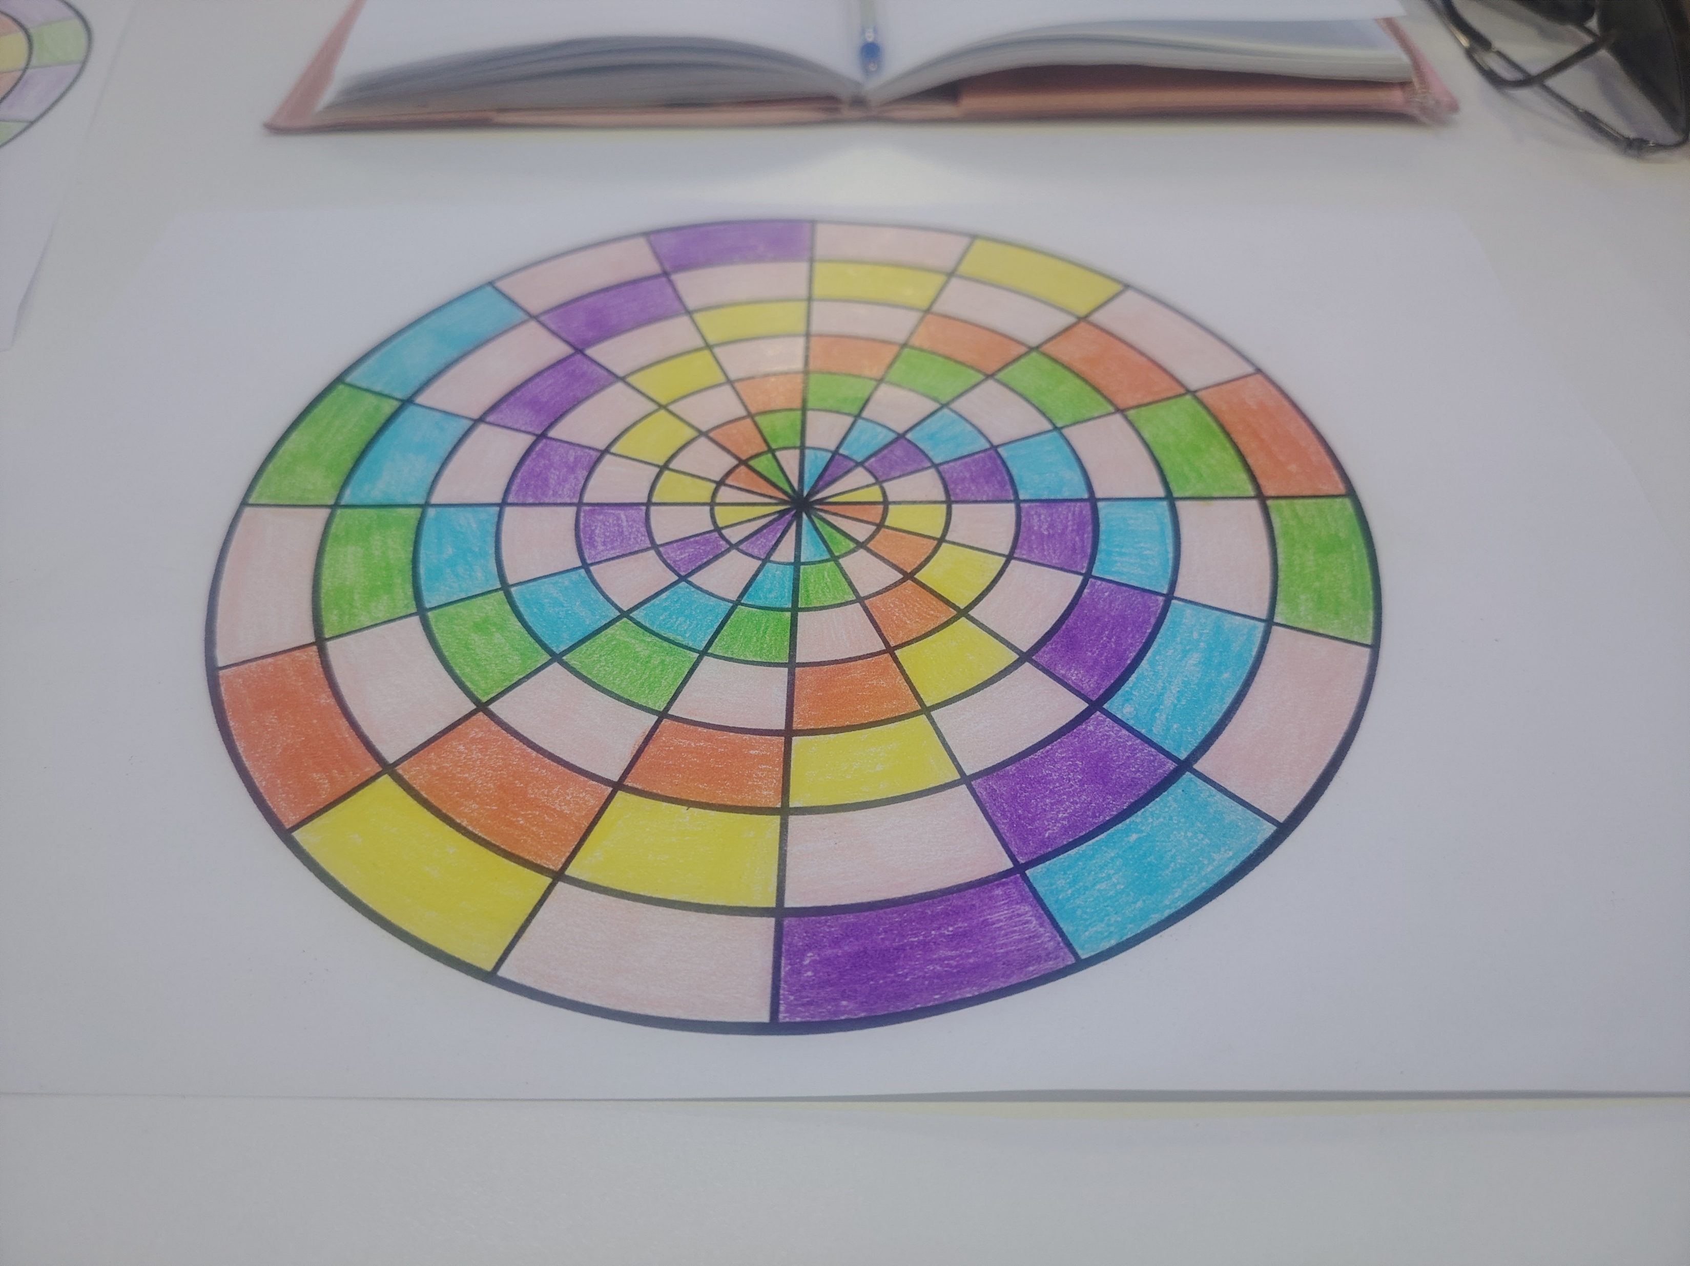
Exercise 2
Συμπληρώνουμε με χρώματα τον κύκλο…

Slide 14
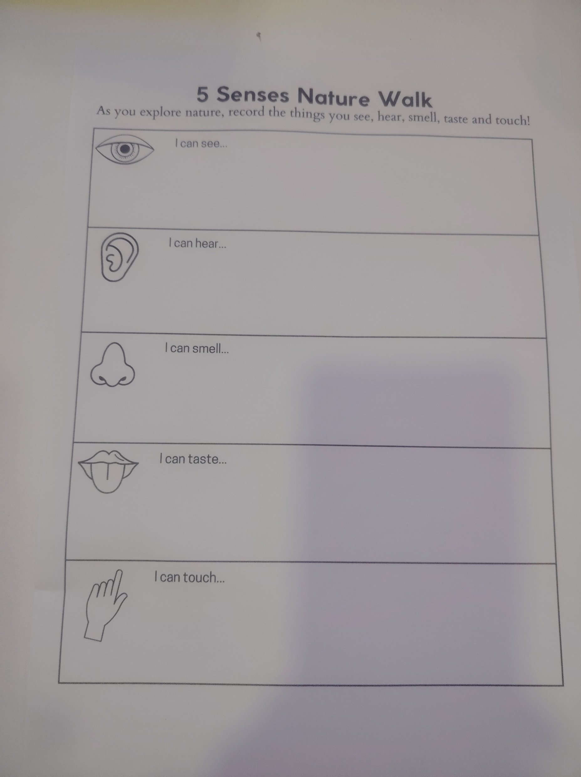
Exercise 3
5 Senses Nature Walk…

Slide 15
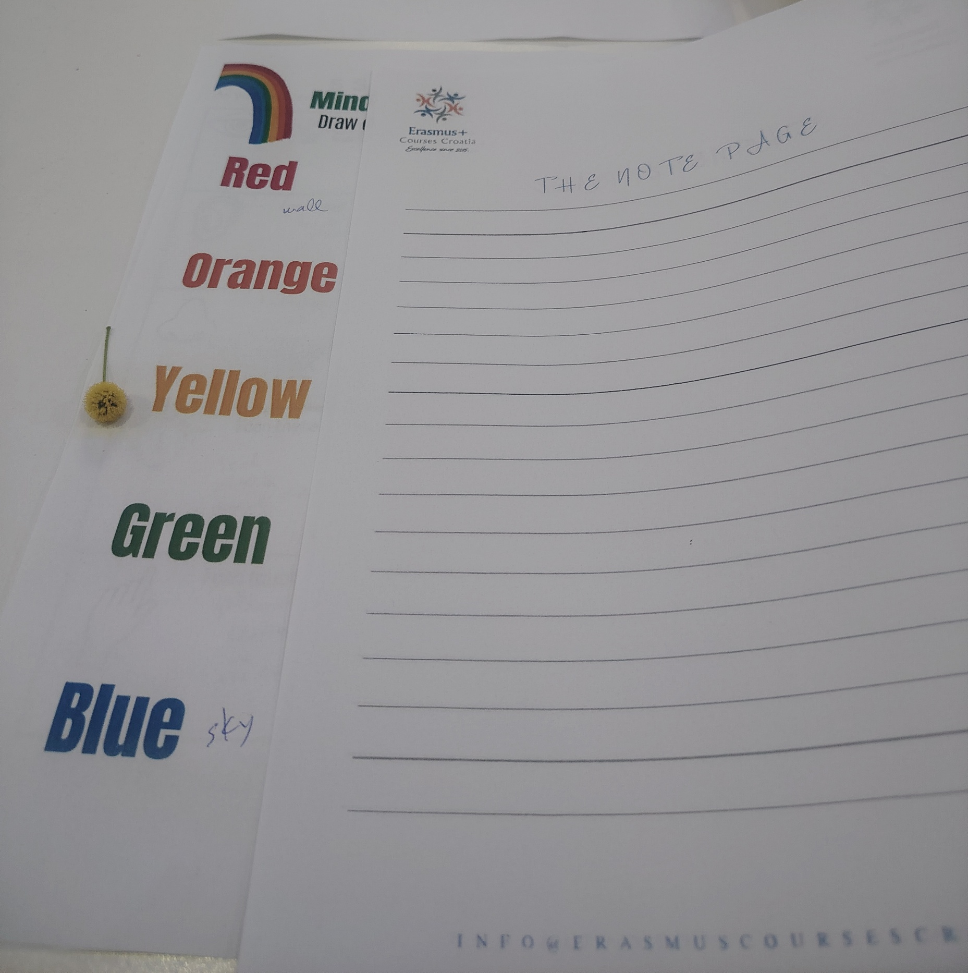
Exercise 4
Something red, something orange, something yellow…

Slide 16
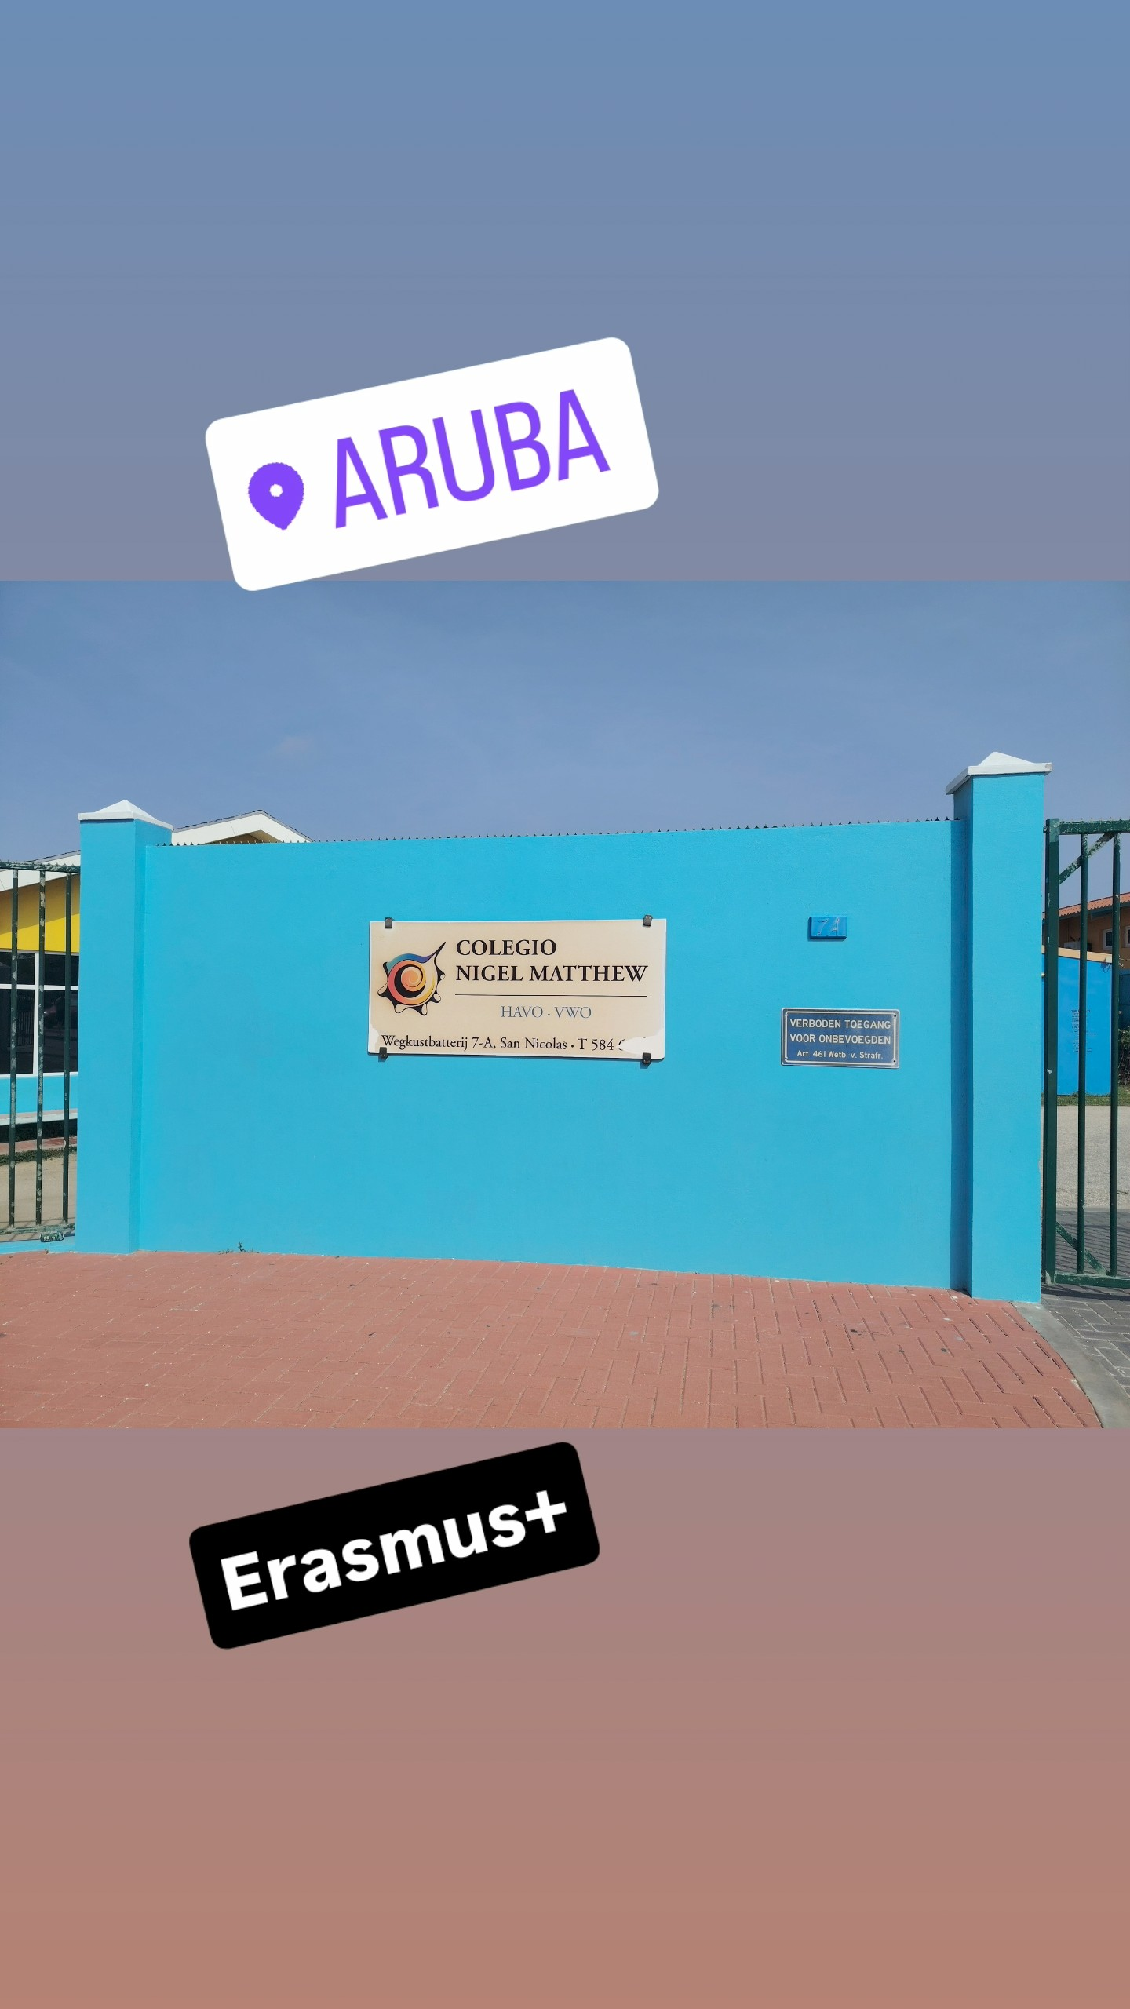
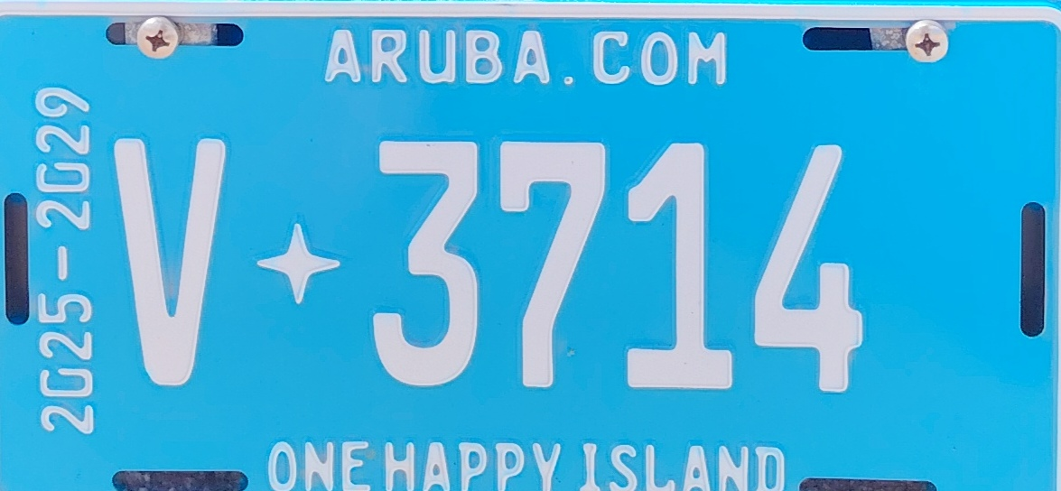
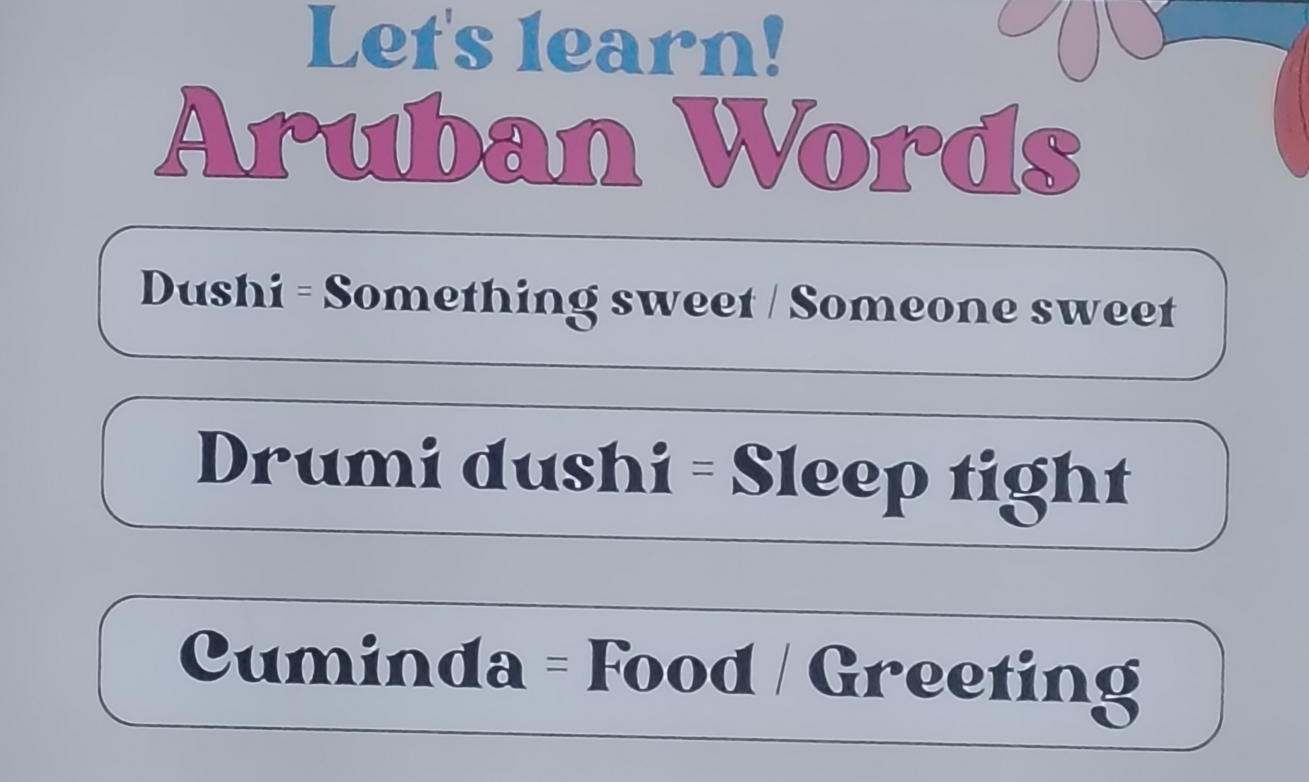
Where?

Slide 17
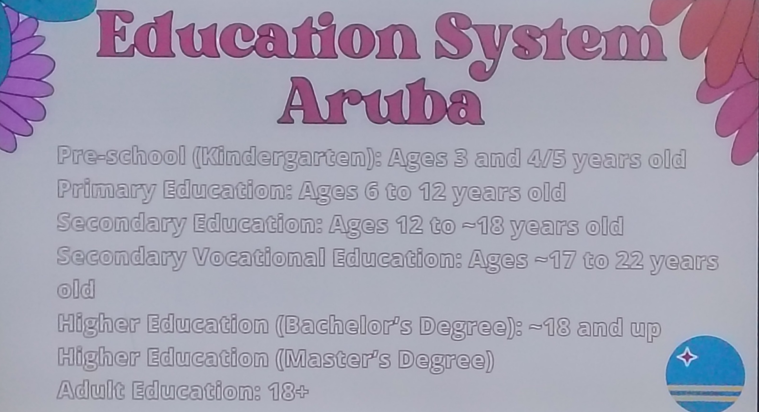
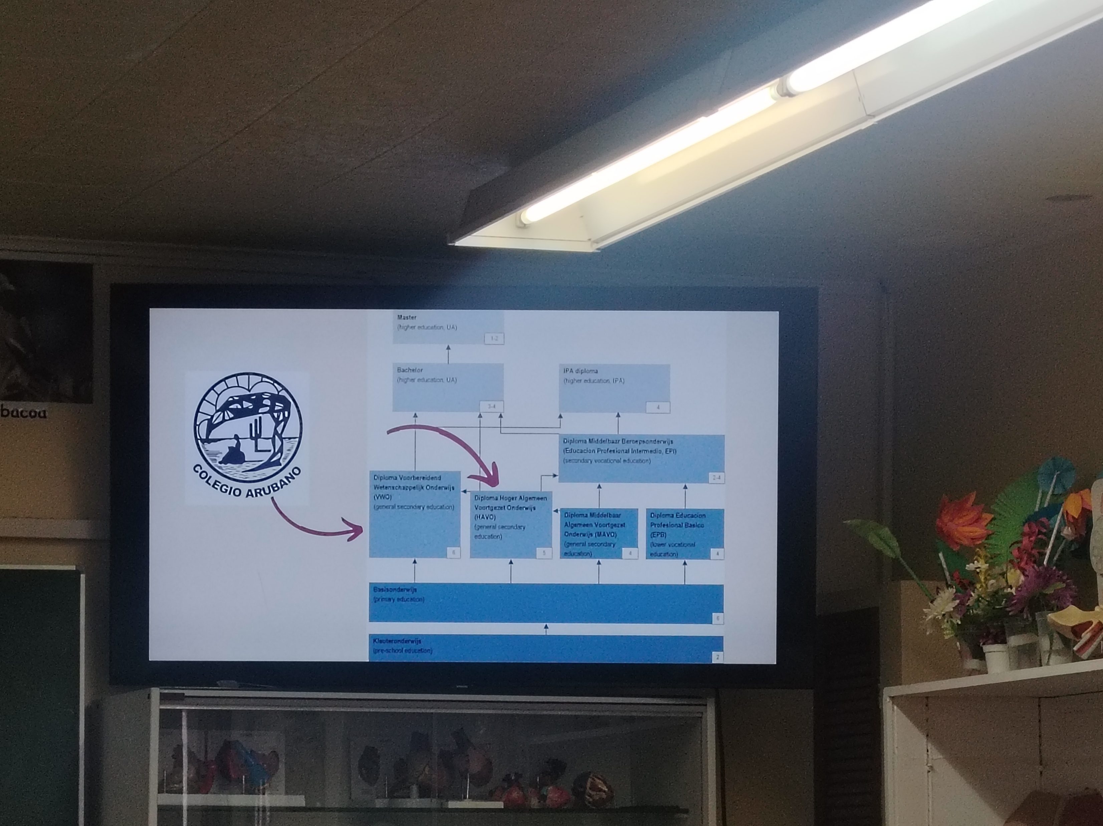
Aruba…

Slide 18
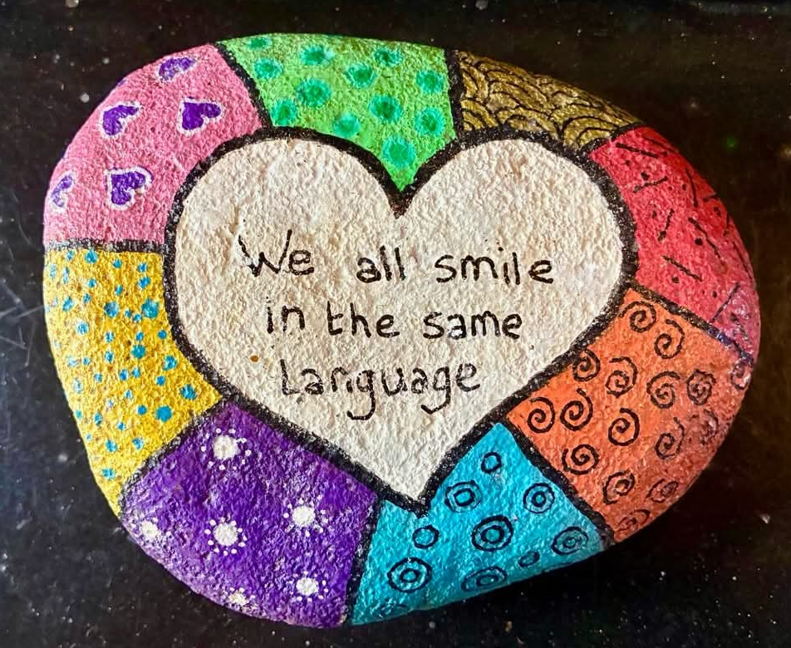
Aruba…

Slide 19

Thank you for your attention!

