Slide 1
Life of pie
1st grade Junior High School

Slide 2

Life of Pie
Take a vocabulary quiz
Watch a video
Read a review of a book.
Evaluate the book
Self- evaluation questionnaire
Writing: A short factfile about the Life of Pie
Αυτή η φωτογραφία από Άγνωστος συντάκτης με άδεια χρήσης CC BY-NC-ND

Slide 3

Previously …….
Last time, we browsed through various books in groups and wrote some evaluations.
Let’s take a short vocabulary quiz.

Slide 4

Video
Have you ever watched a film that was based on a book?
Let’s watch the trailer of the film ‘The life of Pie’.
Αυτή η φωτογραφία από Άγνωστος συντάκτης με άδεια χρήσης CC BY-NC-ND

Slide 5
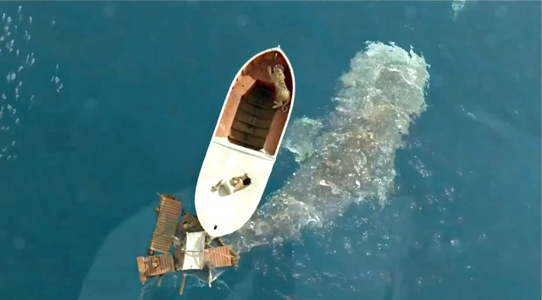
Reading
Let’s read a review.
Αυτή η φωτογραφία από Άγνωστος συντάκτης με άδεια χρήσης CC BY-SA-NC

Slide 6

Let’s speak in pairs

Slide 7
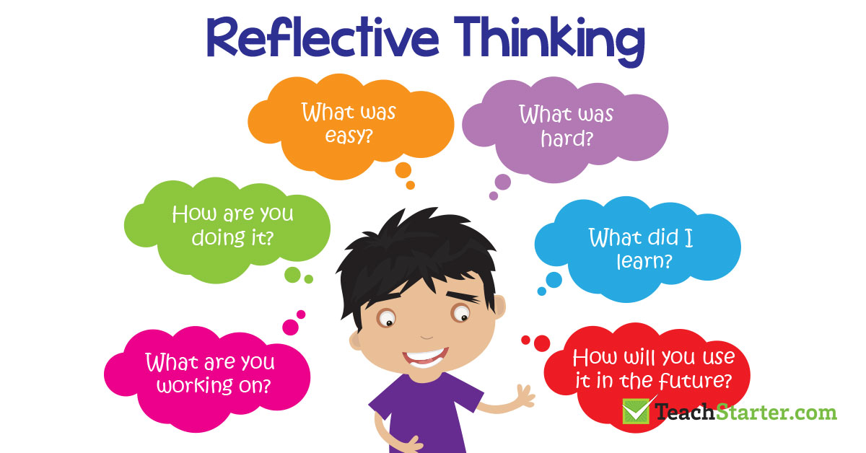
Self- evaluation questionnaire
Αυτή η φωτογραφία από Άγνωστος συντάκτης με άδεια χρήσης CC BY

Slide 8

Well done to all of you!
Today we revised words about books
Watched a video about the Life of Pie
Read a review about the book
Evaluated the book
Completed a questionnaire about the use of video, reading strategies, vocabulary, pairwork
Homework: Writing: A factfile about the Life of Pie.

Slide 9
THANK YOU!

