Slide 1
“My Vincent Van Gogh”
Stellina Gkanoglou

Slide 2
Vincent Willem van Gogh ( 30 March 1853 – 29 July 1890) was a Dutch Post-Impressionist painter who is among the most famous and influential figures in the history of Western art. In just over a decade he created approximately 2100 artworks, including around 860 oil paintings, most of them in the last two years of his life. They include landscapes, still lifes, portraits and self-portraits, and are characterised by bold, symbolic colours, and dramatic, impulsive and highly expressive brushwork that contributed to the foundations of modern art. Only one of his paintings was known by name to have been sold during his lifetime. Van Gogh became famous after his suicide at age 37, which followed years of poverty and mental illness.
Born into an upper-middle-class family, Van Gogh drew as a child and was serious, quiet and thoughtful, but showed signs of mental instability. As a young man he worked as an art dealer, often travelling, but became depressed after he was transferred to London. He turned to religion, and spent time as a missionary in southern Belgium. Later he drifted in ill-health and solitude. He was keenly aware of modernist trends in art and, while back with his parents, took up painting in 1881. His younger brother, Theo, supported him financially, and the two of them kept up a long correspondence by letter.
Van Gogh's early works consisted of mostly still lifes and depictions of peasant labourers. In 1886, he moved to Paris, where he met members of the artistic avant-garde, including Émile Bernard and Paul Gauguin, who were seeking new paths beyond Impressionism. Frustrated in Paris and inspired by a growing spirit of artistic change and collaboration, Van Gogh moved to Arles in south of France in February 1888 with the goal of establishing an artistic retreat and commune. Once there, Van Gogh's art changed. His paintings grew brighter and he turned his attention to the natural world, depicting local olive groves, wheat fields and sunflowers. Van Gogh invited Gauguin to join him in Arles and eagerly anticipated Gauguin's arrival in the fall of 1888.

Slide 3
Van Gogh suffered from psychotic episodes and delusions. Though he worried about his mental stability, he often neglected his physical health, did not eat properly and drank heavily. His friendship with Gauguin ended after a confrontation with a razor when, in a rage, he severed part of his own left ear. He spent time in psychiatric hospitals, including a period at Saint-Rémy. After he discharged himself and moved to the Auberge Ravoux in Auvers-sur-Oise near Paris, he came under the care of the homeopathic doctor Paul Gachet. His depression persisted, and on 27 July 1890, Van Gogh is believed to have shot himself in the chest with a revolver, dying from his injuries two days later.
Van Gogh's art gained critical recognition after his death and his life story captured public imagination as an emblem of misunderstood genius,^{[6]} due in large part to the efforts of his widowed sister-in-law Johanna van Gogh-Bonger.^{[7]} His bold use of color, expressive line and thick application of paint inspired avant garde artistic groups like the Fauves and German Expressionists in the early 20th century. Van Gogh's work gained widespread critical and commercial success in the following decades, and he has become a lasting icon of the romantic ideal of the tortured artist. Today, Van Gogh's works are among the world's most expensive paintings to have ever sold, and his legacy is honoured by a museum in his name, the Van Gogh Museum in Amsterdam, which holds the world's largest collection of his paintings and drawings.

Slide 4
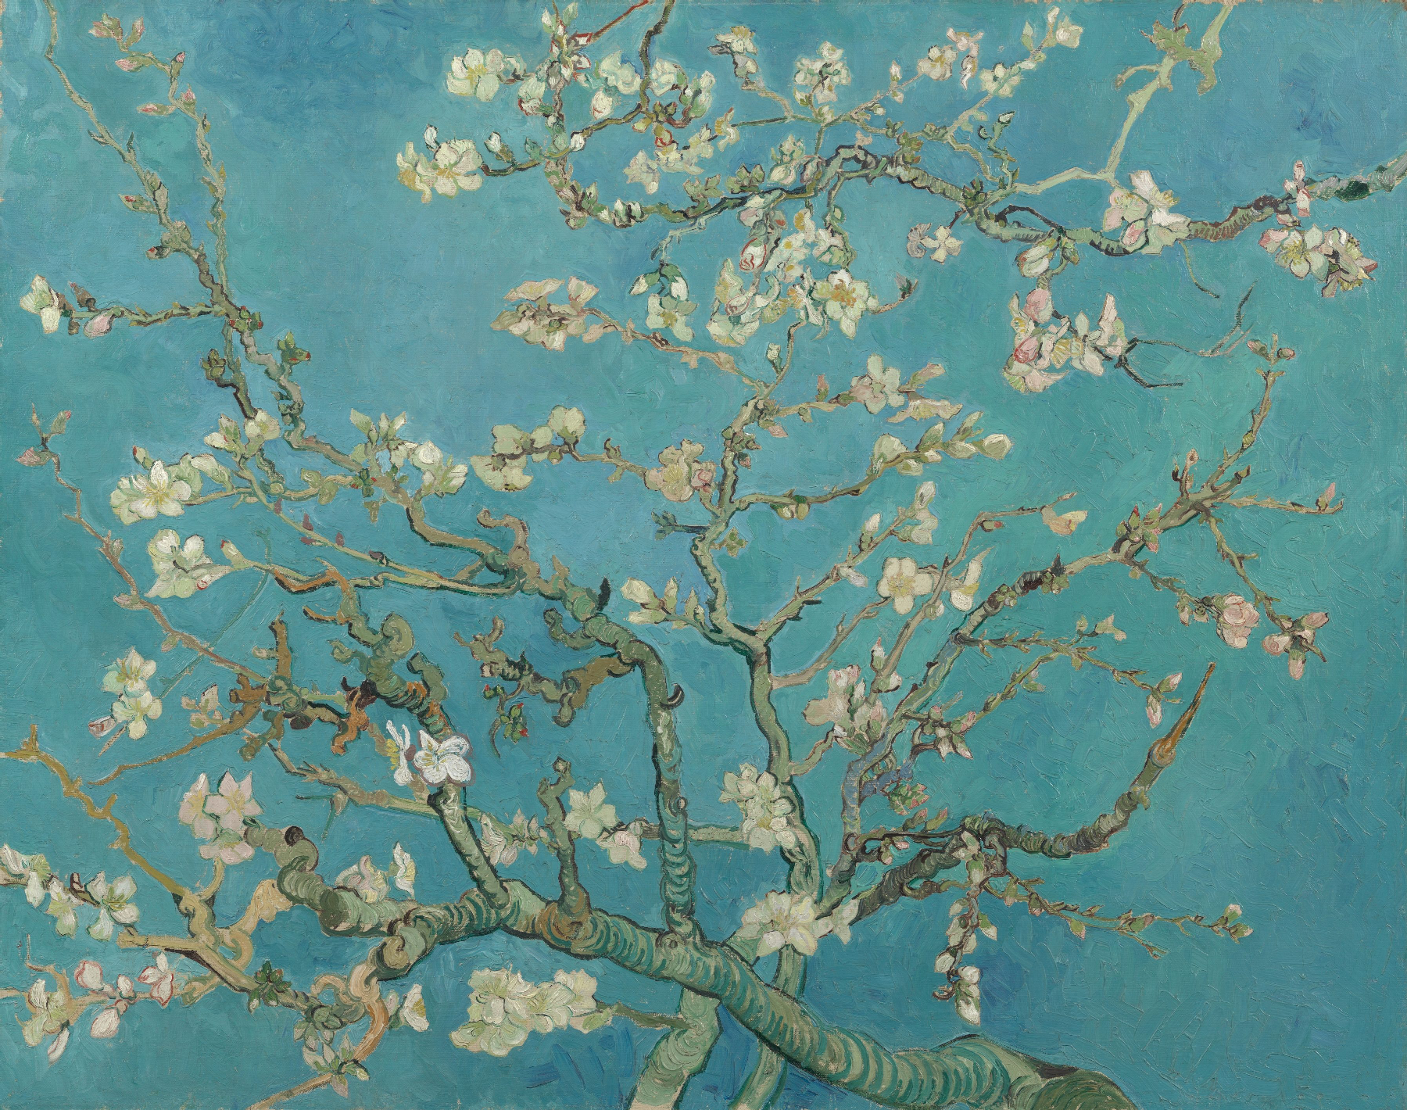
All his works are unique and with his illness he created amazing works but I have singled out some of his works, which are my favourites.
Almond Blossom
Large blossom branches like this against a blue sky were one of Van Gogh’s favourite subjects. Almond trees flower early in the spring making them a symbol of new life. Van Gogh borrowed the subject, the bold outlines and the positioning of the tree in the picture plane from Japanese printmaking.
The painting was a gift for his brother Theo and sister-in-law Jo, who had just had a baby son, Vincent Willem. In the letter announcing the new arrival, Theo wrote: ‘As we told you, we’ll name him after you, and I’m making the wish that he may be as determined and as courageous as you.’ Unsurprisingly, it was this work that remained closest to the hearts of the Van Gogh family. Vincent Willem went on to found the Van Gogh Museum.

Slide 5
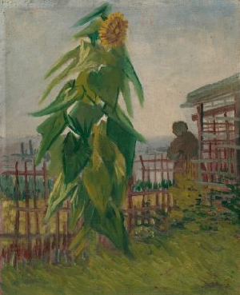
Allotment with Sunflower
The huge sunflower is clearly the main subject of this painting. Van Gogh was very fond of this flower. In southern France, he painted large bouquets of sunflowers. And during his earlier Paris period, he devoted a series of still lifes to this subject.
Van Gogh made this painting on the hill of Montmartre in Paris. In the background, a little bit of the city is visible. On the left are the chimneys of the factories in the Clichy district. He painted this city scene on the back of the painting Head of a Woman, which he had made earlier in Nuenen (NL). This was a way of saving expensive linen canvas.

Slide 6
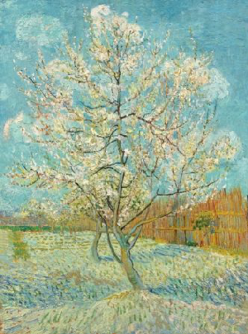
The Pink Peach Tree
Van Gogh painted many fruit orchards during his first weeks in Arles (FR). There is an earlier, nearly identical version of this painting, which Van Gogh had completed in one sitting. ‘I’d worked on a no. 20 canvas in the open air in an orchard — ploughed lilac field, a reed fence — two pink peach trees against a glorious blue and white sky. Probably the best landscape I’ve done’, he wrote.
When he returned home, he saw the death notice of Anton Mauve (1838-1888), his uncle by marriage. Mauve was a well-known painter from whom Van Gogh had once taken lessons. He dedicated that first work to Mauve and made this new version later to send to Theo.

Slide 7
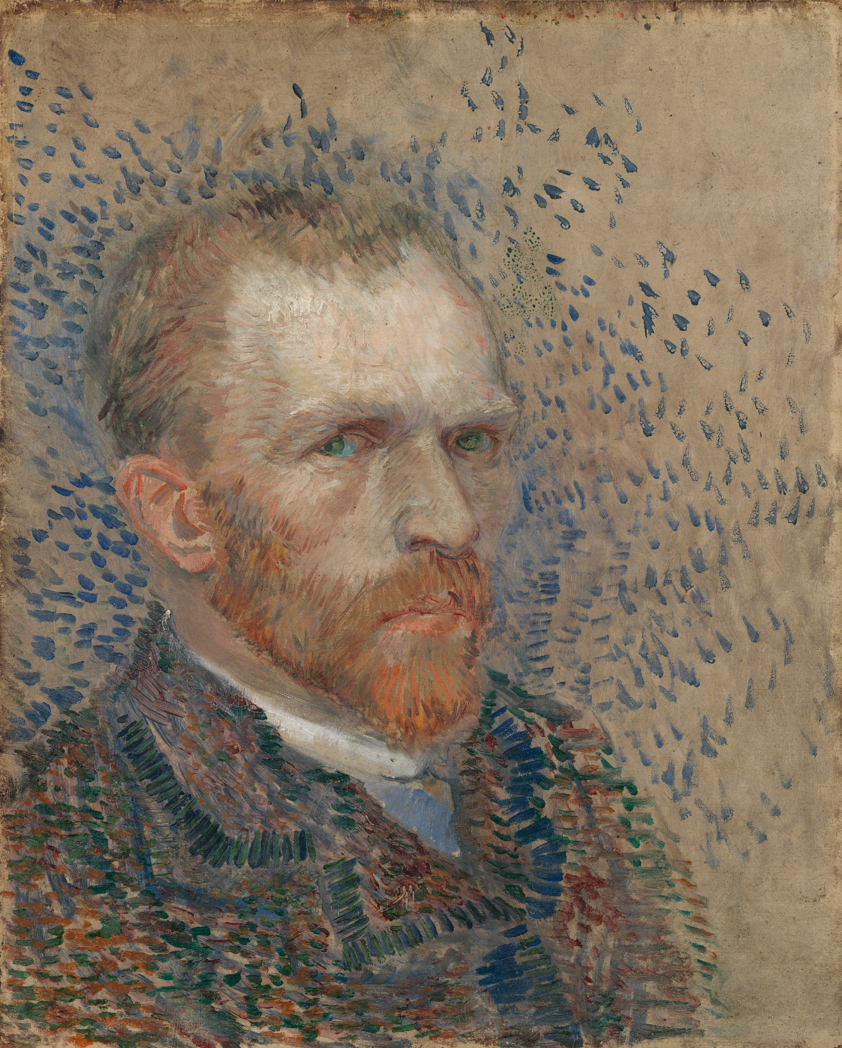
Self-Portrait
Around the world, people recognise this man with a red beard and an earnest look in his eyes. Vincent van Gogh painted about 35 self-portraits in total, most of them in Paris. For him, this was a way of practising portrait painting. His intention was not to portray himself as realistically as possible. He used the Neo-Impressionist style here, with short, rough brushstrokes. These alternate with longer strokes, such as the orange in his beard.
The background was originally purple (a mix of red and blue), but the red pigment has discoloured and has become almost completely transparent.

