Slide 1
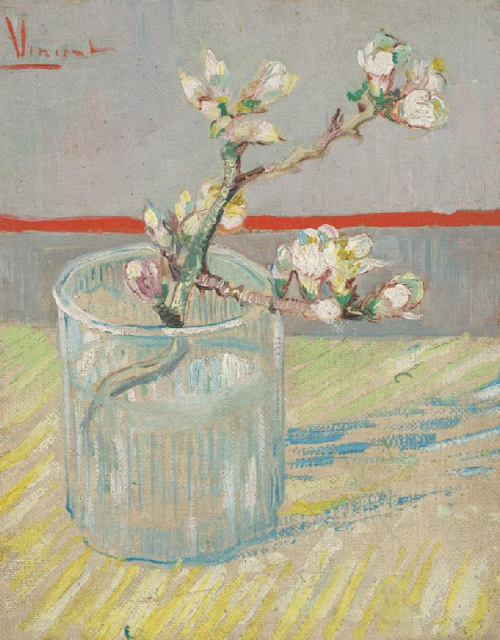
Sprig of Flowering Almond in a Glass

Slide 2
Information
Title : Sprig of Flowering Almond in a Glass
Type of painting: oil on canvas
Height: 24,5 cm Width: 19,5cm
Year it was painted : Vincent van Gogh (1853 - 1890), Arles, March 1888

Slide 3
Viewing notes
A red line divides the picture plane. Van Gogh used the same red to sign this small painting of a sprig of flowering almond. Almond trees are the first to blossom in the spring.
When Van Gogh arrived in Arles (FR), there was still snow on the ground. On 2 March, a little more than a week later, he wrote to his brother, 'There’s a hard frost here, and out in the country there’s still snow — I have a study of a whitened landscape with the town in the background. And then 2 little studies of a branch of an almond tree that’s already in flower despite everything.'
After that, Van Gogh began work on a large series of paintings of flowering orchards: almond, peach, plum and pear trees.

Slide 4
How did it make me feel?
Almond blossoms are a very beautiful flower that even bees love . Their pink and white color give us a sense of calm . It’s like a dream ,which soothes our soul and calms our mind .

