Slide 1
THE RENAISSANCE
1450-1550 AD

Slide 2
Essential Question:
  How did the Renaissance change art in Western Europe?
Warm-Up Question:
  Why did the Renaissance begin in Italy?
  What factors led to the decline of the Middle Ages & rise of the Renaissance?

Slide 3
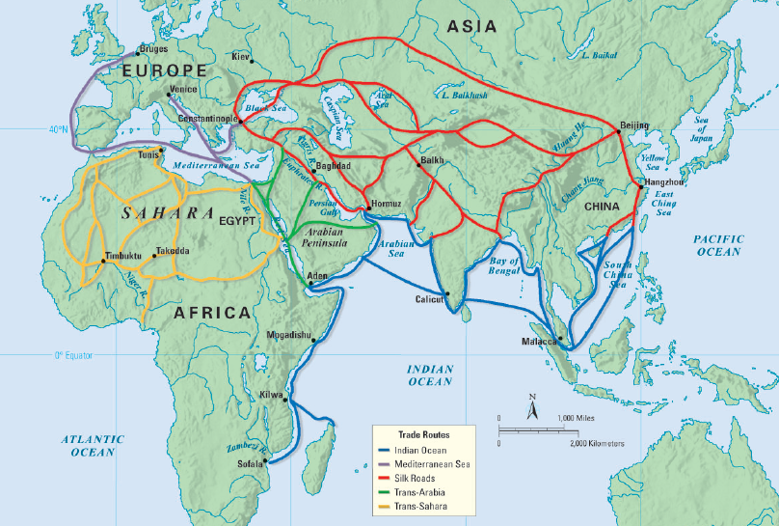
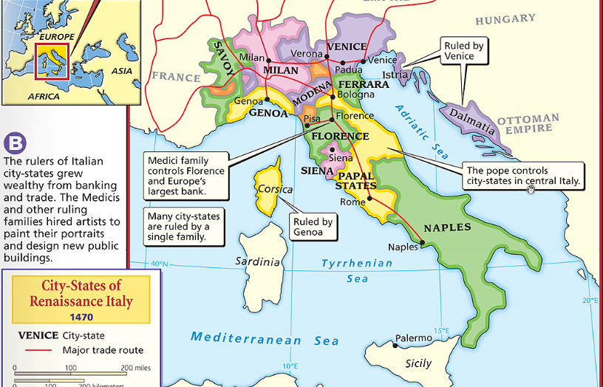
The revival of trade in Europe helped bring an end to the Middle Ages & gave rise to the Renaissance
The rise of cities brought artists together which led to new techniques & styles of art
Increased trade gave rise to Italian city-states &
a wealthy middle class
of bankers & merchants
Wealthy bankers & merchants wanted to show off their new status by commissioning art
Notes:
Art showed peoples’ new social & political status
The rise of cities brought artists together & shared ideas—this led to new techniques & styles

Slide 4
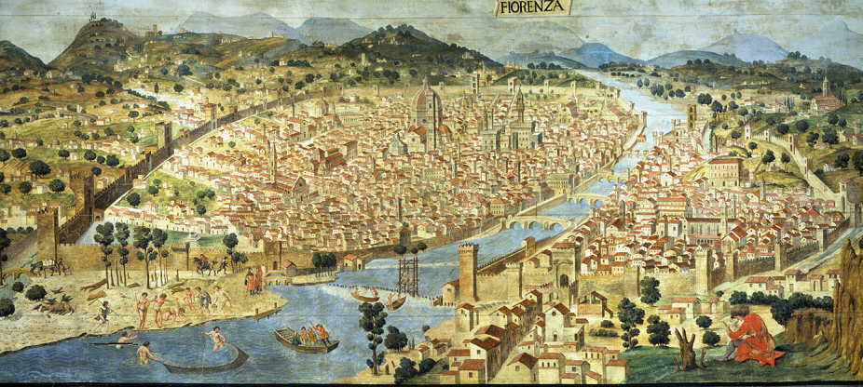
The most important Italian city-state was Florence; In this wealthy trade city, the Renaissance began
Florence was home to
the Medici family, the wealthiest & most powerful bankers in Europe
The Medici used their wealth to commission art for themselves &
to beautify Florence
Notes:
Art showed peoples’ new social & political status
The rise of cities brought artists together & shared ideas—this led to new techniques & styles

Slide 5
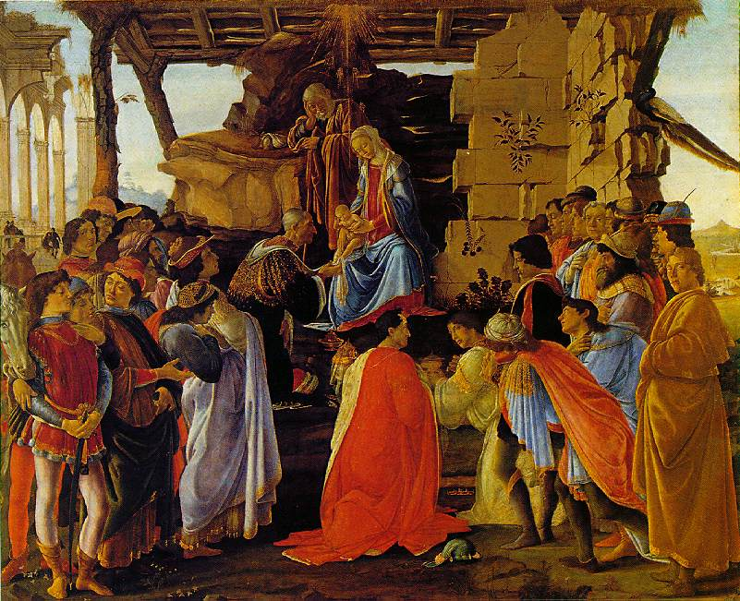
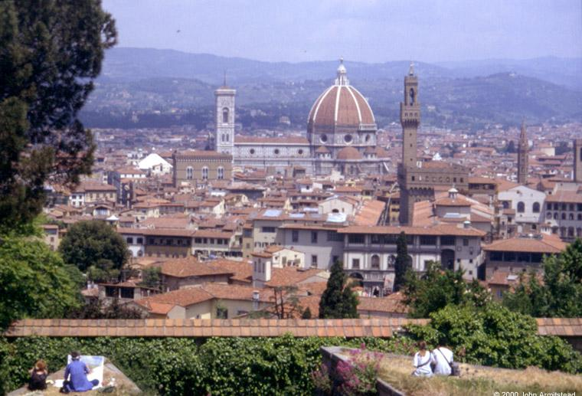
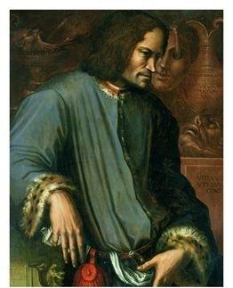
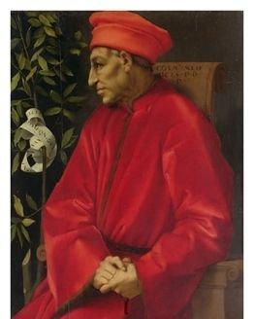
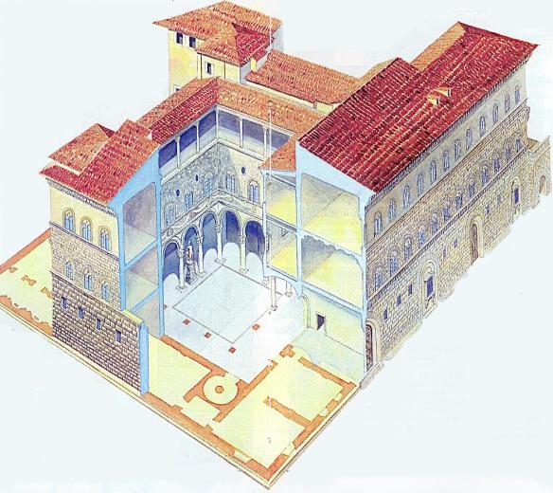
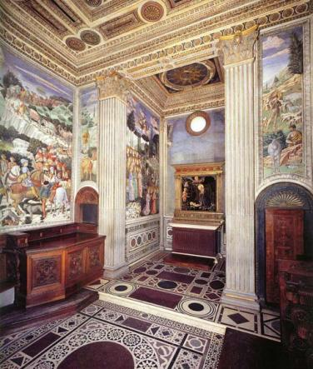
Florence under the Medici
Lorenzo
Cosimo
Guiliano
Medici Chapel
The Medici paid to build a massive domed cathedral for Florence
Lorenzo de Medici commissioned this painting from Botticelli of the Medici brothers as the three magi
The Medici Palace
Notes:
This painting by Botticelli was commissioned by Lorenzo de Medici & depicts Cosimo, Lorenzo, & Guiliano de Medici as the three magi

Slide 6
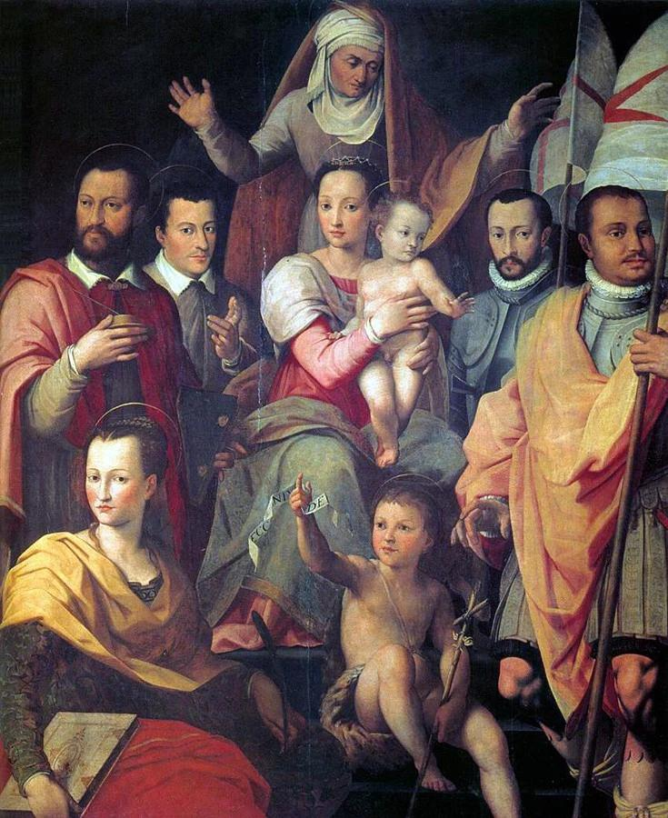
The Medici

Slide 7
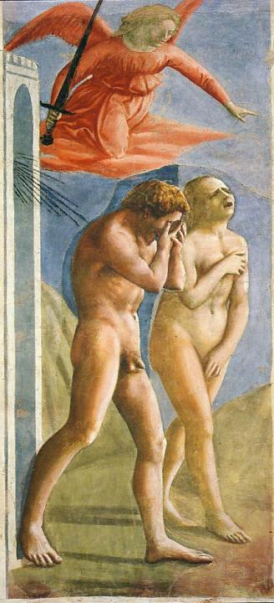
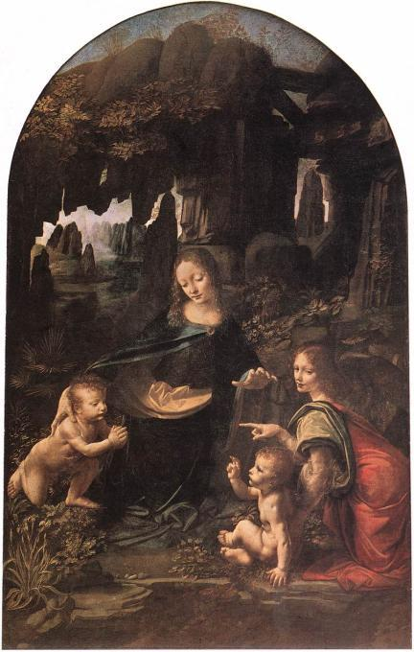
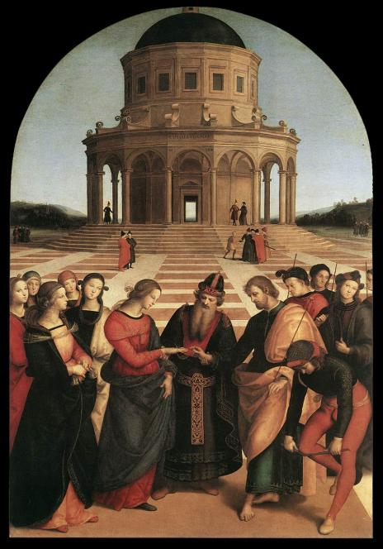
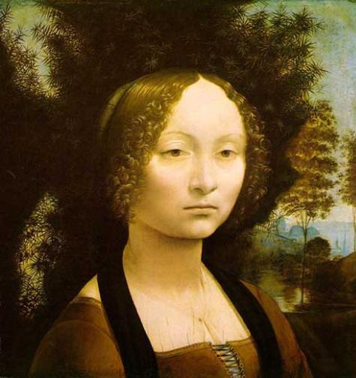
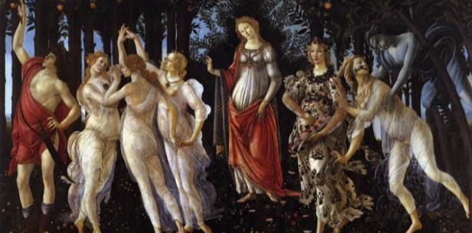
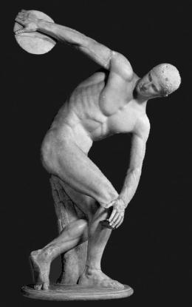
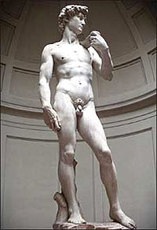
New styles & techniques of Renaissance art
Realism & emotion
Classicism: inspiration from Greece & Rome
Emphasis on individuals & interaction between people
Geometric
arrangements
Perspective
Using light & shadows
Sfumato
The first nude paintings & sculptures since the Romans
Chiaroscuro
Greek
Renaissance
Notes:
Sfumato is a term used by Leonardo da Vinci to refer to a painting technique which overlays translucent layers of colour to create perceptions of depth, volume and form. In particular, it refers to the blending of colours or tones so subtly that there is no perceptible transition.
An element in art, chiaroscuro (Italian for lightdark) is defined as a bold contrast between light and dark

Slide 8
Renaissance
Artists

Slide 9
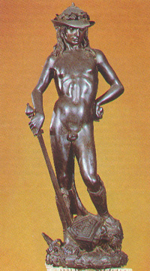
Donatello
Donatello was the 1st great sculptor of the Renaissance
  Donatello revived the classical (Greco-Roman) style of sculpture that were realistic & could be viewed from all sides
  Donatello’s “David” was the 1st large, free-standing human sculpture of the Renaissance

Slide 10
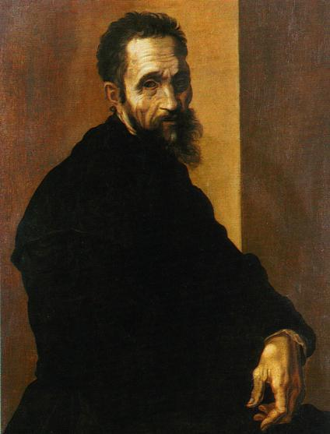
Michelangelo
Michelangelo was one
of the most famous Renaissance artists:
  He was a painter, sculptor, architect,
  & poet
  His sculptures & paintings showed realism, detail of
  the human body, & expression to show personality & emotion
Notes:
In addition, artists such as the sculptor, poet, architect, and painter Michelangelo (MY•kuhl•AN•juh•LOH) Buonarroti used a realistic style when depicting the human body. Donatello (DAHN•uh•TEHL•oh) also made sculpture more realistic by carving natural postures and expressions that reveal personality. He revived a classical form in his statue of David, a boy who, according to the Bible, became a great king.

Slide 11
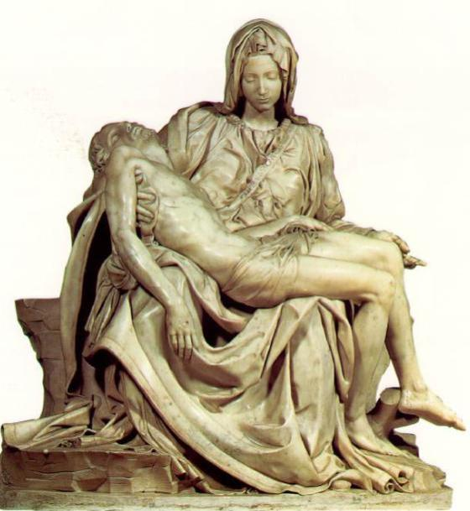
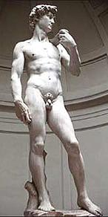
Michelangelo sculptures “Pieta”& “David”
are considered masterpieces

Slide 12
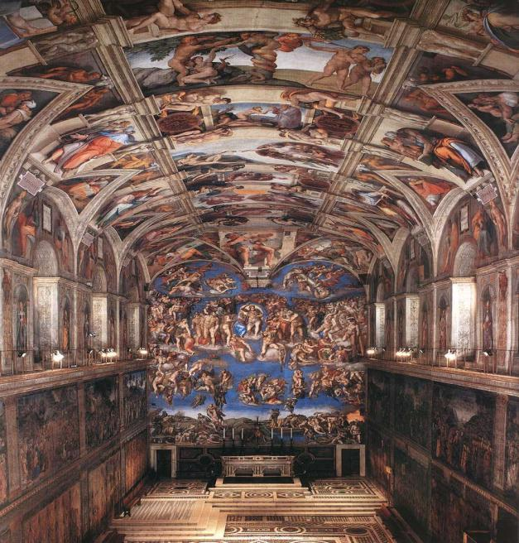
Michelangelo’s greatest work is the 130 ft x 44 ft ceiling of the Sistine Chapel which shows Biblical images
of amazing detail, power, & beauty

Slide 13
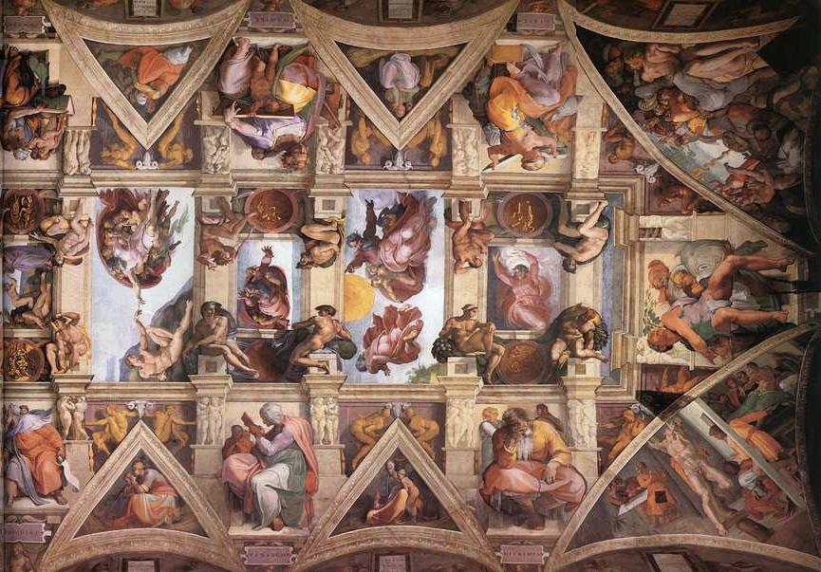

Slide 14
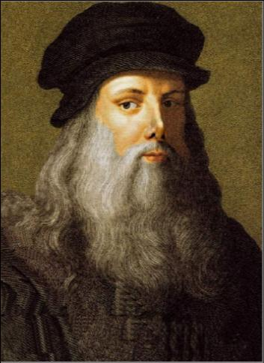
Leonardo da Vinci
Leonardo da Vinci was a
true “Renaissance Man”
  He was a painter &
  sculptor whose art was known for incredible realism & emotion
  He was also an inventor
  & scientist whose sketches reveal observations about human anatomy & new engineering technology
Notes:
Leonardo, Renaissance Man Leonardo da Vinci (LAY•uh•NAHR•doh duh•VIHN•chee) was a painter, sculptor, inventor, and scientist. A true “Renaissance man,” he was interested in how things worked. He studied how a muscle moves and how veins are arranged in a leaf. He filled his notebooks with observations and sketches. Then he incorporated his findings in his art. Among his many masterpieces, Leonardo painted one of the best-known portraits in the world, the Mona Lisa (page 478). The woman in the portrait seems so real that many writers have tried to explain the thoughts behind her smile. Leonardo also produced a famous religious painting, The Last Supper. It shows the personalities of Jesus’ disciples through facial expressions.

Slide 15
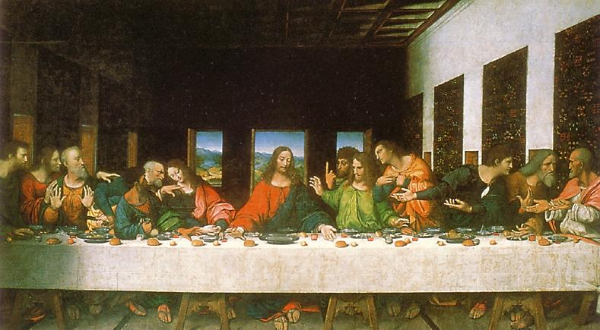
His “Last Supper” shows Jesus’ last meeting with
the 12 apostles before the crucifixion; the facial expressions, detail, emotion made it a masterpiece

Slide 16
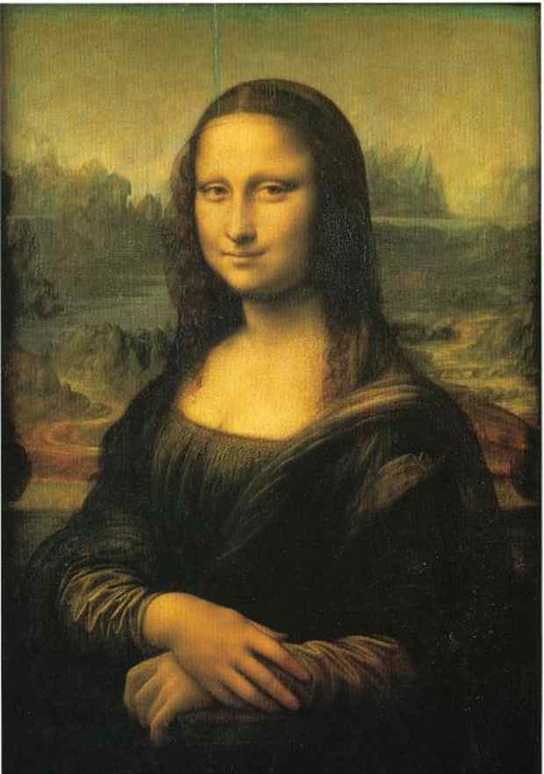
Leonardo da Vinci’s greatest masterpiece was the “Mona Lisa” which was known for its emotion & depth

Slide 17
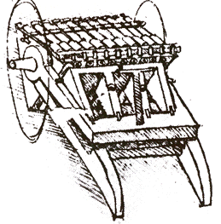
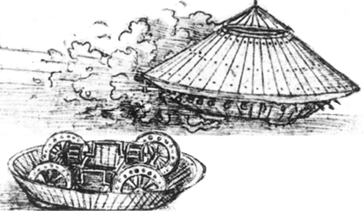
Leonardo’s Inventions

Slide 18
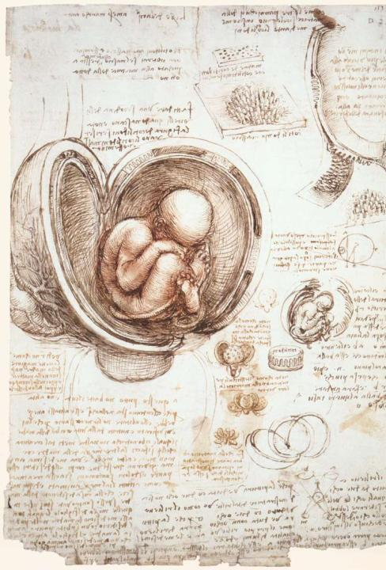
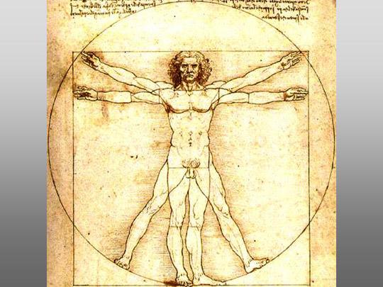
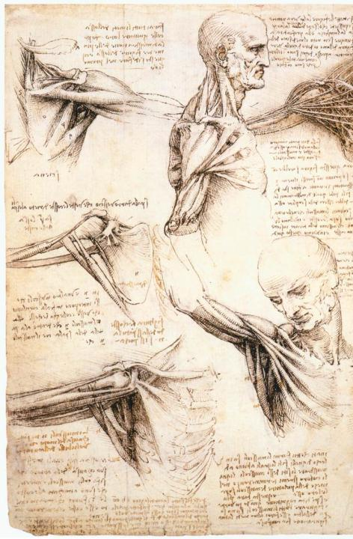

Slide 19
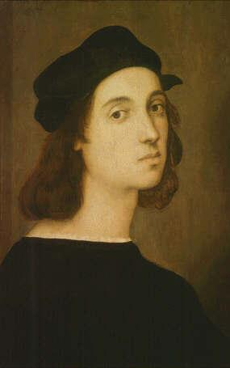
Raphael
Raphael “perfected” Renaissance painting
  He improved perspective and realism by studying Leonardo & Michelangelo
  Raphael became the favorite painter of the Pope because of his amazing detailed paintings showing
  a combination of famous Greeks & Romans along with Renaissance people
Notes:
Raphael Advances Realism Raphael (RAHF•ee•uhl) Sanzio was younger than Michelangelo and Leonardo. He learned from studying their works. One of Raphael’s favorite subjects was the Madonna and child. Raphael often portrayed their expressions as gentle and calm. He was famous for his use of Perspective. In his greatest achievement, Raphael filled the walls of Pope Julius II’s library with paintings. One of these, School of Athens (page 479), conveys the classical influence on the Renaissance. Raphael painted famous Renaissance figures, such as Michelangelo, Leonardo, and himself, as classical philosophers and their students.

Slide 20
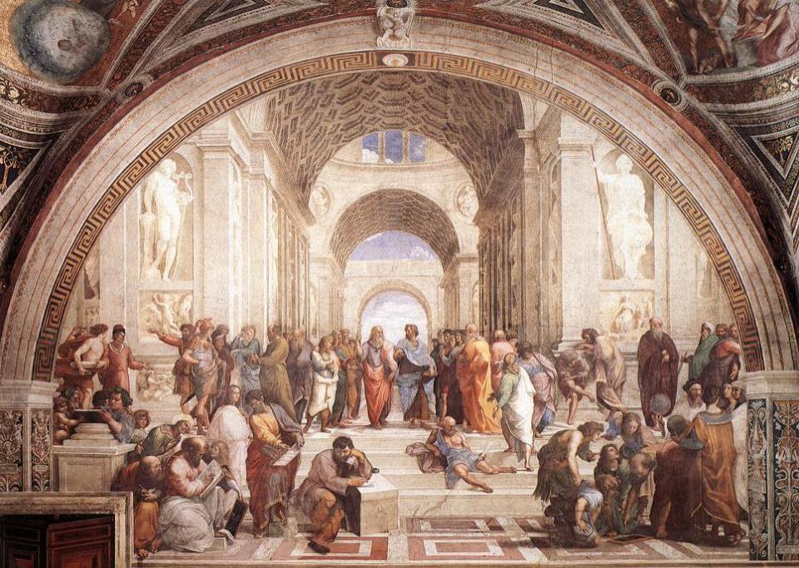
Raphael’s greatest painting was “School of Athens” which blended Classical figures from Greece & Rome with important people from the Renaissance
Plato (drawn to
look like Da Vinci)
Aristotle
Raphael
Pythagoras
Michelangelo
Euclid

Slide 21

Raphael’s “Betrothal of the Virgin”

Slide 22
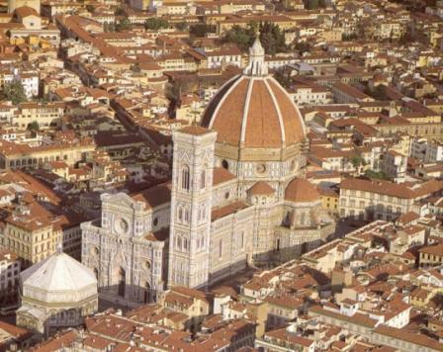
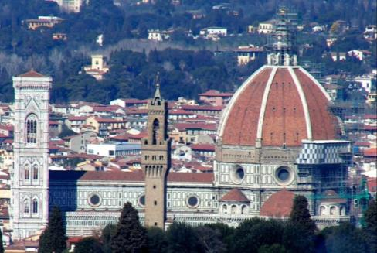
Filippo Brunelleschi
Brunelleschi was Florence’s greatest architect:
  He studied the Roman Pantheon when he built the Cuppolo of Maria del Fiore cathedral in Florence
  The dome inspired modern building designs

Slide 23
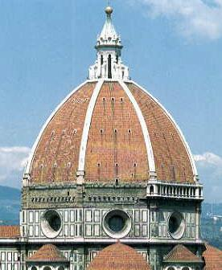
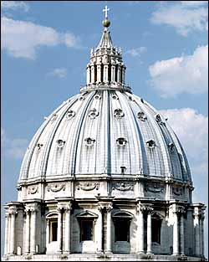
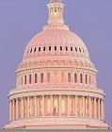
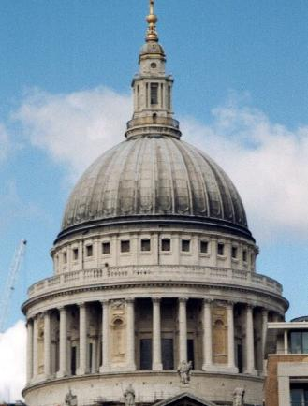
Dome Comparisons
US Capital, Washington, D.C.
St. Peter’s, Rome
Il Duomo, Florence
St. Paul’s, London
Notes:
US capital

