Slide 1
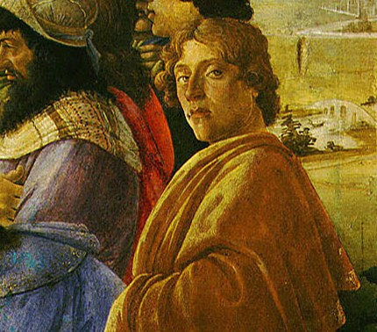
Sandro Botticelli

Slide 2
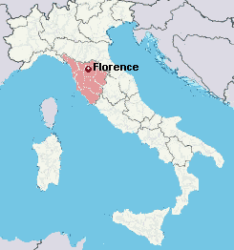
Alessandro di Mariano di Vanni Filipepi known as Sandro Botticelli was an Italian painter of the Early Renaissance.
The date of his birth is not known, but his father's tax returns in following years give his age as two in 1447 and thirteen in 1458, meaning he must have been born between 1444 and 1446.
Botticelli was born in the city of Florence in a house in the street still called Borgo Ognissanti.

Slide 3
How did he start?
Botticelli’s father was a tanner who apprenticed Sandro to a goldsmith after his schooling was finished. But, since Sandro preferred painting, his father then placed him under Filippo Lippi, who was one of the most admired Florentine masters.
Lippi taught Botticelli the techniques of panel painting and fresco and gave him an assured control of linear perspective. Stylistically, Botticelli acquired from Lippi a repertory of types and compositions.
After Lippi left Florence, Botticelli worked to improve the comparatively soft, frail figural style he had learned from his teacher.

Slide 4
Already by 1470 Botticelli was established in Florence as an independent master with his own workshop. Absorbed in his art, he never married, and he lived with his family.
His best-known works are The Birth of Venus and Primavera, both in the Uffizi in Florence. Botticelli lived all his life in the same neighbourhood of Florence
His Birth of Venus and Primavera are often said to epitomize for modern viewers the spirit of the Renaissance, though his elongated, seemingly weightless figures and fairly flat spaces deviate from the naturalism of other Renaissance painters.

Slide 5
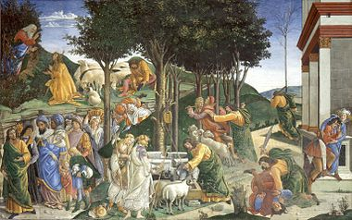
Famous Paintings
Sistine Chapel

Slide 6
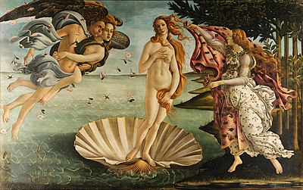
Famous Paintings
The Birth of Venus

Slide 7
Famous Paintings
Primavera

Slide 8
Death
Sandro died in May 17, 1510 in the age of 64-65
The cause of Sandro Botticelli’s death in 1510 has not been widely written about. Biographer Giorgio Vasari described Botticelli as impoverished and disabled in his last years. Other evidence, however, suggests that Botticelli remained fairly prosperous. He may have simply been overtaken by ill health.

